Slide 1
(a) Quality-aware multimodal pretraining
Shared visual backbone
Shared P_Q / D_Q across augmented views
Separate image–text relation space
SafeAug 1
Global · 768-D
z₁
P_Q
D_Q
Symmetric SimSiam
p₁ ↔ sg(q₂)
p₂ ↔ sg(q₁)
Clean aligned image / region features
CLIP
ViT-L/14
P_I
D_I
F
u
s
i
o
n
z
via U + relation-specific adapters
SafeAug 2
z₂
P_Q
D_Q
Text encoder
Frozen
P_T
D_T
ResNet-50
layer4
per-view
outputs
Image–Prompt / Answer
Prompt–Answer
Region–word
z_c
Component anchors + ordinal
Five-level quality text CE
Prompt / Answer / region phrases
Trainable contexts; relation-specific adapters
Clean
7 × 7 × 2048
P_Q
then R.proj: 2048→256
Clean score heads
Quality / Alignment
Artifact / Aesthetics
P_Q → Quality Adapter initialization
Backbone / contexts / alignment adapters / quality bank transferred
(b) Downstream quality & alignment assessment
Five-level text CE · auxiliary
λ=0.005 · score blend=0
CLIP
ViT-L/14
768-D
Semantic–Structure Fusion
Quality branch (Q)
768→256
Global query Q
z
Quality Adapter
a
Q_g
Input image
224 × 224
FC
FC
FC
Global head
+
z bypass
β
Perceptual
Quality Q
Fusion.local_proj: 1×1
r = z + α · sg(‖z‖) · normalize(a)
ResNet-50
layer3
P₀
NSS-guided local quality
Q = (1−β)Q_g + βQ_l
1024→256
n = NSS(image)
sᵢ = sigmoid(Hp(Pqᵢ))
β: learned scalar
Pq = P₀ + N(n)
wᵢ = softmax(G[Pqᵢ,nᵢ])
Σ
Q_l
14 × 14 × 1024
K V
Residual + LayerNorm + FFN
z: 256-D · shared by Q / A
Alignment branch (A)
Shared local projection L
P₀: 196 × 256
z
Image adapter A_G
v
Global pair head
[v, u, |v−u|]
A_g
v, u
u
γ
Text–Image
Alignment A
Prompt + learnable
context tokens
Frozen CLIP
text encoder
U
Text adapter A_T
P₀
Local–text matching
u
Attention
pooling
Local pair head
A = γ A_g + (1−γ) A_l
A_P · X_I / X_T · [e, u, |e−u|]
A_l
γ: sample-wise, conditioned on v, u
u
Same z / P₀ / u / v ports denote the same feature tensors. sg: stop-gradient. Visual encoders trainable; text backbone frozen. Source layer4 → downstream layer3: local projection reset.
Notes:
Editable reconstruction of the paper-style framework. All diagram text, tensors, heatmaps, modules and connectors are native PowerPoint objects. Reused named ports avoid crossed lines. Representation transfer resets task heads and downstream local projection. The matching group is schematic: XI/XT similarities pool AP(P0); u is not a local image token. NSS is computed from the image, not from P0. Detailed source: docs/figures/model_forward_and_sharing.md.

Slide 2
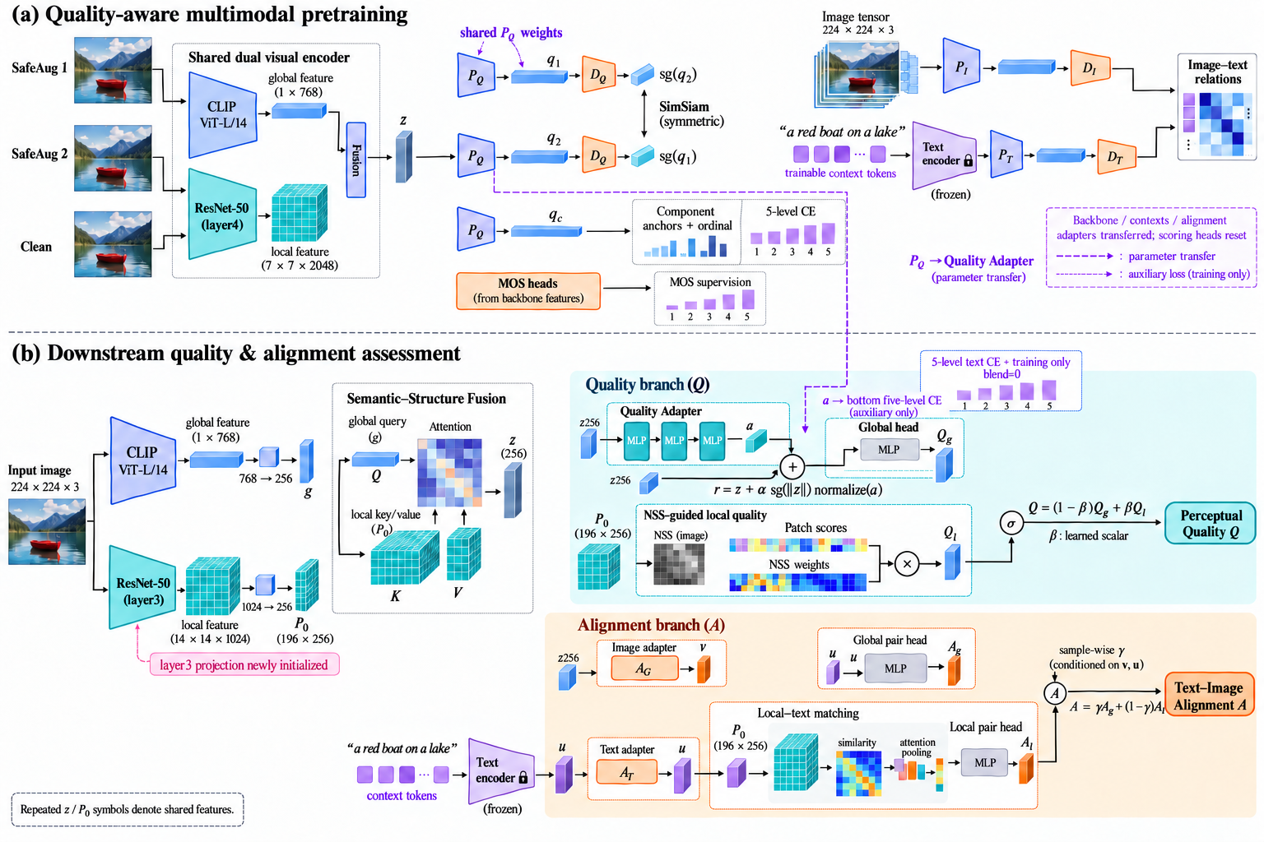
VISUAL REFERENCE ONLY — known connection errors; use slide 1 for the corrected framework.
Notes:
Raster visual reference only. This original generated design has known connectivity errors. Use slide 1 for editable corrections; do not use this raster as the exact implementation diagram.

Slide 3
编辑说明 / Editing guide
第 1 页：可编辑重绘版。文字、公式、模块、箭头、特征张量和热图均为原生 PPT 对象。
第 2 页：原始论文风格图，仅作视觉参考。PNG 本身不能在 PowerPoint 中拆成原生图层。
在第 1 页直接点击文字修改；选中连接线后可拖动端点。图形填充、线条和字体可直接修改。
张量与热图以局部组合保存：右键 → 组合 → 取消组合，可编辑每个小格；也可 Ctrl+单击选择组内对象。
全选多个对象后可组合移动。重复的 z / P₀ / u 是同一个特征的命名端口，用于避免长线交叉。
已按代码修正关键关系：z→全局 Adapter，P₀→局部匹配；质量标量 β，一致性逐样本 γ。
保留原图配色和双面板视觉语言，但原生重绘并非与原 PNG 逐像素一致。
导出论文图：文件 → 导出 → PDF；或另存图片。排版时建议保留矢量 PDF。
依据：代码 e127834；CLIP Large、下游 layer3、Residual Quality Adapter、CE=0.005、标量质量融合。
未纳入实验中的逐图质量门控，也未把学习率消融宣称为已确定主方法。

