Slide 1
Summary of microgrid serious game run 1
Generated on 2022-05-16 10:31

Slide 2
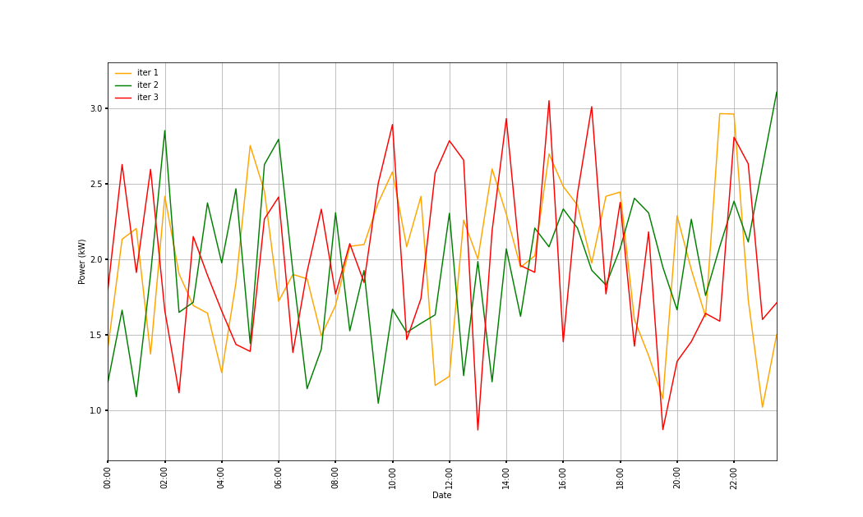
Team team_1 load DURING price-coord. dyn.
(PV) region: grand_nord

Slide 3
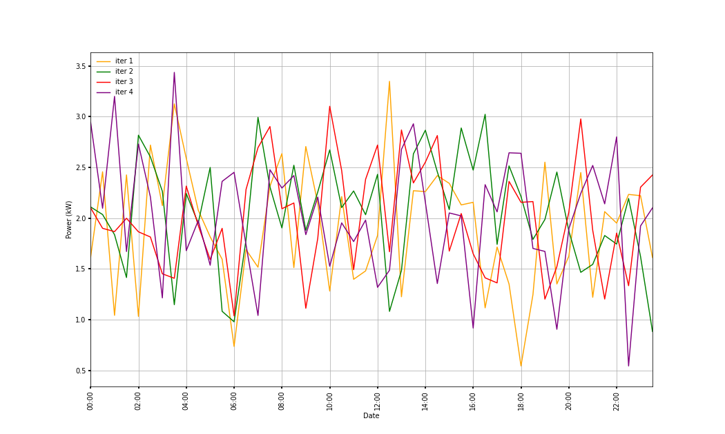
Team team_2 load DURING price-coord. dyn.
(PV) region: grand_nord

Slide 4
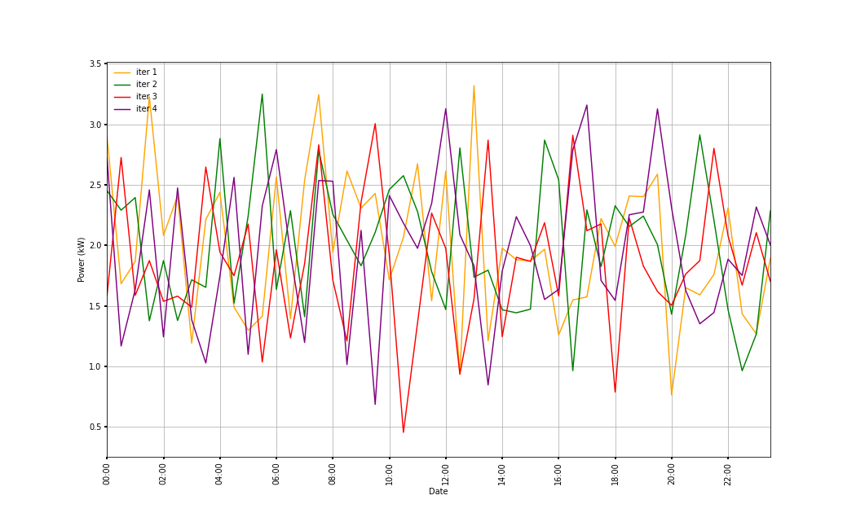
Team team_3 load DURING price-coord. dyn.
(PV) region: grand_nord

Slide 5
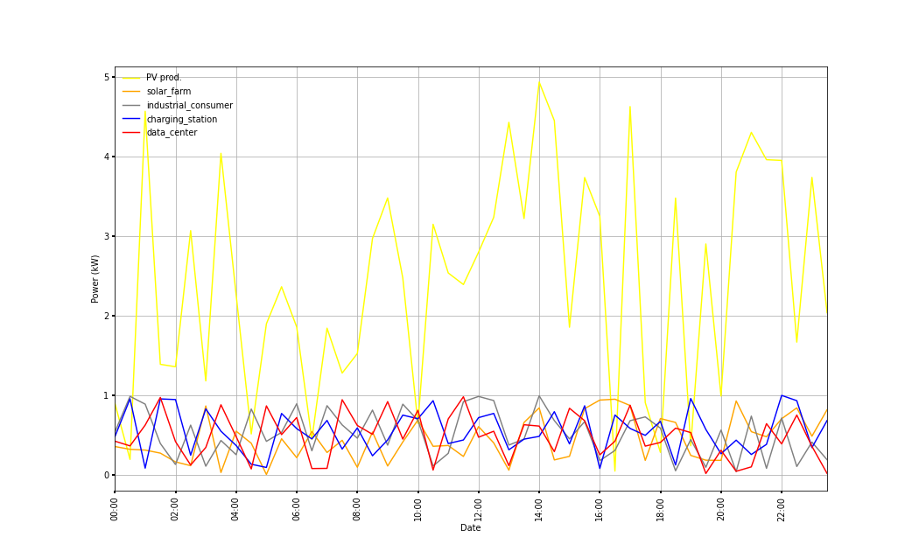
Team team_1 ACTORS' load AT THE END of price-coord. dyn.
(PV) region: grand_nord

Slide 6
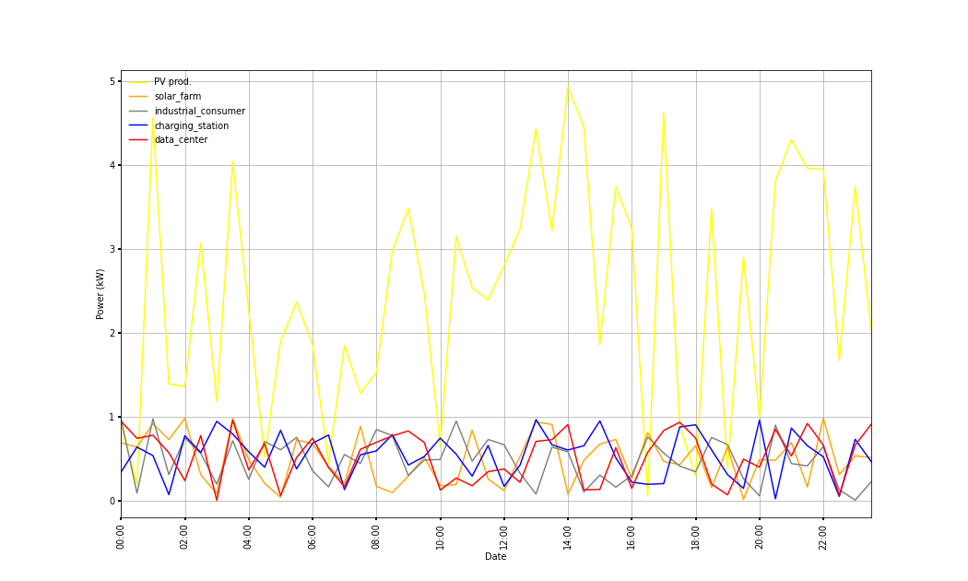
Team team_2 ACTORS' load AT THE END of price-coord. dyn.
(PV) region: grand_nord

Slide 7
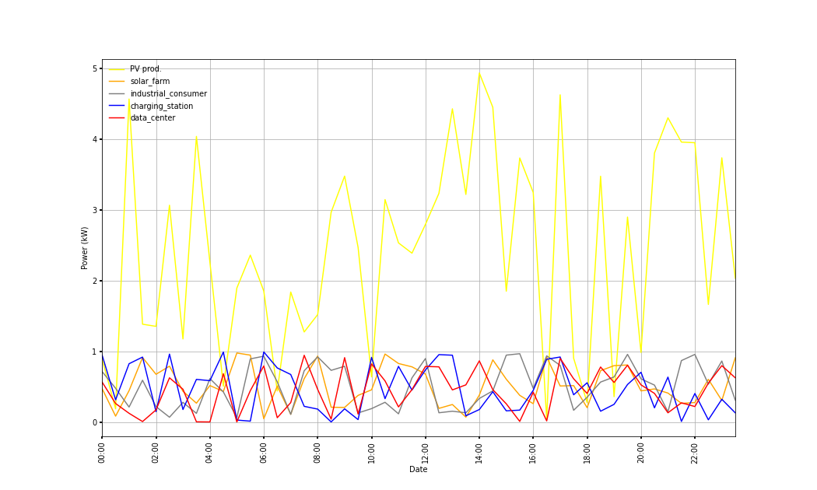
Team team_3 ACTORS' load AT THE END of price-coord. dyn.
(PV) region: grand_nord

Slide 8
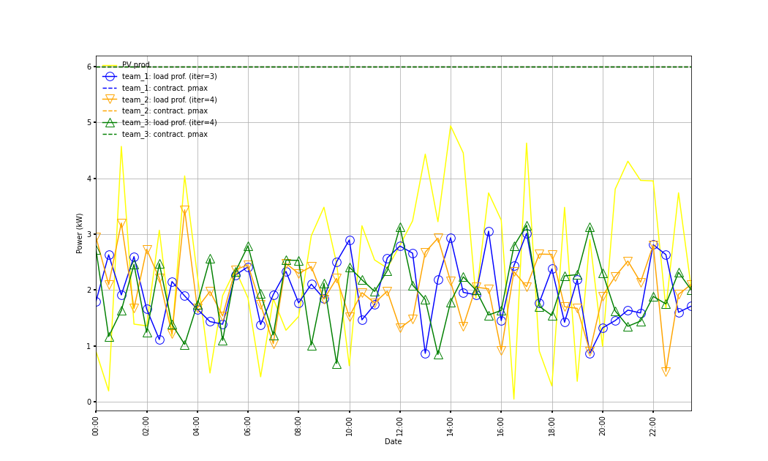
All teams load AT THE END of price-coord. dyn.
(PV) region: grand_nord

Slide 9
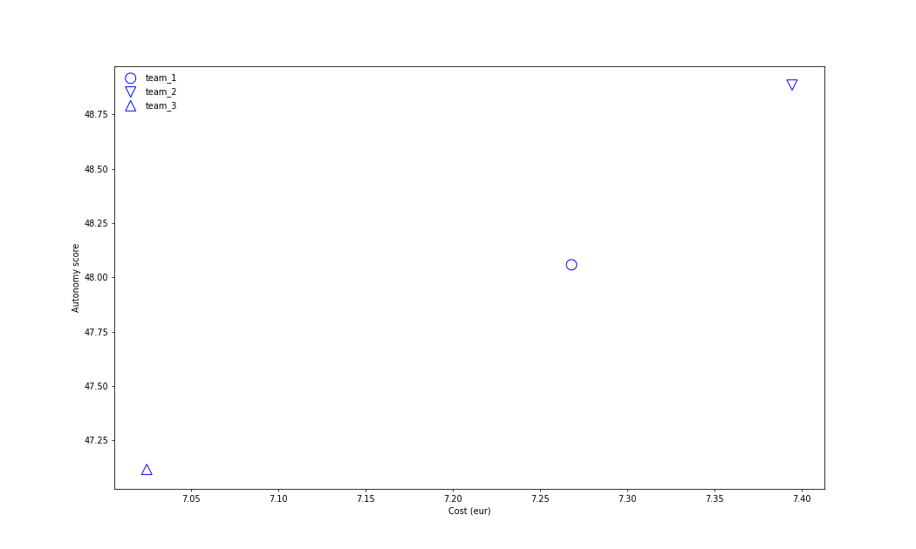
All teams (cost, autonomy) tradeoff with price-coord. dyn.

Slide 10
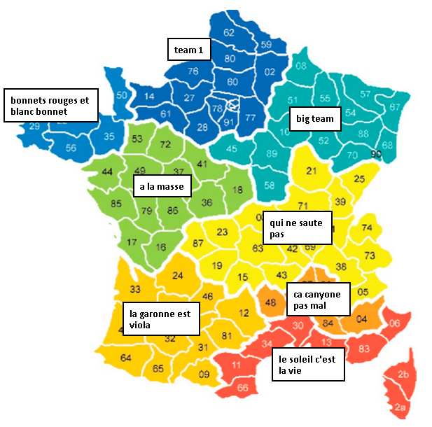
Best team(s) per region (PV prof.)

Slide 11
Scores per team name*region (PV prof.)
See file: aggreg_per_region_res_run_2022-05-16_1031.csv

Slide 12
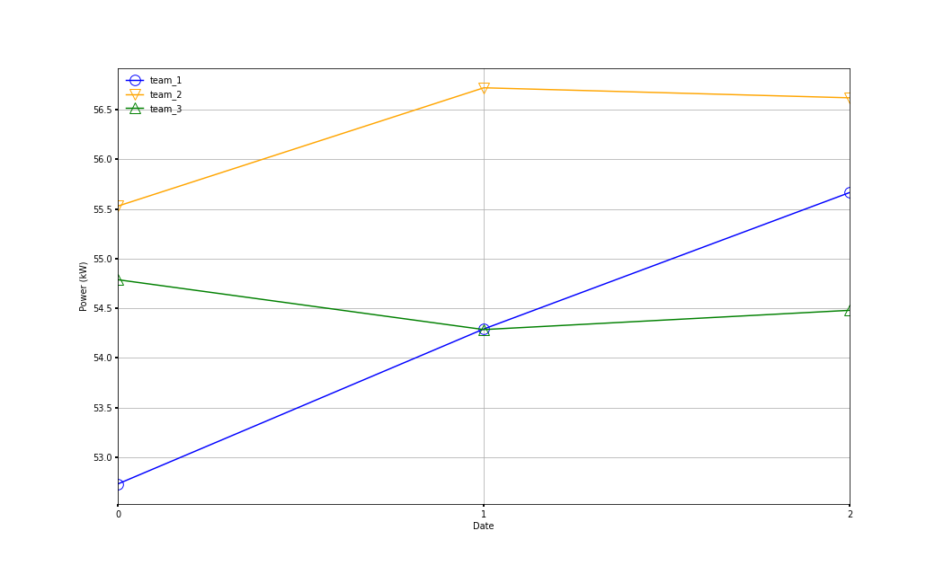
All teams score traj. with price-coord. dyn.

