Slide 1
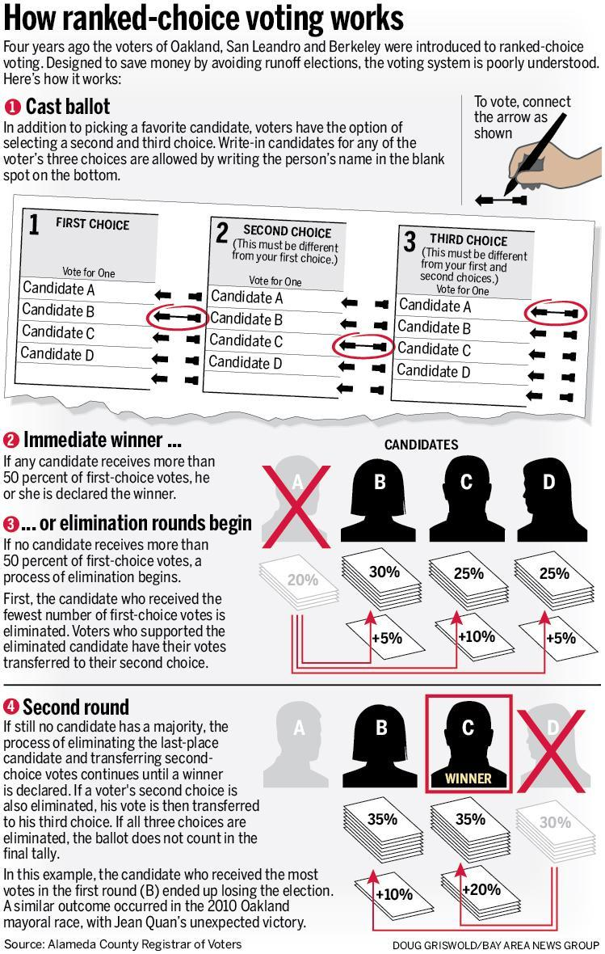
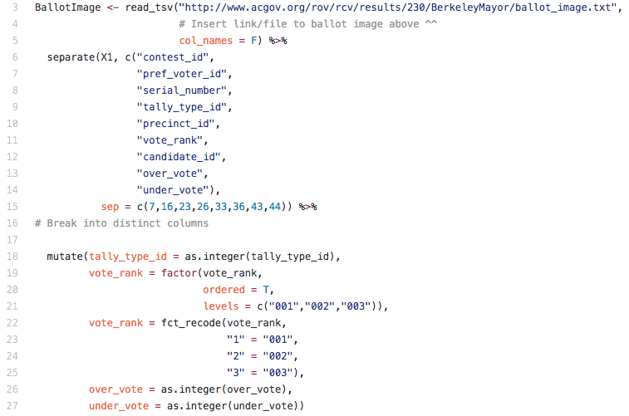
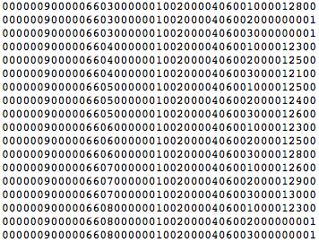
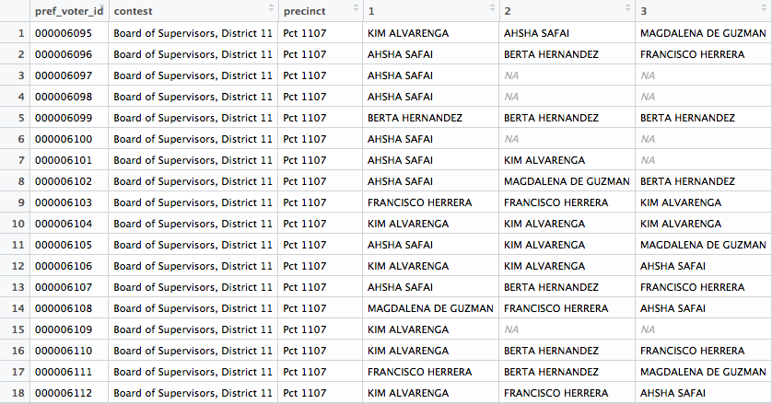
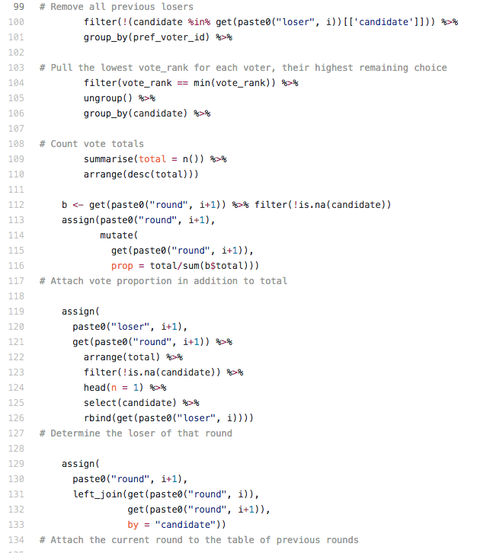
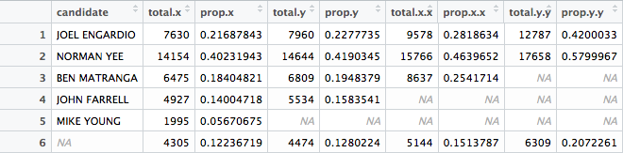
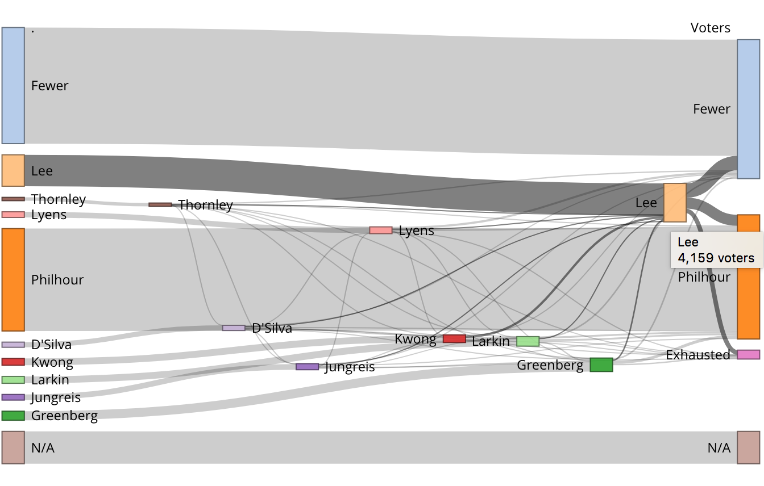
Ranked Choice Voting
Jay Lee, Mia Leung, and Matthew Yancheff
Profs. Andrew Bray & Paul Gronke, Reed College & Theo Landsman ‘16, FairVote
jknef
Raw ballot image from San Francisco's 2016 Election Board of Supervisors:
Each voter has three lines:
each line consists a unique voter code, precinct, district, and a candidate selection.
Output from raw ballot image:
The table displays one voter on each line with their parsed information including their ranked candidates.
Why use RCV?
Adapted from FairVote
More cost effective due to instant runoffs
Higher voter participation than runoff elections; voters only need to vote one time
More issue based campaigning, as candidates are more inclined to positive campaigning
Gives voters more choices and power
Increases majority support, ensures the winner has at least 50% of the votes
Acknowledgments
Theo Landsman ’16, Alameda County Registrar of Voters, San Francisco County Department of Elections, Prof. Andrew Bray, Prof. Paul Gronke, and Chester Ismay
See more of our work at tinyurl.com/reed-rcv

