Slide 1

Summer Internship Project
Project Title : Development of Telugu Large Language Model
Role & Duration:
Under the Guidance of:
Tech Lead, 8 Weeks (Hybrid)
Mrs. Unnati Mohan Khanapurkar (Assistant Professor- CSE Dept)
Submitted by:
Coordinator:
M. Yethishwar - 160722747097
Branch – AI&DS
Dr. Shaik Khaleel Ahmed (Associate Professor – CSE Dept)
Department of Computer Science and Engineering, MCET
Department of Artificial Intelligence and Data Science

Slide 2

Abstract
As a tech lead for Telugu large language models, I guided interns in understanding real-world Project Objectives and activities in technical and non technical perspective. I oversaw the full pipeline—from data collection, cleaning, and normalization to tokenization design and model training. I ensured smooth training of transformer models, reviewed intern progress, and helped them build practical skills in machine learning. The work focused on improving Telugu datasets and creating more accurate, useful language models.
Department of Computer Science and Engineering

Slide 3
Organization & Duration
VISWAM.ai is a Swecha–IIIT Hyderabad joint initiative focused on AI for the Global South
Venture for Innovation and Social Wellbeing through AI for the Marginalised.
Evolved from Swecha's 2004 open-source movement to a 2024 AI Centre of Excellence.
Led by Y Kiran Chandra, Prof. P.J. Narayanan, and Jayesh Ranjan.
Key achievements include Gonthuka ASR, AI Chandamama Kathalu, and Swecha AI OS, driven by a large contributor community.
Mode: Hybrid — weekly in-office visit + online reviews for 8 weeks
Department of Computer Science and Engineering

Slide 4
Introduction
Introduce interns to real-world AI and NLP development.
Teach the end-to-end pipeline of building LLMs for Telugu.
Develop practical skills in data handling, preprocessing, and model evaluation.
Strengthen problem-solving, technical thinking, and teamwork.
Department of Computer Science and Engineering

Slide 5
Project / Task Workflow
Build high-quality Telugu datasets for training Large Language Models.
Collect data from books, websites, conversations, and public sources.
Apply preprocessing, normalization, and dataset organization.
Introduce interns to Python tools, NLP pipelines, and transformer architecture fundamentals.
Department of Computer Science and Engineering

Slide 6
key Activities
Collect, organize, and categorize Telugu text from diverse sources.
Clean and normalize data: fix errors, remove noise, standardize script usage.
Assist with tokenization strategies and dataset formatting.
Maintain documentation, attend weekly review sessions, and present progress.
Learn basics of training and testing LLMs for tasks like summarization and translation.
Department of Computer Science and Engineering

Slide 7
Learning Outcomes
Hands-on experience with NLP data pipelines and corpus creation.
Understanding of how LLMs are trained, fine-tuned, and evaluated.
Improved proficiency in Python, text processing, and dataset structuring.
Enhanced skills in teamwork, communication, version control, and documentation.
Department of Computer Science and Engineering

Slide 8
Technical Stack & Integrated Partners
Used Python, Jupyter, Pandas, and regex-based text cleaning.
Used PyTorch, Hugging Face Transformers, and CUDA for model training.
Managed workflows using Git/GitHub and Google Docs for documentation.
Integrated partners: Meta, IIIT Hyderabad, and Swecha Telangana.
Collaborated on open-source Telugu NLP and LLM development.
Department of Computer Science and Engineering

Slide 9
Week Work Log
Week | Tasks Performed
Week 1 | Project intro, tool setup, found Telugu data sources.
Week 2 | Collected Telugu text and did basic cleaning.
Week 3 | Did deeper cleaning, fixed Unicode, split sentences.
Week 4 | Organized data, tried tokenizers, checked data quality.
Week 5 | Made simple scripts to speed up cleaning work.
Week 6 | Finished dataset and prepared it for training.
Week 7 | Helped test sample model outputs and fixed data issues.
Week 8 | Final review, completed report, and prepared presentation.
Department of Computer Science and Engineering

Slide 10
Conclusion
This 8-week project gave us valuable exposure to AI workflows and contributed toward developing better Telugu language resources. Their efforts improved dataset quality and deepened their understanding of machine learning, preparing them for careers in AI, research, and software development.
Department of Computer Science and Engineering

Slide 11
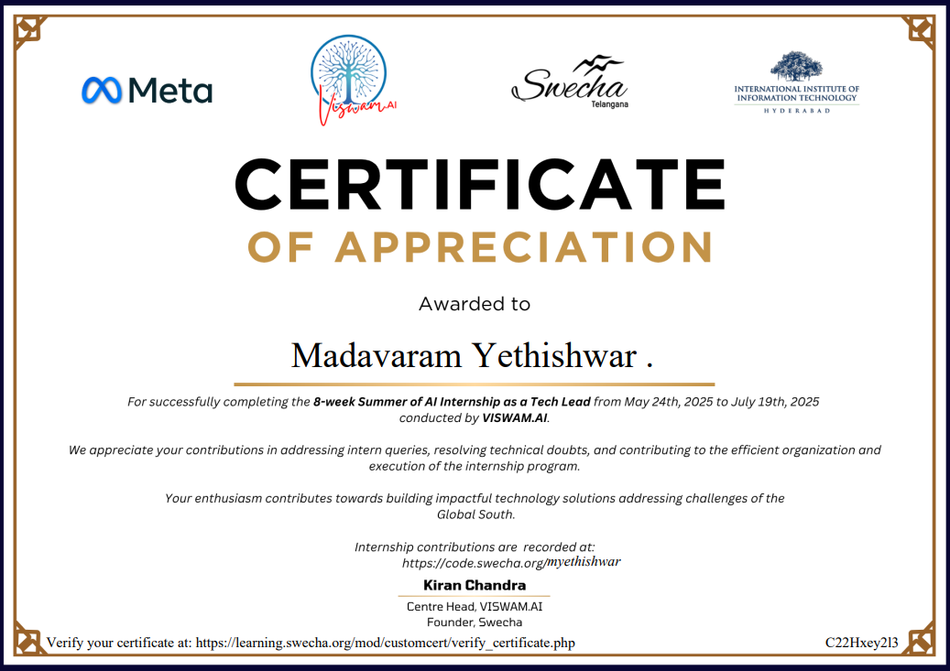

Slide 12
Thank you
Department of Computer Science and Engineering

