Slide 1
Task1 Frequent subgraph mining algorithms for A single large graph
Yun Siyu
17307110448@fudan.edu.cn

Slide 2
BACKGROUND AND MOTIVATION
In many applications, we need to find subgraphs in a single large graph, for instance, discovering structural regularities or web structures, which we do not want to split them into parts.
Most works being done on frequent subgraph mining are focused on graph transactions.
We can get inspiration for FSG and GSPAN.
Notes:
FSG算法和GSPAN算法都是应用于graph transactions 上的频繁子图挖掘，但是我们依然可以从中获取一些灵感
Both the FSG algorithm and the GSPAN algorithm are frequent subgraph mining applied to the graph transactions, but we can still get some inspiration from them

Slide 3
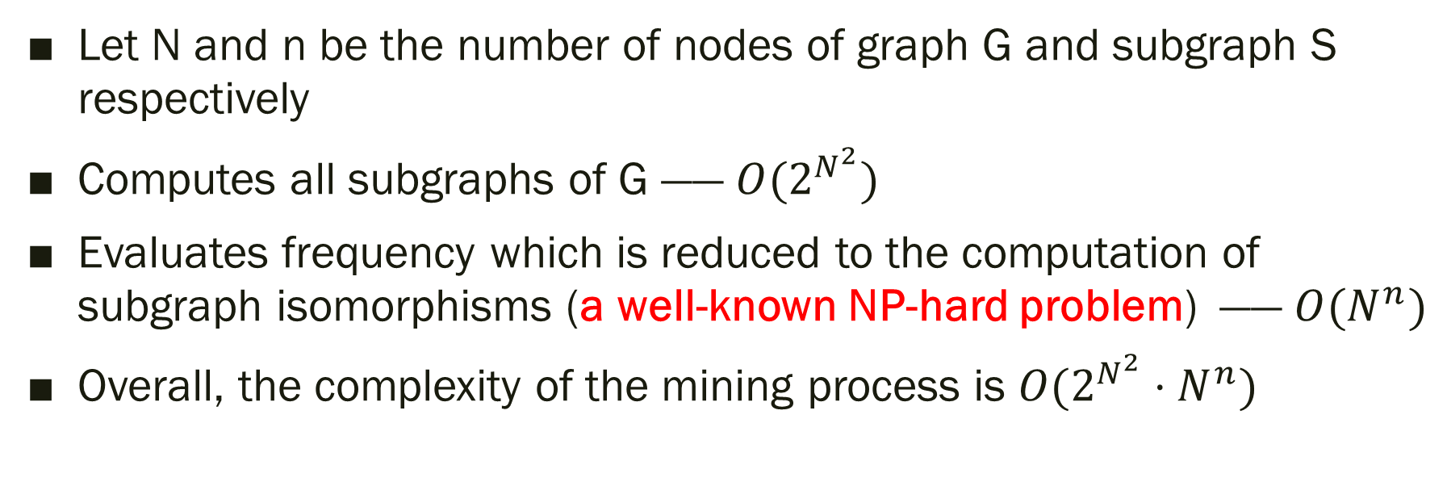
COMPLEXITY
Let N and n be the number of nodes of graph G and subgraph S respectively
Computes all subgraphs of G —— $O(2^{N^{2}})$
Evaluates frequency which is reduced to the computation of subgraph isomorphisms (a well-known NP-hard problem) —— $O(N^{n})$
Overall, the complexity of the mining process is $O(2^{N^{2}}⋅N^{n})$
Notes:
不加任何优化的在一张大图上的频繁子图挖掘的时间复杂度
isomorphisms [,aɪsə'mɔrfɪzm]
complexity [kəmˈpleksəti]
capital N lowercase n

Slide 4
COMPLEXITY
Let N and n be the number of nodes of graph G and subgraph S respectively
Computes all subgraphs of G —— $O(2^{N^{2}})$
Evaluates frequency which is reduced to the computation of subgraph isomorphisms (a well-known NP-hard problem) —— $O(N^{n})$
Overall, the complexity of the mining process is $O(2^{N^{2}}⋅N^{n})$
HOW TO IMPROVE THE ALGORITHM

Slide 5
PREPARATION
we need to ensure the downward closure property to achieve prune (ignore details)
Notes:
首先，我们要解决一个问题——向下传递闭包 （向下传递闭包的意义因为课堂上已经讲解过了，我在这里就不赘述了）
Because we‘ve seen in class what it means to ensure the downward closure property , I won't go into that

Slide 6
PREPARATION
we need to ensure the downward closure property to achieve prune (ignore details)
downward closure property —— for every graph G, A and B, where A is a subgraph of B and G is the input graph, the support of subgraph B in G should never be greater than support of subgraph A in G.
Notes:
首先，我们要解决一个问题——向下传递闭包

Slide 7
PREPARATION
we need to ensure the downward closure property to achieve prune (ignore details)
downward closure property —— for every graph G, A and B, where A is a subgraph of B and G is the input graph, the support of subgraph B in G should never be greater than support of subgraph A in G.
deal with overlap
Notes:
首先，我们要解决一个问题——向下传递闭包

Slide 8

OVERLAP
Definition
An overlap of two or more isomorphs e.g. e1 and e2 of a subgraph S occurs when $e_{1}(E_{s})∩e_{2}(E_{s})≠ ∅$
Notes:
e1 和 e2是两个同构的子图（同构的意义在这里也不赘述了）

Slide 9
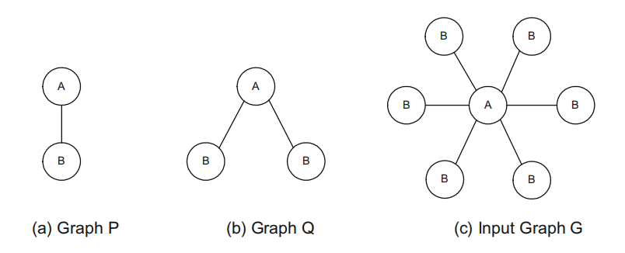
OVERLAP
Jiang X , Xiong H , Wang C , et al. Mining globally distributed frequent subgraphs in a single labeled graph[J]. Data & Knowledge Engineering, 2009, 68(10):1034-1058.
Dhiman A , Jain S K . Optimizing Frequent Subgraph Mining for Single Large Graph[J]. Procedia Computer Science, 2016, 89:378-385.
Definition
An overlap of two or more isomorphs e.g. e1 and e2 of a subgraph S occurs when $e_{1}(E_{s})∩e_{2}(E_{s})≠ ∅$
Notes:
为什么overlap 会导致无法向下传递闭包呢？ P 在 G的support = 6 而 Q在G的support = 5+4+3+2+1 = 15
Why overlap leads to an inability to the downward closure property ?

Slide 10

OVERLAP
Jiang X , Xiong H , Wang C , et al. Mining globally distributed frequent subgraphs in a single labeled graph[J]. Data & Knowledge Engineering, 2009, 68(10):1034-1058.
Dhiman A , Jain S K . Optimizing Frequent Subgraph Mining for Single Large Graph[J]. Procedia Computer Science, 2016, 89:378-385.
Definition
An overlap of two or more isomorphs e.g. e1 and e2 of a subgraph S occurs when${ e}_{1}(E_{s})∩e_{2}(E_{s})≠ ∅$
Notes:
so we can not ensure the downward closure property

Slide 11
PREPARATION
we need to ensure the downward closure property to achieve prune (ignore details)
deal with overlap —— only one out of all the overlapping isomorphs should be counted.

Slide 12
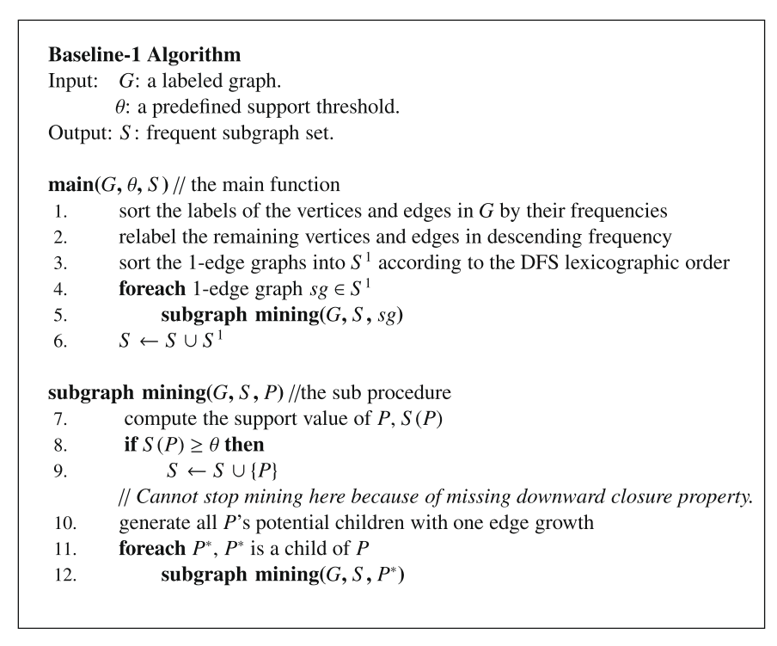
BASIC ALGORITHM
Jiang X , Xiong H , Wang C , et al. Mining globally distributed frequent subgraphs in a single labeled graph[J]. Data & Knowledge Engineering, 2009, 68(10):1034-1058.
Notes:
1.按照频率排序，并删除出现次数少于min_support 的顶点和边
Sort by frequency and remove vertices and edges that appear less frequently than min_support
2. 对于删选后的单边，分别递归调用 subgraph mining函数，每次增加一条边
For each filtered 1-edge, the subgraph mining function is recursively called, adding one edge at a time

Slide 13
BASIC ALGORITHM
Jiang X , Xiong H , Wang C , et al. Mining globally distributed frequent subgraphs in a single labeled graph[J]. Data & Knowledge Engineering, 2009, 68(10):1034-1058.
just like the DFS code for gSpan

Slide 14
BASIC ALGORITHM
Jiang X , Xiong H , Wang C , et al. Mining globally distributed frequent subgraphs in a single labeled graph[J]. Data & Knowledge Engineering, 2009, 68(10):1034-1058.
just like the DFS code for gSpan
How?
Notes:
对于subgraph mining函数，先计算当前子图在大图G中出现的频数，如果频数大于min_support 则将该子图加入S中
For the subgraph mining function, first calculate the frequency of the current subgraph in the large graph G, and add the subgraph to S if the frequency is greater than min_support

Slide 15
IN FACT
Extend a graph with one more edge is equivalent to extending its Minimum DFS Code with one more edge, which is attached to the end of that code
If an extended DFS code is not a minimum DFS code, prune this code (graph) and its possible extended codes (graphs) will not result in loss of any subgraph including frequent subgraph (completeness).
Notes:
对于一张图来说，拓展一条边就等于延伸它的Minimum DFS Code 。如果延伸的dfs code不是Minimum DFS Code ，那就把它裁剪掉

Slide 16
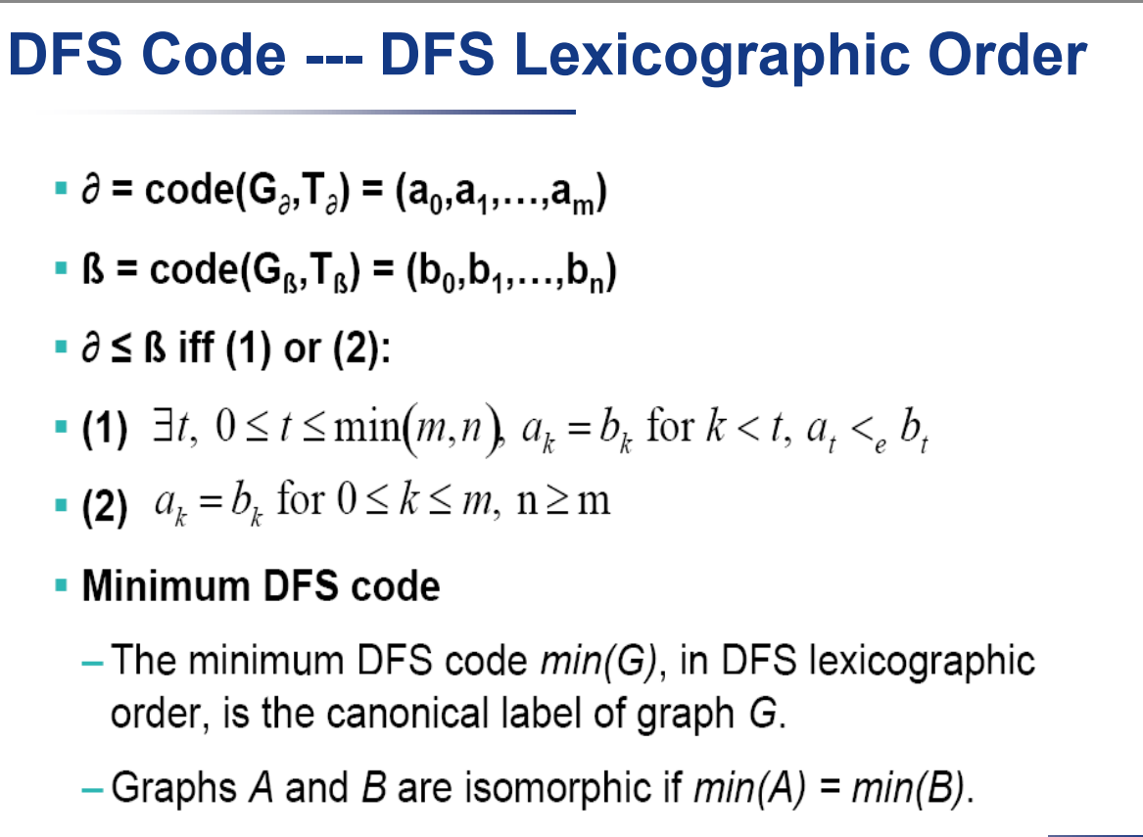
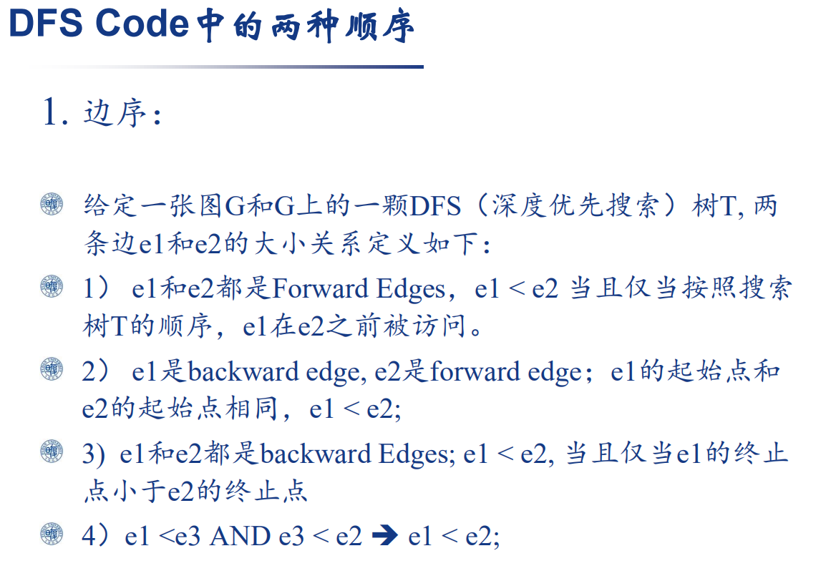
Notes:
Since DFS code has been described in detail in class, I won't go into it here

Slide 17
IN FACT
Extend a graph with one more edge is equivalent to extending its Minimum DFS Code with one more edge, which is attached to the end of that code
If an extended DFS code is not a minimum DFS code, prune this code (graph) and its possible extended codes (graphs) will not result in loss of any subgraph including frequent subgraph (completeness).
JUST LIKE GSPAN

Slide 18
IMPROVEMENT ALGORITHM
Jiang X , Xiong H , Wang C , et al. Mining globally distributed frequent subgraphs in a single labeled graph[J]. Data & Knowledge Engineering, 2009, 68(10):1034-1058.
key for improvement

Slide 19
STEP 1 : eliminated before reaching support computation phase——edge
Principle : Some subgraphs with two or more edges may contain same edge appearing multiple times. That edge of the subgraph which occurs maximum number of times in the graph decides the support of the subgraph
Notes:
Next, I'll show you two ways to improve the algorithm
对于一些拥有相同label边的子图。 那些重复的边出现的最大次数，决定了这个子图的support

Slide 20
EXPLAINATION
in the preparation, I define, for the overlap cases, only one out of all the overlapping isomorphs should be counted.

Slide 21
EXPLAINATION
in the preparation, I define, for the overlap cases, only one out of all the overlapping isomorphs should be counted.
only frequent edges are allowed to extend a frequent subgraph ensuring anti-monotone property (we can prove it by contradiction)
Notes:
对于同构并且存在共享边的两个图或者多个图，在计算support的时候只计算一次，因此每个边在计算支持度的时候只发挥一次“功效”。
For two or more graphs that are isomorphic and have Shared edges, support can be calculated only once, so each edge can only play an "effect" once when calculating support.

Slide 22
EXPLAINATION——EXAMPLE
min_support = 4
subgraph
original graph
The most common edge in this subgraph is A, which happens five times
Notes:
对于同构并且存在共享点的两个图或者多个图，在计算support的时候只计算一次，因此每个点在计算支持度的时候只发挥一次“功效”。

Slide 23
EXPLAINATION——EXAMPLE
min_support = 4
subgraph
original graph
The most common edge in this subgraph is A, which happens five times
the number of e(A) = 16
Notes:
对于同构并且存在共享点的两个图或者多个图，在计算support的时候只计算一次，因此每个点在计算支持度的时候只发挥一次“功效”
可以对original graph按照A分别划片，那么必然存在两个区域重叠
The original graph can be sliced according to A, so there must be two overlapping regions

Slide 24
EXPLAINATION——EXAMPLE
min_support = 4
subgraph
overlap
original graph
The most common edge in this subgraph is A, which happens five times
the number of e(A) = 16
Notes:
对于同构并且存在共享点的两个图或者多个图，在计算support的时候只计算一次，因此每个点在计算支持度的时候只发挥一次“功效”。

Slide 25
EXPLAINATION——EXAMPLE
min_support = 4
subgraph
mostly get 2 support
for this case
original graph
The most common edge in this subgraph is A, which happens five times
the number of e(A) = 16
Notes:
对于同构并且存在共享点的两个图或者多个图，在计算support的时候只计算一次，因此每个点在计算支持度的时候只发挥一次“功效”。
So the subgraph support is no more than 3, but min_support is 4, so we can prune the subgraph

Slide 26
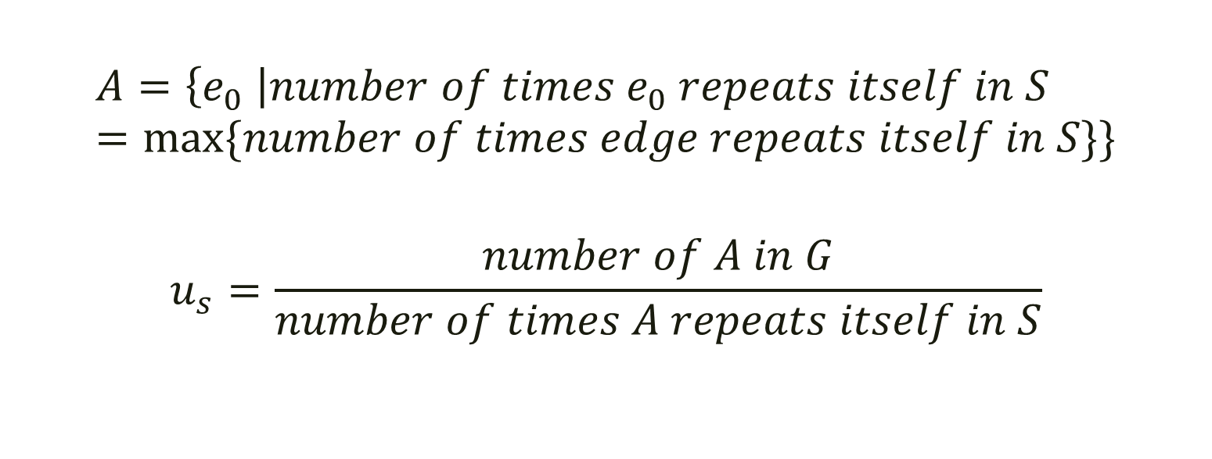
STEP 1 : eliminated before reaching support computation phase——edge
$$A=\left\{e_{0} \right|number of times e_{0} repeats itself in S=max⁡\{number of times edge repeats itself in S\}\}$$
$$u_{s}=\frac{number of A in G}{number of times A repeats itself in S}$$
Notes:
Therefore The calculation formula is as follows:

Slide 27

IMPROVEMENT ALGORITHM
Jiang X , Xiong H , Wang C , et al. Mining globally distributed frequent subgraphs in a single labeled graph[J]. Data & Knowledge Engineering, 2009, 68(10):1034-1058.
Dhiman A , Jain S K . Optimizing Frequent Subgraph Mining for Single Large Graph[J]. Procedia Computer Science, 2016, 89:378-385.
if P* contains repeating edge do
calculate $u_{p∗}$
if $u_{p∗}<min⁡_sup$ do
remove P* from P
continue
Notes:
Pseudo [ˈsuːdoʊ] code

Slide 28
IMPROVEMENT ALGORITHM
Jiang X , Xiong H , Wang C , et al. Mining globally distributed frequent subgraphs in a single labeled graph[J]. Data & Knowledge Engineering, 2009, 68(10):1034-1058.
Dhiman A , Jain S K . Optimizing Frequent Subgraph Mining for Single Large Graph[J]. Procedia Computer Science, 2016, 89:378-385.
if P* contains repeating edge do
calculate $u_{p∗}$
if $u_{p∗}<min⁡_sup$ do
remove P* from P
continue
So I eliminate the infrequent subgraphs from subgraph mining process
without calculating the exact support value!

Slide 29

STEP 2 : CSP for optimizing frequency computation
Definition : let S be a subgraph of a graph G. The subgraph S to graph G CSP, is a CSP($X,D,C$), where
1. X contains a variable for every node
Notes:
第一步我们在计算support之前，prune了一部分的infrequent subgraphs。第二步我们将从计算support这一步骤入手，更快的找出subgraph 的 support
In the first step, we prune some infrequent subgraphs before calculating support.
In the second step, we will start with the step of calculating support to find the support of subgraph faster
I got inspiration from an artificial intelligence class: looking for subgraphs on a large graph can turn into a CSP

Slide 30
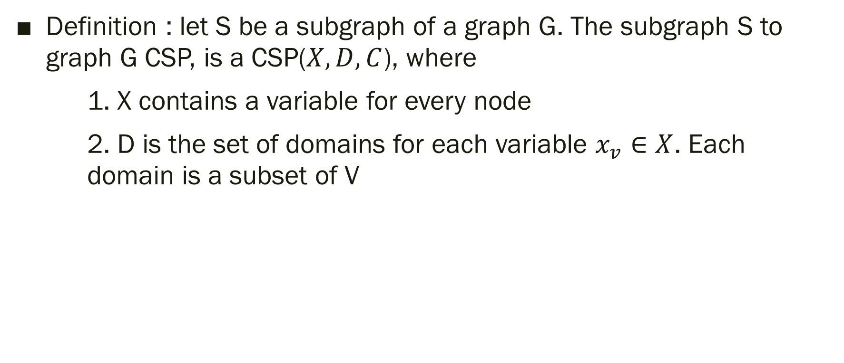
STEP 2 : CSP for optimizing frequency computation
Definition : let S be a subgraph of a graph G. The subgraph S to graph G CSP, is a CSP($X,D,C$), where
1. X contains a variable for every node
2. D is the set of domains for each variable $x_{v}∈X$. Each domain is a subset of V
Notes:
第一步我们在计算support之前，prune了一部分的infrequent subgraphs。第二步我们将从计算support这一步骤入手，更快的找出subgraph 的 support

Slide 31
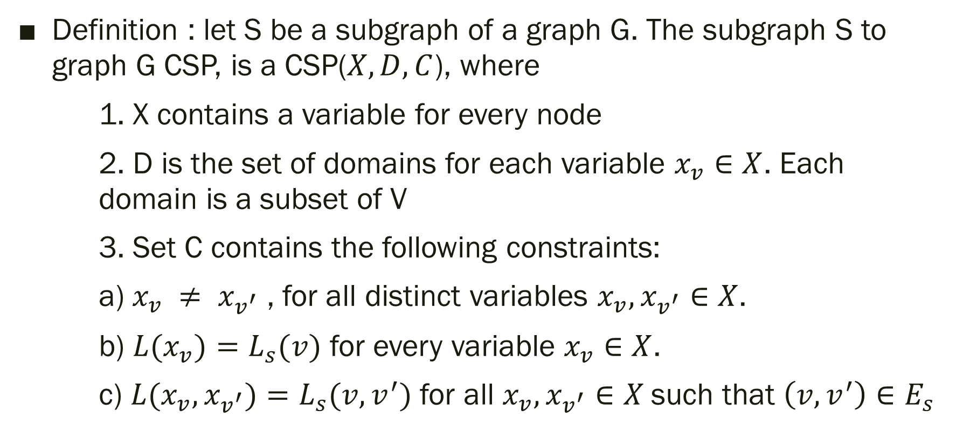
STEP 2 : CSP for optimizing frequency computation
Definition : let S be a subgraph of a graph G. The subgraph S to graph G CSP, is a CSP($X,D,C$), where
1. X contains a variable for every node
2. D is the set of domains for each variable $x_{v}∈X$. Each domain is a subset of V
3. Set C contains the following constraints:
a) $x_{v} ≠ x_{v^{′}}$ , for all distinct variables $x_{v},x_{v^{′}}∈X$.
b) ${L(x}_{v})=L_{s}(v)$ for every variable $x_{v}∈X$.
c) ${L(x}_{v},x_{v^{′}})=L_{s}(v,v^{′})$ for all $x_{v},x_{v^{′}}∈X$such that $\left(v,v^{′}\right)∈E_{s}$
Notes:
第一步我们在计算support之前，prune了一部分的infrequent subgraphs。第二步我们将从计算support这一步骤入手，更快的找出subgraph 的 support

Slide 32
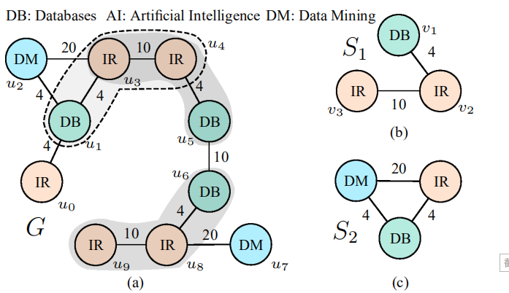
EXPLAINATION——EXAMPLE
Elseidy M , Abdelhamid E , Skiadopoulos S , et al. GRAMI: Frequent Subgraph and Pattern Mining in a Single Large Graph[J]. Proceedings of the Vldb Endowment, 2014, 7(7):517-528.
Notes:
let’s look at this picture, we need to find S1 in the G

Slide 33
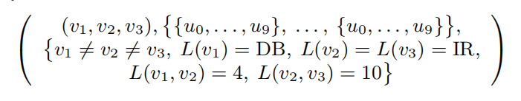
EXPLAINATION—— EXAMPLE
Elseidy M , Abdelhamid E , Skiadopoulos S , et al. GRAMI: Frequent Subgraph and Pattern Mining in a Single Large Graph[J]. Proceedings of the Vldb Endowment, 2014, 7(7):517-528.
Notes:
so the CSP is here. v1 v2 v3 can be assigned from u0 to u9, They are not equal to each other. the label of v1 equals to DB ,while the label of v2 and v3 is IR. the label of edge between v1 and v2 is 4, while the label of edge between v2 and v3 is 10

Slide 34
NODE AND ARC_CONSISTENCY
Node consistency excludes unqualified nodes from the domains
arc consistency ensures the consistency between the assignments of two variables.
Notes:
Let me mention NODE AND ARC_CONSISTENCY briefly here

Slide 35
EXPLAINATION
Definition : An assignment of a node u to a variable v is valid if and only if there exists a solution that assigns u to v. Note that each valid assignment corresponds to an isomorphism.
Notes:
And then we have to define effective. What is effective?

Slide 36
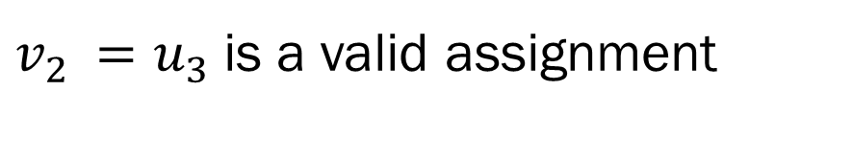
EXPLAINATION
Elseidy M , Abdelhamid E , Skiadopoulos S , et al. GRAMI: Frequent Subgraph and Pattern Mining in a Single Large Graph[J]. Proceedings of the Vldb Endowment, 2014, 7(7):517-528.
Definition : An assignment of a node u to a variable v is valid if and only if there exists a solution that assigns u to v. Note that each valid assignment corresponds to an isomorphism.
$v_{2 }=u_{3}$is a valid assignment

Slide 37
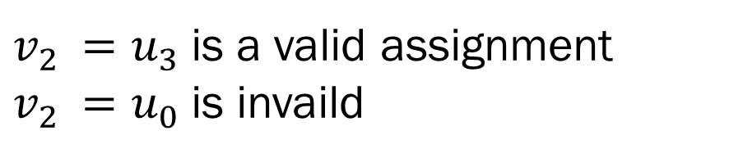
EXPLAINATION
Elseidy M , Abdelhamid E , Skiadopoulos S , et al. GRAMI: Frequent Subgraph and Pattern Mining in a Single Large Graph[J]. Proceedings of the Vldb Endowment, 2014, 7(7):517-528.
Definition : An assignment of a node u to a variable v is valid if and only if there exists a solution that assigns u to v. Note that each valid assignment corresponds to an isomorphism.
$v_{2 }=u_{3}$is a valid assignment
$v_{2 }=u_{0}$is invaild

Slide 38
EXPLAINATION FOR OPTIMIZING
First, we need to save the invalid assignments of subgraphs (the pruned assignments of previously checked subgraphs) to hash table. The hash key is the DFS_code canonical representation
Second, before assign the value, prune invalid assignments according to the hash table.
Notes:
Next, I will introduce the steps of algorithm optimization [,ɑptəmɪ'zeʃən]

Slide 39
EXPLAINATION——1ST ADVANTAGES
Subgraphs take advantage of the respective pruning of smaller subgraphs to prune invalid assignments. Thus, the domains of the subgraph variables are reduced avoiding the expensive search procedure
Notes:
procedure [prəˈsiːdʒər]

Slide 40
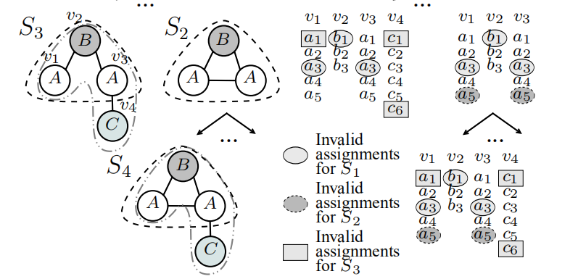
EXPLAINATION——ADVANTAGES
Elseidy M , Abdelhamid E , Skiadopoulos S , et al. GRAMI: Frequent Subgraph and Pattern Mining in a Single Large Graph[J]. Proceedings of the Vldb Endowment, 2014, 7(7):517-528.
Subgraphs take advantage of the respective pruning of smaller subgraphs to prune invalid assignments. Thus, the domains of the subgraph variables are reduced avoiding the expensive search procedure
min_support = 4

Slide 41
EXPLAINATION——ADVANTAGES
Elseidy M , Abdelhamid E , Skiadopoulos S , et al. GRAMI: Frequent Subgraph and Pattern Mining in a Single Large Graph[J]. Proceedings of the Vldb Endowment, 2014, 7(7):517-528.
Subgraphs take advantage of the respective pruning of smaller subgraphs to prune invalid assignments. Thus, the domains of the subgraph variables are reduced avoiding the expensive search procedure
min_support = 4
Notes:
The range size of v1 is only 2, so we can prune the subgraph directly

Slide 42
EXPLAINATION——ADVANTAGES
Elseidy M , Abdelhamid E , Skiadopoulos S , et al. GRAMI: Frequent Subgraph and Pattern Mining in a Single Large Graph[J]. Proceedings of the Vldb Endowment, 2014, 7(7):517-528.
Subgraphs take advantage of the respective pruning of smaller subgraphs to prune invalid assignments. Thus, the domains of the subgraph variables are reduced avoiding the expensive search procedure
min_support = 4

Slide 43
EXPLAINATION——2ND ADVANTAGES
Elseidy M , Abdelhamid E , Skiadopoulos S , et al. GRAMI: Frequent Subgraph and Pattern Mining in a Single Large Graph[J]. Proceedings of the Vldb Endowment, 2014, 7(7):517-528.
This domain reduction also speeds up the search process since it highly depends on the domain size.

Slide 44
EXPLAINATION——2ND ADVANTAGES
Elseidy M , Abdelhamid E , Skiadopoulos S , et al. GRAMI: Frequent Subgraph and Pattern Mining in a Single Large Graph[J]. Proceedings of the Vldb Endowment, 2014, 7(7):517-528.
This domain reduction also speeds up the search process since it highly depends on the domain size.
min_support = 2

Slide 45
EXPLAINATION——2ND ADVANTAGES
Elseidy M , Abdelhamid E , Skiadopoulos S , et al. GRAMI: Frequent Subgraph and Pattern Mining in a Single Large Graph[J]. Proceedings of the Vldb Endowment, 2014, 7(7):517-528.
This domain reduction also speeds up the search process since it highly depends on the domain size.
min_support = 2
the search space is 5*3*5*6 = 450
Notes:
If we don't remove some points that don't meet the constraint, then the search space will be 450

Slide 46
EXPLAINATION——2ND ADVANTAGES
Elseidy M , Abdelhamid E , Skiadopoulos S , et al. GRAMI: Frequent Subgraph and Pattern Mining in a Single Large Graph[J]. Proceedings of the Vldb Endowment, 2014, 7(7):517-528.
This domain reduction also speeds up the search process since it highly depends on the domain size.
min_support = 2
the search space is 5*3*5*6 = 450
the search space is 2*2*3*4 = 48
Notes:
but if we remove

Slide 47
IMPROVEMENT ALGORITHM
Jiang X , Xiong H , Wang C , et al. Mining globally distributed frequent subgraphs in a single labeled graph[J]. Data & Knowledge Engineering, 2009, 68(10):1034-1058.
Dhiman A , Jain S K . Optimizing Frequent Subgraph Mining for Single Large Graph[J]. Procedia Computer Science, 2016, 89:378-385.
Elseidy M , Abdelhamid E , Skiadopoulos S , et al. GRAMI: Frequent Subgraph and Pattern Mining in a Single Large Graph[J]. Proceedings of the Vldb Endowment, 2014, 7(7):517-528.
subgraph mining (G, S, P, hash_table)
according to the CSP, apply node consistency
# 1st case
for each variable x of CSP do
if domain(x) < min_support
return
else
remove invalid element from domain(x) according to the hash_table
apply node consistency to get D
for each element u of D do
if u is satisfied do
count++
else
remove u from the D and add u to the hash_table

Slide 48

IMPROVEMENT ALGORITHM
Jiang X , Xiong H , Wang C , et al. Mining globally distributed frequent subgraphs in a single labeled graph[J]. Data & Knowledge Engineering, 2009, 68(10):1034-1058.
Dhiman A , Jain S K . Optimizing Frequent Subgraph Mining for Single Large Graph[J]. Procedia Computer Science, 2016, 89:378-385.
Elseidy M , Abdelhamid E , Skiadopoulos S , et al. GRAMI: Frequent Subgraph and Pattern Mining in a Single Large Graph[J]. Proceedings of the Vldb Endowment, 2014, 7(7):517-528.
subgraph mining (G, S, P, hash_table)
according to the CSP, apply node consistency
for each variable x of CSP(P) do
if domain(x) < min_support # 1st case
return
else # 2nd case
remove invalid element from domain(x) according to the hash_table
apply node consistency to get D
for each element u of D(P) do
if u is satisfied do
count++
else
remove u from the D and add u to the hash_table
if count >= min_support do
S<- S$∪${P}
generate all P’s potential children with one edge growth
for each P*, P* is a child of P
if P* contains repeating edge do
calculate 𝑢_(𝑝∗)
if 𝑢_(𝑝∗)<min⁡_𝑠𝑢𝑝 do
remove P* from P
continue
subgraph mining(G, S, P*, hash_table)

Slide 49
THE INNOVATION POINTS
Given the subgraph feature, I reduce the calculation times.
Combining the frequent subgraph mining with the constraint satisfaction problem, I effectively reduce the search space.

Slide 50
REFERENCE
Jiang X , Xiong H , Wang C , et al. Mining globally distributed frequent subgraphs in a single labeled graph[J]. Data & Knowledge Engineering, 2009, 68(10):1034-1058.
Dhiman A , Jain S K . Optimizing Frequent Subgraph Mining for Single Large Graph[J]. Procedia Computer Science, 2016, 89:378-385.
Elseidy M , Abdelhamid E , Skiadopoulos S , et al. GRAMI: Frequent Subgraph and Pattern Mining in a Single Large Graph[J]. Proceedings of the Vldb Endowment, 2014, 7(7):517-528.
Abdelhamid E , Abdelaziz I , Kalnis P , et al. ScaleMine: Scalable Parallel Frequent Subgraph Mining in a Single Large Graph[C]// SC16: International Conference for High Performance Computing, Networking, Storage and Analysis. IEEE, 2016.
Zou R, Holder L B. Frequent subgraph mining on a single large graph using sampling techniques[C]// Eighth Workshop on Mining & Learning with Graphs. 2010.

