Slide 1
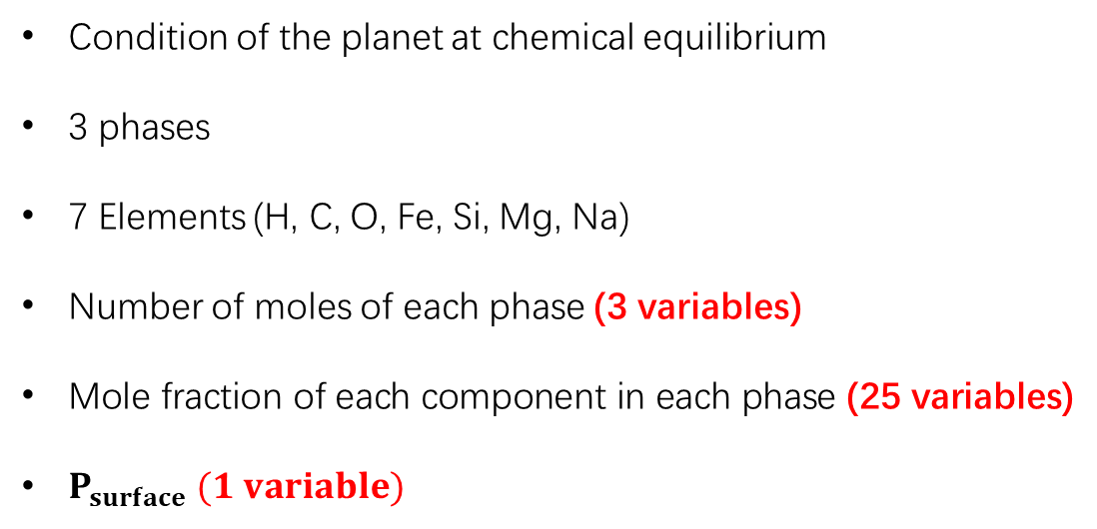
Aim of the project
Envelope (atmosphere)
(H₂, CO, CO₂, CH₄, etc.)
Magma Ocean
(MgO, SiO₂, Na₂O, etc.)
Condition of the planet at chemical equilibrium
3 phases
7 Elements (H, C, O, Fe, Si, Mg, Na)
Number of moles of each phase (3 variables)
Mole fraction of each component in each phase (25 variables)
$P_{surface} (1 variable)$
Core
(Fe, Si, H, O)
$P_{surface}$ (the pressure at the boundary between the magma ocean and the envelope)

Slide 2
Project Frame
Input
Algorithm
Output
Initial values of 29 variables
Temperature, solver settings, total amount of each element
29 Equations for 29 variables
Simulated annealing + MCMC
Best fit values of 29 variables at chemical equilibrium

Slide 3

Equations
18 reactions
$$\sum_{i}{ν_{i}}\ln{x_{i}}+\left[\frac{Δ\hat{G_{\text{rxn}}^{∘}}\left(T,1\right)}{RT}+\sum_{g}{ν_{g}}\ln\left(\frac{P_{surface}}{P^{∘}}\right)\right]=0$$
7 mass balance equations
$$n_{s}−\sum_{k}{\sum_{i}{η_{s,i,k}}} x_{i,k} N_{k}=0$$

Slide 4

Equations
3 unity equations
$$1−\sum_{i}{x_{i,k}}=0$$
Newton's Second Law (solving $P_{surface}$)
$$\left(\frac{P_{\text{surface}}}{1,\text{bar}}\right)≃1×{10}^{6}\frac{M_{\text{atm}}}{M_{p}}{\left(\frac{M_{p}}{M_{⊕}}\right)}^{2/3}$$

Slide 5
Solver
Simulated annealing:
It gives a small region where the best fit lies.
MCMC
It finds the best-fit values in the given region.

Slide 6








$$G^{∘}\left(T,1\right) for each component$$
Database
$$Δ\hat{G_{\text{rxn}}^{∘}}\left(T,1\right)$$
$$V(T,P) for each component$$
H$ere we are.$
Equations of states
Equations
Activity coefficients for nonideal mixing
Functions to solve the variables
Reproduction
P$arameter setting$
Solver
S$imulated annealing + MCMC$
O$utput$
Plotting
M$ake some nice plots!$

Slide 7
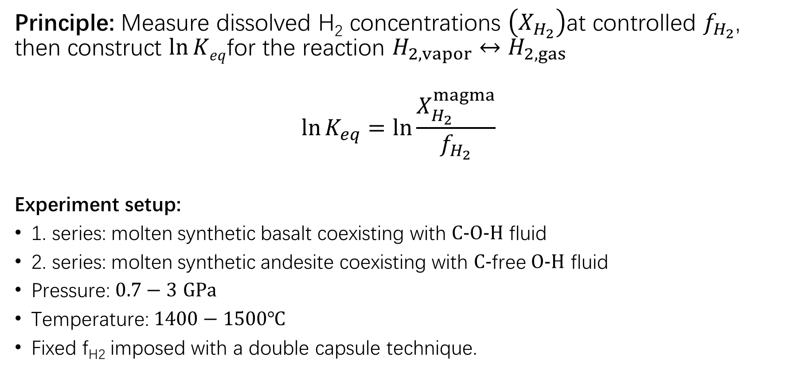
Hirschmann et al. 2012
Principle: Measure dissolved H₂ concentrations $\left(X_{H_{2}}\right)$at controlled $f_{H_{2}}$, then construct $\ln{Keq}$for the reaction $H_{2,vapor}↔H_{2,gas}$
$$\ln{K_{eq}}=\ln{\frac{X_{H_{2}}^{magma}}{f_{H_{2}}}}$$
Experiment setup:
1. series: molten synthetic basalt coexisting with $C−O−H$ fluid
2. series: molten synthetic andesite coexisting with $C−$free $O−H$ fluid
Pressure: $0.7−3$ $GPa$
Temperature: $1400−1500℃$
Fixed f_{H2} imposed with a double capsule technique.

Slide 8
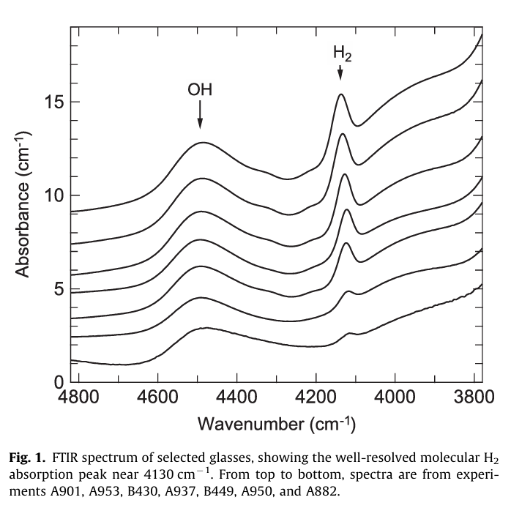

Hirschmann et al. 2012
1. concentration measurement: FTIR from absorption features
$H2$ concentration: absorption peak near $4130 cm−1$
$OH−$ and $H2O$ concentrations: combination bands at $4500$ and $5200 cm−1$

Slide 9
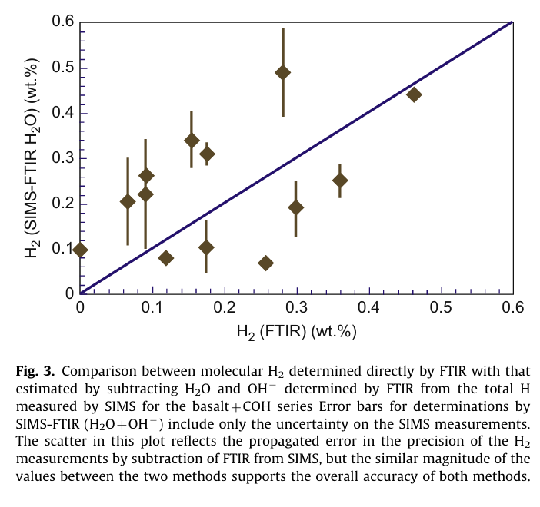

Hirschmann et al. 2012
2. concentration measurements: SMIS
measures the total H content: sum of $H2, OH−,$and $H2O$ (only for basalt)
FTIR H₂ vs. (SIMS total H) – (FTIR H₂O)

Slide 10
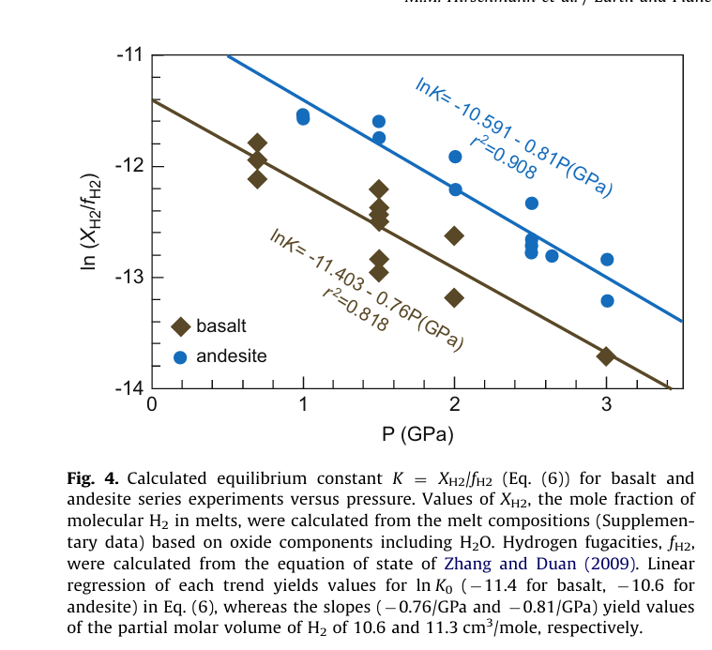

Hirschmann et al. 2012
Result:
$$\ln{K}=\ln{\frac{X_{H_{2}}^{magma}}{f_{H_{2}}}}=\ln{K_{0}}+\frac{ΔH}{R}\left(\frac{1}{T_{0}}−\frac{1}{T}\right)−\frac{ΔV\left(P−P_{0}\right)}{RT}$$
$$T = T0 = 1400 ℃$$
$P0$ = 1 bar
$ΔV$(basalt) = $0.76{\left(GPa\right)}^{−1}×RT_{0}=10.6 cm^{3}/mole$
$ΔV$(andesite) = $0.81{\left(GPa\right)}^{−1}×RT_{0}=11.3 cm^{3}/mole$

Slide 11
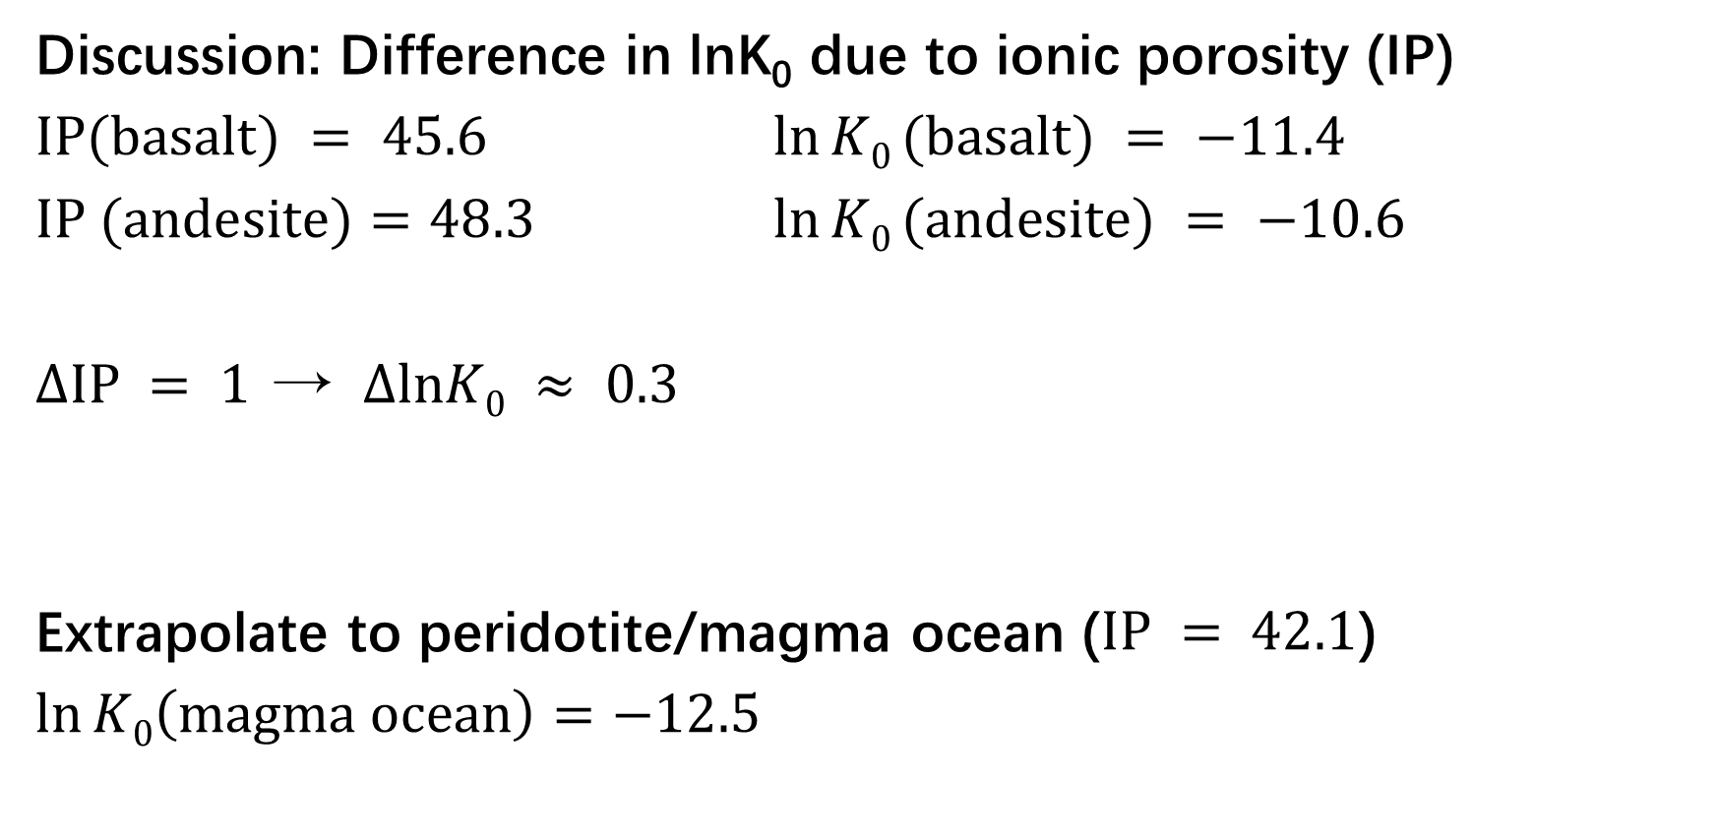
Hirschmann et al. 2012
Discussion: Difference in lnK₀ due to ionic porosity (IP)
$IP(basalt) = 45.6$ $\ln{K0}(basalt) = −11.4$
$IP (andesite)=48.3$ $\ln{K0}(andesite) = −10.6$
$ΔIP = 1$→ $ΔlnK0 ≈ 0.3$
Extrapolate to peridotite/magma ocean ($IP = 42.1$)
$\ln{K0\left(magma ocean\right)}=$ $−12.5$

Slide 12
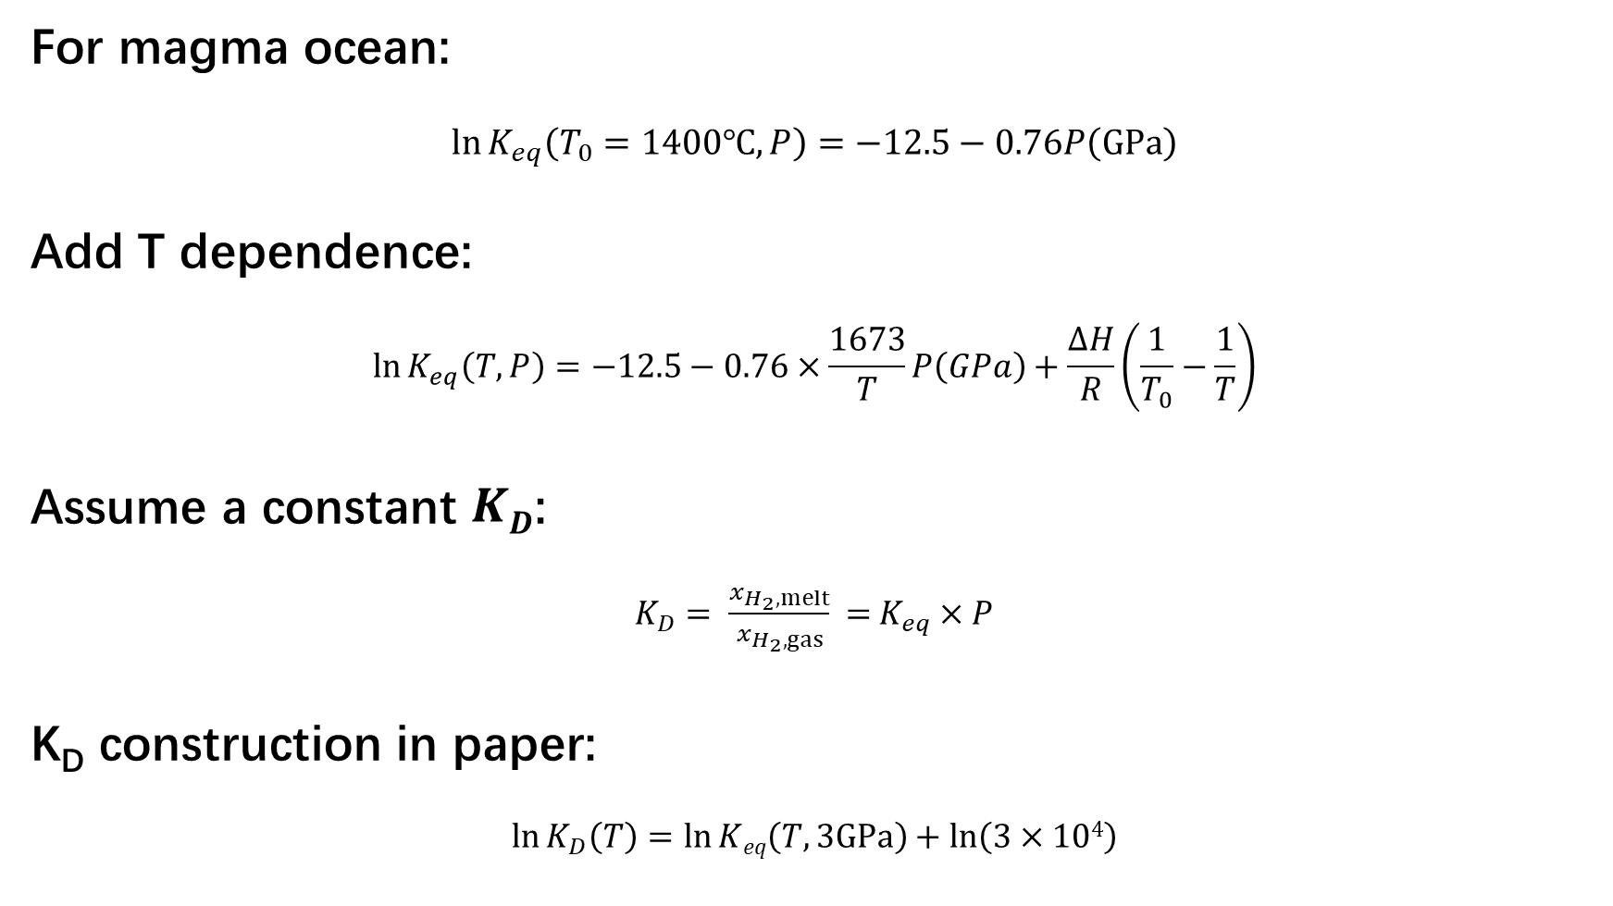
Treatment in the model
For magma ocean:
$$\ln{K_{eq}\left(T_{0}=1400℃,P\right)}=−12.5−0.76P\left(GPa\right)$$
Add T dependence:
$$\ln{K_{eq}\left(T,P\right)}=−12.5−0.76×\frac{1673}{T}P\left(GPa\right)+\frac{ΔH}{R}\left(\frac{1}{T_{0}}−\frac{1}{T}\right)$$
Assume a constant $KD$:
$K_{D}= \frac{x_{H_{2},melt}}{x_{H_{2},gas}}$ = $K_{eq}×P$
K_{D} construction in paper:
$$\ln{K_{D}\left(T\right)}=\ln{Keq\left(T,3GPa\right)}+\ln\left(3×104\right)$$

Slide 13
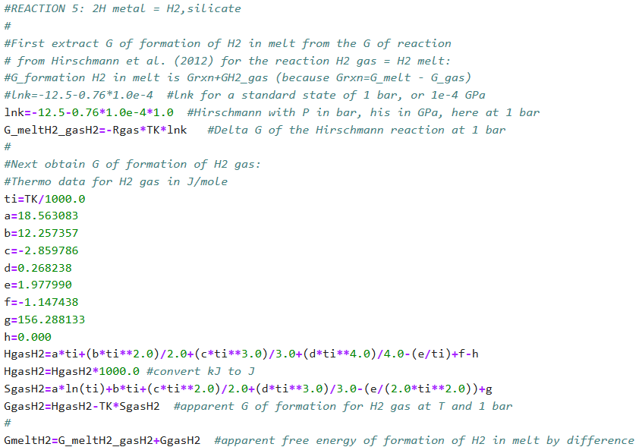
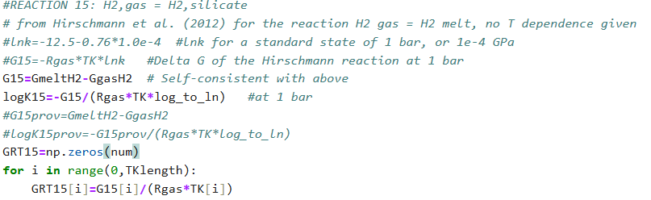

Treatment in code
K_{D} construction in code:
$$\ln{K_{D}\left(T\right)}=\ln{K_{eq}\left(T_{0}=1400℃,1bar\right)}+\ln\left(3GPa/bar\right)$$

Slide 14
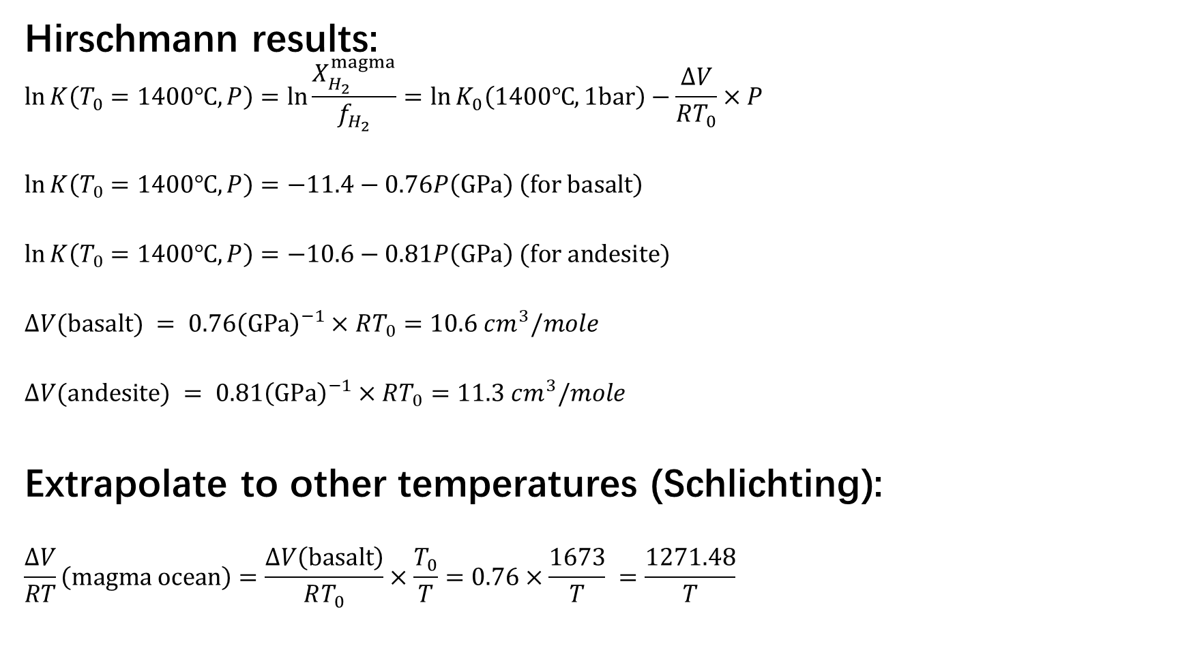
Mistake in the last discussion
Hirschmann results:
$$\ln{K\left(T_{0}=1400℃,P\right)}=\ln{\frac{X_{H_{2}}^{magma}}{f_{H_{2}}}}=\ln{K_{0}\left(1400℃,1bar\right)}−\frac{ΔV}{RT_{0}}×P$$
$$\ln{K\left(T_{0}=1400℃,P\right)}=−11.4−0.76P\left(GPa\right) \left(for basalt\right)$$
$$\ln{K\left(T_{0}=1400℃,P\right)}=−10.6−0.81P\left(GPa\right) (for andesite)$$
$$ΔV(basalt) = 0.76{\left(GPa\right)}^{−1}×RT_{0}=10.6 cm^{3}/mole \\ ΔV(andesite) = 0.81{\left(GPa\right)}^{−1}×RT_{0}=11.3 cm^{3}/mole$$
Extrapolate to other temperatures (Schlichting):
$$\frac{ΔV}{RT}\left(magma ocean\right)=\frac{ΔV\left(basalt\right)}{RT_{0}}×\frac{T_{0}}{T}=0.76×\frac{1673}{T} =\frac{1271.48}{T}$$

Slide 15
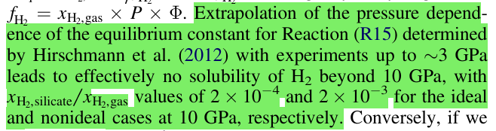
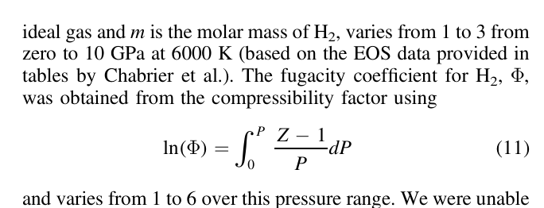
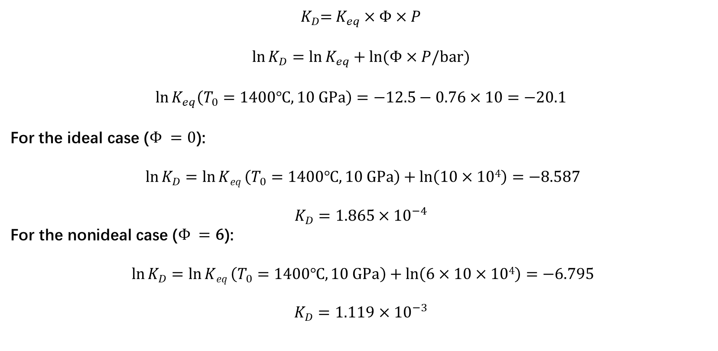
Verify results extrapolated to 10 GPa
$K_{D}$= $K_{eq}×Φ×P$
$$\ln{K_{D}}=\ln{K_{eq}}+\ln{(Φ×P/bar)}$$
For the ideal case ($Φ =0$):
$$\ln{K_{D}}=\ln{Keq}\left(T_{0}=1400℃,10 GPa\right)+\ln\left(10×104\right)=−8.587$$
$$K_{D}=1.865×{10}^{−4}$$
$$\text{For} \text{the} \text{non}\text{ideal} \text{case} \text{(}Φ =\text{6}\text{):}$$
$$\ln{K_{D}}=\ln{Keq}\left(T_{0}=1400℃,10 GPa\right)+\ln\left(6×10×104\right)=−6.795$$
$K_{D}=1.119$ $×{10}^{−3}$

Slide 16
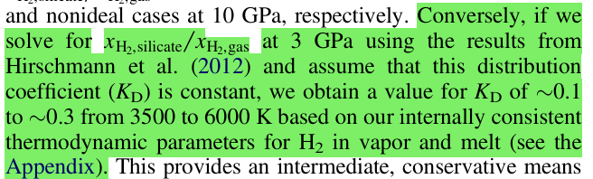

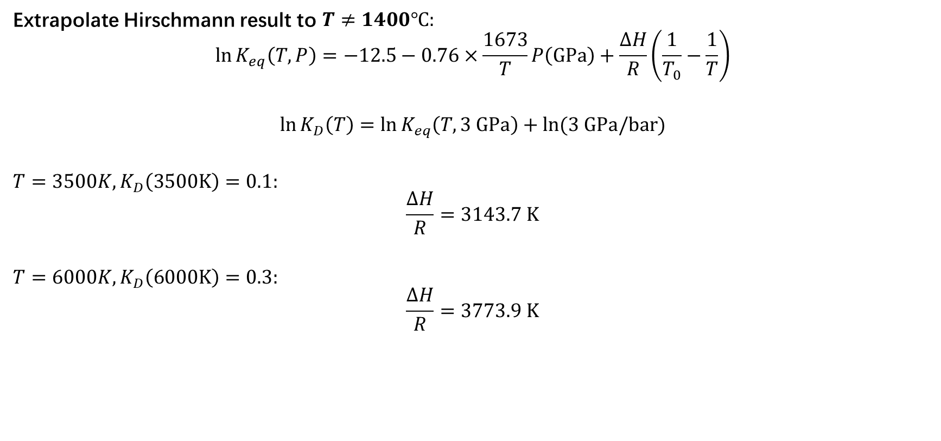
$Calculate$ $\frac{ΔH}{R}$
Extrapolate Hirschmann result to $T≠1400℃:$
$$\ln{K_{eq}\left(T,P\right)}=−12.5−0.76×\frac{1673}{T}P\left(GPa\right)+\frac{ΔH}{R}\left(\frac{1}{T_{0}}−\frac{1}{T}\right)$$
$$\ln{K_{D}\left(T\right)}=\ln{K_{eq}\left(T,3 GPa\right)}+\ln{(3 GPa/bar)}$$
$$T=3500K,K_{D}\left(3500K\right)=0.1:$$
$$\frac{ΔH}{R}=3143.7 K$$
$$T=6000K,K_{D}\left(6000K\right)=0.3:$$
$$\frac{ΔH}{R}=3773.9 K$$

