Slide 1

Business Intelligence Case Study: Flying Whale Airline
Portfolio Project
Muhammad Zain

Slide 2
Highlights – 2017/18
Following statistics are based on 2017 and 2018.
2 million flights booked
490 million kms flight distance
14670 loyalty card members as of end of 2018
12 million point redeemed

Slide 3
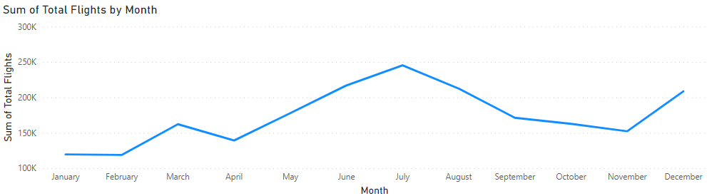
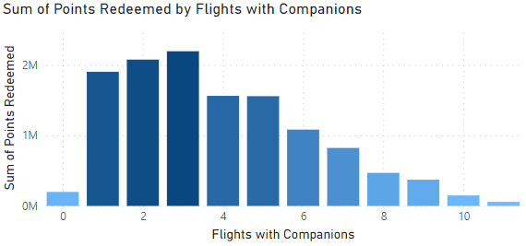
Flight Activity
Flights shows a seasonal trend with two peaks in a year, July and December, with July peak being larger than December.
Either for individual members or for additional passenger, highest points redeemed for number of flights booked during 2017 & 2018 is 3.

Slide 4
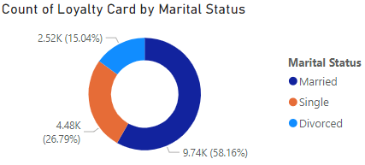
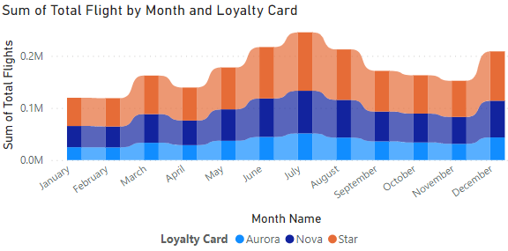
Loyalty Segmentation
There is almost equal number of membership by females and males.
Star loyalty category has the largest membership irrespective of gender, marital status, and geographic location.
Star members have highest median distance (kms) with 519 kms for all flights with Nova members have lowest median distance (kms).
The flights booked follow same seasonal trend irrespective of the type of loyalty card, but Star members have the highest number of flights for all months.

Slide 5
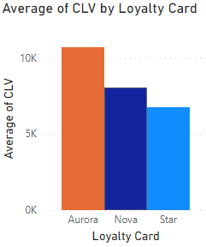
Customer lifetime value (CLV)
Defined as “total invoice value for all flights ever booked by member”.
Aurora members have highest average CLV value with Nova members have second highest average CLV.
Aurora members have equal proportion of females and males. Approximately for both Aurora and Nova members, 60 percent of members are married.

Slide 6
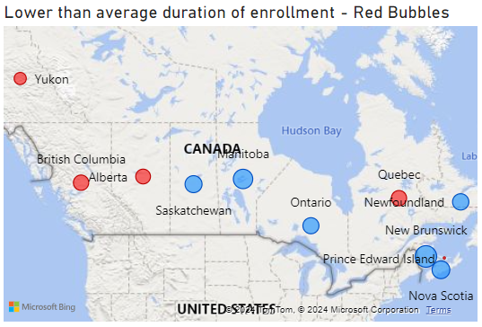
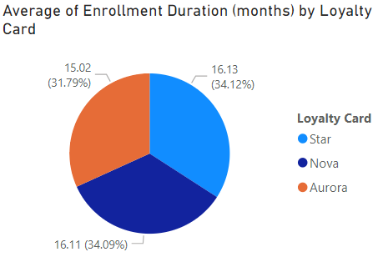
Enrollment & Cancellation
Average duration of enrollment among cancelled members is 15.88 months.
Prince Edward Island, Yukon, Alberta, Quebec, and British Columbia has average duration of enrollment is below the overall average for cancelled members.
Membership cancellation is highest for month of December.
With respect to the loyalty card categories, Aurora has the lowest average duration of enrollment.

Slide 7
Recommendations
Flying whale need to focus on its Aurora and Nova member as they have high customer lifetime value.
They could do this through advertisement campaign or new promotional deals, especially in peak travelling season i.e., July and December
Aurora has lowest average enrollment duration. This needs to be investigated further through filling feedback forms from existing and leaving members.

