Slide 1


Social Network Project
Name: Abdelrahman Mohamed Abdelfattah
ID:
Name: Mohamed
Zoher
Mohamed
ID:
Notes:
This template can be used as a starter file for presenting training materials in a group setting.
Sections
Right-click on a slide to add sections. Sections can help to organize your slides or facilitate collaboration between multiple authors.
Notes
Use the Notes section for delivery notes or to provide additional details for the audience. View these notes in Presentation View during your presentation.
Keep in mind the font size (important for accessibility, visibility, videotaping, and online production)
Coordinated colors
Pay particular attention to the graphs, charts, and text boxes.
Consider that attendees will print in black and white or grayscale. Run a test print to make sure your colors work when printed in pure black and white and grayscale.
Graphics, tables, and graphs
Keep it simple: If possible, use consistent, non-distracting styles and colors.
Label all graphs and tables.

Slide 2
The main goals of this project
1
2
to walk you through all steps necessary to create a network, as well as simple network visualizations
3
to familiarize you with the concept of social networks in a practical sense by working on a real data set
to introduce basic features of a social network that provides insights into a relationship of interests to help you learn how to perform basic network analytics such as clustering and community detection, and to introduce you to some advanced topics that may be of interest to you.
Notes:
This is another option for an Overview slide.

Slide 3


What the program will be?

Slide 4

The program will perform analysis and visualization of the Ethereum exchange data to gain insights into the stablecoin network, including transaction patterns, relationships between addresses, and other relevant metrics.

Slide 5
What the input from the program will be?

Slide 6
The input to the program will be the "alphacore_labels_stablecoin.csv" dataset, which contains information about labels, addresses, names, and assets related to stablecoin transactions on the Ethereum blockchain.

Slide 7
What the output from the program will be?

Slide 8
The output from the program will include visualizations of the stablecoin network, analysis of transaction patterns based on labels and assets, identification of important nodes or addresses within the network, and any other insights derived from the data analysis.

Slide 9
Let’s Start!
Notes:
Use a section header for each of the topics, so there is a clear transition to the audience.

Slide 10
to familiarize you with the concept of social networks in a practical sense by working on a real data set
the dataset contains weighted, directed graphs with partially available node labels. It consists of token (asset) networks extracted from the Ethereum blockchain between Oct-16-2018 and May-04-2020. The dataset also provides address labels (label, address, name, asset)
Which is in the (alphacore_labels_stablecoin.csv) for addresses in the 0.1 depth Alphacore of the stablecoin network.
The dataset seems to focus on the interactions and transactions between different addresses on the Ethereum blockchain, particularly related to token networks and stablecoin networks. It likely includes information about the flow of assets, the relationships between different addresses, and possibly other attributes related to these transactions.
Notes:
This is another option for an Overview slides using transitions.

Slide 11
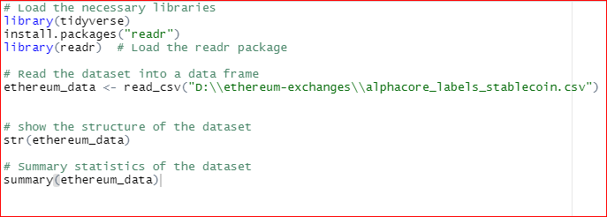
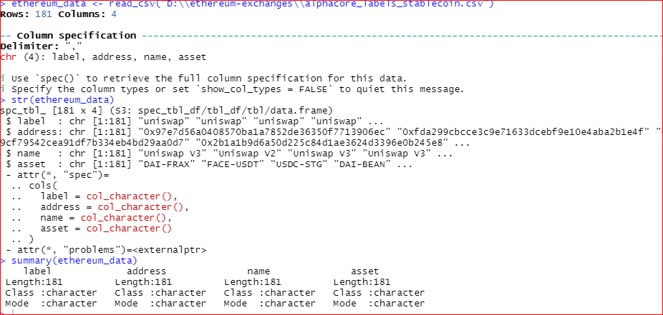
to walk you through all steps necessary to create a network, as well as simple network visualizations;
We have 3 important points
Define the dataset
Show the structure
Summary of dataset

Slide 12
Data Preprocessing

Slide 13
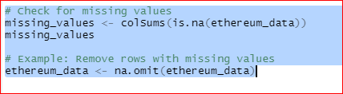

Missing value
duplicated
Notes:
What will the audience be able to do after this training is complete? Briefly describe each objective how the audience will benefit from this presentation.

Slide 14
Network Analysis

Slide 15

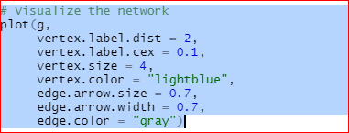
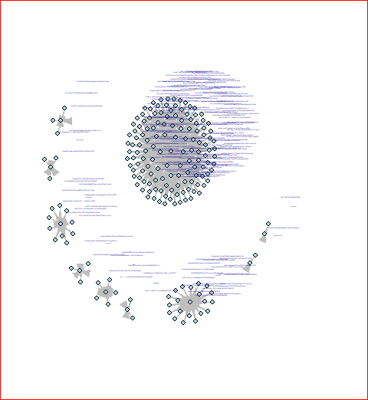
Create the Network
Visualize the directed Graph
Notes:
Add slides to each topic section as necessary, including slides with tables, graphs, and images.
See next section for sample table, graph, image, and video layouts.

Slide 16
Centrality Measures

Slide 17

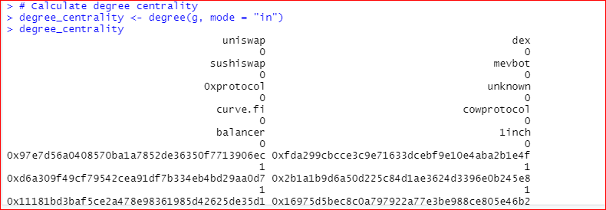
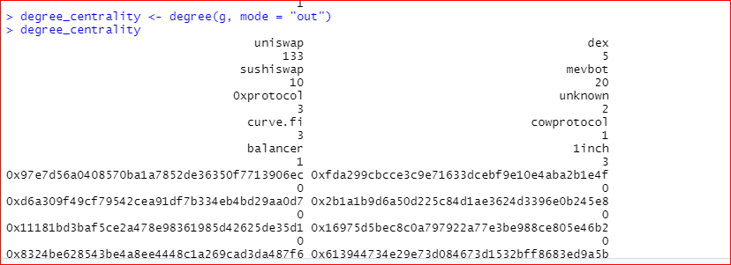
In degree centrality
Out degree centrality

Slide 18
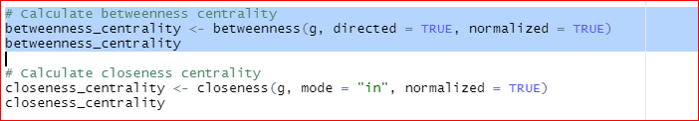
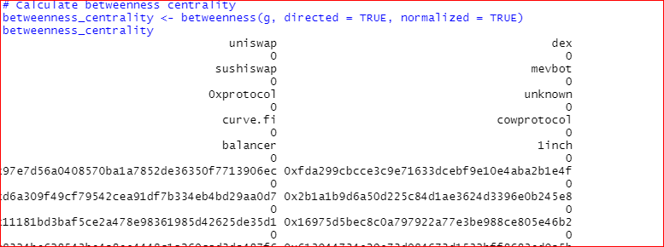
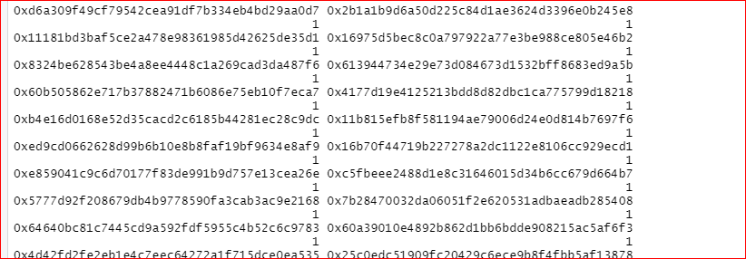
Betweenness centrality
Closeness centrality

Slide 19
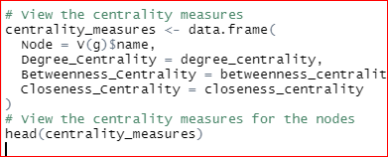
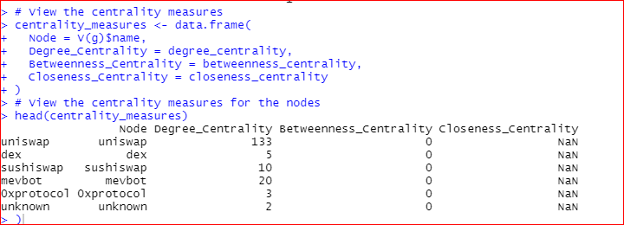
View Of centrality

Slide 20
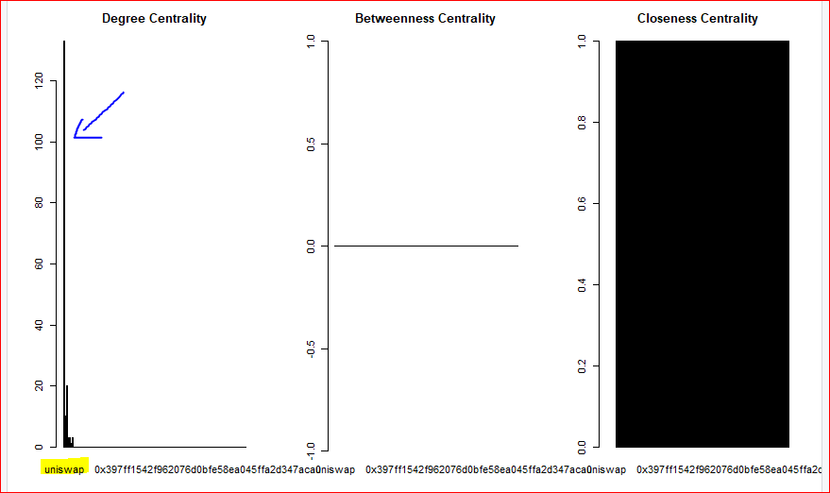
visualization Of centrality

Slide 21
Community Detection

Slide 22
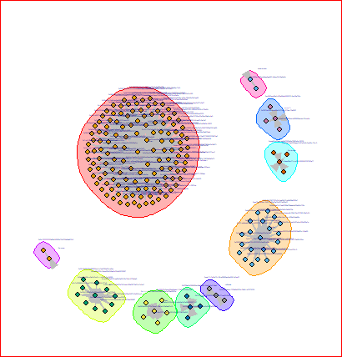
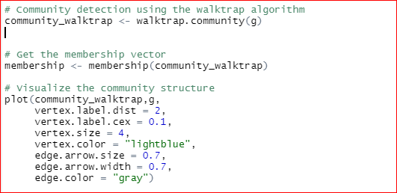
Community detection using the walktrap algorithm
Visualize the community structure

Slide 23
Clustering

Slide 24
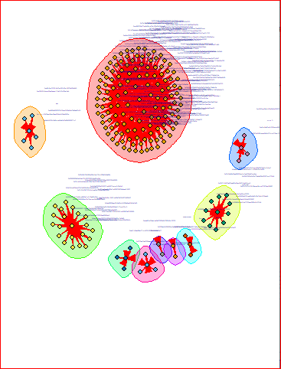
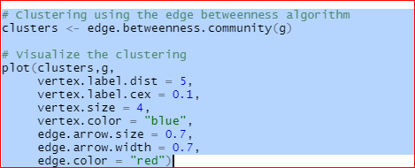
Clustering using the edge Betweenness algorithm
Visualize the clustering

Slide 25
Adjacency
Matrix and Ipmortant
Node

Slide 26
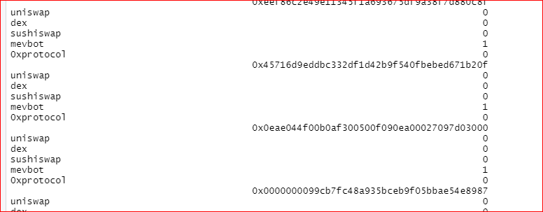
Adjacency Matrix
Important Nodes

Slide 27
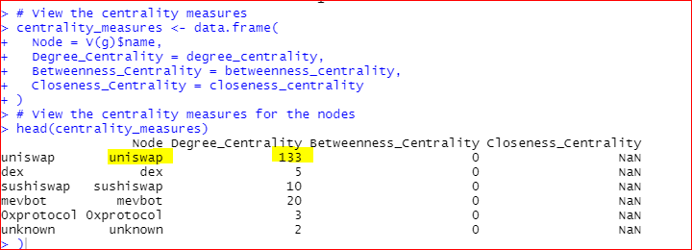
Analysis of Measures
For Betweenness centrality:
If the Betweenness centrality values are all zero for the nodes in the network, it indicate that there are no shortest paths that pass through those nodes. This happen in a network where there are multiple paths of equal length between nodes, or where the network is highly interconnected, making it difficult for any single node to act as a bridge between other nodes.
For closeness centrality :
that every node is reachable from every other node in the network.
For degree centrality:
Upon analyzing the Ethereum exchange network, it was observed that a specific label exhibited the highest out-degree centrality, with a value of 133. This indicates that this particular label has the most outgoing connections to other nodes in the network, suggesting a potentially influential role in the exchange of assets within the Ethereum ecosystem.
Notes:
Add a case study or class simulation to encourage discussion and apply lessons.

Slide 28
Summary
Uniswap is the most important label
There is no bridge edges
Every node is reachable from other
The network is the connected
Notes:
Summarize presentation content by restating the important points from the lessons.
What do you want the audience to remember when they leave your presentation?
Save your presentation to a video for easy distribution (To create a video, click the File tab, and then click Share. Under File Types, click Create a Video.)

Slide 29
Resources
https://snap.stanford.edu/data/ethereum-exchanges.html
https://www.sciencedirect.com/topics/computer-science/betweenness-centrality
https://www.sciencedirect.com/topics/computer-science/community-detection

Slide 30
Thank you !

