Slide 1
Predicting car accident severity

Slide 2
Background
Business Problem
In this project, we will try to predict the possibility of a car driver involved in a car accident under certain weather and road condition. This project will also try to give the possible severity of the accident. Specifically, this project will focus on Seattle City.
2. Data Source
The data set is the collisions records of Seattle City. All collisions provided by SPD and recorded by Traffic Records. This includes all types of collisions.

Slide 3
Data processing
Feature selection:
the weather;
road condition;
the light condition;
speeding or not;
crosswalk or not
Data cleaning
Data encoder

Slide 4
Methodology
Features vs Target
explore the relationship of the 5 features and the severity
Model selection
Logistic Regression

Slide 5
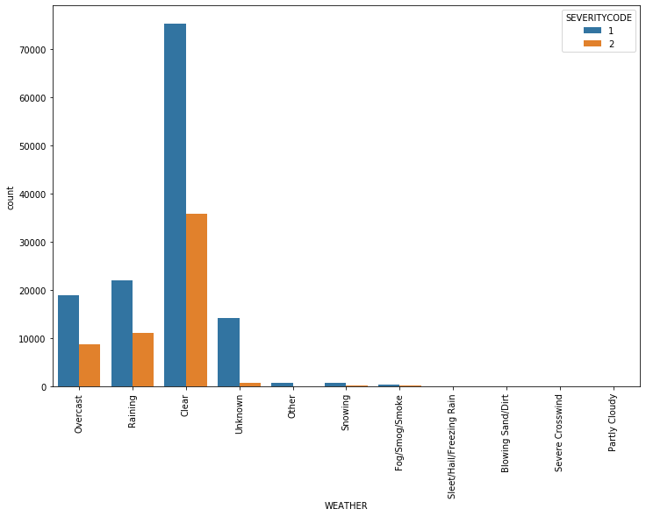
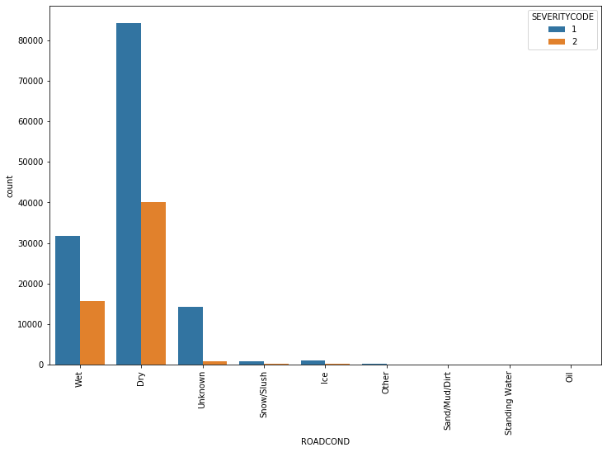
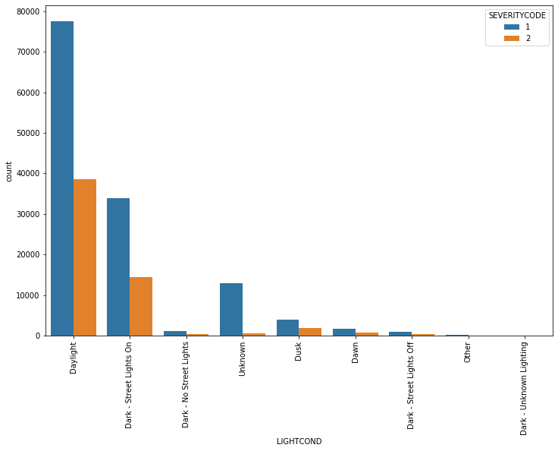
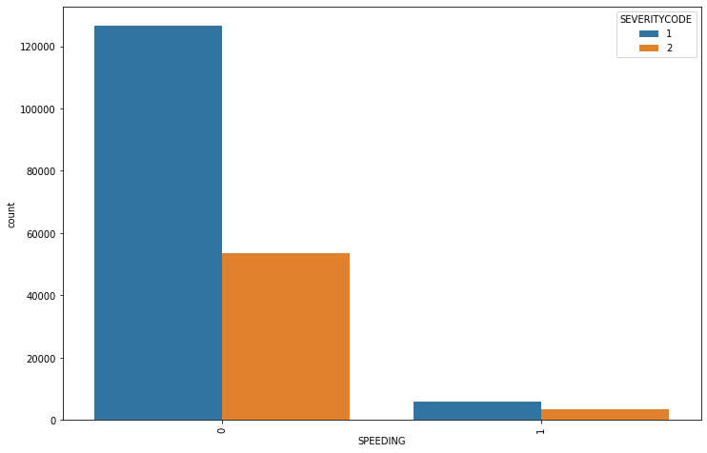
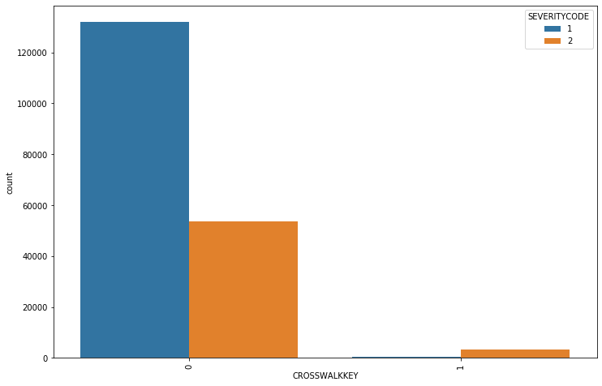
Results

Slide 6
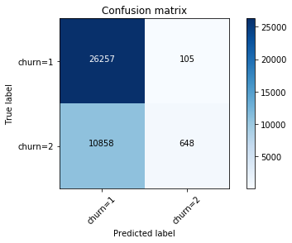
Results

Slide 7
Conclusion
This case provide a possible method to predict the severity of car accident under certain weather and road conditions.
Limitation:
1. There dataset is only including one city, we need more data to get better results;
2. The dataset is unbalance labeled, we need more technologies to deal with this.

