Slide 1
Box Gift

Slide 2
Requirements
3d Printed Box opens and Closes
Looks nice
Lights on top do pretty patterns
Switching to turn off power
Button inside to switch mode, led to indicate mode

Slide 3
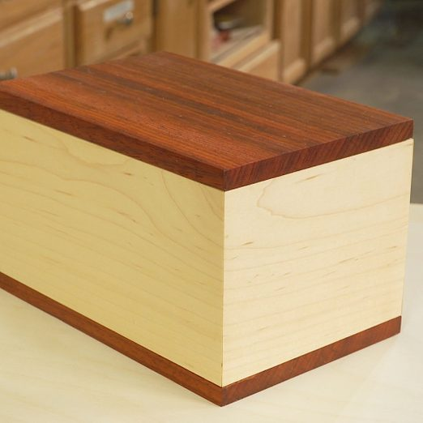
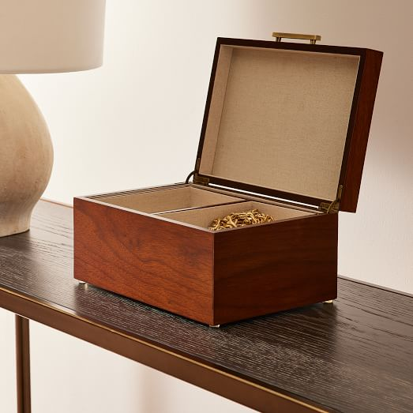
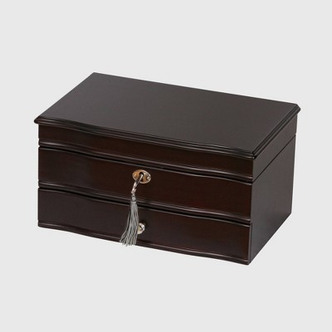
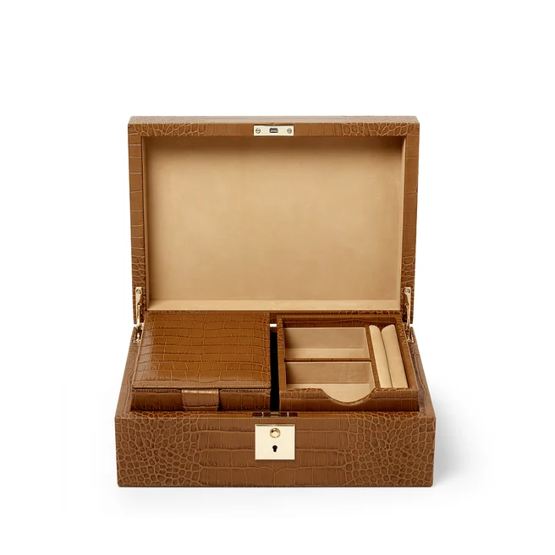
General Inspiration

Slide 4


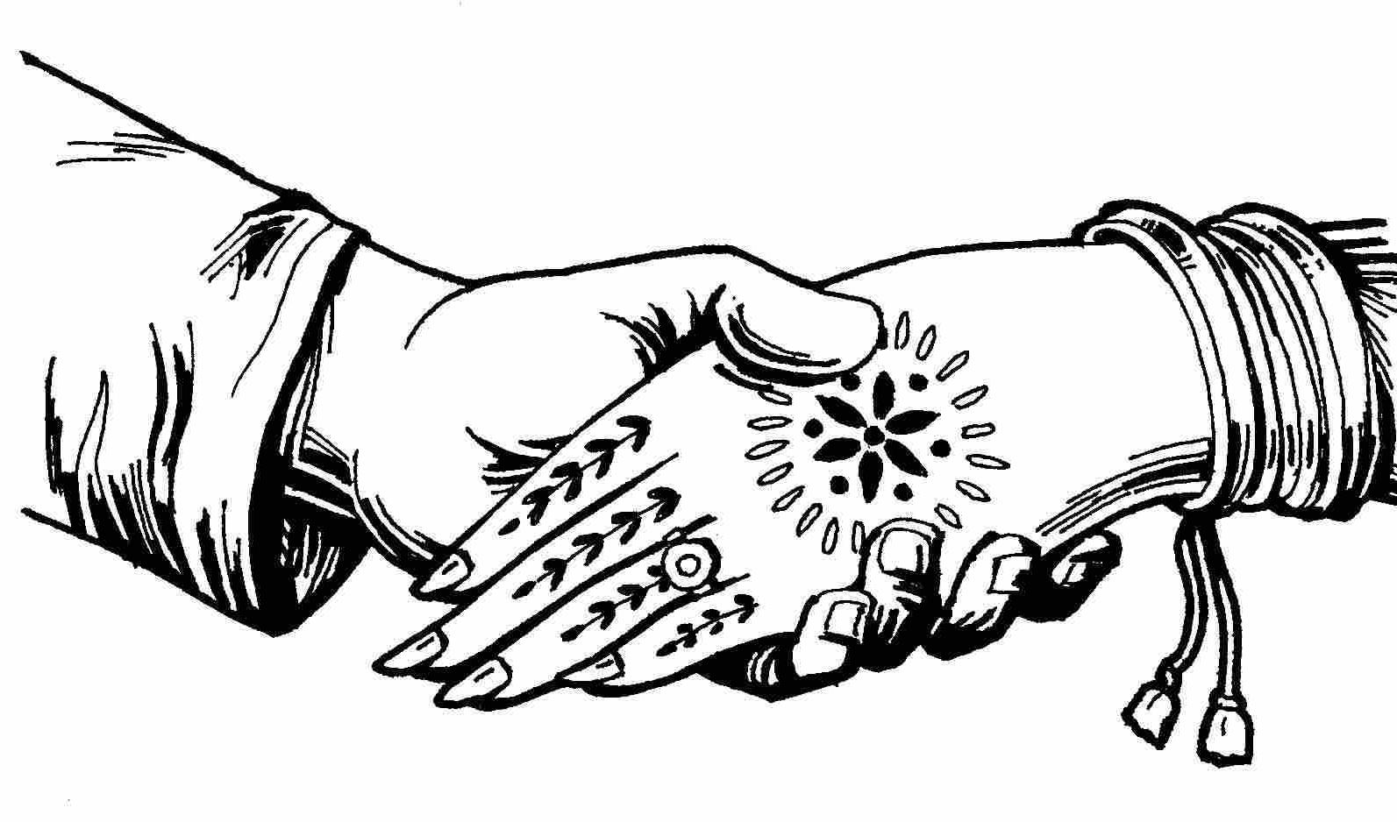
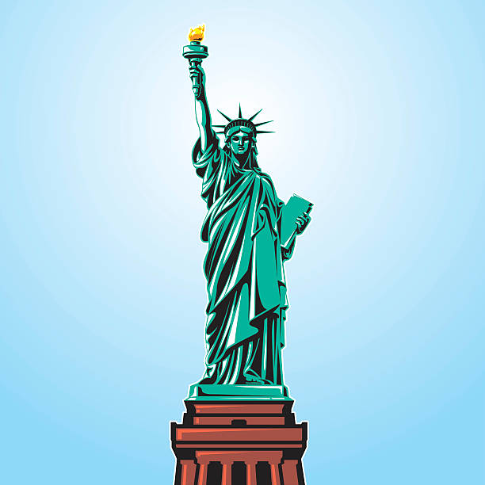


Person 1 Inspirations

Slide 5
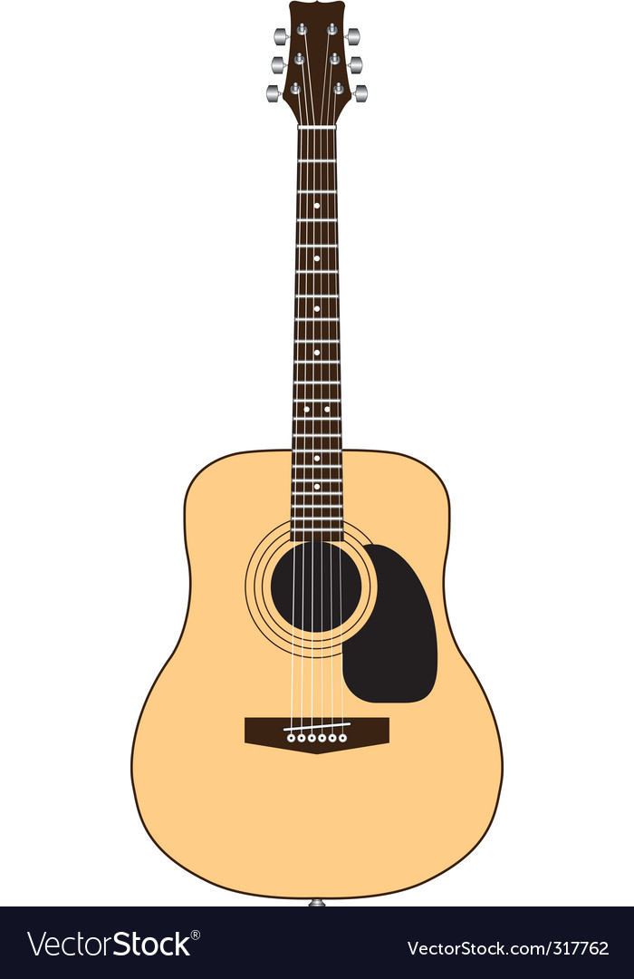
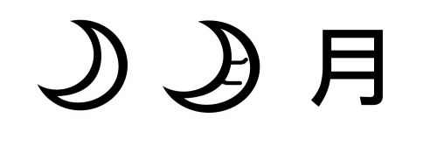


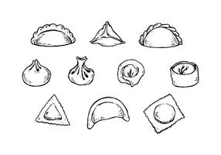
Person 2 inspiration

