Slide 1

Mind reader game
Presented By: Supervised By:
Md. Anowar Kabir KAWSAR AHMED ID: IT-15048 Lecturer,
Session:-2014-2015 Dept of ICT,
& MBSTU.
M. Mashrukh Zayed
ID:IT-15047 Session:-2014-2015
Dept of ICT MBSTU.

Slide 2
INTRODUCTION My project includes some works of functions, files graphics and some conditions. It helps students to think about prediction mathematically. There are 100 numbers from 0-99 in a list and if one take a number from it then my project finds out the exact number in only six steps. It includes graphics work in every steps.

Slide 3
The function which are used:…
setlinestyle();
setcolor();
line();
rectangle();
settextstyle();
outtextxy();
gcvt();
getch();
clrscr();
cleardevice();
scanf();
printf();
sound();
delay();

Slide 4
Overview of the project……
At first we have to draw a table by using line() function and rectangle() function,Which are library function. The line function is used to draw line.It’s declaration process is:
line(int startx,int starty,int endx,int endy);
Another function is rectangle(); It is used to draw rectangle.And it’s declaration process is described below:
rectangle(int startx,int starty,int endx,int endy);

Slide 5

FRONT PAGE:

Slide 6
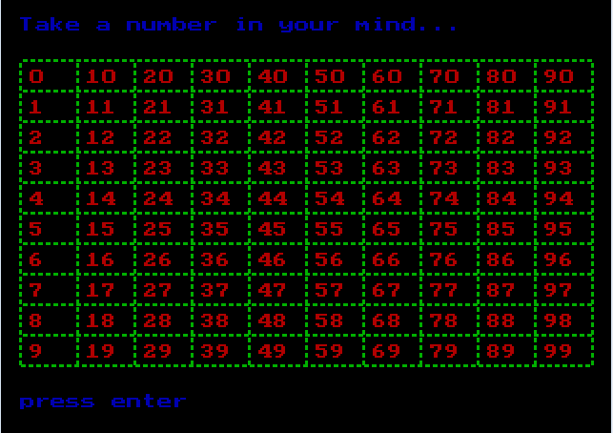
Second page:
Here it showed a of list 100 numbers from 0 to 99.
Then it asks to arbitrarily take a number from it in mind.
Let, We take the
number 45
from here
and follow
the next
steps.

Slide 7
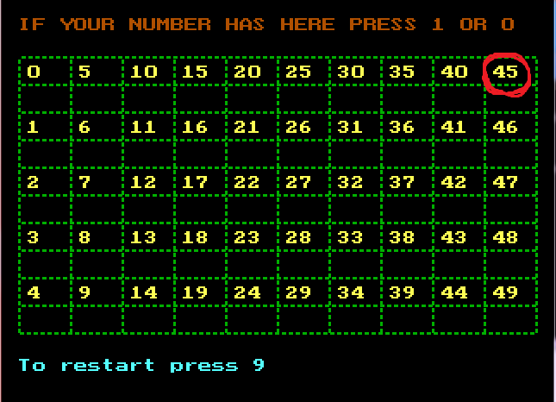
1st step:
Here 45 is present. So we press ‘1’.And then we follow next step. In this project we can go to front page from any step if any wrong selection is made.

Slide 8
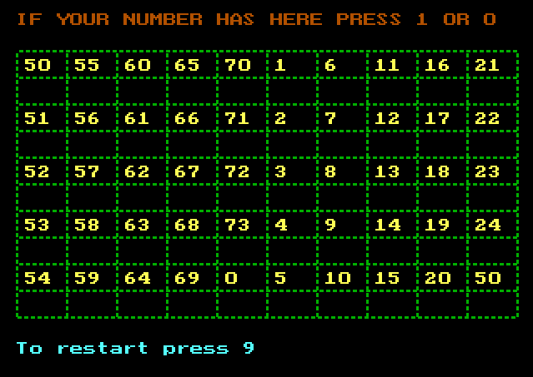
2nd step:
In this step we see that 45 is not present so we press ‘0’.

Slide 9
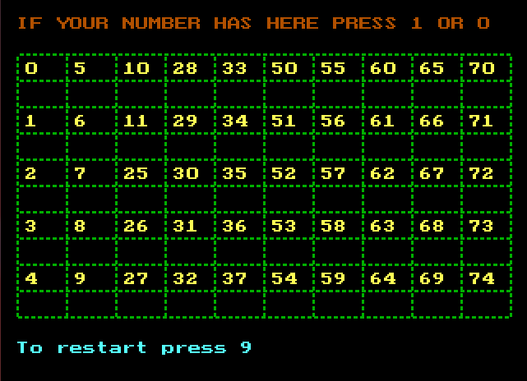
3rd step:
Similarly 45 is not present here. So we press ‘0’.We do several process at next steps.

Slide 10
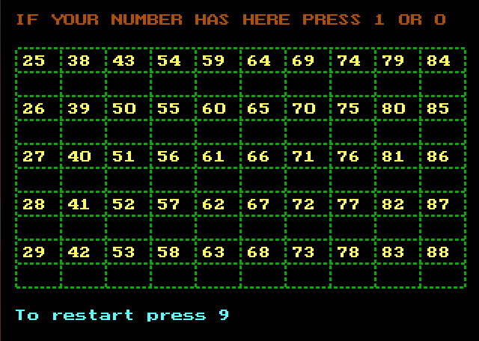
4th step:
In 4th step we can not find the number. So we have to press ‘0’.

Slide 11
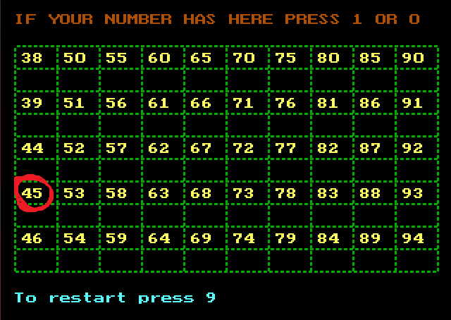
5th step:
In 5th step we see the number ‘45’ which is here so we press ‘1’.

Slide 12
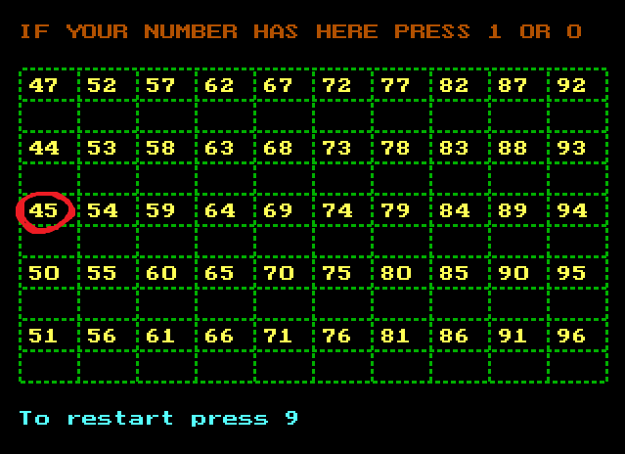
6th step:
Here we see that 45 is present. So press ‘1’ and go to the next step.

Slide 13
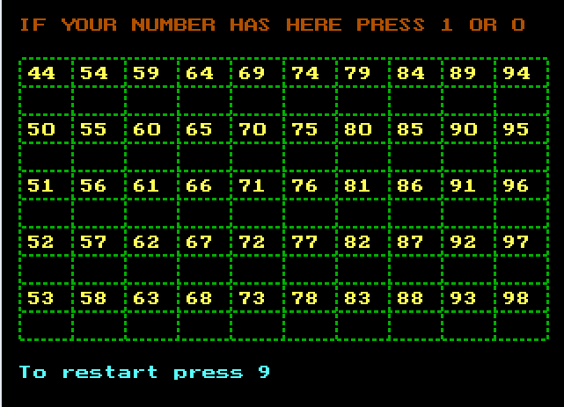
Last step:
Here we see that 45 is not present So we press ‘0’ and wait for the output.

Slide 14
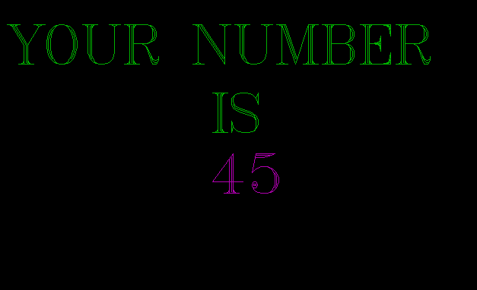
Here this is the final result of the project. Which displays the
the number of your mind.

Slide 15
Limitation:
It will run only in a computer. It can not
be run in any other device.
It is play with a range only 0-99.

Slide 16
THAT’S ALL
AND
THANK YOU

Slide 17
END

