Slide 1


Travel Experts 2.0
Presented by 4 POINT SOFTWARE
Mingyu Z., Ryan D., Kolin L., Frederick F.
Notes:
Title page
FRED

Slide 2

About us
Proven track record
Satisfied clients
10+ years of combined experience
Current technologies and methodologies
Notes:
About Us
KOLIN

Slide 3

goals
Agent and admin desktop application
Customer web-based dashboard
User-friendly interface and UX
Notes:
Goals
RYAN
DESKTOP
-Agency commission cannot be larger than the base price
-Package end date must be later than package start date
-Package name and desc cannot be null
WEB
-Validators
-Enhance the CS sign-up page to enable customer to log in and update their data
-Design a page that will enable a customer to list the travel products they have purchased

Slide 4

The 4 POINT team
Mingyu Zhang Team leader, Full-stack Developer | Ryan Dionne Web-dev lead, Full-stack Developer | Kolin Lovett Database architect, Full-stack Developer | Fred Fernandez Project Manager, Full-stack Developer
Desktop app development Desktop app class library, data layer Web app development | Web app development oversight Registration Login | Database modifications Desktop app presentation and data layer Testing | Development oversight Desktop app development
Notes:
The Team
MINGYU

Slide 5
Desktop app
DEMONSTRATION
Notes:
Desktop Application Deployment
FRED & KOLIN

Slide 6

DESKTOP key features
Easy to navigate
User friendly
Select a module
Exit application
Notes:
Desktop Application Deployment
FRED & KOLIN

Slide 7
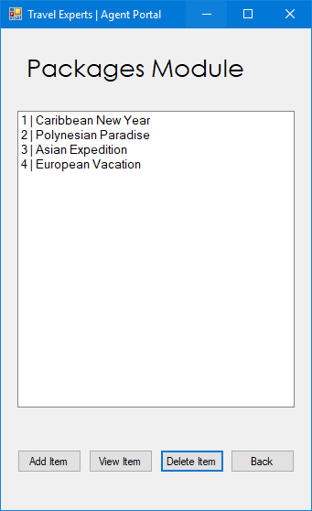
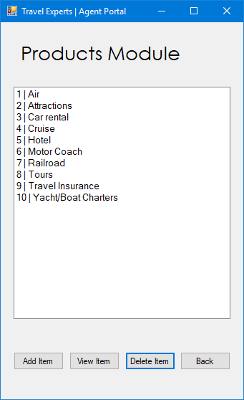
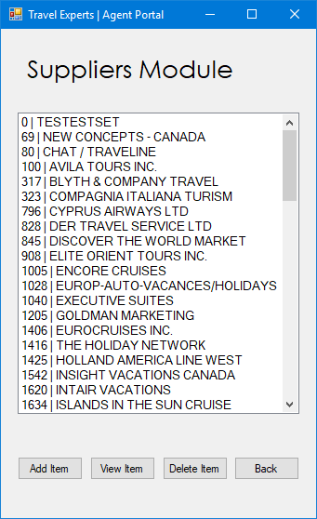
DESKTOP key features - Modules
Notes:
Desktop Application Deployment
FRED & KOLIN

Slide 8
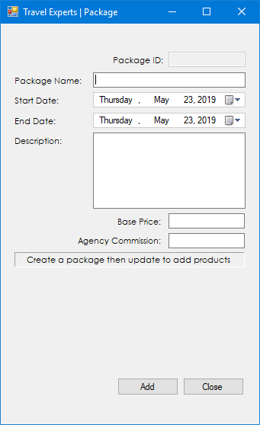
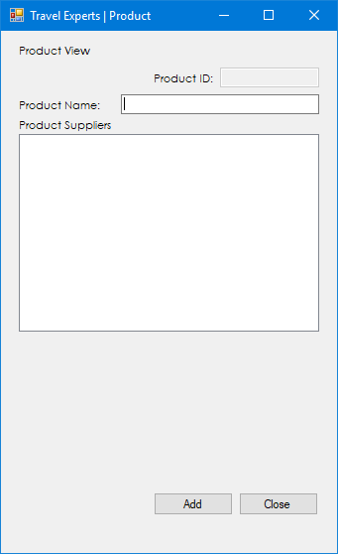
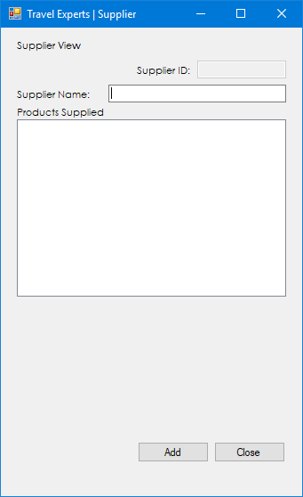
DESKTOP key features - ADD
Notes:
Desktop Application Deployment
FRED & KOLIN

Slide 9
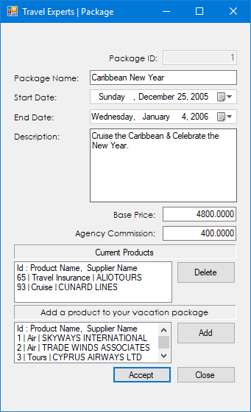
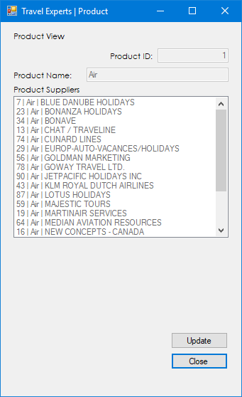
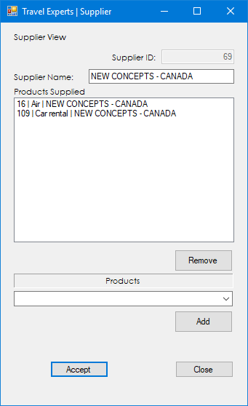
DESKTOP key features – View & Update
Notes:
Desktop Application Deployment
FRED & KOLIN

Slide 10
Web App
DEMONSTRATION
Notes:
Desktop Application Deployment
RYAN & MINGYU

Slide 11
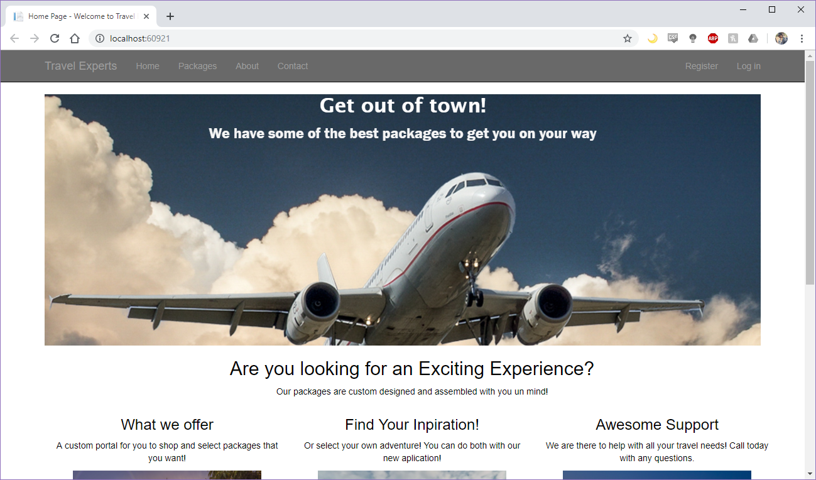
Web Key Features
Simple, easy to navigate, informative
Notes:
Web demonstration
RYAN & MINGYU

Slide 12
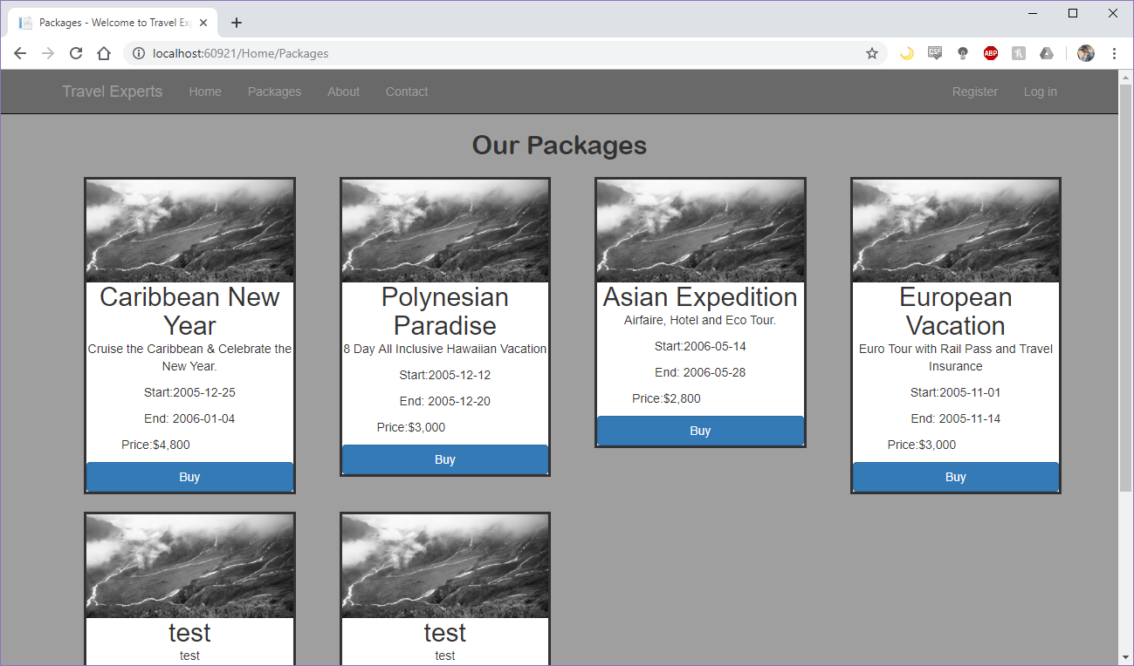
Web Key Features – Package
Notes:
Web demonstration
RYAN & MINGYU

Slide 13
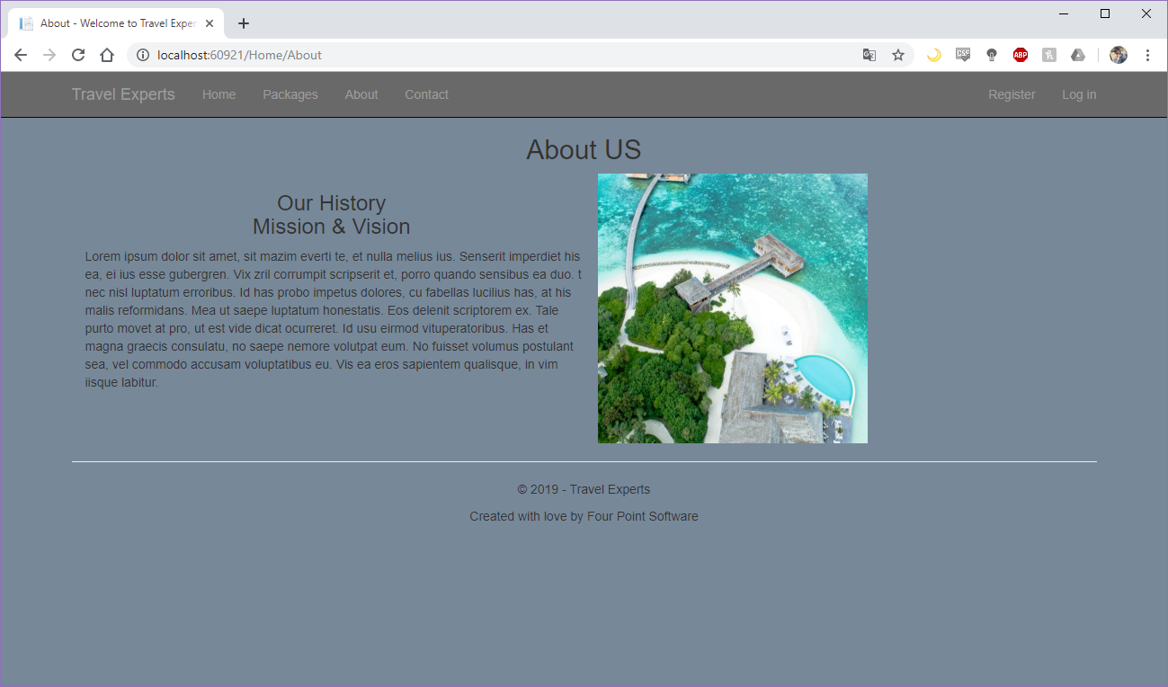
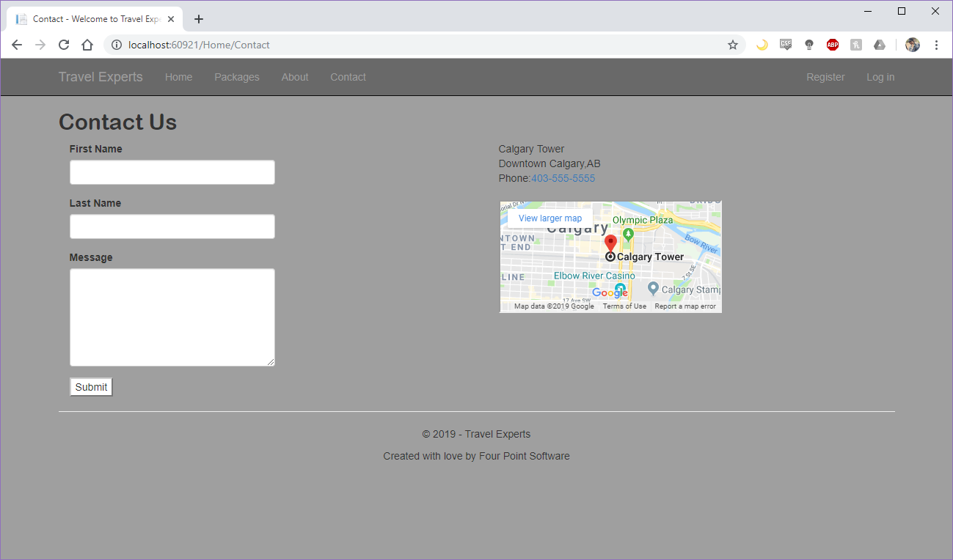
Web Key Features – About & Contact
Notes:
Web demonstration
RYAN & MINGYU

Slide 14
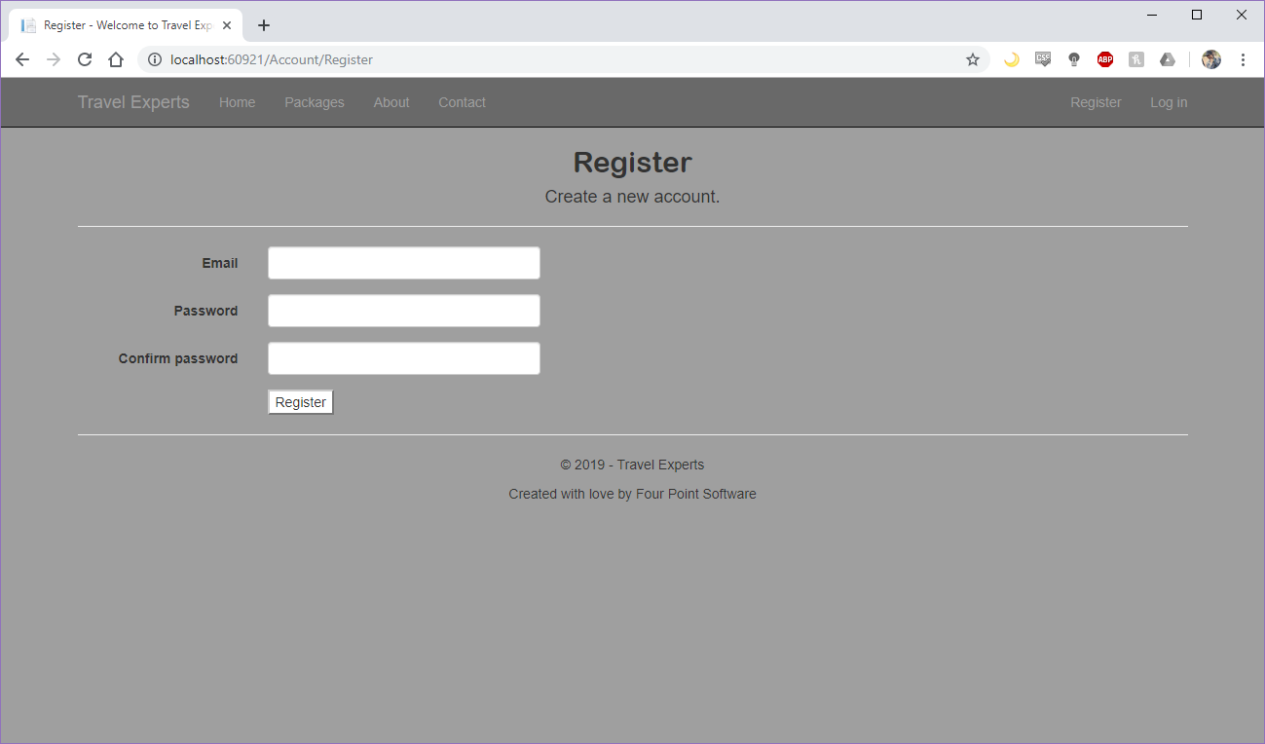
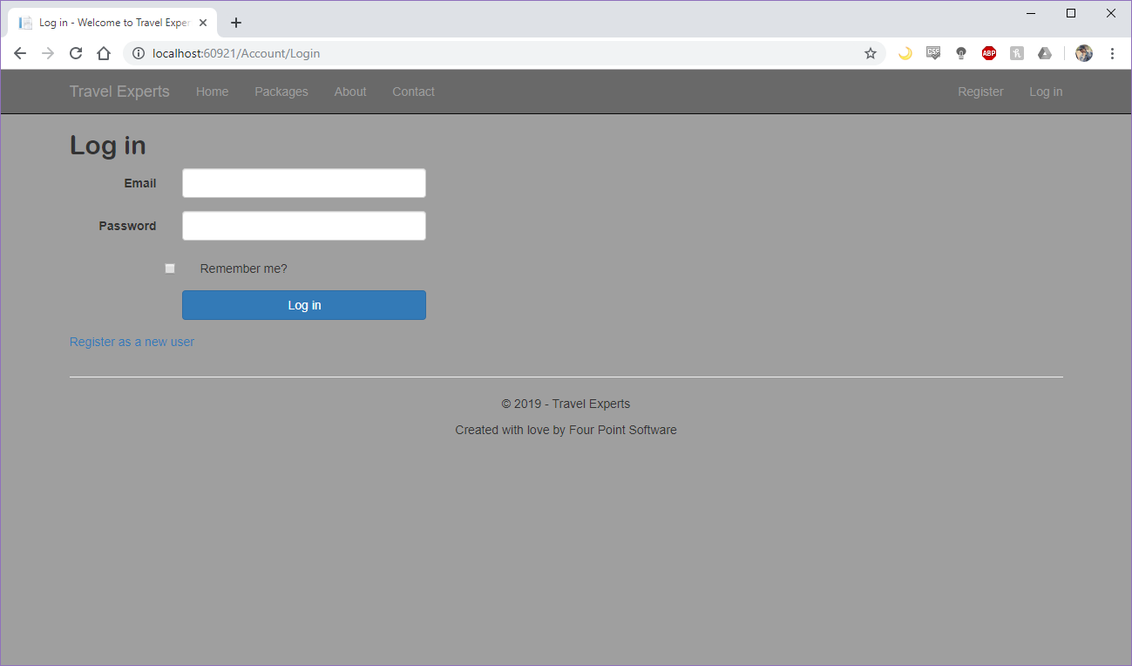
Web Key Features – Register & login
Notes:
Web demonstration
RYAN & MINGYU

Slide 15
We optimize while Your profits increase
1301 16 Ave NW
Calgary, Alberta, CANADA
T2M 0L4
Tel: 403.284.7248 Toll-Free: 1.877.284.7248 Fax: 403.284.7112
Email: info@4pointsoftware.ca
Notes:
Web demonstration

