Slide 1
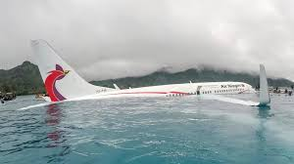
Plane Crash Data Analysis

Slide 2
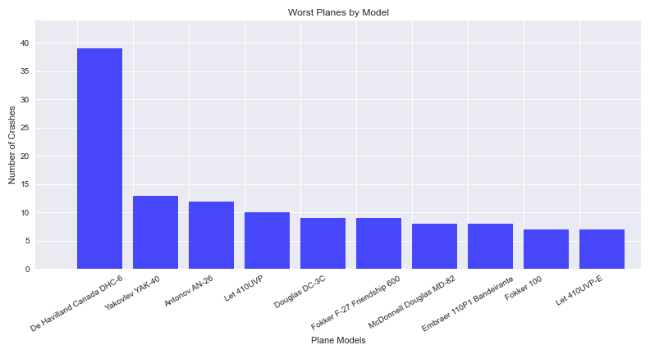
The top 10 worst planes by crashes in 1991-2020

Slide 3
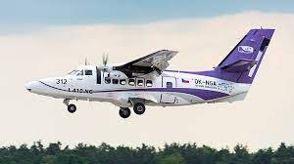
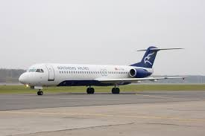
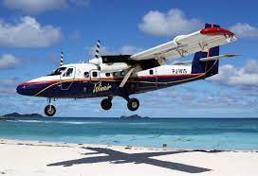
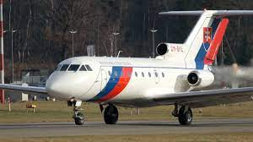
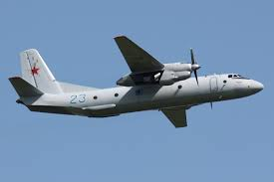
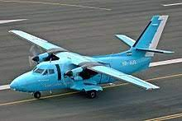
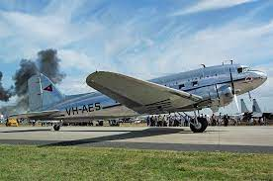
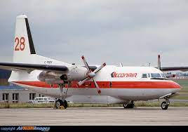
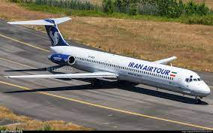
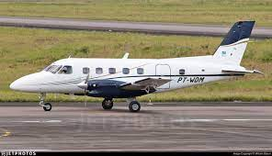
What are these planes?
Let 410UVP-E
Fokker 100
De Havilland Canada DHC-6 Twin Otter 300
Yakovlev YAK-40
Antonov AN-26
Let 410UVP
Douglas DC-3C
Fokker F-27 Friendship 600
McDonnell Douglas MD-82
Embraer 110P1 Bandeirante

Slide 4
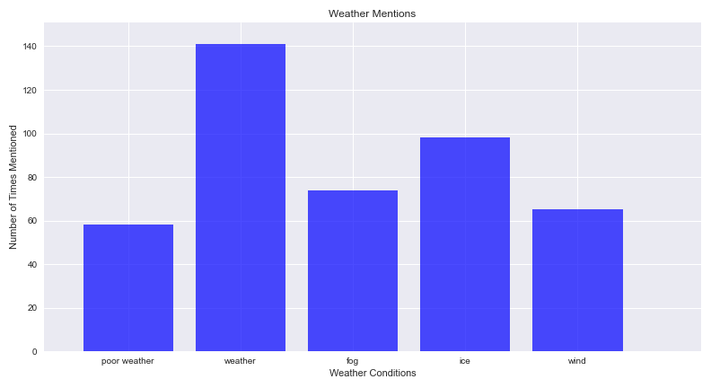
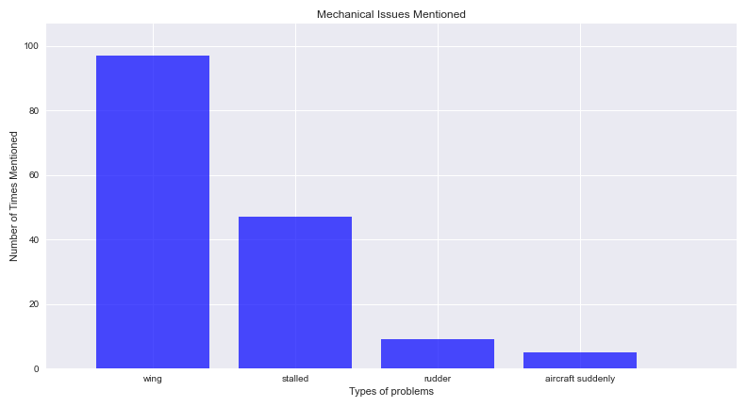
What contributed to fatal accidents?
There were 1101 plane crashes between 1991-2020
Used str.contains() method in summary to find the reasons for crashes.

Slide 5
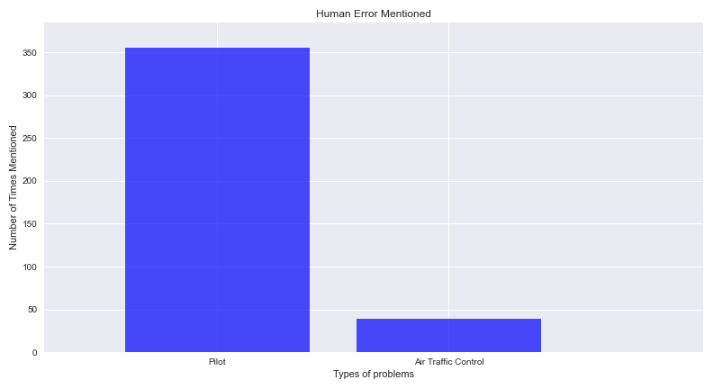
Human Error

Slide 6
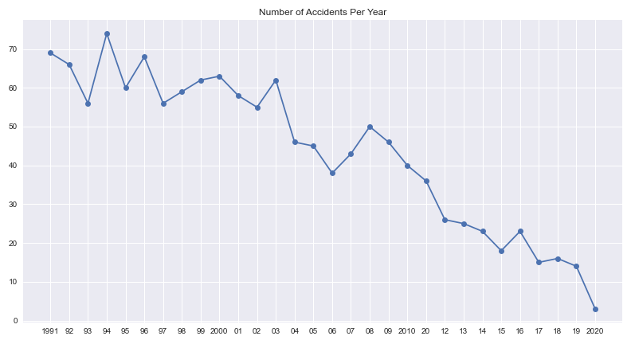
Has Aviation Become Safer?

