Slide 1
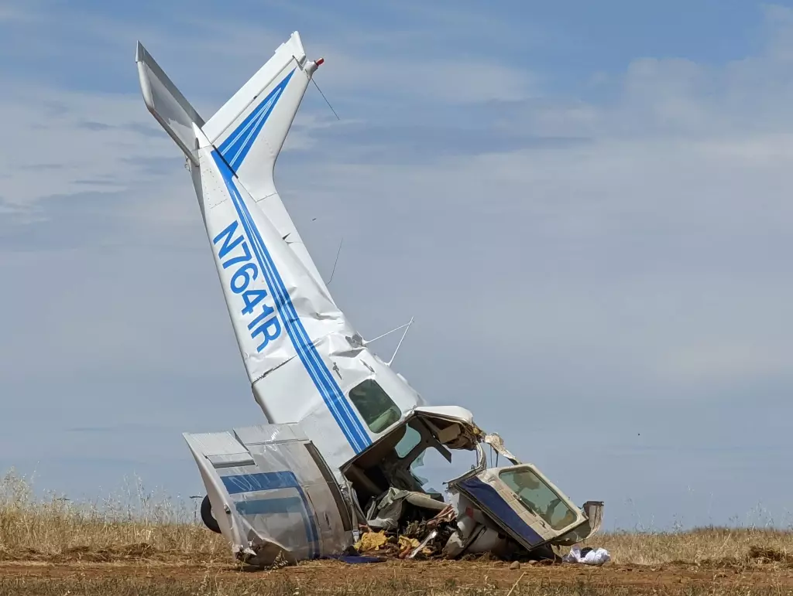
Plane Crash Data Analysis

Slide 2
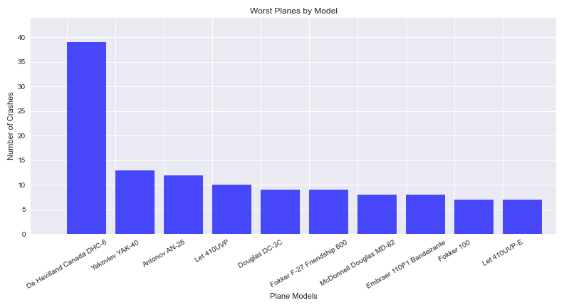
The top 10 worst planes by crashes in 1991-2020

Slide 3
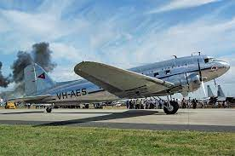
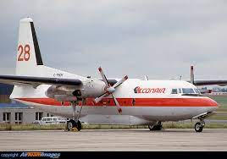
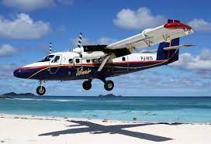
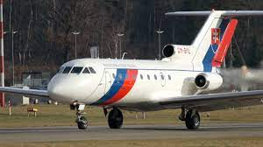
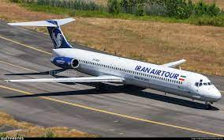
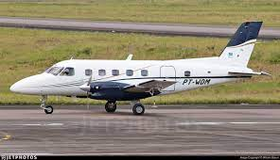
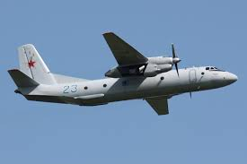
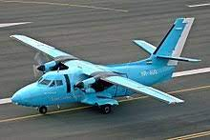
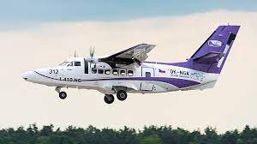
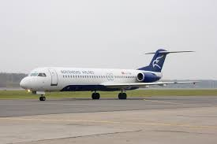
What are these planes?
Douglas DC-3C
Fokker F-27 Friendship 600
De Havilland Canada DHC-6 Twin Otter 300
Yakovlev YAK-40
McDonnell Douglas MD-82
Embraer 110P1 Bandeirante
Antonov AN-26
Let 410UVP
Fokker 100
Let 410UVP-E

Slide 4
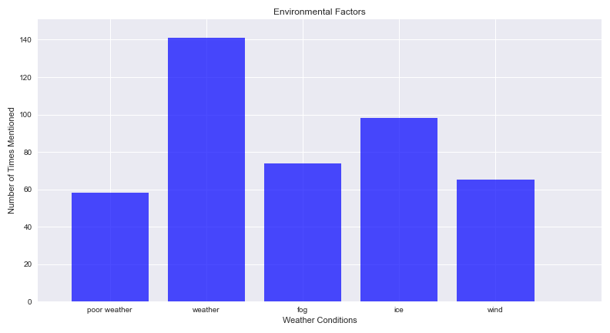
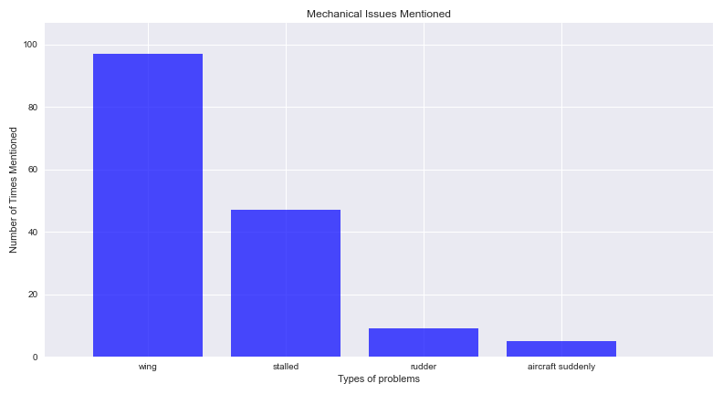
What contributed to fatal accidents?
There were 1101 plane crashes between 1991-2020
Used str.contains() method in summary to find the reasons for crashes.

Slide 5
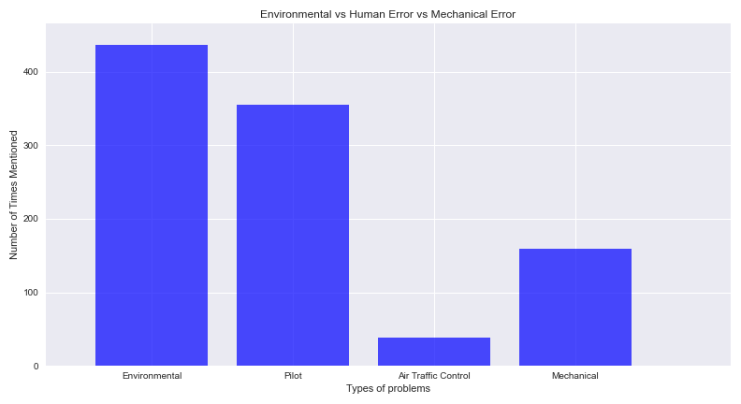
Human Error

Slide 6
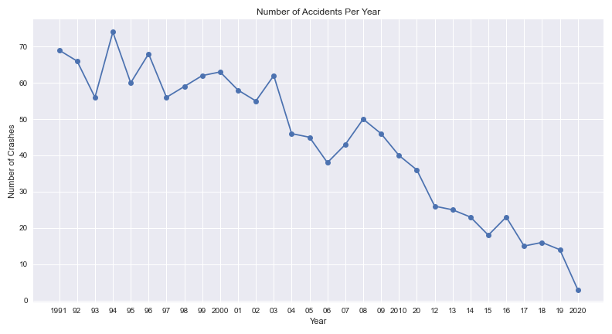
Has Aviation Become Safer?

Slide 7
Summary of Data
In this data set, the average number of people on commercial planes was 36 and the average number of fatalities was 25.
The chance of survival on plane crashes with 1 or more fatalities is 31.6 percent.
The number of commercial plane crashes with one fatality or more is 1078 out of 1101.
The most common areas for aircraft failure are:
Hawaii with 6 incidents, Alaska with 5 incidents and Arizona with 2 incidents.
Aviation safety has improved!

