Slide 1
Fatalities in Transport
Group members: Robert, Maozhu, Dat, Brendan.

Slide 2
Aim and Questions
Aim: To understand some of the reasons behind transport crashes of all types of non-military transport in the United States.
Have vehicles become safer over time?
What is the safest mode of transport per mile?
What are some of the factors that can cause fatalities?
Which are the safest states in the United States for transport?
Which are the most dangerous states in the United States for transport?
We have decided to answer these questions to better understand what modes of transport are safest, and some of the factors that can affect safety.

Slide 3

Plane Crash Data Analysis

Slide 4
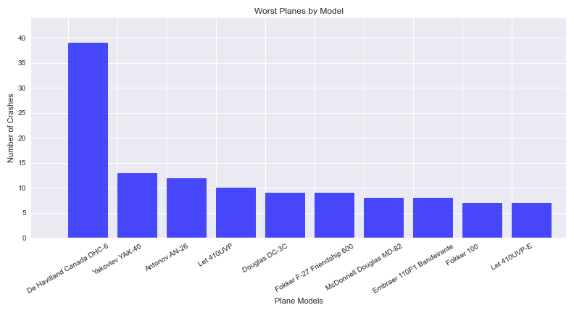
The top 10 worst planes by crashes in 1991-2020
This bar chart shows the most dangerous plane due to the number of crashes. The De Havilland Canada DHC-6 between 1991-2020 was the worst.

Slide 5
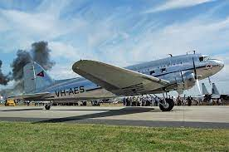
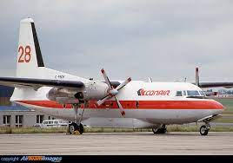
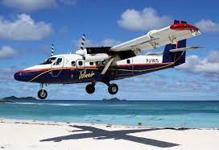
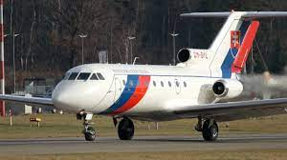
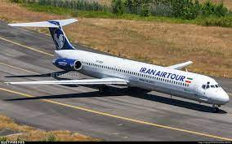

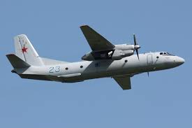
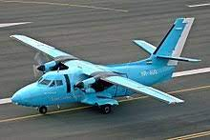

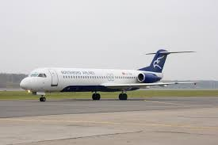
What are these planes?
Douglas DC-3C
Fokker F-27 Friendship 600
De Havilland Canada DHC-6 Twin Otter 300
Yakovlev YAK-40
McDonnell Douglas MD-82
Embraer 110P1 Bandeirante
Antonov AN-26
Let 410UVP
Fokker 100
Let 410UVP-E

Slide 6
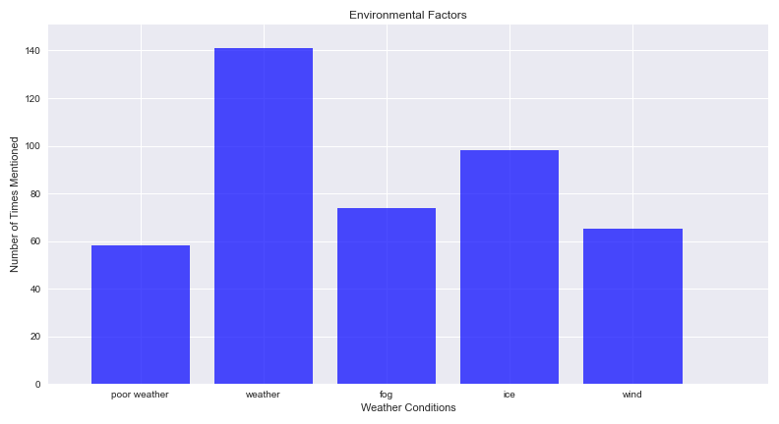
What contributed to fatal accidents?
There were 1101 plane crashes between 1991-2020
The group considered factors that could contribute to plane crashes and put them into categories of environmental, human error and mechanical failures.
We researched these categories by using the str.contains() method in the Summary of Events data to find common vocabulary after reading through a few examples.
This bar chart shows the number of accidents in which “poor weather”, “weather”, “fog", "ice” and “wind were mentioned in the reasons for the crash.
Weather was mentioned 141 times for 1101 flights that crashed. This was split into fog (74), ice (98) and wind (65) as well as “poor weather” (58).

Slide 7
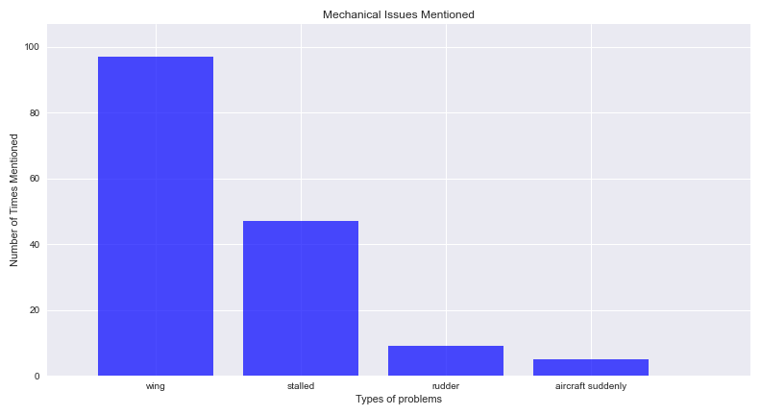
Mechanical Issues that Contributed to Failure
This bar chart shows the number of accidents in which “wing”, “stalled”, “rudder” and “aircraft” were mentioned in the reasons for the crash.
Wings were the largest issue with 97 mentions out of 1101 crashes which was twice as often as “stalled” in the event summary data.
Thankfully very few flights had sudden issues or rudder failure.

Slide 8
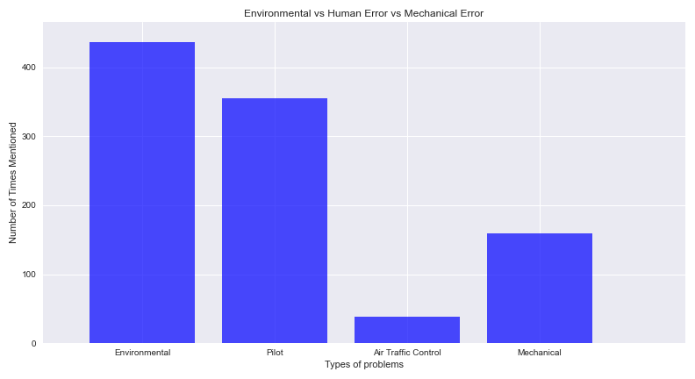
Human Error Involved in Plane Crashes
Human Error in planes crashes was counted by using variations of “pilot” or “air traffic control”.
Included in the bar chart are the total environmental factors and the total mechanical issues for a comparison.
In conclusion, the environmental and pilot errors are the major contributing factors in plane crashes.

Slide 9
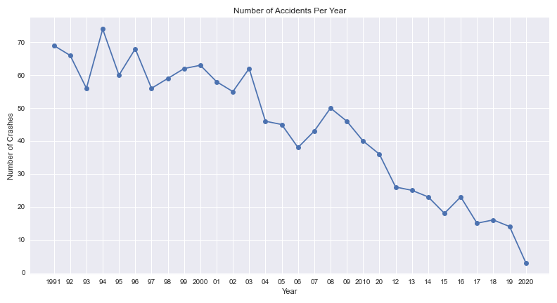
Has Aviation Become Safer?
This graph shows the number of total plane crashes per year between 1991-2020. This shows a trend of aeroplanes becoming safer over the last 30 years.

Slide 10
Summary of Data
In this data set, the average number of people on commercial planes was 36 and the average number of fatalities was 25.
The number of commercial plane crashes with one fatality or more is 1078 out of 1101.
The most common areas for aircraft failure are:
Hawaii with 6 incidents, Alaska with 5 incidents and Arizona with 2 incidents.
The number of plane crashes has reduced dramatically over the past 30 years.
The De Havilland Canada DHC-6 was statistically the most dangerous plane to fly between 1991-2020.
Wings were the largest mechanical issue. Weather in general was a major contributor to crashes but ice was mentioned the most. Pilot choices were by far the most important part of human error.
In conclusion, the environmental and pilot errors are the major contributing factors in plane crashes.
The chance of survival on plane crashes with 1 or more fatalities is 31.6 percent.
Data Source:
Kaggle Datasets, “Airplane Crash Data Since 1908”, sourced from http://www.planecrashinfo.com
Data Limitations:
If I am in a crash, in which mode of transport am I most likely to survive?

