Slide 1
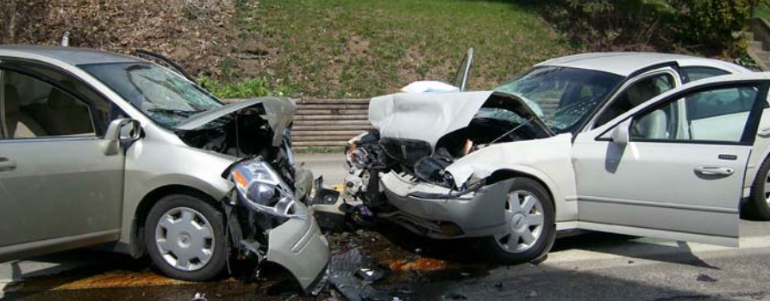
Motor Vehicle Traffic Crashes Analysis for the USA

Slide 2
Question of Interests
What is the trend of motor vehicle fatal crashes in the US?
How were the motor vehicle fatal crashes distributed among the states?
What factors contributes to the motor vehicle fatal crashes?
Is motor vehicle safe compare to train and airplane?

Slide 3
Data collection
Data Source:
Core data: National Highway Traffic Safety Administration Crash data Application Programming Interface (API) & Report.
https://crashviewer.nhtsa.dot.gov/CrashAPI
Bureau of Transportation Statistics.
https://www.bts.gov/content/us-vehicle-miles
Data information:
Records of Motor vehicles accidents and information related such as time, location, vehicle, driver… from 2010 to 2020.
Vehicle miles travelled and population data from 2010 to 2020

Slide 4

Data exploration and clean up.
Loops through various tables and years due to limited allowable records per download.
Convert data and save to csv to explore.
Remove columns not related to our questions to reduce the data size as original data >1GB.
Check data types and convert to right format.
Categorize the data using cut/bin procedure. Handle the missing/null values.
Save the clean data for analysis.

Slide 5
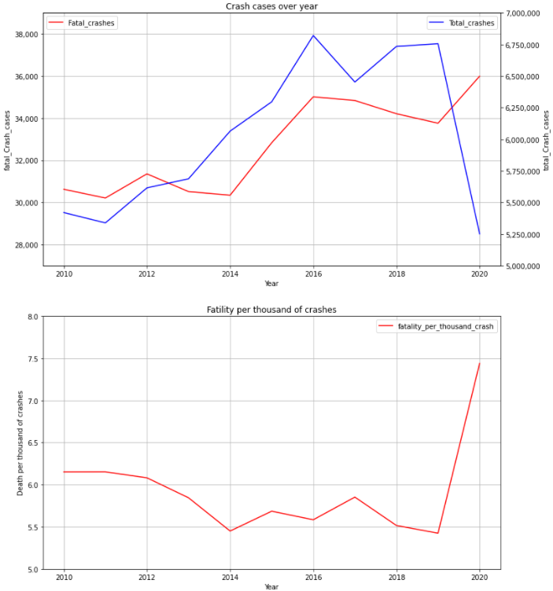
Data analysis: Motor Vehicle Crashes over years
Aggregate the total fatality number over years.
Merge data between fatal and non fatal
Calculate the ratio between fatal crashes over total crashes.
Results:
Total number of crashes increased over years from 2010 to 2019 and drop in 2020 due to Covid 19 pandemic.
Number of fatal crashes still increased in 2020 although total number of crashes decreased
In average, there were ~5.5-6 people death in every 1000 crashes from 2010-2019. This number increased to 7.5 death per a thousand crash in 2020.

Slide 6
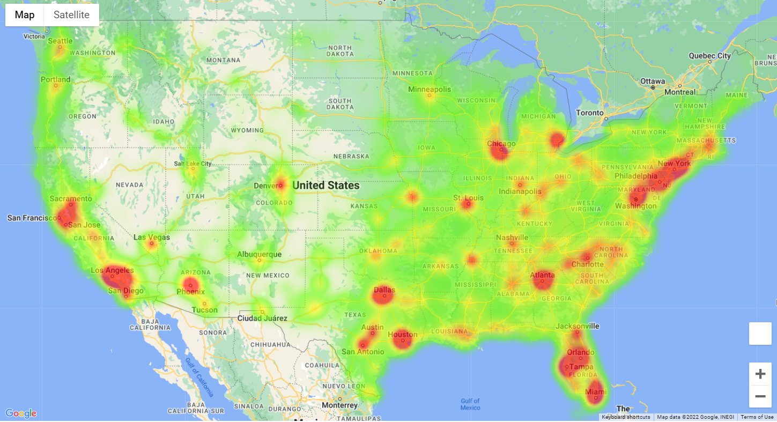
Visualize the fatal crashes over the states
Plot the heatmap using the Longitude and Latitude data available in the dataset with the number of deaths as a weight.
East coast has more fatal crashes than west coast.
Most of the crashes happened in the big cities of the states

Slide 7
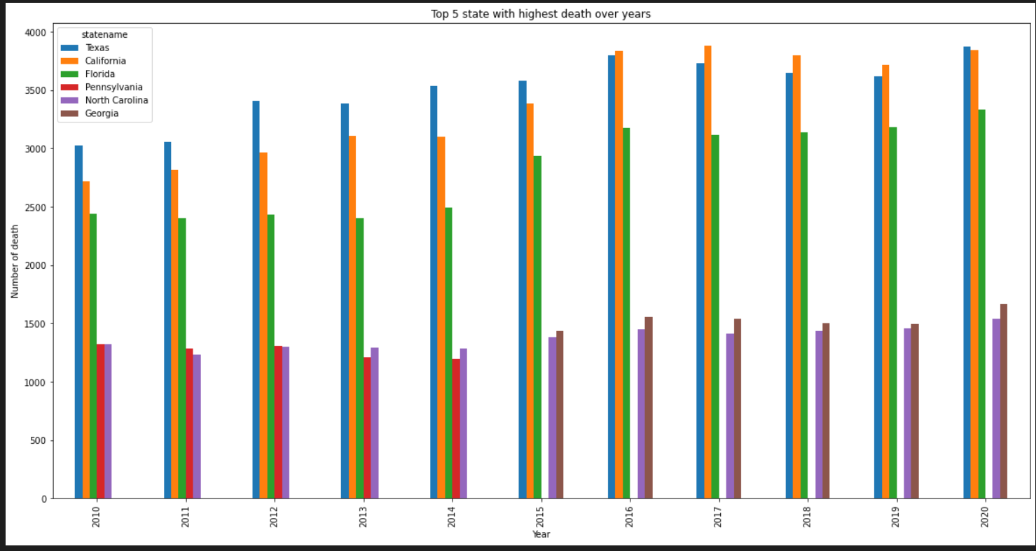
Top 5 states with highest number of death due to motor vehicle crash.
Aggregate the fatality number by states. Create a pivot table by year (rows) and state name (columns).
Texas /Claifornia/Florida were the top 3 state with highest number of death.
Pennsylvania improved and not in the top 5 since 2015.

Slide 8
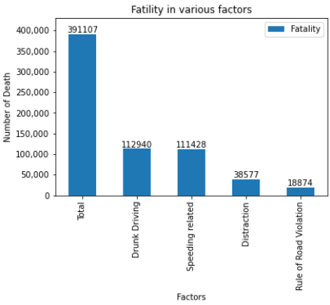
Motor Vehicle fatal crashes due to various factors
There is no primary caused of the fatal crashes for the dataset. Factors were not mutually exclusive (eg: driver could be drunk driving and also speeding).
Merge the data from various tables using case number and year as the unique key.
Categorize the caused code to the factors.
Aggregate the data to a summary table and plot.
Drunk driving and Speeding are the most dangerous. For every 3 fatal crashes, there is almost 1 case related to drunk driving. Similarly rate for Speeding.

Slide 9
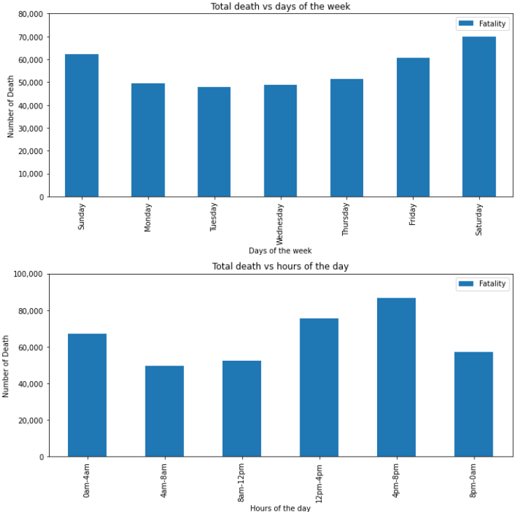
Motor vehicle fatal crashes per days and hours
The dataset has days of the weeks when the accidents happened. Index and sort the days of weeks before plotting so the days appear in order in the plot.
Categorize the hours to 6 period.
Saturday has the highest number of death compare to others days. Friday, Saturday and Sunday are the top 3.
From 4pm to 8pm has the highest number of death. Number of death happened at night time is about equal to number of death happened at day time despite there is much less traffic.
Driving at night is also a risk factor.

Slide 10
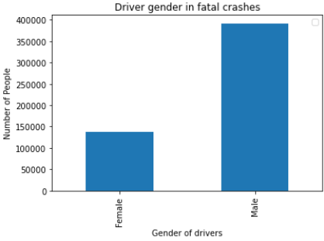
Drivers gender in fatal crashes
Merge the gender table to the data set using case number and year as a key.
Male involved in more fatal crashes than female, about 2.6x times higher.

Slide 11
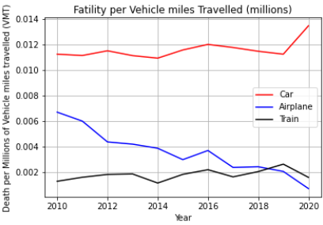
Fatal crashes per a million of vehicle miles travelled.
Merge the fatality dataset with the vehicle miles using year as key.
Calculate the fatality over vehicle miles travelled
Car is more dangerous than train and airplane.

Slide 12
Summary
Motor Vehicles has not become safer overyears
Drug driving and Speeding are the most dangerous behaviours on road (involved is almost 1/3 of the fatal accidents).
Night time driving, male gender, distraction… are also the risk factors in motor vehicle fatal crashes.
Car is most dangerous mode of transportation compared to train and airplane.
Conclusion: Motor vehicles driving is still manual and mainly depends on the driver behaviours and the environmental situation.

