Slide 1
Krankheitslast durch Umgebungslärm in Deutschland
Matthias Lochmann

Slide 2
Einführung
Dieses Dokument analysiert die Lärmbelastung in Hessen und berechnet die damit verbundenen Gesundheitsauswirkungen. Die Analyse basiert auf Lärmexpositionsdaten
hessischen Daten des HLNUG
Landesdaten anderer Landesämter
gesamteuropäischen Lärmexpositionsdaten aus EIONET
sowie
Expositions-Wirkungsfunktionen sowie “Baseline-health data” aus (Engelmann, Guàrdia, et al. 2025) und (Engelmann, Jiang, et al. 2025)

Slide 3
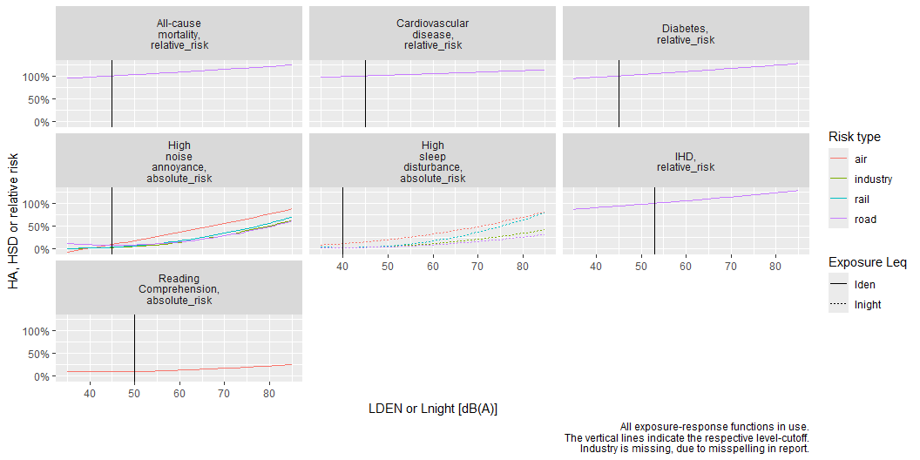
Daten laden und vorbereiten
ETCHE-, HLNUG- sowie Destatis Daten laden.
In Figure 1 all ERFs are on display.
Figure 1: Overview of all imported ERF.

Slide 4
Expositions- und Gemeindedaten zusammenführen
Hier gibts eine breite Tabelle, sollte später noch mehr Richtung saubere Datenbank gepflegt werden.

Slide 5
Expositionsdaten und ERF-Funktionen zusammenführen
noise_source | data_source | mapping_extend | outcome | population_type | AnzBelastetenklassen | Belastete | bhd
road | Bundesland | different sources | High noise annoyance | adults | 30 | 688104 | NA
road | Bundesland | different sources | All-cause mortality | adults | 30 | 688104 | 0.2069215
road | Bundesland | different sources | Cardiovascular disease | adults | 30 | 688104 | 0.0115708
road | Bundesland | different sources | IHD | adults | 30 | 688104 | 0.0012770
road | Bundesland | different sources | Diabetes | adults | 30 | 688104 | 0.0059261
road | Bundesland | different sources | High sleep disturbance | adults | 30 | 514053 | NA
road | Bundesland | major sources | High noise annoyance | adults | 8700 | 2909567 | NA
road | Bundesland | major sources | All-cause mortality | adults | 8700 | 2909567 | 0.2069215
road | Bundesland | major sources | Cardiovascular disease | adults | 8700 | 2909567 | 0.0115708
road | Bundesland | major sources | IHD | adults | 8700 | 2909567 | 0.0012770
road | Bundesland | major sources | Diabetes | adults | 8700 | 2909567 | 0.0059261
road | Bundesland | major sources | High sleep disturbance | adults | 8700 | 1800891 | NA
air | Bundesland | major sources | High noise annoyance | adults | 225 | 400378 | NA
air | Bundesland | major sources | All-cause mortality | adults | 225 | 400378 | 0.2069215
air | Bundesland | major sources | Cardiovascular disease | adults | 225 | 400378 | 0.0115708
air | Bundesland | major sources | Diabetes | adults | 225 | 400378 | 0.0059261
air | Bundesland | major sources | Reading Comprehension | children | 225 | 400378 | NA
air | Bundesland | major sources | High sleep disturbance | adults | 225 | 87759 | NA
industry | Bundesland | different sources | High noise annoyance | adults | 30 | 6336 | NA
industry | Bundesland | different sources | High sleep disturbance | adults | 30 | 4806 | NA
road | EEA | different sources | High noise annoyance | adults | 360 | 10387800 | NA
road | EEA | different sources | All-cause mortality | adults | 360 | 10387800 | 0.2069215
road | EEA | different sources | Cardiovascular disease | adults | 360 | 10387800 | 0.0115708
road | EEA | different sources | IHD | adults | 360 | 10387800 | 0.0012770
road | EEA | different sources | Diabetes | adults | 360 | 10387800 | 0.0059261
road | EEA | different sources | High sleep disturbance | adults | 360 | 7495900 | NA
road | EEA | major sources | High noise annoyance | adults | 365 | 13534300 | NA
road | EEA | major sources | All-cause mortality | adults | 365 | 13534300 | 0.2069215
road | EEA | major sources | Cardiovascular disease | adults | 365 | 13534300 | 0.0115708
road | EEA | major sources | IHD | adults | 365 | 13534300 | 0.0012770
road | EEA | major sources | Diabetes | adults | 365 | 13534300 | 0.0059261
road | EEA | major sources | High sleep disturbance | adults | 365 | 9049700 | NA
air | EEA | different sources | High noise annoyance | adults | 360 | 474800 | NA
air | EEA | different sources | All-cause mortality | adults | 360 | 474800 | 0.2069215
air | EEA | different sources | Cardiovascular disease | adults | 360 | 474800 | 0.0115708
air | EEA | different sources | Diabetes | adults | 360 | 474800 | 0.0059261
air | EEA | different sources | Reading Comprehension | children | 360 | 474800 | NA
air | EEA | different sources | High sleep disturbance | adults | 360 | 132400 | NA
air | EEA | major sources | High noise annoyance | adults | 360 | 456300 | NA
air | EEA | major sources | All-cause mortality | adults | 360 | 456300 | 0.2069215
air | EEA | major sources | Cardiovascular disease | adults | 360 | 456300 | 0.0115708
air | EEA | major sources | Diabetes | adults | 360 | 456300 | 0.0059261
air | EEA | major sources | Reading Comprehension | children | 360 | 456300 | NA
air | EEA | major sources | High sleep disturbance | adults | 360 | 131200 | NA
rail | EEA | different sources | High noise annoyance | adults | 360 | 2531400 | NA
rail | EEA | different sources | All-cause mortality | adults | 360 | 2531400 | 0.2069215
rail | EEA | different sources | Cardiovascular disease | adults | 360 | 2531400 | 0.0115708
rail | EEA | different sources | Diabetes | adults | 360 | 2531400 | 0.0059261
rail | EEA | different sources | High sleep disturbance | adults | 360 | 1882700 | NA
rail | EEA | major sources | High noise annoyance | adults | 365 | 2459600 | NA
rail | EEA | major sources | All-cause mortality | adults | 365 | 2459600 | 0.2069215
rail | EEA | major sources | Cardiovascular disease | adults | 365 | 2459600 | 0.0115708
rail | EEA | major sources | Diabetes | adults | 365 | 2459600 | 0.0059261
rail | EEA | major sources | High sleep disturbance | adults | 365 | 1879600 | NA
industry | EEA | different sources | High noise annoyance | adults | 360 | 92100 | NA
industry | EEA | different sources | High sleep disturbance | adults | 360 | 32100 | NA
Um die Umweltbedingte Krankheitslast zu berechnen, braucht healthiar ein dataframe mit Expositionszahlen und ERF zusammen. Das Zusammenführen geschieht hier:
Die zusammengeführten Daten haben diese Statistik:

Slide 6
Altergruppen verwenden
noise_source | data_source | mapping_extend | outcome | population_type | AnzBelastetenklassen | Belastete
road | Bundesland | different sources | High noise annoyance | adults | 30 | 574373.50
road | Bundesland | different sources | All-cause mortality | adults | 30 | 574373.50
road | Bundesland | different sources | Cardiovascular disease | adults | 30 | 574373.50
road | Bundesland | different sources | IHD | adults | 30 | 574373.50
road | Bundesland | different sources | Diabetes | adults | 30 | 574373.50
road | Bundesland | different sources | High sleep disturbance | adults | 30 | 429089.82
road | Bundesland | major sources | High noise annoyance | adults | 8700 | 2428670.95
road | Bundesland | major sources | All-cause mortality | adults | 8700 | 2428670.95
road | Bundesland | major sources | Cardiovascular disease | adults | 8700 | 2428670.95
road | Bundesland | major sources | IHD | adults | 8700 | 2428670.95
road | Bundesland | major sources | Diabetes | adults | 8700 | 2428670.95
road | Bundesland | major sources | High sleep disturbance | adults | 8700 | 1503237.99
air | Bundesland | major sources | High noise annoyance | adults | 225 | 334203.14
air | Bundesland | major sources | All-cause mortality | adults | 225 | 334203.14
air | Bundesland | major sources | Cardiovascular disease | adults | 225 | 334203.14
air | Bundesland | major sources | Diabetes | adults | 225 | 334203.14
air | Bundesland | major sources | Reading Comprehension | children | 225 | 39551.32
air | Bundesland | major sources | High sleep disturbance | adults | 225 | 73254.11
industry | Bundesland | different sources | High noise annoyance | adults | 30 | 5288.78
industry | Bundesland | different sources | High sleep disturbance | adults | 30 | 4011.66
road | EEA | different sources | High noise annoyance | adults | 360 | 8670894.36
road | EEA | different sources | All-cause mortality | adults | 360 | 8670894.36
road | EEA | different sources | Cardiovascular disease | adults | 360 | 8670894.36
road | EEA | different sources | IHD | adults | 360 | 8670894.36
road | EEA | different sources | Diabetes | adults | 360 | 8670894.36
road | EEA | different sources | High sleep disturbance | adults | 360 | 6256970.39
road | EEA | major sources | High noise annoyance | adults | 365 | NA
road | EEA | major sources | All-cause mortality | adults | 365 | NA
road | EEA | major sources | Cardiovascular disease | adults | 365 | NA
road | EEA | major sources | IHD | adults | 365 | NA
road | EEA | major sources | Diabetes | adults | 365 | NA
road | EEA | major sources | High sleep disturbance | adults | 365 | NA
air | EEA | different sources | High noise annoyance | adults | 360 | 396324.60
air | EEA | different sources | All-cause mortality | adults | 360 | 396324.60
air | EEA | different sources | Cardiovascular disease | adults | 360 | 396324.60
air | EEA | different sources | Diabetes | adults | 360 | 396324.60
air | EEA | different sources | Reading Comprehension | children | 360 | 46903.09
air | EEA | different sources | High sleep disturbance | adults | 360 | 110516.80
air | EEA | major sources | High noise annoyance | adults | 360 | 380882.29
air | EEA | major sources | All-cause mortality | adults | 360 | 380882.29
air | EEA | major sources | Cardiovascular disease | adults | 360 | 380882.29
air | EEA | major sources | Diabetes | adults | 360 | 380882.29
air | EEA | major sources | Reading Comprehension | children | 360 | 45075.57
air | EEA | major sources | High sleep disturbance | adults | 360 | 109515.14
rail | EEA | different sources | High noise annoyance | adults | 360 | 2113007.76
rail | EEA | different sources | All-cause mortality | adults | 360 | 2113007.76
rail | EEA | different sources | Cardiovascular disease | adults | 360 | 2113007.76
rail | EEA | different sources | Diabetes | adults | 360 | 2113007.76
rail | EEA | different sources | High sleep disturbance | adults | 360 | 1571525.52
rail | EEA | major sources | High noise annoyance | adults | 365 | NA
rail | EEA | major sources | All-cause mortality | adults | 365 | NA
rail | EEA | major sources | Cardiovascular disease | adults | 365 | NA
rail | EEA | major sources | Diabetes | adults | 365 | NA
rail | EEA | major sources | High sleep disturbance | adults | 365 | NA
industry | EEA | different sources | High noise annoyance | adults | 360 | 76877.62
industry | EEA | different sources | High sleep disturbance | adults | 360 | 26794.48
Da offensichtlich für die verschiedenen Endpunkte nur jeweils für eine Sub-Population (“children” vs. “adults”) gelten sollen, werden hier entsprechend sowohl die Bevölkerungs- als auch die Belastetenzahlen mithilfe der Alters-Fraktionen der jeweiligen Gemeinde berechnet. Dieses Vorgehen muss noch kritisch hinterfragt werden! So wäre zu klären, ob nicht zumindest manche Endpunkte auch eine größere Bevölkerung in Risiko setzen.

Slide 7
Gesundheitsauswirkungen für verschiedene Lärmquellen berechnen
Here, we filter the overall exposure data to use only the exposure data provided by EEA and calculate then the health impact: all endpoints as absolute risk and all endpoints relative risk.
# A tibble: 1 × 6 noise_source metric outcome data_source mapping_extend agglomeration <chr> <chr> <chr> <chr> <chr> <chr> 1 road lden High noise annoy… EEA different sou… inside agglo… # A tibble: 1 × 8 noise_source metric outcome data_source mapping_extend agglomeration n <chr> <chr> <chr> <chr> <chr> <chr> <int> 1 road lden High noise… EEA different sou… inside agglo… 360 # ℹ 1 more variable: expon <dbl> # A tibble: 1 × 6 noise_source metric outcome data_source mapping_extend agglomeration <chr> <chr> <chr> <chr> <chr> <chr> 1 road lnight High sleep distu… EEA different sou… inside agglo… # A tibble: 1 × 8 noise_source metric outcome data_source mapping_extend agglomeration n <chr> <chr> <chr> <chr> <chr> <chr> <int> 1 road lnight High sleep… EEA different sou… inside agglo… 360 # ℹ 1 more variable: expon <dbl> # A tibble: 1 × 6 noise_source metric outcome data_source mapping_extend agglomeration <chr> <chr> <chr> <chr> <chr> <chr> 1 road lden High noise annoy… EEA major sources inside agglo… # A tibble: 1 × 8 noise_source metric outcome data_source mapping_extend agglomeration n <chr> <chr> <chr> <chr> <chr> <chr> <int> 1 road lden High noise… EEA major sources inside agglo… 360 # ℹ 1 more variable: expon <dbl> # A tibble: 1 × 6 noise_source metric outcome data_source mapping_extend agglomeration <chr> <chr> <chr> <chr> <chr> <chr> 1 road lnight High sleep distu… EEA major sources inside agglo… # A tibble: 1 × 8 noise_source metric outcome data_source mapping_extend agglomeration n <chr> <chr> <chr> <chr> <chr> <chr> <int> 1 road lnight High sleep… EEA major sources inside agglo… 360 # ℹ 1 more variable: expon <dbl> # A tibble: 1 × 6 noise_source metric outcome data_source mapping_extend agglomeration <chr> <chr> <chr> <chr> <chr> <chr> 1 air lden High noise annoy… EEA different sou… inside agglo… # A tibble: 1 × 8 noise_source metric outcome data_source mapping_extend agglomeration n <chr> <chr> <chr> <chr> <chr> <chr> <int> 1 air lden High noise… EEA different sou… inside agglo… 360 # ℹ 1 more variable: expon <dbl> # A tibble: 1 × 6 noise_source metric outcome data_source mapping_extend agglomeration <chr> <chr> <chr> <chr> <chr> <chr> 1 air lden Reading Comprehe… EEA different sou… inside agglo… # A tibble: 1 × 8 noise_source metric outcome data_source mapping_extend agglomeration n <chr> <chr> <chr> <chr> <chr> <chr> <int> 1 air lden Reading Co… EEA different sou… inside agglo… 360 # ℹ 1 more variable: expon <dbl> # A tibble: 1 × 6 noise_source metric outcome data_source mapping_extend agglomeration <chr> <chr> <chr> <chr> <chr> <chr> 1 air lnight High sleep distu… EEA different sou… inside agglo… # A tibble: 1 × 8 noise_source metric outcome data_source mapping_extend agglomeration n <chr> <chr> <chr> <chr> <chr> <chr> <int> 1 air lnight High sleep… EEA different sou… inside agglo… 360 # ℹ 1 more variable: expon <dbl> # A tibble: 1 × 6 noise_source metric outcome data_source mapping_extend agglomeration <chr> <chr> <chr> <chr> <chr> <chr> 1 air lden High noise annoy… EEA major sources inside agglo… # A tibble: 1 × 8 noise_source metric outcome data_source mapping_extend agglomeration n <chr> <chr> <chr> <chr> <chr> <chr> <int> 1 air lden High noise… EEA major sources inside agglo… 360 # ℹ 1 more variable: expon <dbl> # A tibble: 1 × 6 noise_source metric outcome data_source mapping_extend agglomeration <chr> <chr> <chr> <chr> <chr> <chr> 1 air lden Reading Comprehe… EEA major sources inside agglo… # A tibble: 1 × 8 noise_source metric outcome data_source mapping_extend agglomeration n <chr> <chr> <chr> <chr> <chr> <chr> <int> 1 air lden Reading Co… EEA major sources inside agglo… 360 # ℹ 1 more variable: expon <dbl> # A tibble: 1 × 6 noise_source metric outcome data_source mapping_extend agglomeration <chr> <chr> <chr> <chr> <chr> <chr> 1 air lnight High sleep distu… EEA major sources inside agglo… # A tibble: 1 × 8 noise_source metric outcome data_source mapping_extend agglomeration n <chr> <chr> <chr> <chr> <chr> <chr> <int> 1 air lnight High sleep… EEA major sources inside agglo… 360 # ℹ 1 more variable: expon <dbl> # A tibble: 1 × 6 noise_source metric outcome data_source mapping_extend agglomeration <chr> <chr> <chr> <chr> <chr> <chr> 1 rail lden High noise annoy… EEA different sou… inside agglo… # A tibble: 1 × 8 noise_source metric outcome data_source mapping_extend agglomeration n <chr> <chr> <chr> <chr> <chr> <chr> <int> 1 rail lden High noise… EEA different sou… inside agglo… 360 # ℹ 1 more variable: expon <dbl> # A tibble: 1 × 6 noise_source metric outcome data_source mapping_extend agglomeration <chr> <chr> <chr> <chr> <chr> <chr> 1 rail lnight High sleep distu… EEA different sou… inside agglo… # A tibble: 1 × 8 noise_source metric outcome data_source mapping_extend agglomeration n <chr> <chr> <chr> <chr> <chr> <chr> <int> 1 rail lnight High sleep… EEA different sou… inside agglo… 360 # ℹ 1 more variable: expon <dbl> # A tibble: 1 × 6 noise_source metric outcome data_source mapping_extend agglomeration <chr> <chr> <chr> <chr> <chr> <chr> 1 rail lden High noise annoy… EEA major sources inside agglo… # A tibble: 1 × 8 noise_source metric outcome data_source mapping_extend agglomeration n <chr> <chr> <chr> <chr> <chr> <chr> <int> 1 rail lden High noise… EEA major sources inside agglo… 360 # ℹ 1 more variable: expon <dbl> # A tibble: 1 × 6 noise_source metric outcome data_source mapping_extend agglomeration <chr> <chr> <chr> <chr> <chr> <chr> 1 rail lnight High sleep distu… EEA major sources inside agglo… # A tibble: 1 × 8 noise_source metric outcome data_source mapping_extend agglomeration n <chr> <chr> <chr> <chr> <chr> <chr> <int> 1 rail lnight High sleep… EEA major sources inside agglo… 360 # ℹ 1 more variable: expon <dbl> # A tibble: 1 × 6 noise_source metric outcome data_source mapping_extend agglomeration <chr> <chr> <chr> <chr> <chr> <chr> 1 industry lden High noise annoy… EEA different sou… inside agglo… # A tibble: 1 × 8 noise_source metric outcome data_source mapping_extend agglomeration n <chr> <chr> <chr> <chr> <chr> <chr> <int> 1 industry lden High noise… EEA different sou… inside agglo… 360 # ℹ 1 more variable: expon <dbl> # A tibble: 1 × 6 noise_source metric outcome data_source mapping_extend agglomeration <chr> <chr> <chr> <chr> <chr> <chr> 1 industry lnight High sleep distu… EEA different sou… inside agglo… # A tibble: 1 × 8 noise_source metric outcome data_source mapping_extend agglomeration n <chr> <chr> <chr> <chr> <chr> <chr> <int> 1 industry lnight High sleep… EEA different sou… inside agglo… 360 # ℹ 1 more variable: expon <dbl> # A tibble: 1 × 6 noise_source metric outcome data_source mapping_extend agglomeration <chr> <chr> <chr> <chr> <chr> <chr> 1 road lden High noise annoy… EEA major sources outside aggl… # A tibble: 1 × 8 noise_source metric outcome data_source mapping_extend agglomeration n <chr> <chr> <chr> <chr> <chr> <chr> <int> 1 road lden High noise… EEA major sources outside aggl… 5 # ℹ 1 more variable: expon <dbl> # A tibble: 1 × 6 noise_source metric outcome data_source mapping_extend agglomeration <chr> <chr> <chr> <chr> <chr> <chr> 1 road lnight High sleep distu… EEA major sources outside aggl… # A tibble: 1 × 8 noise_source metric outcome data_source mapping_extend agglomeration n <chr> <chr> <chr> <chr> <chr> <chr> <int> 1 road lnight High sleep… EEA major sources outside aggl… 5 # ℹ 1 more variable: expon <dbl> # A tibble: 1 × 6 noise_source metric outcome data_source mapping_extend agglomeration <chr> <chr> <chr> <chr> <chr> <chr> 1 rail lden High noise annoy… EEA major sources outside aggl… # A tibble: 1 × 8 noise_source metric outcome data_source mapping_extend agglomeration n <chr> <chr> <chr> <chr> <chr> <chr> <int> 1 rail lden High noise… EEA major sources outside aggl… 5 # ℹ 1 more variable: expon <dbl> # A tibble: 1 × 6 noise_source metric outcome data_source mapping_extend agglomeration <chr> <chr> <chr> <chr> <chr> <chr> 1 rail lnight High sleep distu… EEA major sources outside aggl… # A tibble: 1 × 8 noise_source metric outcome data_source mapping_extend agglomeration n <chr> <chr> <chr> <chr> <chr> <chr> <int> 1 rail lnight High sleep… EEA major sources outside aggl… 5 # ℹ 1 more variable: expon <dbl>
# A tibble: 1 × 6 noise_source metric outcome data_source mapping_extend agglomeration <chr> <chr> <chr> <chr> <chr> <chr> 1 road lden All-cause mortal… EEA different sou… inside agglo… # A tibble: 1 × 8 noise_source metric outcome data_source mapping_extend agglomeration n <chr> <chr> <chr> <chr> <chr> <chr> <int> 1 road lden All-cause … EEA different sou… inside agglo… 360 # ℹ 1 more variable: expon <dbl> # A tibble: 1 × 6 noise_source metric outcome data_source mapping_extend agglomeration <chr> <chr> <chr> <chr> <chr> <chr> 1 road lden Cardiovascular d… EEA different sou… inside agglo… # A tibble: 1 × 8 noise_source metric outcome data_source mapping_extend agglomeration n <chr> <chr> <chr> <chr> <chr> <chr> <int> 1 road lden Cardiovasc… EEA different sou… inside agglo… 360 # ℹ 1 more variable: expon <dbl> # A tibble: 1 × 6 noise_source metric outcome data_source mapping_extend agglomeration <chr> <chr> <chr> <chr> <chr> <chr> 1 road lden IHD EEA different sources inside agglomeratio… # A tibble: 1 × 8 noise_source metric outcome data_source mapping_extend agglomeration n <chr> <chr> <chr> <chr> <chr> <chr> <int> 1 road lden IHD EEA different sources inside agglom… 360 # ℹ 1 more variable: expon <dbl> # A tibble: 1 × 6 noise_source metric outcome data_source mapping_extend agglomeration <chr> <chr> <chr> <chr> <chr> <chr> 1 road lden Diabetes EEA different sources inside agglomerati… # A tibble: 1 × 8 noise_source metric outcome data_source mapping_extend agglomeration n <chr> <chr> <chr> <chr> <chr> <chr> <int> 1 road lden Diabetes EEA different sources inside agglo… 360 # ℹ 1 more variable: expon <dbl> # A tibble: 1 × 6 noise_source metric outcome data_source mapping_extend agglomeration <chr> <chr> <chr> <chr> <chr> <chr> 1 road lden All-cause mortal… EEA major sources inside agglo… # A tibble: 1 × 8 noise_source metric outcome data_source mapping_extend agglomeration n <chr> <chr> <chr> <chr> <chr> <chr> <int> 1 road lden All-cause … EEA major sources inside agglo… 360 # ℹ 1 more variable: expon <dbl> # A tibble: 1 × 6 noise_source metric outcome data_source mapping_extend agglomeration <chr> <chr> <chr> <chr> <chr> <chr> 1 road lden Cardiovascular d… EEA major sources inside agglo… # A tibble: 1 × 8 noise_source metric outcome data_source mapping_extend agglomeration n <chr> <chr> <chr> <chr> <chr> <chr> <int> 1 road lden Cardiovasc… EEA major sources inside agglo… 360 # ℹ 1 more variable: expon <dbl> # A tibble: 1 × 6 noise_source metric outcome data_source mapping_extend agglomeration <chr> <chr> <chr> <chr> <chr> <chr> 1 road lden IHD EEA major sources inside agglomerations # A tibble: 1 × 8 noise_source metric outcome data_source mapping_extend agglomeration n <chr> <chr> <chr> <chr> <chr> <chr> <int> 1 road lden IHD EEA major sources inside agglomera… 360 # ℹ 1 more variable: expon <dbl> # A tibble: 1 × 6 noise_source metric outcome data_source mapping_extend agglomeration <chr> <chr> <chr> <chr> <chr> <chr> 1 road lden Diabetes EEA major sources inside agglomerations # A tibble: 1 × 8 noise_source metric outcome data_source mapping_extend agglomeration n <chr> <chr> <chr> <chr> <chr> <chr> <int> 1 road lden Diabetes EEA major sources inside agglomer… 360 # ℹ 1 more variable: expon <dbl> # A tibble: 1 × 6 noise_source metric outcome data_source mapping_extend agglomeration <chr> <chr> <chr> <chr> <chr> <chr> 1 air lden All-cause mortal… EEA different sou… inside agglo… # A tibble: 1 × 8 noise_source metric outcome data_source mapping_extend agglomeration n <chr> <chr> <chr> <chr> <chr> <chr> <int> 1 air lden All-cause … EEA different sou… inside agglo… 360 # ℹ 1 more variable: expon <dbl> # A tibble: 1 × 6 noise_source metric outcome data_source mapping_extend agglomeration <chr> <chr> <chr> <chr> <chr> <chr> 1 air lden Cardiovascular d… EEA different sou… inside agglo… # A tibble: 1 × 8 noise_source metric outcome data_source mapping_extend agglomeration n <chr> <chr> <chr> <chr> <chr> <chr> <int> 1 air lden Cardiovasc… EEA different sou… inside agglo… 360 # ℹ 1 more variable: expon <dbl> # A tibble: 1 × 6 noise_source metric outcome data_source mapping_extend agglomeration <chr> <chr> <chr> <chr> <chr> <chr> 1 air lden Diabetes EEA different sources inside agglomerati… # A tibble: 1 × 8 noise_source metric outcome data_source mapping_extend agglomeration n <chr> <chr> <chr> <chr> <chr> <chr> <int> 1 air lden Diabetes EEA different sources inside agglo… 360 # ℹ 1 more variable: expon <dbl> # A tibble: 1 × 6 noise_source metric outcome data_source mapping_extend agglomeration <chr> <chr> <chr> <chr> <chr> <chr> 1 air lden All-cause mortal… EEA major sources inside agglo… # A tibble: 1 × 8 noise_source metric outcome data_source mapping_extend agglomeration n <chr> <chr> <chr> <chr> <chr> <chr> <int> 1 air lden All-cause … EEA major sources inside agglo… 360 # ℹ 1 more variable: expon <dbl> # A tibble: 1 × 6 noise_source metric outcome data_source mapping_extend agglomeration <chr> <chr> <chr> <chr> <chr> <chr> 1 air lden Cardiovascular d… EEA major sources inside agglo… # A tibble: 1 × 8 noise_source metric outcome data_source mapping_extend agglomeration n <chr> <chr> <chr> <chr> <chr> <chr> <int> 1 air lden Cardiovasc… EEA major sources inside agglo… 360 # ℹ 1 more variable: expon <dbl> # A tibble: 1 × 6 noise_source metric outcome data_source mapping_extend agglomeration <chr> <chr> <chr> <chr> <chr> <chr> 1 air lden Diabetes EEA major sources inside agglomerations # A tibble: 1 × 8 noise_source metric outcome data_source mapping_extend agglomeration n <chr> <chr> <chr> <chr> <chr> <chr> <int> 1 air lden Diabetes EEA major sources inside agglomer… 360 # ℹ 1 more variable: expon <dbl> # A tibble: 1 × 6 noise_source metric outcome data_source mapping_extend agglomeration <chr> <chr> <chr> <chr> <chr> <chr> 1 rail lden All-cause mortal… EEA different sou… inside agglo… # A tibble: 1 × 8 noise_source metric outcome data_source mapping_extend agglomeration n <chr> <chr> <chr> <chr> <chr> <chr> <int> 1 rail lden All-cause … EEA different sou… inside agglo… 360 # ℹ 1 more variable: expon <dbl> # A tibble: 1 × 6 noise_source metric outcome data_source mapping_extend agglomeration <chr> <chr> <chr> <chr> <chr> <chr> 1 rail lden Cardiovascular d… EEA different sou… inside agglo… # A tibble: 1 × 8 noise_source metric outcome data_source mapping_extend agglomeration n <chr> <chr> <chr> <chr> <chr> <chr> <int> 1 rail lden Cardiovasc… EEA different sou… inside agglo… 360 # ℹ 1 more variable: expon <dbl> # A tibble: 1 × 6 noise_source metric outcome data_source mapping_extend agglomeration <chr> <chr> <chr> <chr> <chr> <chr> 1 rail lden Diabetes EEA different sources inside agglomerati… # A tibble: 1 × 8 noise_source metric outcome data_source mapping_extend agglomeration n <chr> <chr> <chr> <chr> <chr> <chr> <int> 1 rail lden Diabetes EEA different sources inside agglo… 360 # ℹ 1 more variable: expon <dbl> # A tibble: 1 × 6 noise_source metric outcome data_source mapping_extend agglomeration <chr> <chr> <chr> <chr> <chr> <chr> 1 rail lden All-cause mortal… EEA major sources inside agglo… # A tibble: 1 × 8 noise_source metric outcome data_source mapping_extend agglomeration n <chr> <chr> <chr> <chr> <chr> <chr> <int> 1 rail lden All-cause … EEA major sources inside agglo… 360 # ℹ 1 more variable: expon <dbl> # A tibble: 1 × 6 noise_source metric outcome data_source mapping_extend agglomeration <chr> <chr> <chr> <chr> <chr> <chr> 1 rail lden Cardiovascular d… EEA major sources inside agglo… # A tibble: 1 × 8 noise_source metric outcome data_source mapping_extend agglomeration n <chr> <chr> <chr> <chr> <chr> <chr> <int> 1 rail lden Cardiovasc… EEA major sources inside agglo… 360 # ℹ 1 more variable: expon <dbl> # A tibble: 1 × 6 noise_source metric outcome data_source mapping_extend agglomeration <chr> <chr> <chr> <chr> <chr> <chr> 1 rail lden Diabetes EEA major sources inside agglomerations # A tibble: 1 × 8 noise_source metric outcome data_source mapping_extend agglomeration n <chr> <chr> <chr> <chr> <chr> <chr> <int> 1 rail lden Diabetes EEA major sources inside agglomer… 360 # ℹ 1 more variable: expon <dbl> # A tibble: 1 × 6 noise_source metric outcome data_source mapping_extend agglomeration <chr> <chr> <chr> <chr> <chr> <chr> 1 road lden All-cause mortal… EEA major sources outside aggl… # A tibble: 1 × 8 noise_source metric outcome data_source mapping_extend agglomeration n <chr> <chr> <chr> <chr> <chr> <chr> <int> 1 road lden All-cause … EEA major sources outside aggl… 5 # ℹ 1 more variable: expon <dbl>
# A tibble: 1 × 6 noise_source metric outcome data_source mapping_extend agglomeration <chr> <chr> <chr> <chr> <chr> <chr> 1 road lden Cardiovascular d… EEA major sources outside aggl… # A tibble: 1 × 8 noise_source metric outcome data_source mapping_extend agglomeration n <chr> <chr> <chr> <chr> <chr> <chr> <int> 1 road lden Cardiovasc… EEA major sources outside aggl… 5 # ℹ 1 more variable: expon <dbl>
# A tibble: 1 × 6 noise_source metric outcome data_source mapping_extend agglomeration <chr> <chr> <chr> <chr> <chr> <chr> 1 road lden IHD EEA major sources outside agglomerations # A tibble: 1 × 8 noise_source metric outcome data_source mapping_extend agglomeration n <chr> <chr> <chr> <chr> <chr> <chr> <int> 1 road lden IHD EEA major sources outside agglomer… 5 # ℹ 1 more variable: expon <dbl>
# A tibble: 1 × 6 noise_source metric outcome data_source mapping_extend agglomeration <chr> <chr> <chr> <chr> <chr> <chr> 1 road lden Diabetes EEA major sources outside agglomerations # A tibble: 1 × 8 noise_source metric outcome data_source mapping_extend agglomeration n <chr> <chr> <chr> <chr> <chr> <chr> <int> 1 road lden Diabetes EEA major sources outside agglome… 5 # ℹ 1 more variable: expon <dbl>
# A tibble: 1 × 6 noise_source metric outcome data_source mapping_extend agglomeration <chr> <chr> <chr> <chr> <chr> <chr> 1 rail lden All-cause mortal… EEA major sources outside aggl… # A tibble: 1 × 8 noise_source metric outcome data_source mapping_extend agglomeration n <chr> <chr> <chr> <chr> <chr> <chr> <int> 1 rail lden All-cause … EEA major sources outside aggl… 5 # ℹ 1 more variable: expon <dbl>
# A tibble: 1 × 6 noise_source metric outcome data_source mapping_extend agglomeration <chr> <chr> <chr> <chr> <chr> <chr> 1 rail lden Cardiovascular d… EEA major sources outside aggl… # A tibble: 1 × 8 noise_source metric outcome data_source mapping_extend agglomeration n <chr> <chr> <chr> <chr> <chr> <chr> <int> 1 rail lden Cardiovasc… EEA major sources outside aggl… 5 # ℹ 1 more variable: expon <dbl>
# A tibble: 1 × 6 noise_source metric outcome data_source mapping_extend agglomeration <chr> <chr> <chr> <chr> <chr> <chr> 1 rail lden Diabetes EEA major sources outside agglomerations # A tibble: 1 × 8 noise_source metric outcome data_source mapping_extend agglomeration n <chr> <chr> <chr> <chr> <chr> <chr> <int> 1 rail lden Diabetes EEA major sources outside agglome… 5 # ℹ 1 more variable: expon <dbl>
The same for data provided directly from the Bundesländer; here starting only with those calculating the major sources.
# A tibble: 1 × 6 noise_source metric outcome data_source mapping_extend agglomeration <chr> <chr> <chr> <chr> <chr> <chr> 1 road lden High noise annoy… Bundesland different sou… inside agglo… # A tibble: 1 × 8 noise_source metric outcome data_source mapping_extend agglomeration n <chr> <chr> <chr> <chr> <chr> <chr> <int> 1 road lden High noise… Bundesland different sou… inside agglo… 30 # ℹ 1 more variable: expon <dbl> # A tibble: 1 × 6 noise_source metric outcome data_source mapping_extend agglomeration <chr> <chr> <chr> <chr> <chr> <chr> 1 road lnight High sleep distu… Bundesland different sou… inside agglo… # A tibble: 1 × 8 noise_source metric outcome data_source mapping_extend agglomeration n <chr> <chr> <chr> <chr> <chr> <chr> <int> 1 road lnight High sleep… Bundesland different sou… inside agglo… 30 # ℹ 1 more variable: expon <dbl> # A tibble: 1 × 6 noise_source metric outcome data_source mapping_extend agglomeration <chr> <chr> <chr> <chr> <chr> <chr> 1 road lden High noise annoy… Bundesland major sources outside aggl… # A tibble: 1 × 8 noise_source metric outcome data_source mapping_extend agglomeration n <chr> <chr> <chr> <chr> <chr> <chr> <int> 1 road lden High noise… Bundesland major sources outside aggl… 8700 # ℹ 1 more variable: expon <dbl> # A tibble: 1 × 6 noise_source metric outcome data_source mapping_extend agglomeration <chr> <chr> <chr> <chr> <chr> <chr> 1 road lnight High sleep distu… Bundesland major sources outside aggl… # A tibble: 1 × 8 noise_source metric outcome data_source mapping_extend agglomeration n <chr> <chr> <chr> <chr> <chr> <chr> <int> 1 road lnight High sleep… Bundesland major sources outside aggl… 8700 # ℹ 1 more variable: expon <dbl> # A tibble: 1 × 6 noise_source metric outcome data_source mapping_extend agglomeration <chr> <chr> <chr> <chr> <chr> <chr> 1 air lden High noise annoy… Bundesland major sources inside agglo… # A tibble: 1 × 8 noise_source metric outcome data_source mapping_extend agglomeration n <chr> <chr> <chr> <chr> <chr> <chr> <int> 1 air lden High noise… Bundesland major sources inside agglo… 30 # ℹ 1 more variable: expon <dbl> # A tibble: 1 × 6 noise_source metric outcome data_source mapping_extend agglomeration <chr> <chr> <chr> <chr> <chr> <chr> 1 air lden Reading Comprehe… Bundesland major sources inside agglo… # A tibble: 1 × 8 noise_source metric outcome data_source mapping_extend agglomeration n <chr> <chr> <chr> <chr> <chr> <chr> <int> 1 air lden Reading Co… Bundesland major sources inside agglo… 30 # ℹ 1 more variable: expon <dbl> # A tibble: 1 × 6 noise_source metric outcome data_source mapping_extend agglomeration <chr> <chr> <chr> <chr> <chr> <chr> 1 air lnight High sleep distu… Bundesland major sources inside agglo… # A tibble: 1 × 8 noise_source metric outcome data_source mapping_extend agglomeration n <chr> <chr> <chr> <chr> <chr> <chr> <int> 1 air lnight High sleep… Bundesland major sources inside agglo… 30 # ℹ 1 more variable: expon <dbl> # A tibble: 1 × 6 noise_source metric outcome data_source mapping_extend agglomeration <chr> <chr> <chr> <chr> <chr> <chr> 1 air lden High noise annoy… Bundesland major sources outside aggl… # A tibble: 1 × 8 noise_source metric outcome data_source mapping_extend agglomeration n <chr> <chr> <chr> <chr> <chr> <chr> <int> 1 air lden High noise… Bundesland major sources outside aggl… 195 # ℹ 1 more variable: expon <dbl> # A tibble: 1 × 6 noise_source metric outcome data_source mapping_extend agglomeration <chr> <chr> <chr> <chr> <chr> <chr> 1 air lden Reading Comprehe… Bundesland major sources outside aggl… # A tibble: 1 × 8 noise_source metric outcome data_source mapping_extend agglomeration n <chr> <chr> <chr> <chr> <chr> <chr> <int> 1 air lden Reading Co… Bundesland major sources outside aggl… 195 # ℹ 1 more variable: expon <dbl> # A tibble: 1 × 6 noise_source metric outcome data_source mapping_extend agglomeration <chr> <chr> <chr> <chr> <chr> <chr> 1 air lnight High sleep distu… Bundesland major sources outside aggl… # A tibble: 1 × 8 noise_source metric outcome data_source mapping_extend agglomeration n <chr> <chr> <chr> <chr> <chr> <chr> <int> 1 air lnight High sleep… Bundesland major sources outside aggl… 195 # ℹ 1 more variable: expon <dbl> # A tibble: 1 × 6 noise_source metric outcome data_source mapping_extend agglomeration <chr> <chr> <chr> <chr> <chr> <chr> 1 industry lden High noise annoy… Bundesland different sou… inside agglo… # A tibble: 1 × 8 noise_source metric outcome data_source mapping_extend agglomeration n <chr> <chr> <chr> <chr> <chr> <chr> <int> 1 industry lden High noise… Bundesland different sou… inside agglo… 30 # ℹ 1 more variable: expon <dbl> # A tibble: 1 × 6 noise_source metric outcome data_source mapping_extend agglomeration <chr> <chr> <chr> <chr> <chr> <chr> 1 industry lnight High sleep distu… Bundesland different sou… inside agglo… # A tibble: 1 × 8 noise_source metric outcome data_source mapping_extend agglomeration n <chr> <chr> <chr> <chr> <chr> <chr> <int> 1 industry lnight High sleep… Bundesland different sou… inside agglo… 30 # ℹ 1 more variable: expon <dbl>
# A tibble: 1 × 6 noise_source metric outcome data_source mapping_extend agglomeration <chr> <chr> <chr> <chr> <chr> <chr> 1 air lden All-cause mortal… Bundesland major sources inside agglo… # A tibble: 1 × 8 noise_source metric outcome data_source mapping_extend agglomeration n <chr> <chr> <chr> <chr> <chr> <chr> <int> 1 air lden All-cause … Bundesland major sources inside agglo… 30 # ℹ 1 more variable: expon <dbl> # A tibble: 1 × 6 noise_source metric outcome data_source mapping_extend agglomeration <chr> <chr> <chr> <chr> <chr> <chr> 1 air lden Cardiovascular d… Bundesland major sources inside agglo… # A tibble: 1 × 8 noise_source metric outcome data_source mapping_extend agglomeration n <chr> <chr> <chr> <chr> <chr> <chr> <int> 1 air lden Cardiovasc… Bundesland major sources inside agglo… 30 # ℹ 1 more variable: expon <dbl> # A tibble: 1 × 6 noise_source metric outcome data_source mapping_extend agglomeration <chr> <chr> <chr> <chr> <chr> <chr> 1 air lden Diabetes Bundesland major sources inside agglomerations # A tibble: 1 × 8 noise_source metric outcome data_source mapping_extend agglomeration n <chr> <chr> <chr> <chr> <chr> <chr> <int> 1 air lden Diabetes Bundesland major sources inside agglomer… 30 # ℹ 1 more variable: expon <dbl> # A tibble: 1 × 6 noise_source metric outcome data_source mapping_extend agglomeration <chr> <chr> <chr> <chr> <chr> <chr> 1 air lden All-cause mortal… Bundesland major sources outside aggl… # A tibble: 1 × 8 noise_source metric outcome data_source mapping_extend agglomeration n <chr> <chr> <chr> <chr> <chr> <chr> <int> 1 air lden All-cause … Bundesland major sources outside aggl… 195 # ℹ 1 more variable: expon <dbl> # A tibble: 1 × 6 noise_source metric outcome data_source mapping_extend agglomeration <chr> <chr> <chr> <chr> <chr> <chr> 1 air lden Cardiovascular d… Bundesland major sources outside aggl… # A tibble: 1 × 8 noise_source metric outcome data_source mapping_extend agglomeration n <chr> <chr> <chr> <chr> <chr> <chr> <int> 1 air lden Cardiovasc… Bundesland major sources outside aggl… 195 # ℹ 1 more variable: expon <dbl> # A tibble: 1 × 6 noise_source metric outcome data_source mapping_extend agglomeration <chr> <chr> <chr> <chr> <chr> <chr> 1 air lden Diabetes Bundesland major sources outside agglomerations # A tibble: 1 × 8 noise_source metric outcome data_source mapping_extend agglomeration n <chr> <chr> <chr> <chr> <chr> <chr> <int> 1 air lden Diabetes Bundesland major sources outside agglome… 195 # ℹ 1 more variable: expon <dbl>

Slide 8
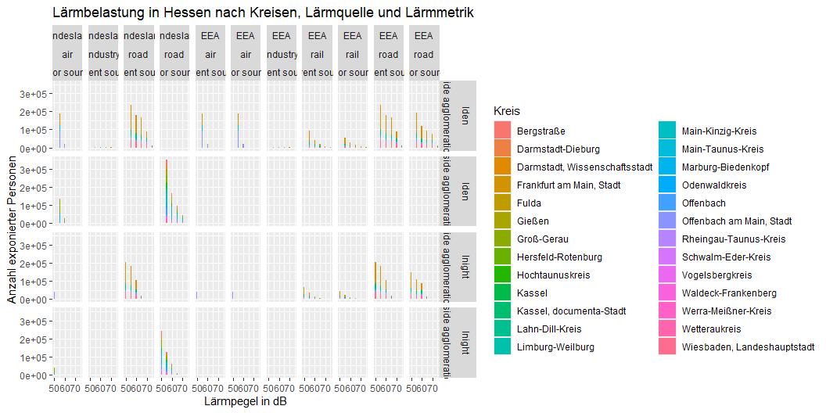
Visualisierungen
Lärmbelastung in Hessen nach Kreisen

Slide 9
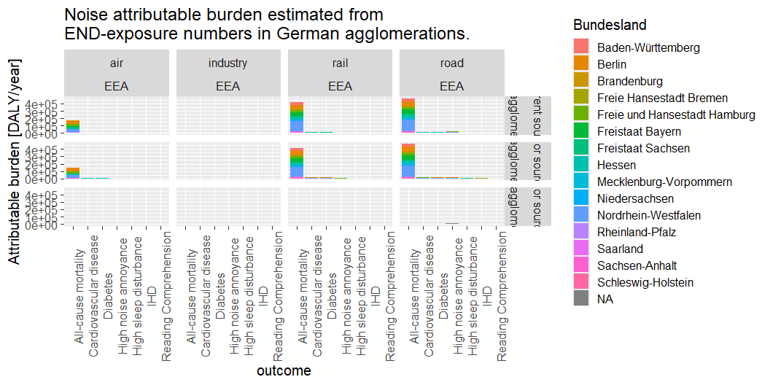
Gesundheitsauswirkungen in Regionen
Figure 2

Slide 10
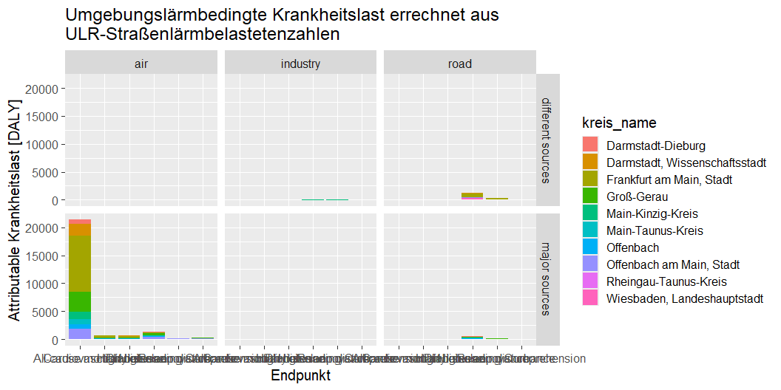

Slide 11
noise_source | outcome | agglomeration | DALY | avg_paf
road | High noise annoyance | inside agglomerations | 35029.1794 | NaN
road | High sleep disturbance | inside agglomerations | 8408.5070 | NaN
air | High noise annoyance | inside agglomerations | 3235.3120 | NaN
air | Reading Comprehension | inside agglomerations | 695.9863 | NaN
air | High sleep disturbance | inside agglomerations | 594.4854 | NaN
rail | High noise annoyance | inside agglomerations | 7720.6975 | NaN
rail | High sleep disturbance | inside agglomerations | 3141.3675 | NaN
industry | High noise annoyance | inside agglomerations | -873.7269 | NaN
industry | High sleep disturbance | inside agglomerations | -293.0835 | NaN
road | High noise annoyance | outside agglomerations | 12638.8657 | NaN
road | High sleep disturbance | outside agglomerations | 2734.7426 | NaN
rail | High noise annoyance | outside agglomerations | 2449.1994 | NaN
rail | High sleep disturbance | outside agglomerations | 1032.2486 | NaN
road | All-cause mortality | inside agglomerations | 944860.2898 | 0.0885848
road | Cardiovascular disease | inside agglomerations | 31631.8398 | 0.0530222
road | IHD | inside agglomerations | 4618.1366 | 0.0694668
road | Diabetes | inside agglomerations | 30243.9265 | 0.0990140
air | All-cause mortality | inside agglomerations | 315295.3834 | 0.0652682
air | Cardiovascular disease | inside agglomerations | 10515.6489 | 0.0389245
air | Diabetes | inside agglomerations | 10103.6740 | 0.0730318
rail | All-cause mortality | inside agglomerations | 829788.2015 | 0.0776814
rail | Cardiovascular disease | inside agglomerations | 27724.7409 | 0.0464118
rail | Diabetes | inside agglomerations | 26576.2981 | 0.0868741

Slide 12
Engelmann, Nicole, Núria Blanes Guàrdia, Jaume Fons Esteve, Danielle Vienneau, Martin Röösli, and Eulalia Peris. 2025. Environmental Noise Health Risk Assessment: Methodology for Assessing Health Risks Using Data Reported Under the Environmental Noise Directive. ETC HE Report 2023/11. https://doi.org/10.5281/ZENODO.15641306.
Engelmann, Nicole, Xing Jiang, Núria Blanes Guàrdia, Danielle Vienneau, and Martin Röösli. 2025. Health Effects of Transportation Noise for Children and Adolescents: An Umbrella Review and Burden of Disease Estimation. ETC HE Report 2024/11. https://doi.org/10.5281/ZENODO.14892796.

