Slide 1
QFI INTERNSHIP PROJECT
Advanced Equity Portfolio
Risk Management
VaR, Expected Shortfall, volatility scaling, backtesting and stress testing
$297K
$4.40M
34 / 31.2
99% one-day GJR-HS VaR
2008 crisis replay loss
actual / expected exceptions
How much can the portfolio lose, how reliable is that estimate, and what should we do about it?
QFI risk engine | saved data through 23 October 2026
01
Notes:
Hello everyone. Today I will present a risk engine built for a ten-stock equity portfolio. The central question is simple: how much can the portfolio lose, how reliable is that estimate, and what should a risk manager do with the result?

Slide 2
OVERVIEW
Project scope and the language of risk
A portfolio combines investments; risk management measures and controls the losses that can follow
Portfolio
Equity portfolio
A group of investments held together; each holding has a weight.
A portfolio made mainly of listed company shares.
VaR
Expected Shortfall
A loss threshold for a stated horizon and confidence level, not a maximum loss.
The average loss after the VaR threshold has been crossed.
Volatility
Drawdown
How widely returns move from day to day.
The fall from a previous portfolio peak to a later low.
01
02
03
04
05
06
07
08
09
10
Collect
Clean
Build
Measure
Scale
Forecast
Test
Compare
Stress
Decide
QFI risk engine | saved data through 23 October 2026
02
Notes:
A portfolio is a collection of investments. Risk management does not remove all risk; it measures possible losses, checks whether they are acceptable, and defines what to do when they become too large. VaR marks a warning line, while Expected Shortfall describes the average loss beyond that line.

Slide 3
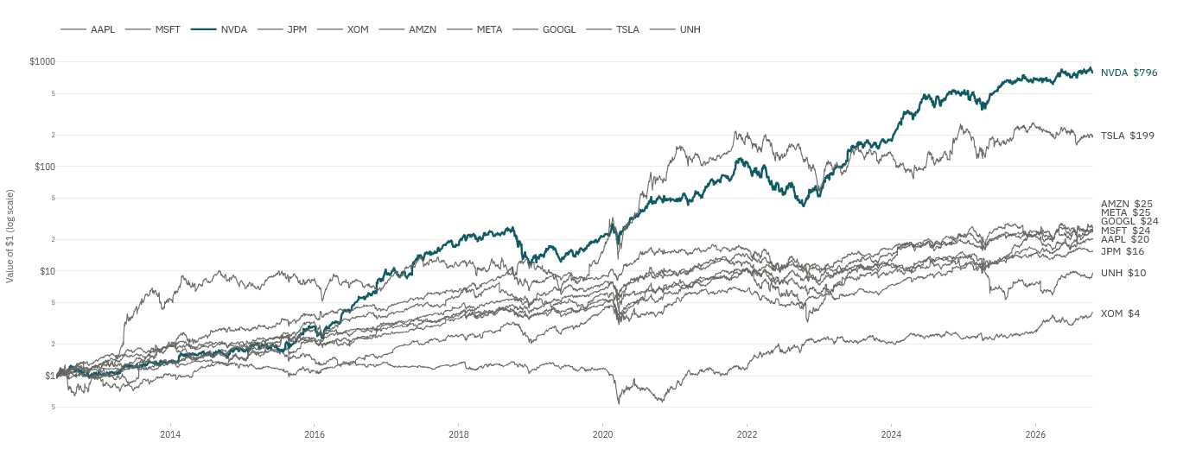
PHASE 01
Phase 1 Data collection
Adjusted prices, benchmark data, sectors, weights and the risk-free rate create the raw input
01
Growth of $1 invested in each stock
3,619
shared trading days
same dates across every holding
10 + SPY
stocks and benchmark
Adjusted close
Returns and weights
Reference inputs
Corrects splits and dividends so corporate actions do not create false returns.
Returns make different stock prices comparable; weights translate each move into portfolio impact.
SPY, the short-term risk-free rate and sector classifications support comparison and stress testing.
Adjusted prices are aligned across all holdings before portfolio returns are calculated
QFI risk engine | saved data through 23 October 2026
03
Notes:
Phase 1 collects adjusted daily prices for Apple, Microsoft, Nvidia, JPMorgan, ExxonMobil, Amazon, Meta, Alphabet, Tesla and UnitedHealth, plus SPY and the risk-free rate. Adjusted prices prevent splits and dividends from becoming false losses. The local cache keeps the process reproducible when a provider is unavailable.

Slide 4
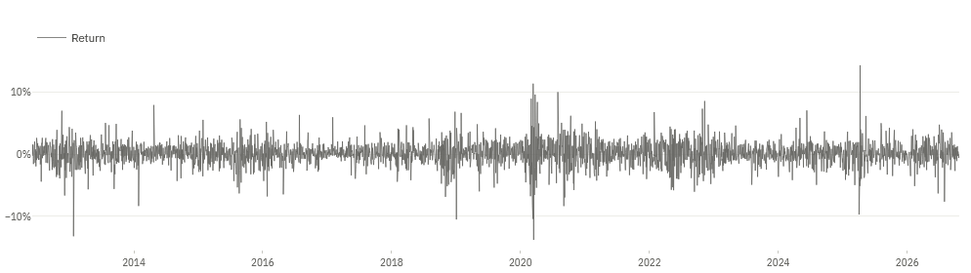
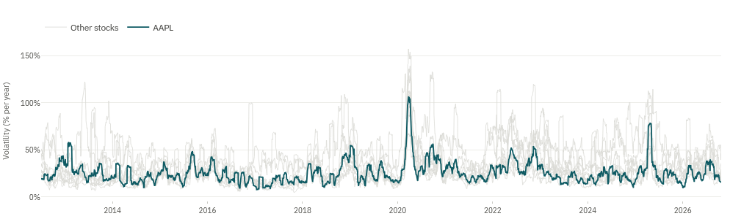
PHASE 02
Phase 2 Data cleaning
The portfolio is only credible when every stock return refers to the same trading day
02
Apple daily returns
WHY THIS MATTERS
Comparable prices
Split and dividend adjustments prevent corporate actions from creating false returns.
One shared calendar
Every stock movement refers to the same trading date before the portfolio is combined.
Rolling annualized volatility: Apple vs other holdings
Real shocks preserved
Genuine crashes remain in the sample because they contain the tail-risk information we need.
Model-ready output
Clean stock returns feed the portfolio return series and the rolling risk models.
Output: clean prices, clean returns, portfolio returns and rolling volatility
QFI risk engine | saved data through 23 October 2026
04
Notes:
Phase 2 aligns the trading calendar, checks missing and stale prices, and converts prices into log returns. Winsorization is reserved for verified errors because genuine market crashes belong in the risk sample. The output is a clean price matrix, return matrix, portfolio return series and rolling volatility series.

Slide 5
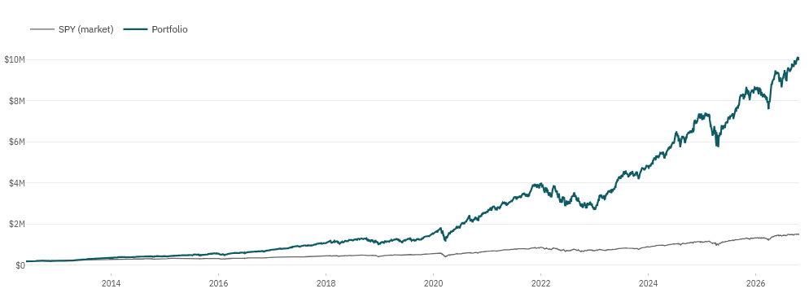
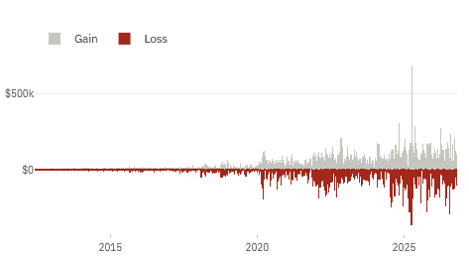
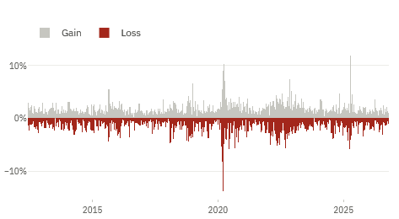
PHASE 03
Phase 3 Portfolio construction
Weights, initial value and rebalancing turn ten stock returns into one investable portfolio
03
Portfolio value vs SPY benchmark
$10M
initial reporting value
10%
starting weight per stock
Equal weight
Every stock starts near the same money weight.
Daily portfolio P&L
Daily portfolio returns
User or market-cap weight
The engine also accepts custom allocations or weights based on company size.
Monthly rebalance
Reset drift toward the target allocation; more frequent trading would add costs.
QFI risk engine | saved data through 23 October 2026
05
Notes:
Phase 3 combines the cleaned returns into one portfolio. The engine supports equal, user-defined, market-cap and optional long-short weights. Daily return is the percentage movement, daily value compounds that movement, and daily P&L expresses it in dollars. The two lower charts show P&L and returns at the same time.

Slide 6
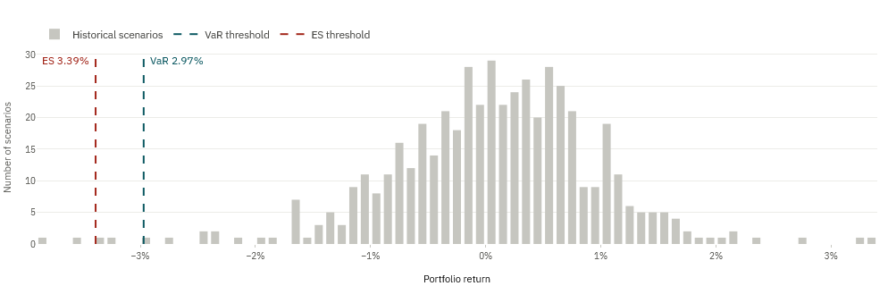
PHASE 04
Phase 4 Historical Simulation VaR
Rank the recent portfolio outcomes and read the loss cutoff directly from history
04
Historical portfolio return and P&L distribution
$337K
99% one-day VaR
$463K
Expected Shortfall
$1.06M
99% ten-day VaR
250
days
about 1 year
500
days
about 2 years
750
days
about 3 years
Confidence choices: 95%, 99% and 99.5%. Higher confidence moves deeper into the loss tail.
QFI risk engine | saved data through 23 October 2026
06
Notes:
Historical Simulation uses actual past portfolio outcomes. A 99 percent one-day VaR of about 337 thousand dollars marks the start of the worst one percent of days in the selected 500-day window. Expected Shortfall is larger because it averages the losses beyond that threshold. VaR is not a maximum possible loss.

Slide 7
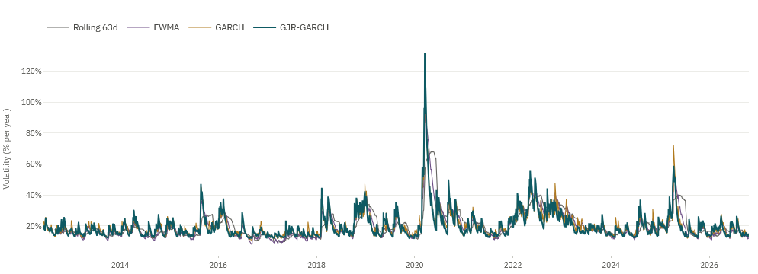
PHASE 05
Phase 5 EWMA volatility scaling
Recent shocks receive more weight, so old returns are resized to today's volatility
05
Annualized volatility by model
0.94
daily decay factor, lambda
11.7%
current annualized EWMA volatility
$240K
EWMA-scaled 99% VaR
What lambda means
Why scale
Each day keeps 94% of yesterday's variance estimate and adds 6% from the newest squared return.
A historical shock from a calm period should become larger when today's market is more volatile, and smaller when it is calmer.
EWMA reacts quickly, but a lower current estimate still has to earn trust in backtesting
QFI risk engine | saved data through 23 October 2026
07
Notes:
EWMA stands for Exponentially Weighted Moving Average. Lambda equals 0.94 for daily data, so the model remembers most of yesterday's variance while giving the newest observation meaningful weight. The model standardizes old returns by their historical volatility and rescales them by today's volatility.

Slide 8
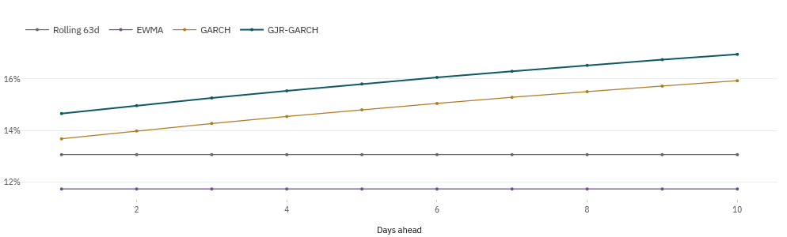
PHASE 06
Phase 6 GARCH volatility scaling
Volatility clusters and then decays gradually instead of resetting each day
06
10-day volatility forecast by model
13.7%
current GARCH volatility
$275K
GARCH-scaled 99% VaR
21.3 days
estimated shock half-life
GARCH(1,1)
Conditional volatility
One-day forecast
Today's variance depends on one recent squared shock and one previous variance estimate.
The risk estimate changes with information available at that point in time.
The model projects tomorrow's volatility, then scales the historical returns and tail loss.
Persistence 0.968 means volatility shocks fade slowly rather than disappearing immediately
QFI risk engine | saved data through 23 October 2026
08
Notes:
GARCH models volatility clustering: large moves tend to be followed by large moves. The model estimates conditional volatility for each day and a one-day forecast for tomorrow. Persistence close to one means a shock fades gradually, and the estimated half-life is about one trading month.

Slide 9
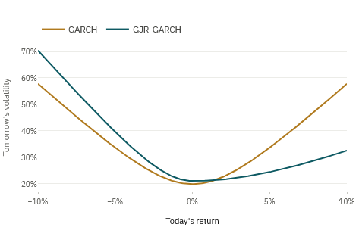
PHASE 07
Phase 7 GJR-GARCH volatility scaling
Negative equity shocks can raise future volatility more than positive shocks of the same size
07
GARCH vs GJR-GARCH leverage response
14.7%
current GJR volatility
0.154
leverage-effect parameter
$297K
GJR-scaled 99% VaR
Asymmetry
Equity relevance
Fit check
The extra leverage term activates after a negative return.
Bad news often produces more fear and volatility than equally large good news.
GJR AIC 11,485 versus GARCH 11,581; lower is better on the same sample.
QFI risk engine | saved data through 23 October 2026
09
Notes:
GJR-GARCH extends GARCH with an asymmetric response. The positive leverage parameter indicates that negative returns increased later volatility more strongly in this sample. A lower AIC supports the relative fit, but the model only becomes useful if its forecasts also perform well out of sample.

Slide 10
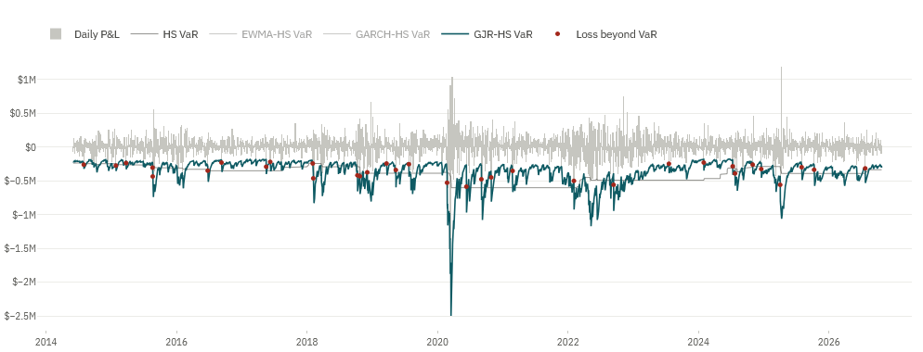
PHASE 08
Phase 8 VaR backtesting
Every forecast uses information available before the day whose loss it is tested against
08
Actual daily P&L vs GJR-HS VaR
34
exceptions versus 31.2 expected
0.618
Kupiec frequency p-value
0.056
independence p-value
Kupiec POF
Christoffersen
Is the total exception count plausible?
Are exceptions independent rather than clustered?
Conditional coverage
Basel traffic light
Do frequency and timing pass together?
Is the recent count green, yellow or red?
QFI risk engine | saved data through 23 October 2026
10
Notes:
Backtesting compares each forecast with the loss that occurred afterward. An exception occurs when the actual loss exceeds VaR. Kupiec checks frequency, Christoffersen checks clustering, and conditional coverage checks both. A green traffic-light result is useful, but it does not replace the statistical tests.

Slide 11
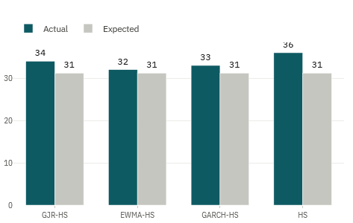
PHASE 09
Phase 9 Model comparison
The best model earns its role through validation, not by producing the smallest risk number
Actual vs expected exceptions by model
Model
Exceptions
Kupiec
Independence
Decision
GJR-HS
34 / 31.2
0.618
0.056
PASS
EWMA-HS
32 / 31.2
0.885
0.044
REVIEW
GARCH-HS
33 / 31.2
0.747
0.005
REVIEW
HS
36 / 31.2
0.398
0.001
REVIEW
Primary: GJR-HS | Challenger: EWMA-HS | Transparent benchmark: Historical Simulation
Comparison metrics
Exceptions, exception ratio, average VaR, VaR volatility, worst loss, Expected Shortfall, p-values and traffic-light zone.
QFI risk engine | saved data through 23 October 2026
11
Notes:
Phase 9 compares all four models using exception counts, clustering, average risk, stability and Expected Shortfall. GJR-HS ranks first because it passes frequency, independence and joint coverage at the selected level. EWMA remains a fast challenger, and Historical Simulation remains the simplest benchmark.

Slide 12
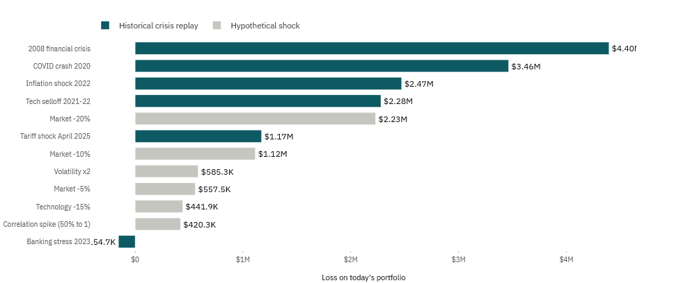
PHASE 10
Phase 10 Stress testing
VaR supports daily monitoring; stress testing asks whether the portfolio can survive a crisis
10
Stress scenario loss ranking
$4.40M
2008 crisis replay
$3.46M
COVID crash replay
$957K
stressed VaR
Historical
Hypothetical
2008, COVID, 2022 inflation, 2023 banking stress and the technology selloff.
Market falls, doubled volatility, correlation spikes and sector-specific shocks.
QFI risk engine | saved data through 23 October 2026
12
Notes:
Stress testing asks what would happen to today's portfolio if a severe historical or hypothetical shock occurred. It is not a forecast and it assigns no probability. The 2008 replay produces the largest tested loss, about 4.40 million dollars, far beyond ordinary one-day VaR.

Slide 13
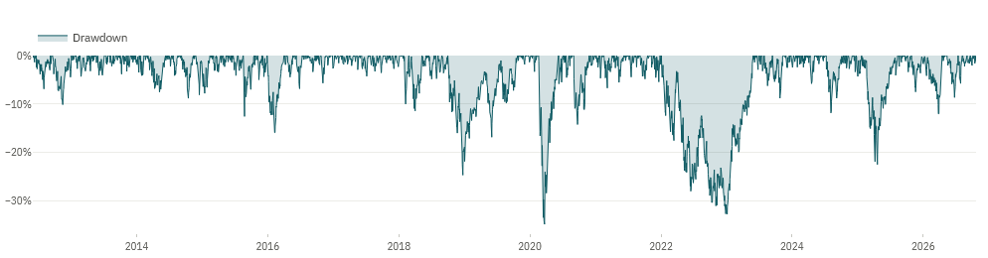
RESULTS
Strong returns came with a 34.9% drawdown
Historical performance is not a forecast; the path reveals the risk taken to achieve it
Portfolio drawdown from the previous peak
31.6%
annualized return
21.9%
annualized volatility
-34.9%
maximum drawdown
Sharpe 1.28 | beta 1.19 | correlation with SPY 0.90
Interpretation
Ten stocks reduce company-specific risk, but high market correlation leaves the portfolio exposed to broad equity shocks.
QFI risk engine | saved data through 23 October 2026
13
Notes:
The portfolio delivered strong historical returns, but it also experienced a drawdown close to 35 percent. Beta above one and a 0.90 correlation with SPY show that broad market stress still reaches most holdings at the same time.

Slide 14
RESULTS
Current model choice moves one-day VaR from $240K to $337K
All figures use 99% confidence, a one-day horizon and today's $10 million portfolio value
Historical portfolio return and P&L distribution
HS
$337K
$463K
VaR
ES
EWMA-HS
$240K
$277K
VaR
ES
GARCH-HS
$275K
$319K
VaR
ES
GJR-HS
$297K
$339K
VaR
ES
Model risk is visible: the method changes the threshold, so governance keeps a primary model, challenger and benchmark
Rule
Expected Shortfall must remain above VaR because it averages losses after the threshold is crossed.
QFI risk engine | saved data through 23 October 2026
14
Notes:
The filtered models currently produce lower VaR than unscaled Historical Simulation because recent volatility is below the longer-window level. This difference is model risk. The selected number must therefore be accompanied by a challenger, a benchmark and regular validation.

Slide 15
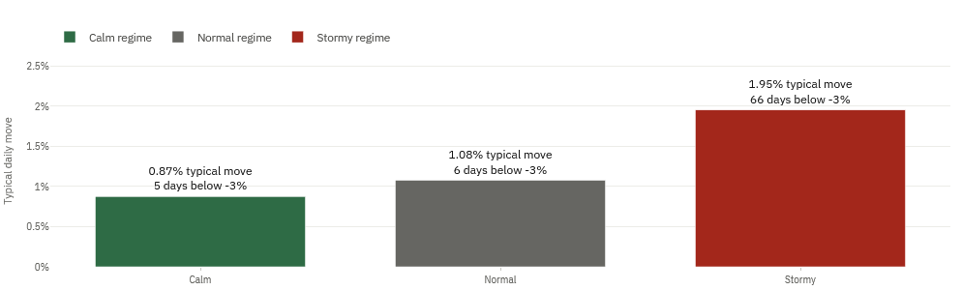
MODEL EVIDENCE
Volatility changes regime, and downside shocks matter more
The models respond to both persistence and asymmetry in equity returns
Annualized volatility by model
0.967
GJR persistence
20.8 days
shock half-life
0.154
downside leverage parameter
Volatility regimes
Residual check
Standardized-residual kurtosis falls from 12.0 to 4.5, but extreme tails remain.
QFI risk engine | saved data through 23 October 2026
15
Notes:
The volatility models capture the main regime changes and the slower decay of shocks. GJR-GARCH adds the stronger response after negative returns. Standardization improves the residual distribution, but it does not make extreme tail risk disappear.

Slide 16
VALIDATION
GJR-HS is the only model that passes all 99% backtests
A reasonable exception count is not enough when losses still arrive in clusters
Actual daily P&L vs GJR-HS VaR
0.618
Kupiec p-value
0.056
Independence p-value
0.143
Conditional p-value
34 exceptions versus 31.2 expected | Basel zone: GREEN
Boundary
Passing the historical backtest supports daily use. It does not prove the model will capture a new crisis, liquidity shock or structural break.
QFI risk engine | saved data through 23 October 2026
16
Notes:
GJR-HS produces 34 exceptions against 31.2 expected. Its p-values do not reject frequency, independence or joint coverage at the five percent level. The model earns the primary role, but the pass is conditional on this sample and must be monitored.

Slide 17
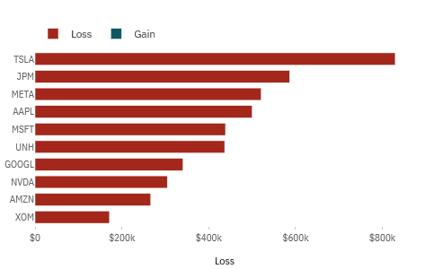
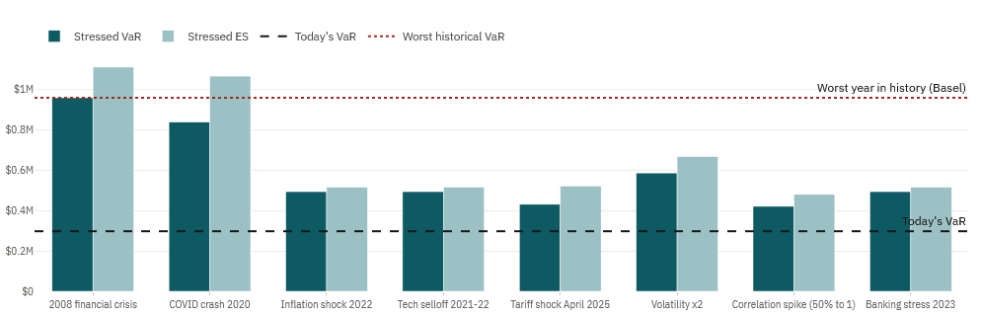
STRESS AND ATTRIBUTION
Crisis loss and tail concentration are larger than daily VaR
The worst historical replay removes 44% of value, while two stocks supply 39% of Expected Shortfall
Stressed VaR vs current VaR
2008 crisis replay loss by stock
44.0%
39.0%
20.6%
38.4%
2008 replay loss
TSLA and AMZN share of ES
their share of capital
diversification benefit
Decision insight
Equal money weights do not create equal tail-risk contributions. Risk reduction should target the positions that dominate severe losses.
QFI risk engine | saved data through 23 October 2026
17
Notes:
The stress tests answer a different question from daily VaR. The 2008 replay removes about 44 percent of portfolio value. Tail attribution also shows that Tesla and Amazon contribute about 39 percent of Expected Shortfall from roughly 21 percent of capital.

Slide 18
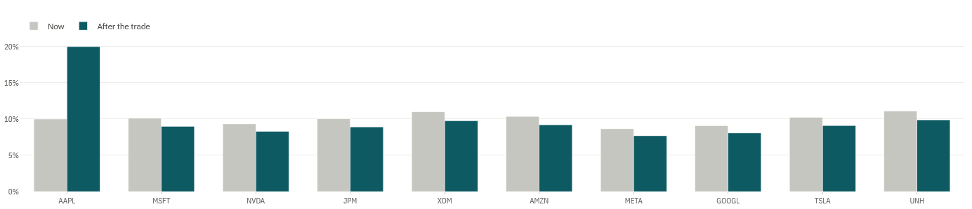
DECISIONS
The analytics support hedging or reallocation, not automatic trading
Every action changes costs, exposures and the assumptions behind the risk estimate
Portfolio weights before and after optimization
58.6%
illustrative SPY hedge VaR reduction
$230K
optimized-split ES
$331K
current-split ES
Hedge
Reallocate
A beta-neutral SPY example uses a −$10.50M short. It cuts modelled VaR but creates basis, financing and execution risk.
The historical optimization lowers tail risk but also changes expected return and concentrates the new portfolio in five names.
Before acting: test liquidity, transaction costs, taxes, borrowing constraints and performance on new data
QFI risk engine | saved data through 23 October 2026
18
Notes:
The engine supports two possible responses. A broad-market hedge can cut systematic risk, while reallocation can reduce tail contribution from the riskiest positions. Both examples are analytical scenarios, not trade instructions, and both need cost and implementation checks.

Slide 19
GOVERNANCE
Risk limits turn model output into a repeatable control process
Numbers become useful only when ownership, escalation and review are explicit
01
Monitor
Calculate primary, challenger and benchmark VaR each day.
02
Investigate
Review every exception, data issue and unexplained model divergence.
03
Escalate
Trigger portfolio review when limits, stress losses or concentration thresholds are breached.
04
Decide
Reduce, hedge or explicitly accept the residual risk with named approval.
05
Document
Record the estimate, evidence, action, owner and follow-up date.
Proposed controls require approval; they are not policies already in force
QFI risk engine | saved data through 23 October 2026
19
Notes:
The dashboard becomes a control only when the organization defines who monitors it, who investigates exceptions, who approves action and how the decision is recorded. These are proposed governance steps for approval, not existing policy.

Slide 20
RECOMMENDATION
Use GJR-HS for daily risk,
but manage the crisis exposure separately
PRIMARY
GJR-HS
Only model to pass frequency, independence and joint coverage at 99%.
CHALLENGER
EWMA-HS
Fast response and a useful second opinion when volatility changes quickly.
BENCHMARK
Historical Simulation
Transparent loss ranking that keeps the complex models accountable.
ACTION
Review concentration
TSLA and AMZN supply about 39% of Expected Shortfall from about 21% of capital.
Daily VaR is a control threshold, not a crisis-loss ceiling
20
Notes:
My recommendation is to use GJR-HS as the primary daily model, EWMA-HS as the challenger and Historical Simulation as the transparent benchmark. Expected Shortfall, stress testing and risk contribution must remain beside VaR. If the 44 percent crisis loss or the concentration in Tesla and Amazon does not fit the risk appetite, management must reduce it, hedge it or explicitly accept it.

Slide 21
SIMULATED PERFORMANCE
What the historical simulation produced from a $10M start
Equal weighted and rebalanced monthly from June 2012 through October 2026
$513.4M
$503.4M
31.6%
21.9%
-34.9%
ending value
cumulative profit
annualized return
annualized volatility
maximum drawdown
Portfolio value from a $10M starting investment
Contribution to simulated profit by holding
Drawdown from the previous portfolio peak
Worst period: 19 Feb to 23 Mar 2020 | -34.9% | recovered by 5 Jun 2020
Nvidia was the largest contributor, followed by Tesla and Alphabet. Monthly rebalancing repeatedly redistributed gains back toward the target weights.
Historical simulation before transaction costs and taxes. It is not a forecast of future performance.
21
Notes:
A hypothetical ten-million-dollar investment at the beginning of the sample grows to about $513.4M, creating about $503.4M of cumulative simulated profit. Nvidia contributes the most, followed by Tesla and Alphabet. The worst drawdown occurred during the COVID shock, when the portfolio fell -34.9% from its previous peak. These figures are historical, before transaction costs and taxes, and do not forecast future performance.

