Slide 1
DEPARTMENT OF MATHEMATICS · PROJECT
Trapped by Stability
A Falsification Framework for Acquisition-Driven Radiomic Phenotypes
Multi-vendor breast MRI reanalysis in 922 patients
Presented by Malek M. Itani
Supervisor Dr. Lama Affara
DATE
20 May 2026
Notes:
“Good morning. This presentation is not about claiming a new breast MRI biomarker. It is about showing how a result can look like a biomarker, pass standard checks, and still fail once we test whether it is truly biological. Meaning a cluster may be reproducible to resampling and demonstrate what appears to be meaningful prognostic signal but lack biological identity The central message is simple: stability is not the same as validity.”
The Stability Trap”: the mathematical illusion that a data partition is biologically valid simply because its underlying technical artifact is highly stable and reproducible.

Slide 2
THE PROMISE — AND THE RISK
Radiomics promises biology from imaging alone.
THE PROMISE
THE RISK
Quantitative descriptors of vascularity, morphology, cellularity, and heterogeneity can reveal latent imaging phenotypes that visual reading and receptor labels cannot.
MRI signal is also shaped by scanner vendor, pulse-sequence, field strength, matrix, TR / TE, voxel geometry, reconstruction, and timing.
Breast DCE-MRI offers a particularly rich substrate — enhancement kinetics, texture, washout.
These technical sources of variance can be stable, reproducible, and dominant in the feature space.
What if a stable phenotype is only a stable technical artifact?
01 · MOTIVATION
Trapped by Stability · Project
Notes:
“Radiomics means turning medical images into numbers. Instead of only looking at the MRI visually, we extract quantitative features: texture, enhancement, shape, vascularity, and heterogeneity. The promise is that these numbers may reveal hidden tumor subtypes. The risk is that MRI numbers are also affected by the machine: vendor, sequence settings, field strength, TR, TE, and reconstruction. So the key question is: what if the cluster we discover is stable, but only because the scanner effect is stable?”

Slide 3
CENTRAL CLAIM
Stability is not biological validity.
Stability ≠ Biological Validity
WHAT STABILITY TESTS
Silhouette, Calinski-Harabasz, and bootstrap ARI assess whether a partition is reproducible under resampling.
WHAT IT DOES NOT TEST
Whether the partition is biological. Reproducibility says nothing about identity, meaning, or mechanism.
A reproducible cluster can still be a reproducible artifact.
02 · CORE THESIS
Trapped by Stability · Project
Notes:
In statistics, stability means that a result stays similar when the data or analysis is slightly perturbed.
Stability is considered a form of internal validation. Scientists use it to check whether a result is reproducible and not just random noise.
If I repeat the clustering process on slightly different versions of the dataset, do I keep getting almost the same patient groups?
“The thesis of this talk is: stability is not biological validity. Stability metrics tell us whether a clustering result can be reproduced. They do not tell us whether the cluster represents tumor biology. A scanner artifact can be highly reproducible. So if we only ask, ‘Can I reproduce this cluster?’ we may miss the more important question: ‘What is this cluster actually representing?’”

Slide 4
COHORT
922 patients, 529 radiomic features, two vendors.
922
529
628 / 294
87
Patients (breast MRI)
Quantitative MRI features
GE / Siemens exams
Recurrence events
MOLECULAR SUBTYPE COMPOSITION
PREPROCESSING
< 5% missingness filter
Low-variance filter (≥ 2 unique)
Median imputation
Z-score standardization
No variables removed by QC
A standard analysis matrix — 922 × 529, two vendors, intentionally conventional pipeline.
03 · DATA
Trapped by Stability · Project
Notes:
“We analyzed 922 breast MRI patients and 529 radiomic features. The cohort includes two main scanner vendors: 628 GE exams and 294 Siemens exams. There were 87 recurrence events. The preprocessing was intentionally standard: remove highly missing or low-variance features, impute missing values using the median, and standardize features using z-scores. Z-scoring means putting all variables on the same scale, so one feature does not dominate simply because it has larger numerical units.”

Slide 5
BY STANDARD VALIDATION
This looks compelling.
OPTIMAL k
SILHOUETTE
CALINSKI-HARABASZ
BOOTSTRAP ARI
2
0.196
200.93
0.893
selected by internal validity
highest across candidate k
decreases monotonically as k grows
SD 0.084 · 20× 80% subsampling
VARIANCE EXPLAINED · TOP 10 PCs ≈ 58%
IMPORTANT NUANCE
PC1 – PC2 forms a continuous cloud, not a sharply separated set of natural groups.
Any two-cluster solution is imposed on a gradient. Internal validity favours k = 2, but the geometry is not a clean binary.
04 · THE APPARENT DISCOVERY
Trapped by Stability · Project
Notes:
“Using a standard workflow, the result initially looks compelling. PCA was used first. PCA means reducing hundreds of features into a smaller number of summary axes that capture the main variation in the data. Then k-means clustering was applied. K-means simply tries to divide patients into k groups so patients inside each group are similar. The best k was 2. The silhouette score, Calinski-Harabasz index, and bootstrap ARI all supported that. But the important warning is that the PCA plot looked like a continuum, not two naturally separated islands.”
The top 10 pcs represtn 58% of the variation

Slide 6
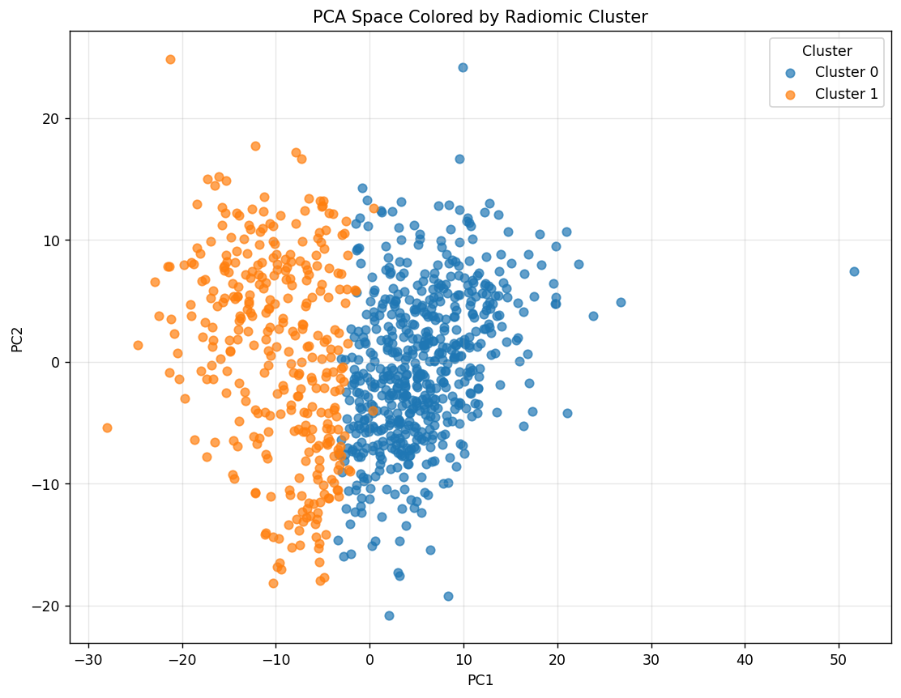
BY STANDARD VALIDATION
This looks compelling.
IMPORTANT NUANCE
PC1 – PC2 forms a continuous cloud, not a sharply separated set of natural groups.
Any two-cluster solution is imposed on a gradient. Internal validity favours k = 2, but the geometry is not a clean binary.
04 · THE APPARENT DISCOVERY
Trapped by Stability · Project
Notes:
“Using a standard workflow, the result initially looks compelling. PCA was used first. PCA means reducing hundreds of features into a smaller number of summary axes that capture the main variation in the data. Then k-means clustering was applied. K-means simply tries to divide patients into k groups so patients inside each group are similar. The best k was 2. The silhouette score, Calinski-Harabasz index, and bootstrap ARI all supported that. But the important warning is that the PCA plot looked like a continuum, not two naturally separated islands.”

Slide 7
TOP SEPARATING FEATURES
A biologically plausible feature story.
FEATURE STORY
Top separators are dominated by signal-enhancement-ratio (SER) and peak-enhancement (PE) descriptors — entropy, homogeneity, dispersion.
Cohen d > 2.2 for top features;
q-values down to ~1e-164.
Reads naturally as a vascularity-like appearance — heterogeneous vs. homogeneous enhancement.
Biological plausibility makes the result attractive. It is not evidence by itself.
04 · THE APPARENT DISCOVERY
Trapped by Stability · Project
Notes:
“The features separating the two clusters also looked biologically plausible. They were dominated by SER and PE features. SER means signal enhancement ratio, and PE means peak enhancement. In simple terms, these describe how strongly and how heterogeneously the tumor enhances after contrast. That naturally sounds like vascularity. But this is exactly where caution is needed: biological plausibility is not proof. A technical effect can still produce features that sound clinically meaningful.”
Cohen’s d measures how strongly a feature separates two groups, standardized by variability. Large absolute values mean the feature distributions overlap very little between clusters.” 0.8 is large effect

Slide 8
SUBGROUP SURVIVAL ANALYSIS
An apparent HR+/HER2+ survival signal.
EVENT RATE · HR+/HER2+ SUBGROUP (n = 101)
STATISTICAL SUMMARY
Log-rank p
0.010
Unadjusted Cox HR
4.76
95% CI
1.22 – 18.61
Cox p
0.02
Only 10 recurrence events · the unadjusted estimate is large but imprecise — this becomes the counterexample for the falsification chain.
04 · THE APPARENT DISCOVERY
Trapped by Stability · Project
Notes:
“In the HR-positive, HER2-positive subgroup, the raw clusters appeared to separate recurrence-free survival. Kaplan-Meier curves estimate the probability of remaining recurrence-free over time.
The log-rank test compares whether two survival curves are statistically different. Here, the log-rank p-value was 0.010. The Cox model estimated a hazard ratio of 4.76, meaning Cluster 1 had higher estimated recurrence risk than Cluster 0. But this was based on only 10 recurrence events, so the estimate is unstable and imprecise.”
The log-rank p test evaluates whether there is a statistically significant difference between the survival distributions of two or more groups.
The Cox HR test is a statistical method used in survival analysis to test the significance of the hazard ratio (HR) derived from the Cox proportional hazards model. It helps determine whether the HR is equal to one, indicating no effect on the time to event, or whether it is greater than one, indicating a significant effect on the time to event.

Slide 9
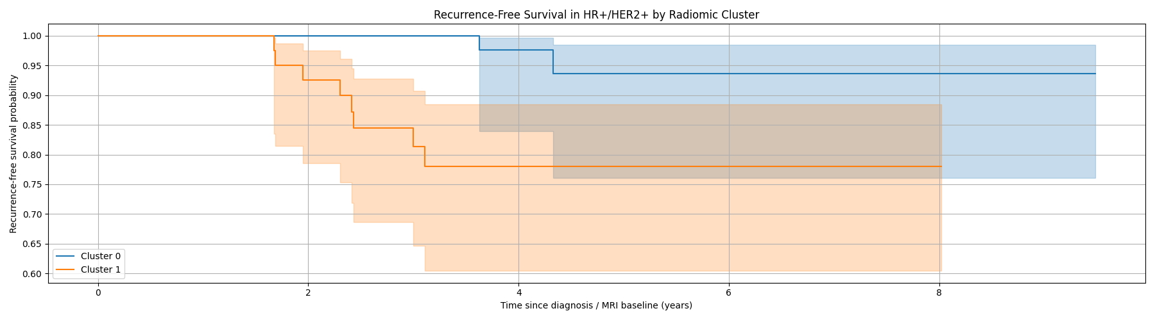
SUBGROUP SURVIVAL ANALYSIS
An apparent HR+/HER2+ survival signal.
Only 10 recurrence events · the unadjusted estimate is large but imprecise — this becomes the counterexample for the falsification chain.
04 · THE APPARENT DISCOVERY
Trapped by Stability · Project
Notes:
“In the HR-positive, HER2-positive subgroup, the raw clusters appeared to separate recurrence-free survival. Kaplan-Meier curves estimate the probability of remaining recurrence-free over time.
The log-rank test compares whether two survival curves are statistically different. Here, the log-rank p-value was 0.010. The Cox model estimated a hazard ratio of 4.76, meaning Cluster 1 had higher estimated recurrence risk than Cluster 0. But this was based on only 10 recurrence events, so the estimate is unstable and imprecise.”
The log-rank p test evaluates whether there is a statistically significant difference between the survival distributions of two or more groups.
The Cox HR test is a statistical method used in survival analysis to test the significance of the hazard ratio (HR) derived from the Cox proportional hazards model. It helps determine whether the HR is equal to one, indicating no effect on the time to event, or whether it is greater than one, indicating a significant effect on the time to event.

Slide 10
PIVOT
Now we ask whether this survives falsification.
Not “does a stable cluster exist?”
It does.
The real question is whether the same biological interpretation survives when technical structure is explicitly challenged.
If the phenotype is biological, technical correction should refine it — not replace it.
04 · THE TURN
Trapped by Stability · Project
Notes:
Hinge of the talk. Pause here. Speak slowly. Repeat the final line. This is the line the audience should remember when you reveal the manufacturer split two slides from now.
“At this point, a conventional paper might start calling this a vascularity-like prognostic phenotype. But this study does not stop there. Now we ask a harder question: does the interpretation survive technical challenge? If the cluster is truly biological, technical correction should refine it. It should not completely replace which patients belong to which group.”

Slide 11
METHOD
An acquisition-aware falsification chain.
1
2
3
4
5
Raw MRI features
Preprocessing & z-score
PCA
k-means clustering
Bootstrap stability
6
7
8
9
10
Technical enrichment
Mfr. residualization
ComBat harmonization
Identity test (ARI vs raw)
Survival & biomarker adjudication
Standard discovery pipeline
Acquisition-aware challenge (steps 6 – 9)
The first half generates a candidate. The second half tries to break it.
05 · FALSIFICATION FRAMEWORK
Trapped by Stability · Project
Notes:
“The first half of the pipeline creates the candidate: raw MRI features, preprocessing, PCA, k-means clustering, and stability testing. The second half tries to break the candidate: test whether the cluster is enriched for technical variables, remove manufacturer effects using residualization and ComBat, then check whether the same patients remain grouped together. ComBat is a harmonization method originally developed to reduce batch effects. Here, the batch is scanner manufacturer.”

Slide 12
TWO DISTINCT VALIDATION TARGETS
Stability and identity are different questions.
STABILITY
IDENTITY
Can the same data condition reproduce a cluster under resampling?
Are the same patients still grouped together after technical correction?
METRIC
METRIC
Bootstrap ARI under 80% subsampling
ARI of harmonized labels vs. raw labels
Tells you: the partition is reproducible.
Tells you: the patients are the same partition.
This study fails identity while preserving stability.
05 · FALSIFICATION FRAMEWORK
Trapped by Stability · Project
Notes:
“This slide separates two ideas. Stability asks: if I repeat the analysis under the same condition, do I get a similar cluster? Identity asks: after technical correction, are the same patients still grouped together? Both are measured using ARI, the adjusted Rand index. ARI compares two cluster labelings. A value near 1 means they are very similar. A value near 0 means they are almost unrelated. This study preserves stability but fails identity.”

Slide 13
ACQUISITION ENRICHMENT
The phenotype was largely a vendor split.
RAW CLUSTER × MANUFACTURER · PROPORTION
MANUFACTURER × CLUSTER
p = 8.0 × 10⁻¹⁰⁴
FOR CONTRAST
Molecular subtype p = 0.146
Whole-cohort recurrence p = 0.766
Cluster 0: 547 GE · 39 Siemens Cluster 1: 81 GE · 255 Siemens
The contingency pattern is not subtle — it is overwhelming.
06 · THE REVEAL
Trapped by Stability · Project
Notes:
“Here is the reveal. The raw cluster was strongly associated with manufacturer. Cluster 0 was mostly GE: 547 GE and only 39 Siemens. Cluster 1 was mostly Siemens: 255 Siemens and 81 GE. The manufacturer association had a p-value of 8 times 10 to the minus 104, which is overwhelming. By contrast, molecular subtype had p = 0.146 and whole-cohort recurrence had p = 0.766. So the cluster aligned much more with scanner vendor than with tumor subtype or recurrence.”

Slide 14
SAME SPACE, TWO COLOURINGS
Now color the same space by manufacturer.
COLOURED BY RAW CLUSTER
COLOURED BY MANUFACTURER
The two displays are nearly interchangeable. Belief breaks here.
07 · THE REVEAL
Trapped by Stability · Project
Notes:
“This is the same PCA space colored two ways. On the left, patients are colored by raw cluster. On the right, they are colored by manufacturer. The two views are nearly interchangeable. This is the moment where the interpretation changes. The algorithm is not mainly recovering tumor biology. It is largely recovering the scanner domain.”

Slide 15
VARIANCE ATTRIBUTION ON PC1
Technical, not subtype-defined.
READING
Four technical variables dwarf molecular subtype on PC1.
Subtype remains ≤ 0.04 across the top ten PCs.
The partition is not noisy — it is stable, and the stable signal is acquisition-linked.
Acquisition dominates the leading variance axis; biology does not.
07 · THE REVEAL
Trapped by Stability · Project
Notes:
“This slide asks what drives PC1, the first and strongest PCA axis. TR explains about 0.76, TE about 0.63, acquisition matrix about 0.57, and manufacturer about 0.49. Molecular subtype stays below about 0.04 across the top PCs. TR and TE are MRI timing parameters. Eta-squared here is a measure of how much variation in a PC is associated with a variable. The contrast is the key point: technical variables dominate; subtype does not.”

Slide 16
07 · THE CORE LESSON
The stability trap.
A cluster can be reproducible because the artifact is reproducible.
High bootstrap ARI may mean that the scanner-domain structure is reproducible — not that the cluster is biological. Reproducibility of an artifact still produces reproducible labels.
Stability ≠ Identity ≠ Biology
Notes:
“This is the stability trap. A cluster can be reproducible because the artifact is reproducible. High bootstrap ARI does not automatically mean biology. It may simply mean that the scanner-related structure is consistent. So the correct chain is: stability is not identity, and identity is not biology.”

Slide 17
STABILITY VERSUS IDENTITY ACROSS CONDITIONS
Stable clusters. Different patients.
PANEL A · INTERNAL STABILITY (bootstrap ARI)
PANEL B · IDENTITY VERSUS RAW LABELS (ARI)
The clusters remained reproducible. The patients changed.
08 · CENTRAL RESULT
Trapped by Stability · Thesis Defense
Notes:
“This is the visual center of the talk. Panel A shows that internal stability stayed high: raw, residualized, and ComBat clusters all had bootstrap ARI around 0.9. Panel B shows that identity collapsed: residualized and ComBat labels had ARI around 0.06 versus the raw labels. In plain language: the clusters remained reproducible, but the patients changed.”

Slide 18
CORRECTION REPLACED THE PHENOTYPE.
Same space, reshuffled patients.
RAW
POST-HARMONIZATION
Post-cluster 0
Cluster 0
n ≈ 480
n = 586
Post-cluster 1
Cluster 1
n ≈ 442
n = 336
ARI vs raw labels ≈ 0.06 near-random
08 · CENTRAL RESULT
Trapped by Stability · Project
Notes:
“Here the alluvial plot shows where patients moved after harmonization. The raw two-cluster solution on the left is not preserved after correction on the right. Many patients are reassigned. ARI around 0.06 is close to random agreement. So harmonization did not simply clean the original phenotype. It replaced it with a different stable structure.”

Slide 19
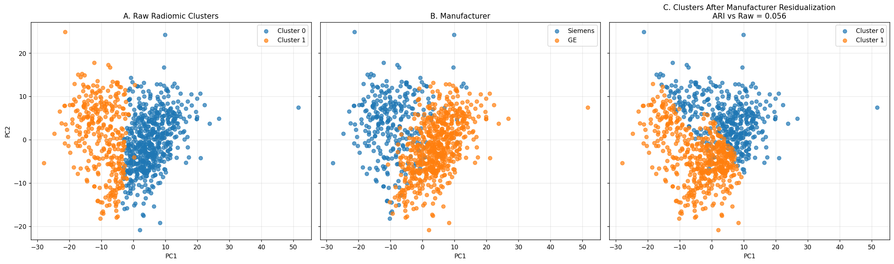
CORRECTION REPLACED THE PHENOTYPE.
Same space, reshuffled patients.
08 · CENTRAL RESULT
Trapped by Stability · Project
Notes:
“Here the alluvial plot shows where patients moved after harmonization. The raw two-cluster solution on the left is not preserved after correction on the right. Many patients are reassigned. ARI around 0.06 is close to random agreement. So harmonization did not simply clean the original phenotype. It replaced it with a different stable structure.”

Slide 20
SIGNAL WEAKENS AFTER ADJUSTMENT.
HR+/HER2+ subgroup · n = 101 · 10 events.
Unadjusted Cox
Cluster 1 vs Cluster 0
p = 0.020
HR = 4.76
Adjusted for manufacturer
Cluster effect (residual)
p = 0.291
HR = 2.48
Adjusted for cluster
Siemens vs GE
p = 0.200
HR = 2.99
0.5
1
2
5
10
20
Hazard Ratio (log-scaled axis)
Only 10 events · two correlated predictors · the signal is not robust enough to support a biomarker claim — not “false”, insufficiently robust.
09 · CLINICAL ROBUSTNESS
Trapped by Stability · Project
Notes:
Walk through the forest plot. "Unadjusted HR 4.76 with confidence interval crossing well above 1." "Once we adjust for manufacturer, the cluster HR drops to 2.48 and the CI now includes 1." "Manufacturer itself, in the same model, is also non-significant but co-correlated." Conclude: "Do not say the signal is false. Say it is not robust enough to support a biomarker claim.“
“The survival signal also weakens after adjustment. The unadjusted Cox model gave HR = 4.76 and p = 0.020. After adjusting for manufacturer, the cluster hazard ratio dropped to 2.48 and became non-significant, with p = 0.291. The confidence interval becomes very wide and includes 1, meaning we cannot conclude a reliable effect. I would not say the signal is false. I would say it is not robust enough to support a biomarker claim.”

Slide 21
RESIDUAL STRUCTURE AFTER CORRECTION
Cleaner is not biological.
1
VENDOR-DECOUPLED
2
SIZE-LINKED
3
NOT VALIDATED
Manufacturer association removed.
Strongest association is with tumour size.
No robust subtype or recurrence association.
Residualized p = 0.53
ComBat p = 0.18
Bounding-box volume
p ≈ 10⁻²⁶
Subtype p ≥ 0.7
Recurrence p ≈ 0.05 – 0.07 (borderline)
The residual structure is statistically cleaner — but biologically unvalidated.
09 · CLINICAL ROBUSTNESS
Trapped by Stability · Project
Notes:
Three quick points. 30 seconds each. Land on: "vendor-decoupled and size-linked is not the same as biologically validated.“
“After correction, the new structure is cleaner with respect to vendor. Manufacturer association is removed. But cleaner does not mean biological. The strongest remaining association is tumor bounding-box volume, with p around 10 to the minus 26. In simple terms, after removing scanner effects, the cluster seems more related to tumor size than recurrence or subtype. That may be real structure, but it is not validated as a biological phenotype.”

Slide 22
11 · CONCLUSION
The negative result is the result.
A radiomic partition can be internally stable, visually coherent, and apparently prognostic — while failing to represent a biological subgroup.
The discovery is not the raw phenotype. The discovery is the failure mode.
Notes:
Slow down. State the headline. Pause for at least 2 seconds. Make sure the audience understands: this is the contribution of the work. The negative result is the result.
“The negative result is the result. The raw phenotype looked stable, interpretable, and apparently prognostic. But falsification showed that it failed biological identity. The contribution of this work is not a new radiomic subtype. The contribution is identifying a failure mode: a stable technical artifact can masquerade as a biological phenotype.”

Slide 23
A PROPOSED MINIMUM STANDARD
Before calling a cluster a phenotype, stress-test it.
01
02
Multi-condition discovery
Harmonization sensitivity
Repeat discovery across raw, residualized, ComBat-harmonized, and vendor-restricted conditions.
Repeat the headline clinical test after residualization, ComBat, and manufacturer adjustment.
03
04
Partition identity check
Within-vendor sanity check
Report ARI / NMI of harmonized labels versus raw labels — stability is not enough.
Verify that known biological structure is recoverable when vendor heterogeneity is removed.
Stability should start validation, not end it.
12 · RECOMMENDATIONS
Trapped by Stability · Project
Notes:
Four-point summary of the proposed minimum standard. Read each card briefly. Close on: "Stability should START validation, not end it.“
Before calling an unsupervised cluster a phenotype, we should stress-test it. Repeat discovery across raw, residualized, ComBat, and vendor-restricted conditions. Repeat the clinical test after harmonization and manufacturer adjustment. Report identity metrics such as ARI or NMI against the raw labels. And perform within-vendor sanity checks. Stability should start validation, not end it.”

Slide 24
CLOSING
Limitations and conclusion.
LIMITATIONS
CONCLUSION
10 events in the HR+/HER2+ subgroup — wide confidence intervals.
Manufacturer is a proxy — TR, TE, matrix, field strength, geometry, coils, reconstruction all co-vary.
Feature-domain correction only — image-domain harmonization was not available.
k-means in PCA space is transparent but not exhaustive.
Harmonization is not ground truth — treat it as a challenge test, not validation.
1
Stable radiomic clusters can be technically induced.
2
Harmonization can preserve stability while destroying identity.
3
Acquisition-aware falsification should become a minimum standard.
13 · LIMITATIONS & CONCLUSION
Trapped by Stability · Project
Notes:
State limitations cleanly without minimizing them. Then deliver the 3 conclusions slowly — read each one. Conclusion 3 is the methodological pitch: acquisition-aware falsification as a minimum standard.
“The limitations matter. The HR+/HER2+ subgroup had only 10 events, so survival estimates are unstable.
Manufacturer is only a proxy; TR, TE, matrix, field strength, geometry, coils, and reconstruction co-vary.
We only had feature-domain correction, not image-domain harmonization.
K-means in PCA space is transparent but not exhaustive.
And harmonization is not ground truth. The conclusion is that stable radiomic clusters can be technically induced, and acquisition-aware falsification should become a minimum standard.”
“Just because a signal disappears or changes after harmonization does not automatically prove the original signal was false.”

Slide 25
Project· 2026
“Stability should be treated as the beginning of validation — not the end.”
Thank you.
Questions & discussion.
Notes:
Hold this slide. Invite questions. End calmly.
“Thank you. The main takeaway is that stability should be treated as the beginning of validation, not the end. I am happy to take questions.”

Slide 26
APPENDIX
Backup slides for Q&A
Notes:
Backup section.

Slide 27
BACKUP B1
Preprocessing & QC summary.
Step | Patients | Features | Result
Raw imaging matrix | 922 | 529 | Numeric MRI-derived radiomic features.
Missingness filter (<5%) | 922 | 529 | No variables exceeded threshold.
Low-variance filter (≥2 unique) | 922 | 529 | No variables removed.
Median imputation | 922 | 529 | Residual missing values imputed feature-wise.
Z-score standardization | 922 | 529 | Mean-centered, variance-scaled.
Final analysis matrix | 922 | 529 | Input to PCA, clustering, harmonization, survival.
APPENDIX · B1
Trapped by Stability · Project
Notes:
“This table shows the analysis matrix construction. We started with 922 patients and 529 imaging features. No variables were removed by the missingness or low-variance filters. Remaining missing values were median-imputed, and all features were z-score standardized before PCA, clustering, harmonization, and survival modeling.”

Slide 28
BACKUP B2
Top raw cluster-separating features.
Feature | Mean C0 | Mean C1 | Δ (C1−C0) | Cohen d | q-value
SER entropy | −0.552 | 0.964 | 1.516 | 2.214 | 1.1 × 10⁻¹⁰⁰
SER sum entropy | −0.552 | 0.963 | 1.515 | 2.211 | 2.7 × 10⁻¹⁰⁹
SER std. dev. | 0.550 | −0.960 | −1.510 | −2.196 | 2.4 × 10⁻¹⁶⁴
SER difference entropy | −0.546 | 0.953 | 1.499 | 2.162 | 1.2 × 10⁻¹⁰³
SER homogeneity (2) | 0.540 | −0.942 | −1.483 | −2.114 | 2.5 × 10⁻⁹⁵
SER homogeneity (1) | 0.539 | −0.940 | −1.479 | −2.104 | 1.7 × 10⁻⁹⁷
PE std. dev. | 0.532 | −0.927 | −1.459 | −2.047 | 1.7 × 10⁻¹⁶⁴
APPENDIX · B2
Trapped by Stability · Project
Notes:
“These are the top raw cluster-separating features. Most are SER, PE, and enhancement-texture descriptors. They explain why the cluster looked vascularity-like. But the main talk shows why this feature story is not enough: acquisition sensitivity must be ruled out before using biological language.”

Slide 29
BACKUP B3
Raw cluster × subtype, raw cluster × recurrence.
BY MOLECULAR SUBTYPE (raw cluster)
Cluster | Luminal-like | HR+/HER2+ | HER2-only | TNBC
0 | 383 | 56 | 41 | 106
1 | 212 | 48 | 18 | 58
BY RECURRENCE EVENT (raw cluster)
Cluster | No recurrence | Recurrence
0 | 527 | 57
1 | 306 | 30
APPENDIX · B3
Trapped by Stability · Project
Notes:
“This table supports the claim that the raw cluster was not meaningfully subtype-defined or recurrence-defined in the whole cohort. Molecular subtype and recurrence distributions do not show the same overwhelming separation that manufacturer showed.”

Slide 30
BACKUP B4
Full stability vs. identity table.
Condition | Mean bootstrap ARI | SD ARI | ARI vs. raw labels | Interpretation
Raw | 0.893 | 0.084 | 1.000 | Stable baseline partition (reference).
Manufacturer residualized | 0.919 | 0.047 | 0.056 | Stable, but nearly unrelated to raw labels.
ComBat harmonized | 0.903 | 0.058 | 0.065 | Stable, but nearly unrelated to raw labels.
APPENDIX · B4
Trapped by Stability · Project
Notes:
“This is the numerical version of the central result. Raw bootstrap ARI was 0.893. Residualized and ComBat clusters were also stable, with ARI around 0.919 and 0.903. But their ARI against the raw labels was only about 0.056 and 0.065. Stability stayed high; identity collapsed.”

Slide 31
BACKUP B5
Manufacturer-adjusted Cox model, HR+/HER2+ subgroup.
Covariate | Coefficient | Hazard ratio | 95% CI | p-value | Interpretation
Raw cluster (1 vs 0) | 0.908 | 2.48 | 0.46 – 13.39 | 0.291 | Cluster effect attenuates; loses significance.
Manufacturer (Siemens vs GE) | 1.097 | 2.99 | 0.56 – 16.03 | 0.200 | Non-significant in sparse subgroup; correlated with cluster.
10 events; two correlated predictors · estimates are unstable.
APPENDIX · B5
Trapped by Stability · Project
Notes:
“This is the manufacturer-adjusted Cox model in the HR+/HER2+ subgroup. The raw cluster effect drops and becomes non-significant. Manufacturer is also non-significant, but the model is underpowered because there are only 10 events and two correlated predictors. So this model should be read as a robustness failure, not as a definitive causal explanation.”

Slide 32
BACKUP B6
Prespecified biomarker criteria — full table.
Criterion | Observed result | Status
Endpoint association | Cluster-level recurrence signals were borderline or non-robust; adjusted clinical models did not establish a durable association. | Not met
Incremental predictive value | Radiomic / vascularity-augmented models did not improve recurrence prediction beyond clinical features in nested CV. | Not met
Within-vendor direction consistency | Direction and magnitude were not sufficiently reliable across vendor-restricted analyses to support a biomarker claim. | Not met
Overall conclusion | Residual structure is vendor-cleaner and size-linked, but is not validated as a biological or clinical phenotype in this cohort. | Fails threshold
APPENDIX · B6
Trapped by Stability · Project
Notes:
This table gives the full adjudication. Endpoint association was not robust. Incremental predictive value was not shown. Within-vendor consistency was not sufficient. Therefore, the residual structure fails the biomarker threshold.”

