Slide 1
Attendance Management System
A Modern, Role-Based Web Application
By [Your Name] / [USN]

Slide 2
1. Problem Statement
Traditional attendance methods are manual and paper-based.
High risk of proxy attendance and human error.
Time-consuming administrative consolidation.
Lack of real-time visibility for students and administration.

Slide 3
2. Proposed Solution
A centralized, cloud-ready web application for real-time tracking.
Strict Role-Based Access Control (RBAC) for Admins, Trainers, and Students.
Interactive dashboard for rapid attendance marking by trainers.
Real-time analytics and transparency for students.

Slide 4
3. System Architecture & Tech Stack
Frontend: React (Vite), TypeScript, Tailwind CSS, TanStack Query.
Backend: Java 21, Spring Boot (REST APIs), Spring Data JPA.
Database: PostgreSQL for reliable, relational data storage.
Security: Spring Security with JWT token-based authentication.
Architecture: Client-Server with isolated business logic and presentation layers.

Slide 5
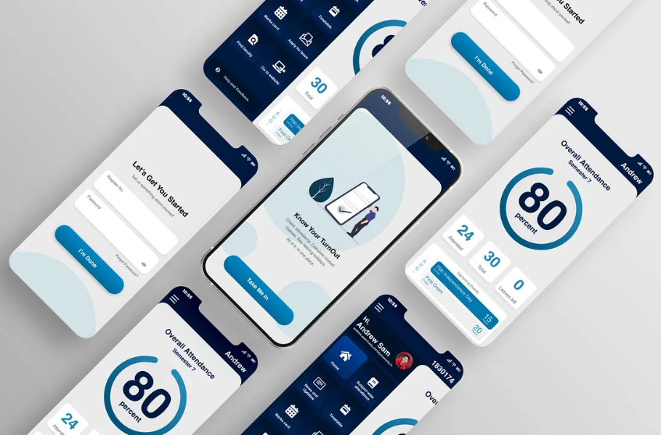
System Interface: Login Portal

Slide 6
System Interface: Admin Dashboard

Slide 7
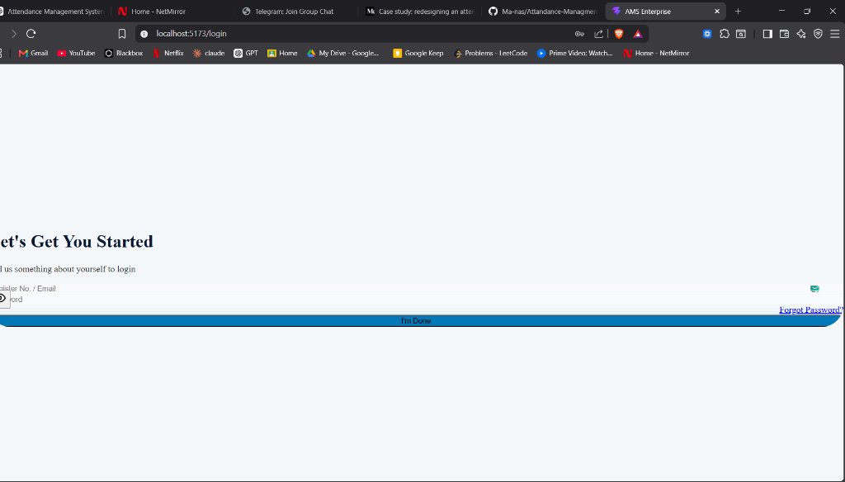
System Interface: Trainer Interface

Slide 8
4. Conclusion & Future Scope
Conclusion:
- Successfully digitized the attendance workflow with a sub-second response rate.
- Reduced administrative overhead significantly.
Future Enhancements:
- Integration with Biometric or RFID scanners.
- Automated warning emails to parents for low attendance.
- Machine Learning analytics to predict student dropout rates.

Slide 9
Thank You
Questions?

