Slide 1
Tilemaps
De basis

Slide 2
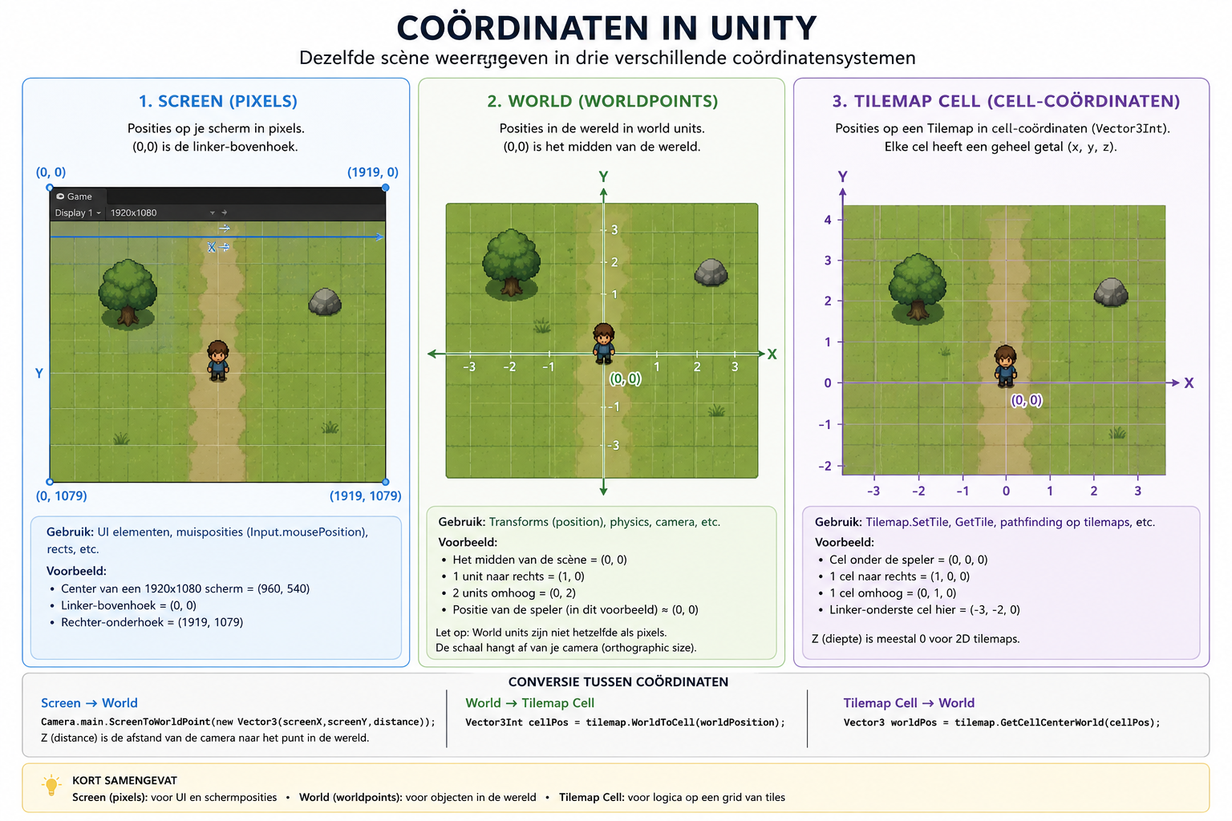

Slide 3
Drie posities van belang
De positie van de muis
Vector3 MousePosition = Input.mousePosition;
De wereldpositie van de muis
Vector3 WorldPosition = Camera.main.ScreenToWorldPoint( MousePosition );
De positie van de Cell waar op is geklikt
Vector3Int CellPosition = myTilemap.WorldToCell( WorldPosition );

Slide 4
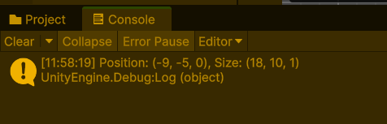
De cellBounds
[SerializeField] Tilemap myTilemap;
BoundsInt bounds;
void Start()
{
bounds = myTilemap.cellBounds;
Debug.Log(bounds);
}

Slide 5
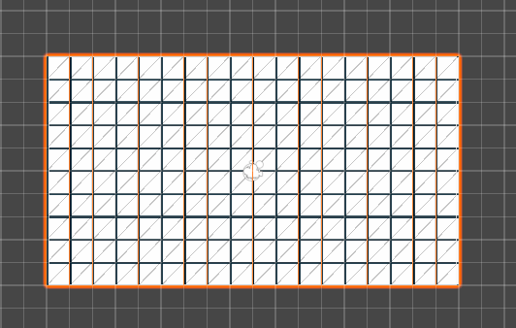
De CellBounds
BoundsInt bounds = tilemap.cellBounds;
Vector3Int position = bounds.position;
int sizeY = bounds.size.y;
int sizeX = bounds.size.x;

Slide 6
Iteratie door een TileMap
for(int i = 0; i < bounds.size.x; i++)
{
for (int j = 0; j < bounds.size.y; j++)
{
Vector3Int pos = new Vector3Int(i, j, 0);
}
}
 | i=0 | i=1 | i=2 | i=3
j=0 | (0,0) | (1,0) | (2,0) | (3,0)
j=1 | (0,1) | (1,1) | (2,1) | (3,1)
j=2 | (0,2) | (1,2) | (2,2) | (3,2)
j=3 | (0,3) | (1,3) | (2,3) | (3,3)
j=4 | (0,4) | (1,4) | (2,4) | (3,4)

Slide 7

De CellBounds
 | i=0 | i=1 | i=2 | i=3
j=0 | (0,0) | (1,0) | (2,0) | (3,0)
j=1 | (0,1) | (1,1) | (2,1) | (3,1)
j=2 | (0,2) | (1,2) | (2,2) | (3,2)
j=3 | (0,3) | (1,3) | (2,3) | (3,3)
j=4 | (0,4) | (1,4) | (2,4) | (3,4)
(-2,2) | (-1,2) | (0,2) | (1,2)
(-2,1) | (-1,1) | (0,1) | (1,1)
(-2,0) | (-1,0) | (0,0) | (1,0)
(-2,-1) | (-1,-1) | (0,-1) | (1,-1)
(-2,-2) | (-1,-2) | (0,-2) | (1,-2)
Iteratie
Tilemap

Slide 8
Declareren van de CellBounds
[SerializeField] Tilemap myTilemap;
BoundsInt bounds;
int width, height;
int x0, y0;
void Start()
{
bounds = myTilemap.cellBounds;
width = bounds.size.x;
height = bounds.size.y;
x0 = bounds.xMin;
y0 = bounds.yMin;
}

Slide 9
Itereren door de tileMap
for(int i = 0 + x0; i < bounds.size.x; i++)
{
for (int j = 0 + y0; j < bounds.size.y; j++)
{
Vector3Int pos = new Vector3Int(i, j, 0);
}
}

Slide 10
Opdracht
Itereer bij een muisklik door de tilemap en
kleur de cell die de muis aanwijst rood
kleur alle andere cellen (die niet aangewezen worden) wit

