Slide 1
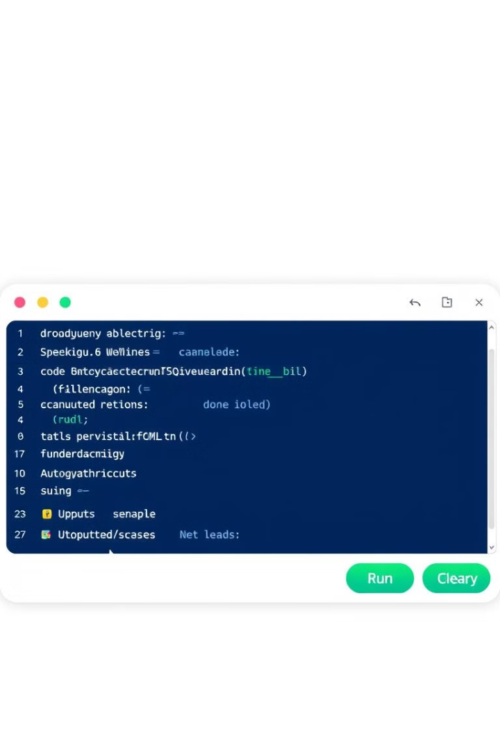
Python Sorting Algorithm Compiler
This presentation explores the "Python Sorting Algorithm Compiler," an interactive desktop application designed to enhance understanding of sorting and searching algorithms.

Slide 2
Project Overview
Objective
Features
The primary objective is to create an educational tool that helps users understand algorithm implementation, experiment with Python code execution, and learn about Big-O complexities and execution times.
The application features a predefined algorithm library, a user interface with a dropdown menu, code editor, output console, and buttons, and performance insights including runtime and Big-O complexity analysis.

Slide 3
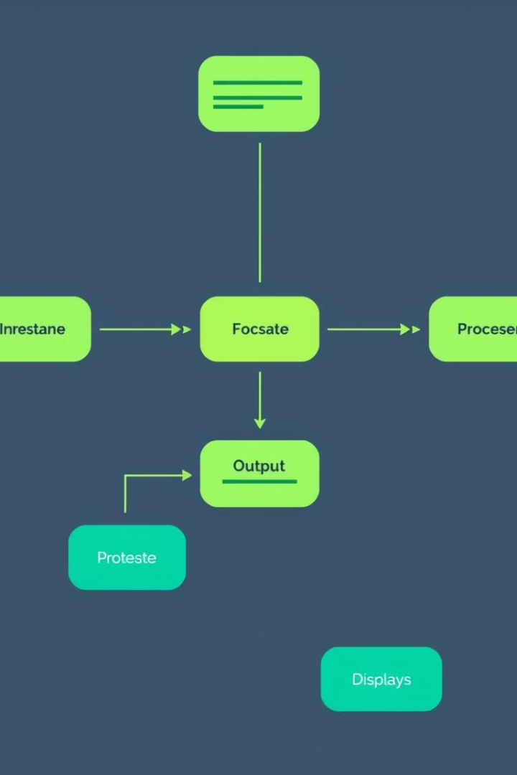
Technical Specifications
1
Technology Stack
2
Key Functionalities
The application utilizes the Flet framework for the frontend and Python's native libraries for the backend.
Key functionalities include a dropdown menu for algorithm selection, Python's exec() function for code execution, dynamic output capturing, and clear functionality for resetting the workspace.
3
Algorithms
4
Performance Metrics
The application includes sorting algorithms such as Merge Sort, Quick Sort, Bubble Sort, Selection Sort, and Insertion Sort, as well as searching algorithms like Linear Search and Binary Search.
Performance metrics include runtime calculation and Big-O complexity analysis, comparing user-modified code to predefined templates.

Slide 4
Design and Implementation
User Interface
Application Flow
The user interface is designed with responsiveness to support various screen sizes and includes components like dropdowns, text fields, buttons, and labeled sections. Visual aesthetics include a light theme with a background color of #6A1E55 and buttons styled with rounded corners and a gradient color scheme.
The application flow involves the user selecting an algorithm, loading the corresponding Python code into the editor, executing the code, viewing the output and performance metrics, and using the clear functionality to reset the workspace.

Slide 5






Usage Workflow
Launch
Launch the application.
Select
Select an algorithm from the dropdown menu.
View/Edit
View or edit the algorithm's code in the editor.
Run
Click "Run" to execute the algorithm.
Observe
Observe the sorted/search results, Big-O complexity, and runtime in the output console.
Clear
Use "Clear" to reset for another session.

Slide 6
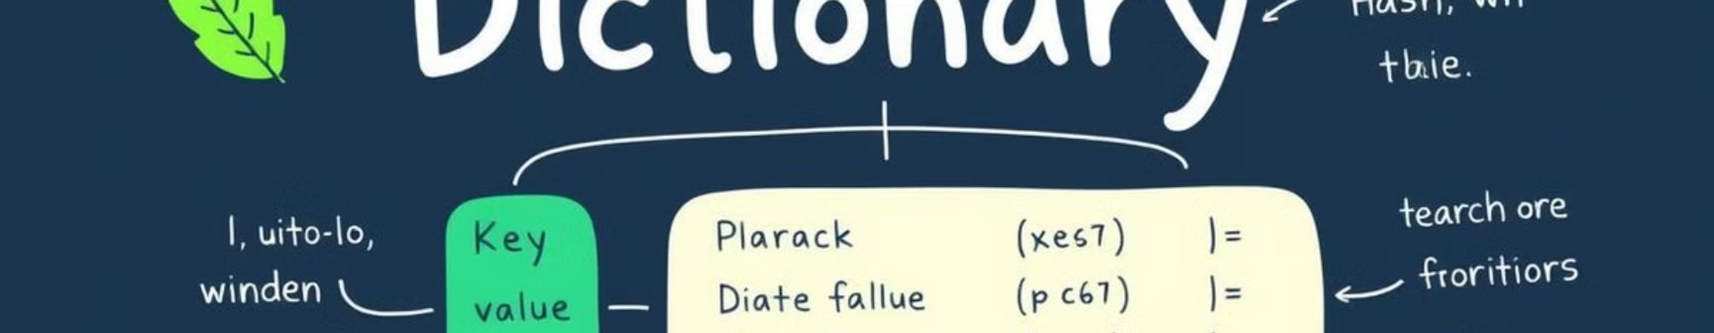
Code Structure
Algorithm Dictionary
Main Components
Logic Highlights
The application utilizes an algorithm dictionary to store predefined algorithms and their Big-O complexities. For example, {"Merge Sort": {"code": "def merge_sort...", "big_o": "O(n log n)"}}.
Main components include a dropdown for algorithm selection, a TextField for code editing and output display, and a Button for code execution and clearing fields.
Logic highlights include redirecting stdout to capture execution logs, dynamically calculating runtime for each algorithm, and validating user-modified code against predefined templates.

Slide 7
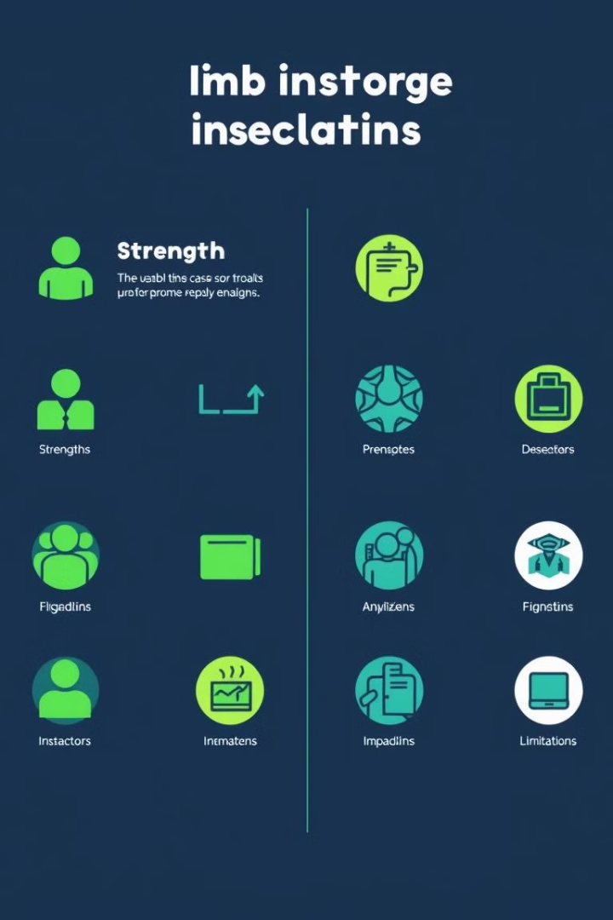


Strengths and Limitations
Strengths
Limitations
The application is an interactive and educational tool for algorithm learning, features a clear and minimalistic UI, and provides real-time insights into algorithm performance.
Limitations include execution restricted to defined algorithms, no error-handling for advanced Python syntax, and limited visualization capabilities.

Slide 8




Future Enhancements
Visualization
1
Add support for visualizing algorithm execution steps.
Algorithm Expansion
2
Include more algorithms (e.g., Heap Sort, Radix Sort).
User-Defined Scripts
3
Enable loading user-defined Python scripts.
Dark Mode
4
Implement a dark mode for better usability.

