Slide 1
APPLICATIONS OF SPREADSHEET

Slide 2
Lyka is interested in keeping track of her weekly allowance. She must learn more about spreadsheets to stay organized in the Spreadsheet. Can we clarify the topic of spreadsheets for her?

Slide 3
This project emphasizes the learning of applications of a Spreadsheet and highlighting the value of spreadsheets in daily life.

Slide 4
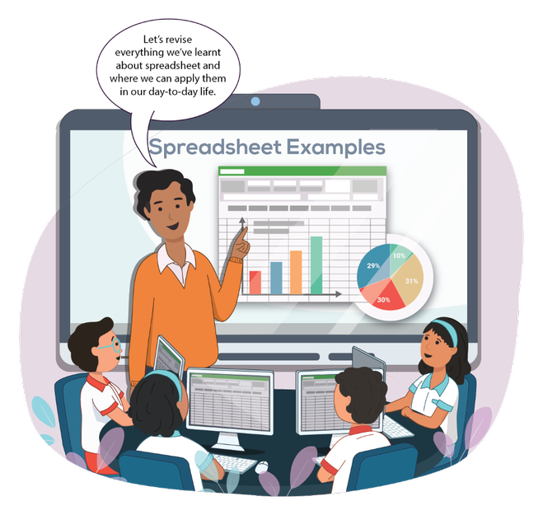
To gain knowledge about Spreadsheets in detail.
To explore the applications of a Spreadsheet.
To recall and practice everything about spreadsheets that we learnt in the previous lessons.

Slide 5


Spreadsheets
A spreadsheet can be used to complete different kinds of tasks. It can be used in various ways.

Slide 6
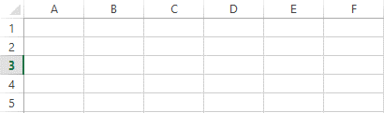
Recall
A spreadsheet is a computer program that looks like a worksheet and is used to organise, analyse, and store data. It consists of rows and columns.

Slide 7
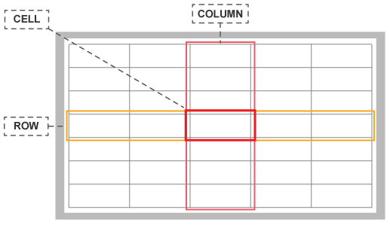
A spreadsheet contains cells in a grid of rows and columns.
Information can be stored in cells in the form of numbers or words.

Slide 8
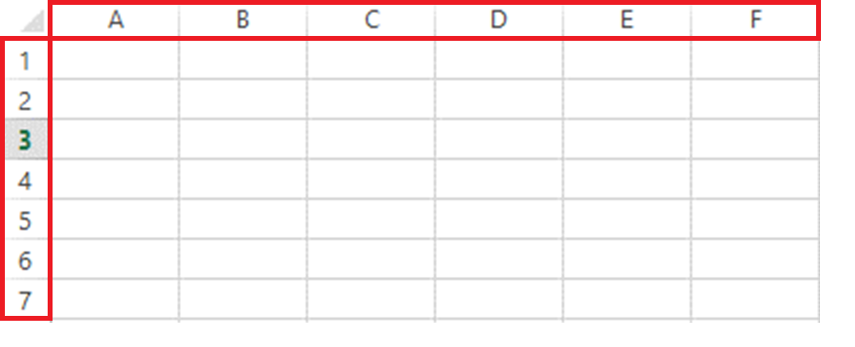
Columns are denoted by alphabets and rows are denoted by numbers.

Slide 9
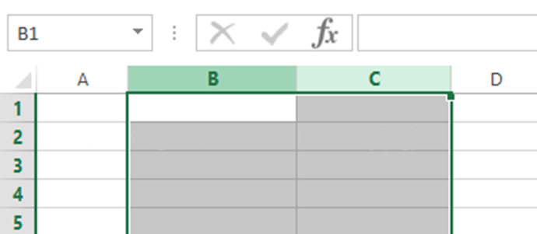
The height of rows and width of columns can be changed to fit the information inside the cell.

Slide 10
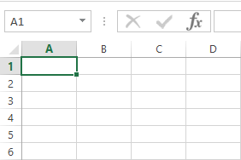
Every cell has a unique name called a ‘cell reference’. It is made up of its column heading and row number.
Example: The first cell in a spreadsheet is A1, since the column heading is ‘A’ and the row number is ‘1’

Slide 11
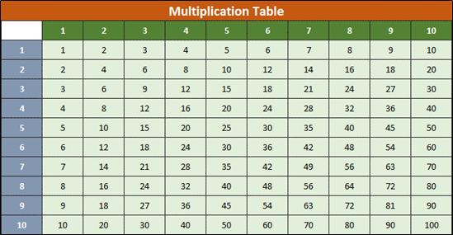
Uses of Spreadsheet
Multiplication Table
A multiplication table can be created with spreadsheet formulas. A table like this lets us view multiples of different numbers.
We use a multiplication formula for this kind of table like, C4 = C$3 * $B4

Slide 12
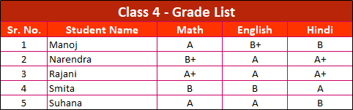
Grade list
A grade list helps us store and analyse student grades for various subjects.

Slide 13
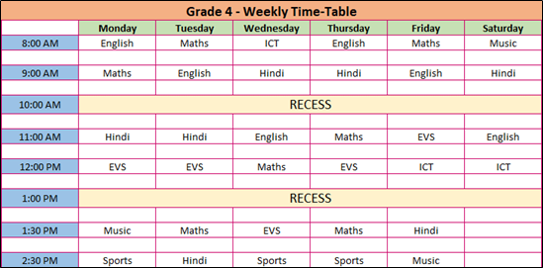
Class Timetable
This kind of spreadsheet arranges classes for each day and helps us remember the weeks’ timetable.

Slide 14
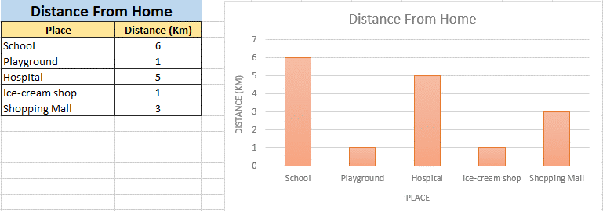
Distance chart
The Bar Graph option is used to create a distance chart. A distance chart helps us analyse the distance between different locations.

Slide 15

A Spreadsheet stores information in columns and rows. This arrangement of information can make calculations simple and accurate.
Numbers, texts, charts, graphs, and formulas can be added in a spreadsheet. This can make it easier to understand and analyse the information.

Slide 16

Bytes
A spreadsheet can have up to 512 fonts.
It has 1048576 rows ranging from 1 to 1048576.
It has 16384 columns ranging from A to XFD.

Slide 17

What is the Grade List?
What is a Cell Reference?
Explain the uses of a Spreadsheet.

Slide 18

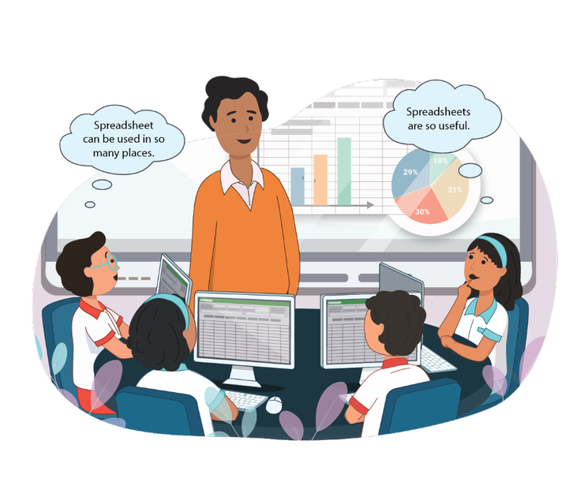
Create a spreadsheet displaying a chart and graph on the topic of your favourite books

