Slide 1
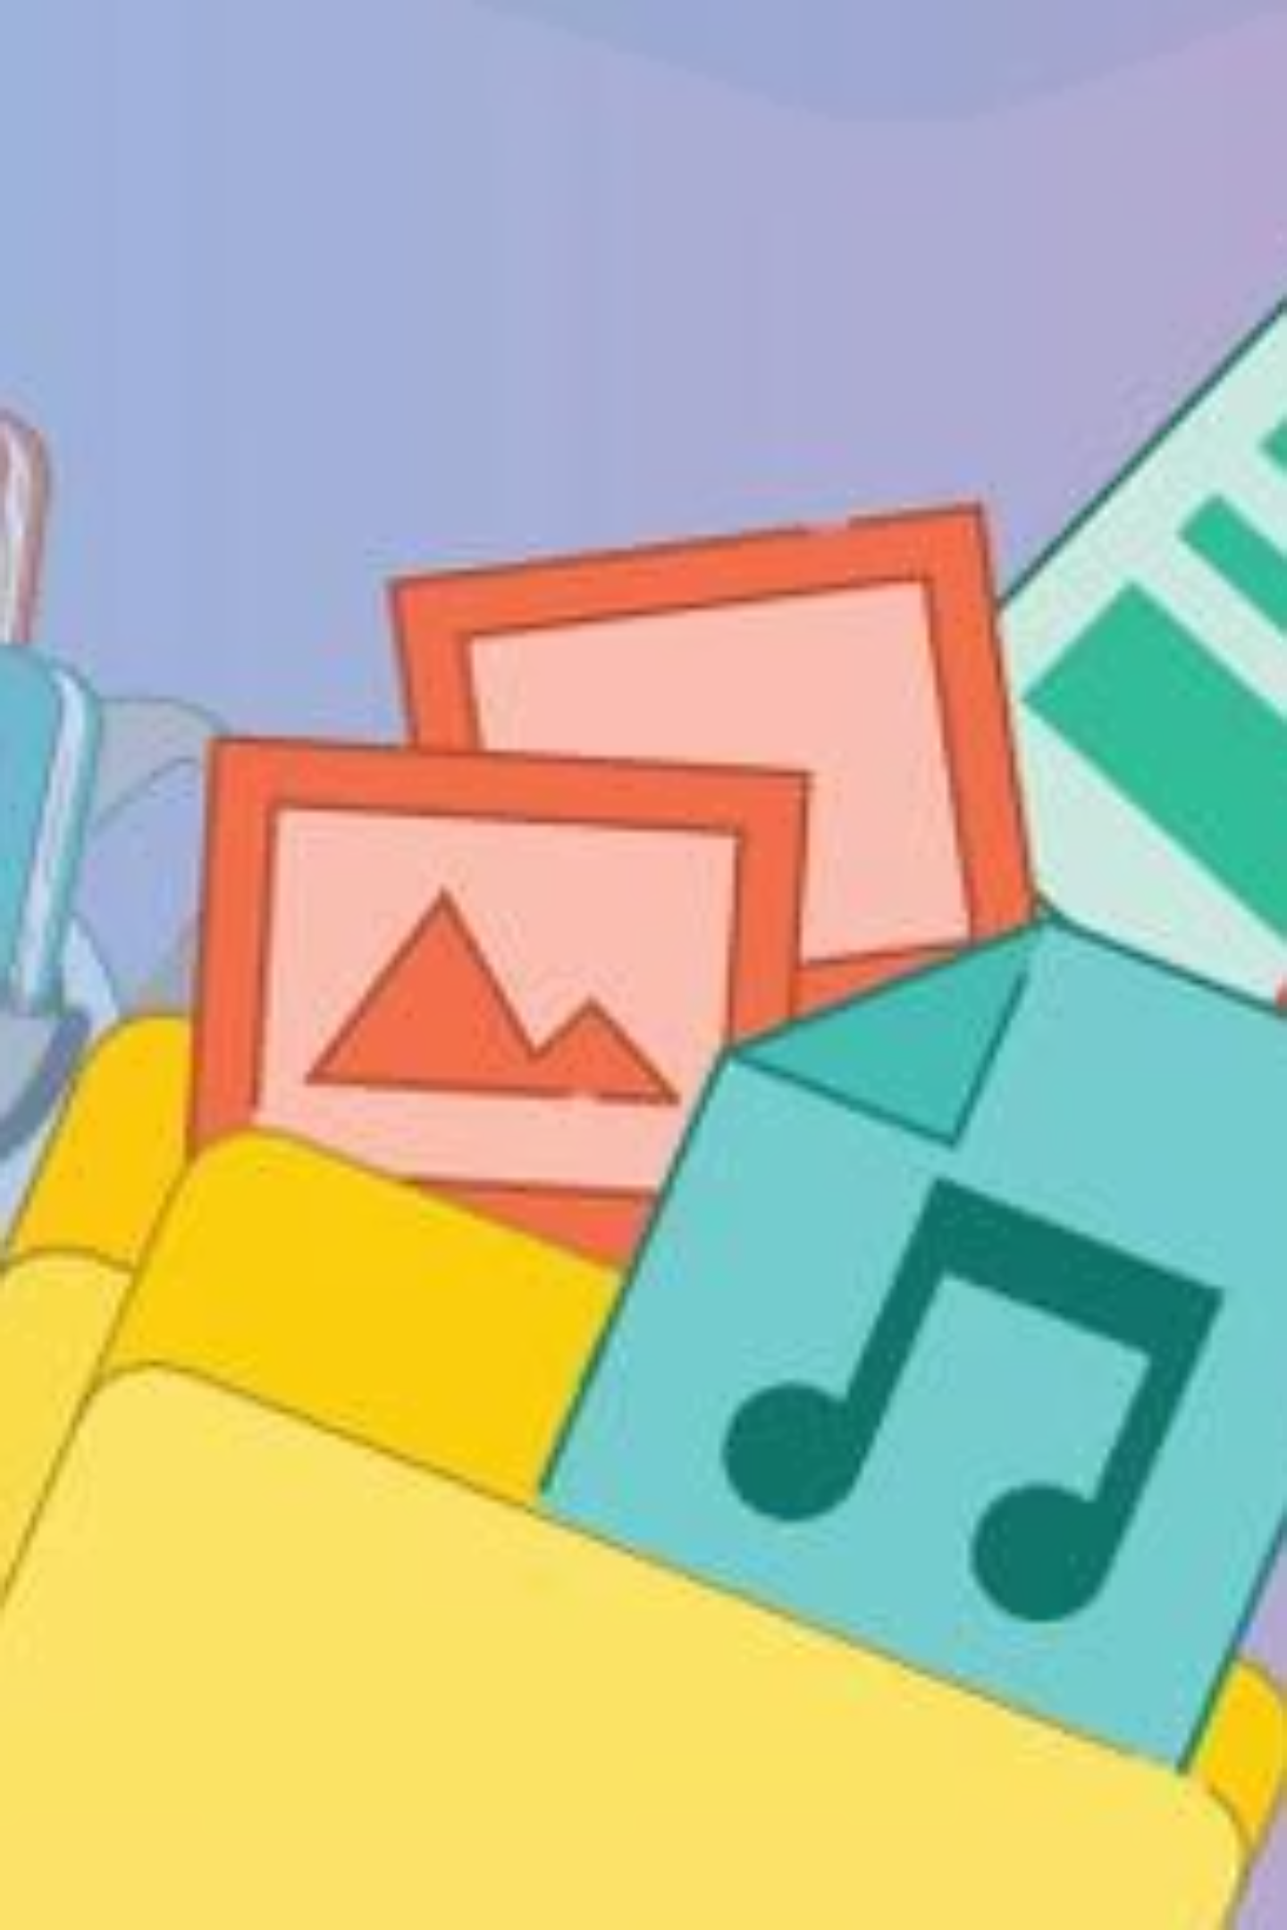
CHAPTER 08
Files and Folders
Computers help us do many things! We need to keep our work safe and organised so we can find it easily. That's where Files and Folders come in! 🎒💻

Slide 2
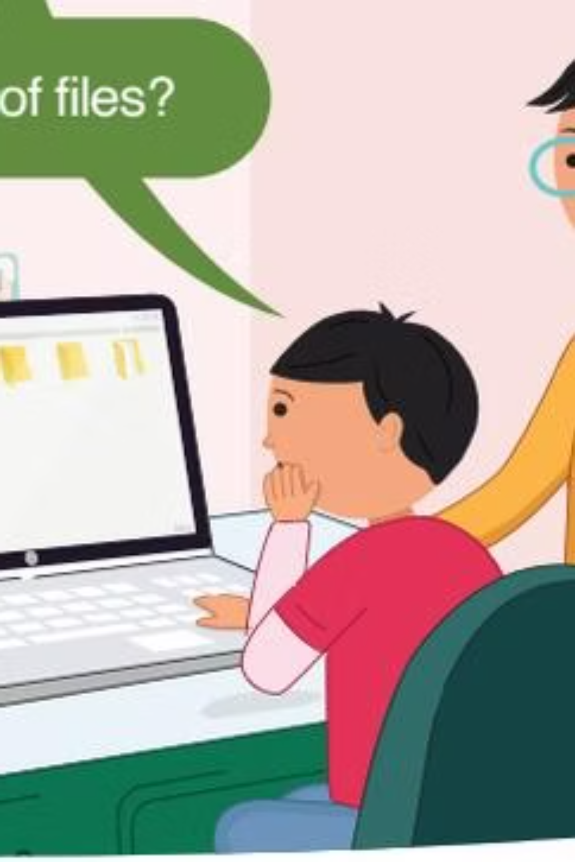
What is a File? 📄
A file saves information on a computer. It can be of any type. Every picture you draw, every song you hear, every story you write — they are all files!

Slide 3



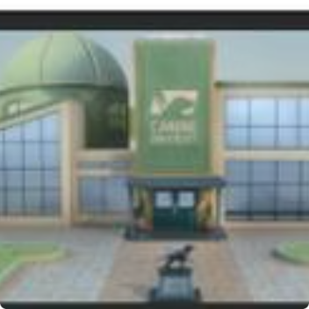
Types of Files 🗂️
There are four main types of files you will find on a computer:
Document 📝
Image 🖼️
Music 🎵
Video 🎬
Text and writing files
Photos and pictures
Songs and sounds
Movies and clips

Slide 4

What is a Folder? 📁
Files are like our notebooks and books. We keep books in a school bag 🎒 — just like that, we keep many files together in a folder! A folder is like a storage box for files on a computer.

Slide 5


Empty vs. Full Folder 👀
Folder with Files
Empty Folder
Has files stored inside!
No files inside yet!

Slide 6
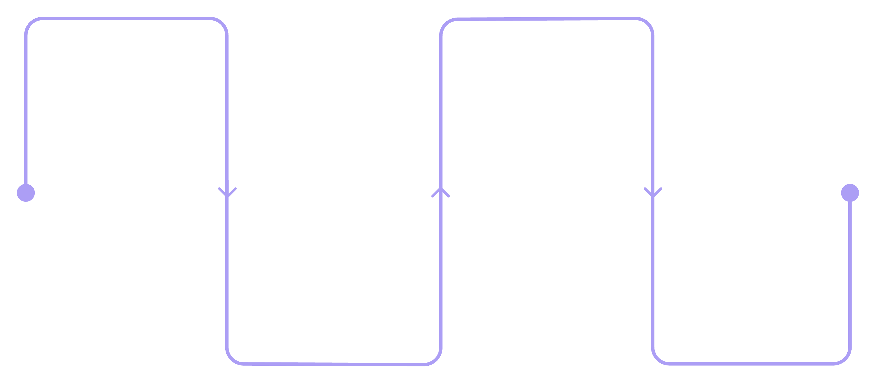
How to Create a Folder 🖱️
Right-click
Folder
On your desktop background
Click Folder from the list
New
Name
Choose the New menu option
Type the folder name
Follow these simple steps on your computer to make a brand new folder anytime you need one!

Slide 7
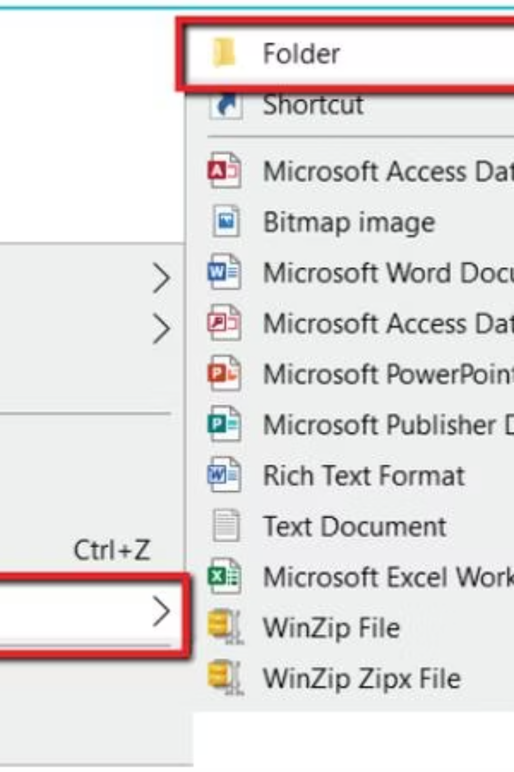
Step by Step 🖥️
01
Right-click on the Desktop
A menu box will appear on screen.
02
Click "New"
Look for the New option in the menu.
03
Click "Folder"
A new folder will appear on the desktop.
04
Type a Name
Give your folder a helpful name, like "My Photos"!

Slide 8


💡 Tip: Give your folder a name that tells you what's inside. Example: "My Photos" for a folder with pictures. This helps you find files easily!

Slide 9
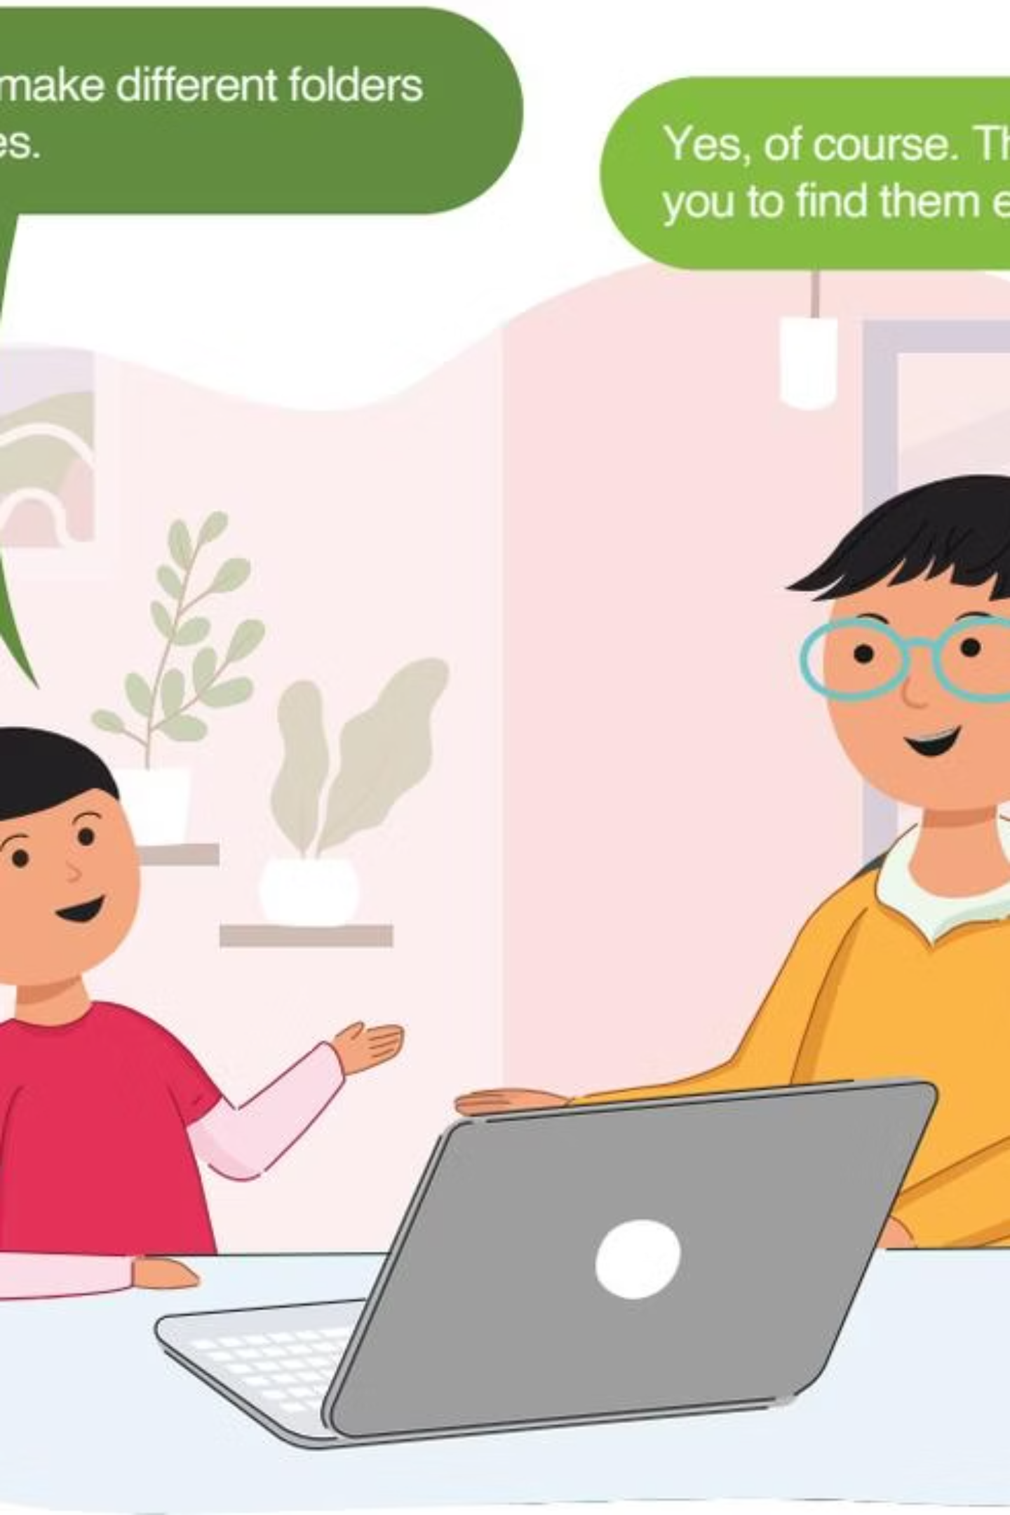

Let's Remember! 🌟
File
Any type of information stored on a computer.
Folder
Stores and organises files of different types.

Slide 10
Exercise Time! ✏️
1
2
3
True or False
Match the Pairs
Circle the Answer
Files are of different types. ______
A folder can save different types of files. ______
Match each file type — Document, Image, Video, Music — to its correct icon! 🎯
Which menu option do you click to create a new folder? Find "New" in the context menu!

