Slide 1

Mazen
Saad
Computer teacher

Slide 2
ICT
Grade 2

Slide 3

Enter the notebook and write the following:

Slide 4
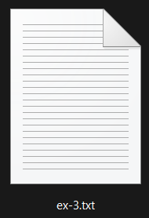

Lesson title
Manage Files and Folders
The Date
2025 / 9 / 7

Slide 5
1- Drives are usually named local Disk followed by an English alphbet label such as (C:), (D:), and (E:). 2- A Memory Device is a computer hardware that saves information. 3- All The softwere are saved in C: drive 4- Tow or more files or folders with same name can not be saved in the same location.

Slide 6
5- Hard Disk is a memory device. 6- on the left side in file explore, you will see alist if files and folders. this list is called the navigation pane. 7- the address bar gives us information about the location of the opened folder. 8- the ribbon contains various options of actions for the files or folders.

Slide 7
Start

Slide 8

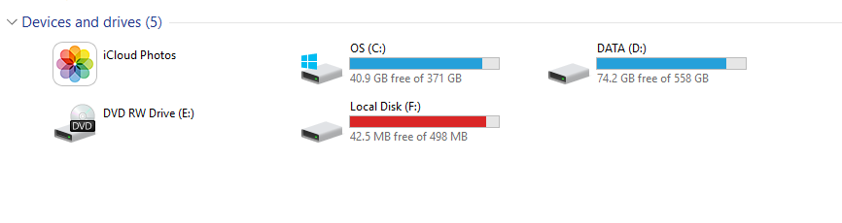



1- Drives are usually named local Disk followed by an English alphbet label such as (C:), (D:), and (E:).

Slide 9
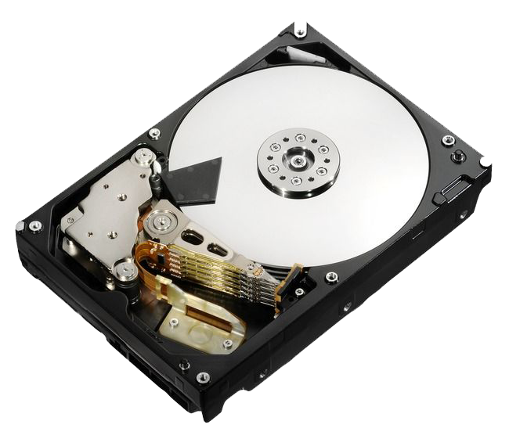
2- A Memory Device is a computer hardware that saves information.

Slide 10
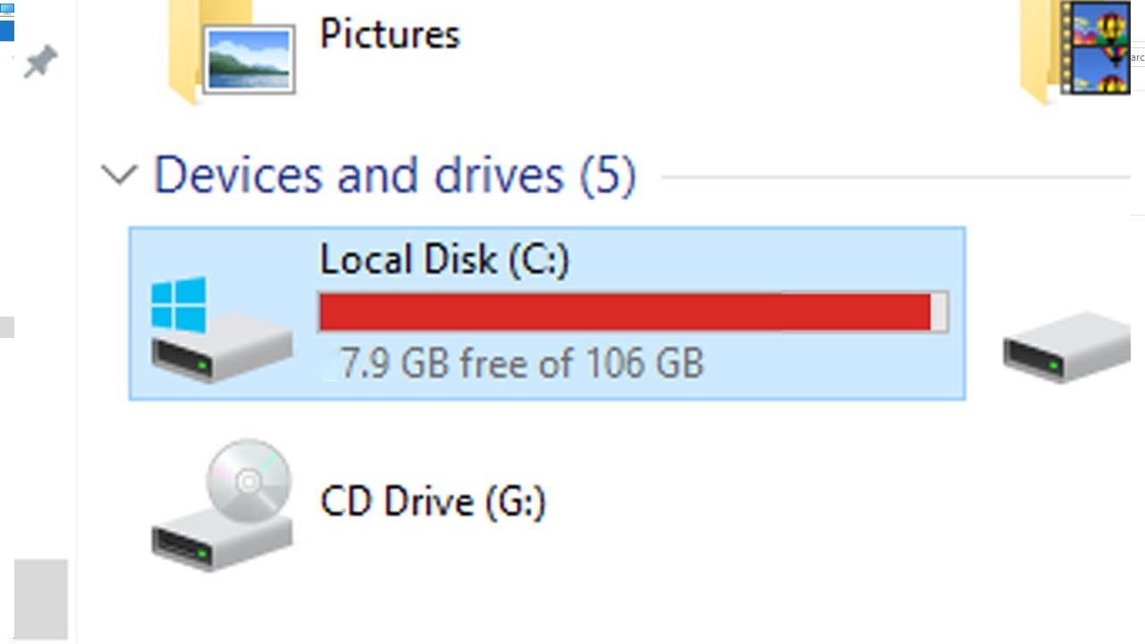
3- All The softwere are saved in C: drive

Slide 11

We follow the explanation
Yes Or No

Slide 12


4- Tow or more files or folders with same name can not be saved in the same location.
file1
file1

Slide 13
5- Hard Disk is a memory device.

Slide 14

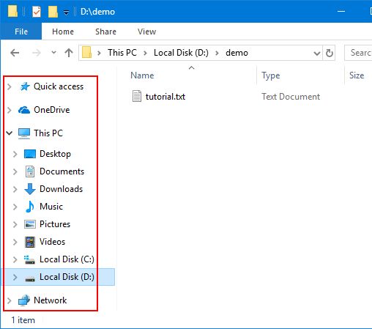
6- on the left side in file explore, you will see alist if files and folders. this list is called the navigation pane.

Slide 15

Exercise

Slide 16
Page Number 04

Slide 17

Question A: Tick the correct answer. 1. Which of these is a proper label for a drive on the computer? a. Any Name b. Alphabet c. Numbers d. Alphabet and Numbers

Slide 18
Question A: Tick the correct answer. 1. Which of these is a proper label for a drive on the computer? a. Any Name b. Alphabet c. Numbers d. Alphabet and Numbers

Slide 19

Question B: Fill in the blanks. 2. The memory device that is used to store information in a computer is called as a _____

Slide 20
2. The memory device that is used to store information in a computer is called as a _____ HardDisk______

