Slide 1

Mazen
Saad
Computer teacher

Slide 2
ICT
Grade 3

Slide 3

Enter the notebook and write the following:

Slide 4
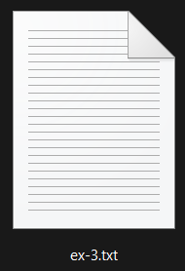

Lesson title
Inside a computer
The Date
2025 / 9 / 7

Slide 5
1- the power supply unit (psu) provides electric power to the computer 2- Motherboard it connects all the parts of the computer with each other. 3- ram stores data for a short amount of time 4- hard disk it is the largest data storage device in the computer

Slide 6
5- a disk drive is inside the cpu cabinet or the the laptop.

Slide 7
Start

Slide 8

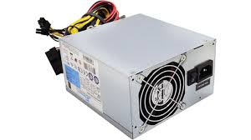



1- the power supply unit (psu) provides electric power to the computer

Slide 9
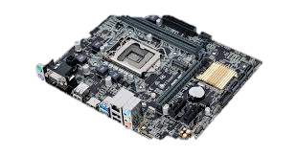
2- Motherboard it connects all the parts of the computer with each other.

Slide 10
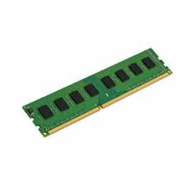
3- ram stores data for a short amount of time

Slide 11
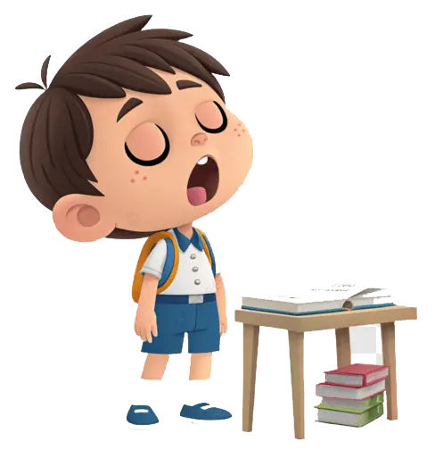
We follow the explanation
Yes Or No

Slide 12
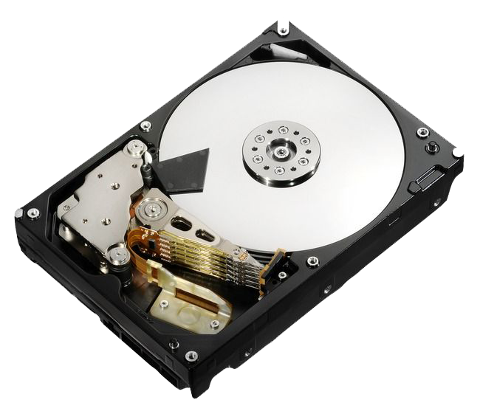
4- hard disk it is the largest data storage device in the computer

Slide 13


Exercise

Slide 14
Page Number 04

Slide 15


Slide 17


