Slide 1
Photo Album
by Bradaric, Maja

Slide 2
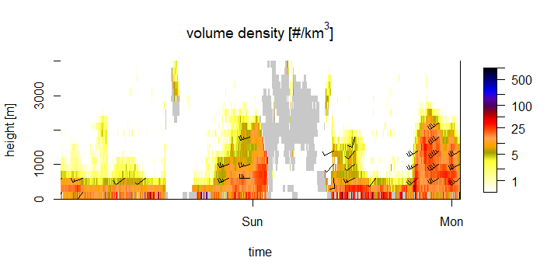
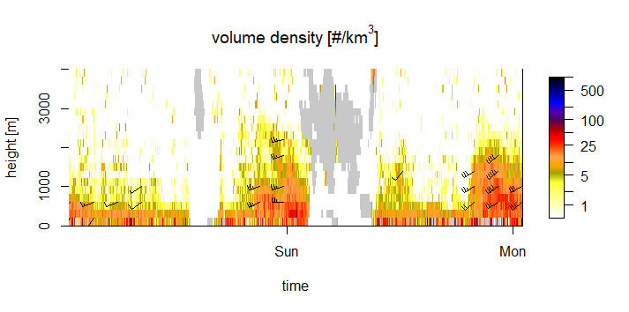
10/03/2018-11/03/2018
land
sea
775.88
827.48
888.36
667.79

Slide 3
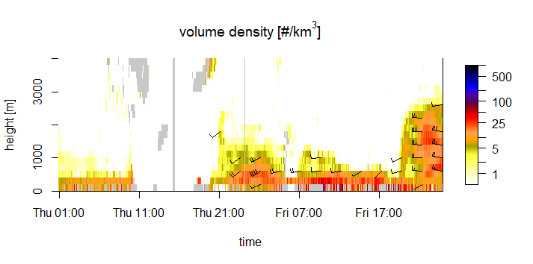
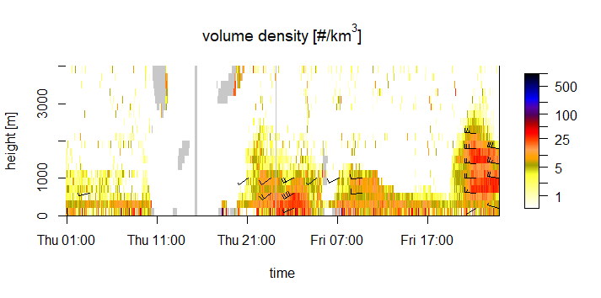
15/03/2018-16/03/2018
land
sea
567.09
818.61
885.58
664.84

Slide 4
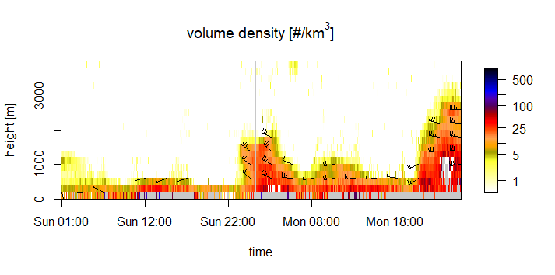
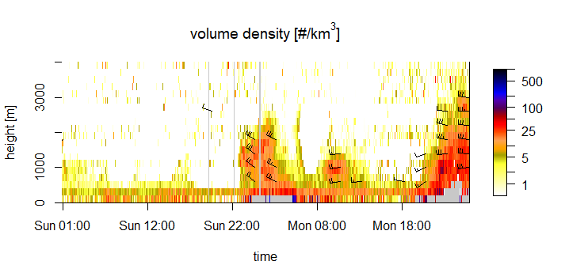
25/03/2018-26/03/2018
land
sea
464.15
805
610.17
842.81

Slide 5
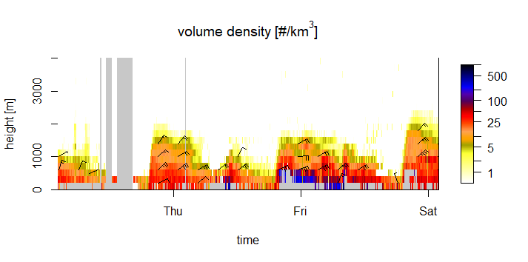
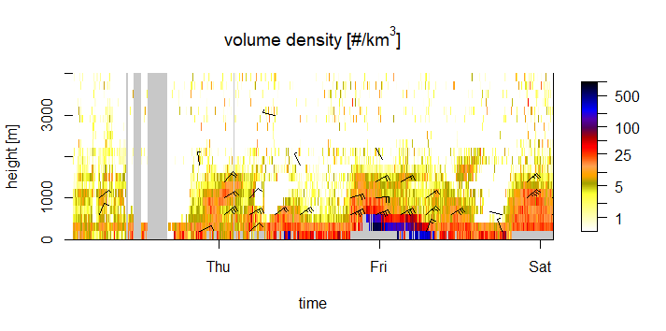
17/10/2018-19/10/2018
land
sea
398.71
248.39
543.31
686.31
227.6
626.68

Slide 6
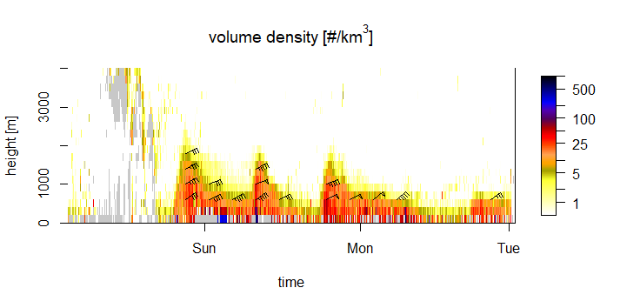
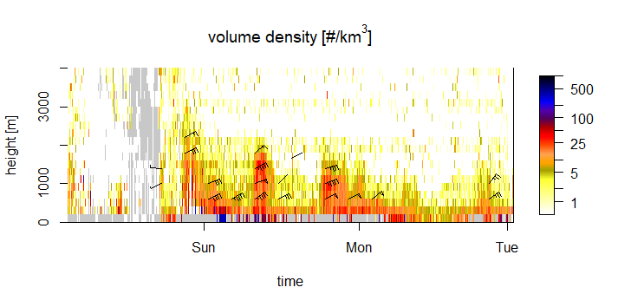
27/10/2018-29/10/2018
land
sea
279.6
257.3
195.08
383.54
393.01
534.0

