Slide 1

Neural Network Models for Object Recognition using CIFAR-10 dataset
A brief overview of the task: Building a Convolutional Neural Network (CNN) for object recognition using the CIFAR-10 dataset.

Slide 2
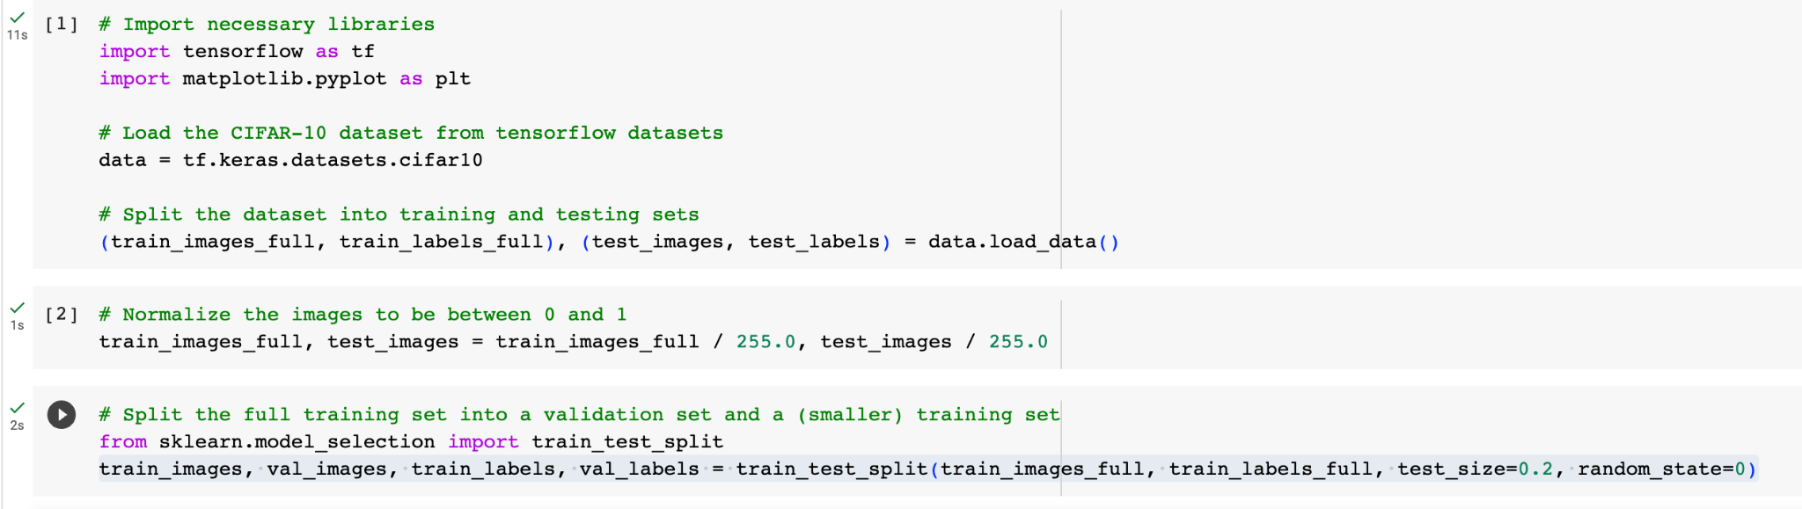
Dataset and Validation Set Creation
Load data from CIFAR-10 dataset which include 60,000 32x32 colour images in 10 classes, 6000 per class
First split data into training and test datasets.
Normalize images data to be between 0 or 1 by dividing with 255.
Split full training dataset into 80% training and 20% validation datasets with 0 random state.
Figure 1: Loading and Splitting Datasets

Slide 3
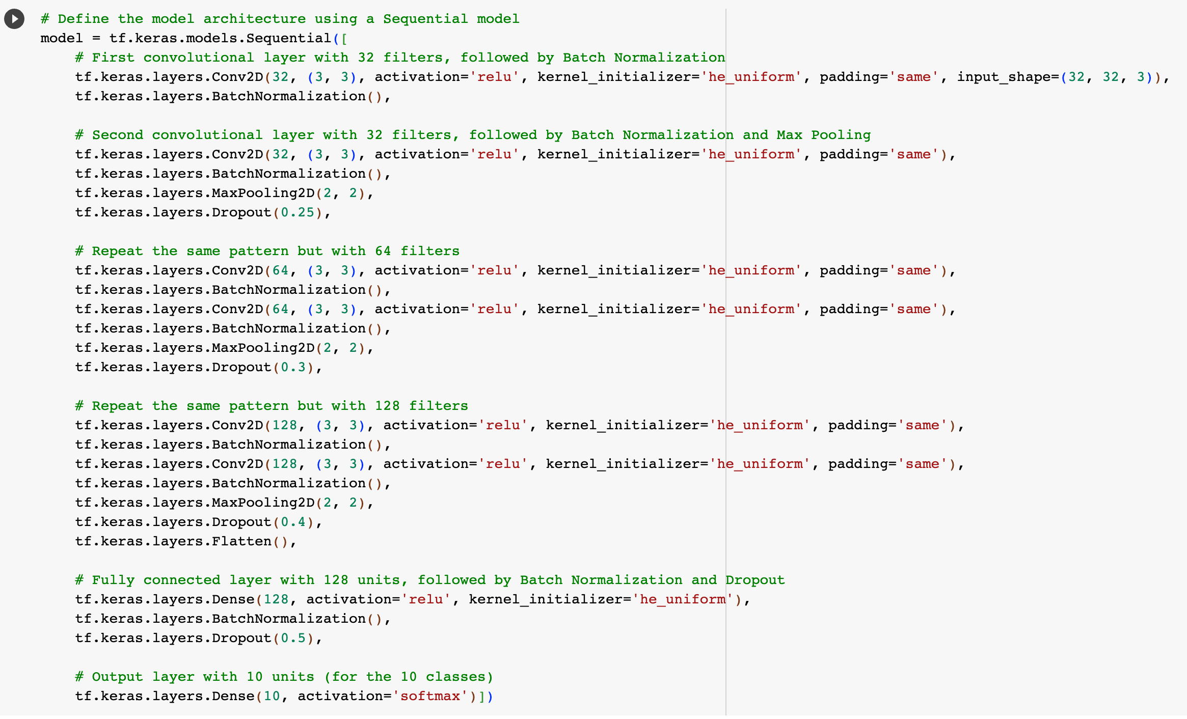
Model Architecture
We applied Convolutional Neural Network (CNN) which is ideal for image-based tasks to the model.
The model includes six convolutional layers with 32 ,64,128 filters of size(3,3), and followed by batch normalization, max pooling, and dropout layers.
The flattened layer is added to convert 3D tensor output to 1D tensor output.
Finally added a fully connected layer with 128 units and an output layer with 10 units.
Figure 2: CNN Model Architecture

Slide 4
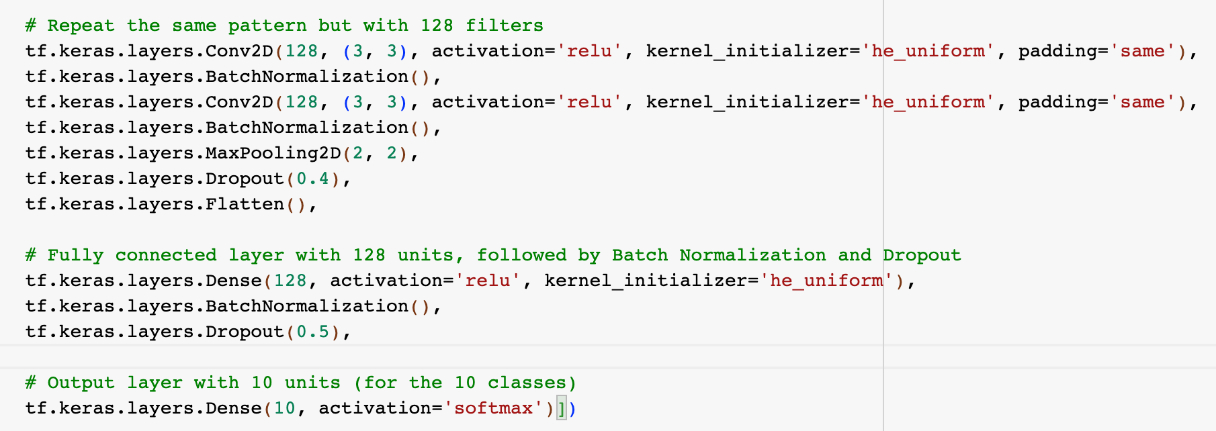
Activation and Loss Functions
We use Rectified Linear Unit (ReLU) activation function in the convolutional and dense layers.
For the initializing weight of the neurons, we use "he_uniform" kernel initializer to minimize the issues of dead neurons
In the output layer, we use softmax activation function for the purpose of multi-class classification.
As for the loss function, we use "sparse_categorical_crossentropy" which is suitable for multi-class classification tasks.
Figure 4: Loss Function
Figure 3: Activation Functions

Slide 5
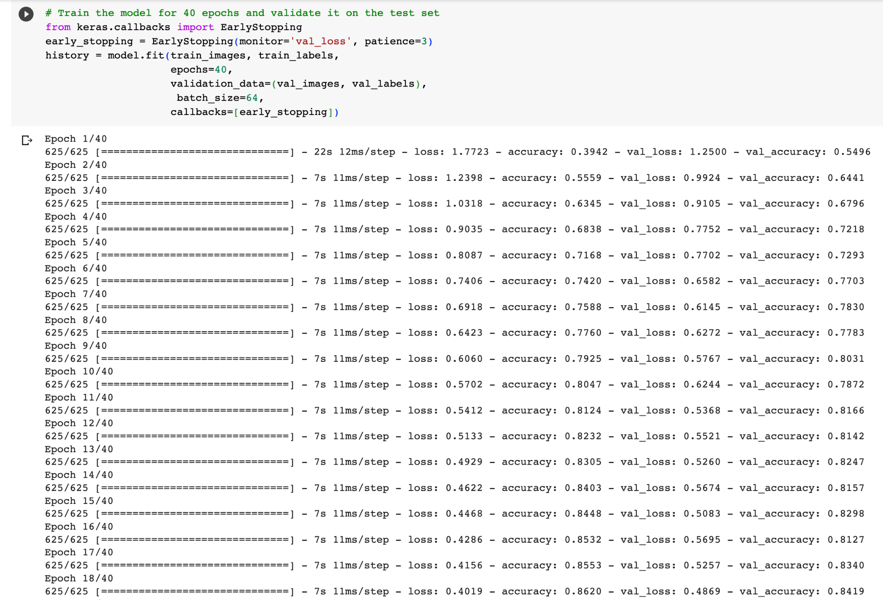
Training the Model
We trained model for 40 epochs.
We added ”EarlyStopping” function (To prevent overfitting).
Finally we validate the accuracy of our model by using test data.
Figure 5: Training Model with 40 Epochs
Notes:
In this slide, we'll discuss how we trained our model.
Our model was trained for 40 epochs. An epoch is one complete pass through the entire training dataset. The number of epochs is a hyper-parameter that defines the number of times the learning algorithm processes the entire training dataset.
We chose to train our model for 40 epochs based on its performance on the validation set. It is important to monitor the performance of the model on the validation set to ensure that the model is learning effectively and not simply memorising training data, which can lead to overfitting.
To prevent overfitting, early stopping is also implemented. Early stopping is a method of specifying an arbitrarily large number of training epochs and stopping training when the performance of the model stops improving on the holdout validation dataset. In our case, training is stopped if the validation loss does not improve after three epochs.
The code snippet on this slide shows how we trained our model for 40 epochs and validated it on the test set, with early stopping implemented.

Slide 6
Neural Network Design
Usage of Keras library with TensorFlow backend for ease of use and flexibility.
Choice of CNN for image classification tasks due to its ability to capture spatial relationships.
Implementation of batch normalization and dropout to improve model performance and control overfitting.
Usage of Adam optimizer for efficient gradient descent.
Use the "EarlyStopping" function to reduce overlearning.

Slide 7
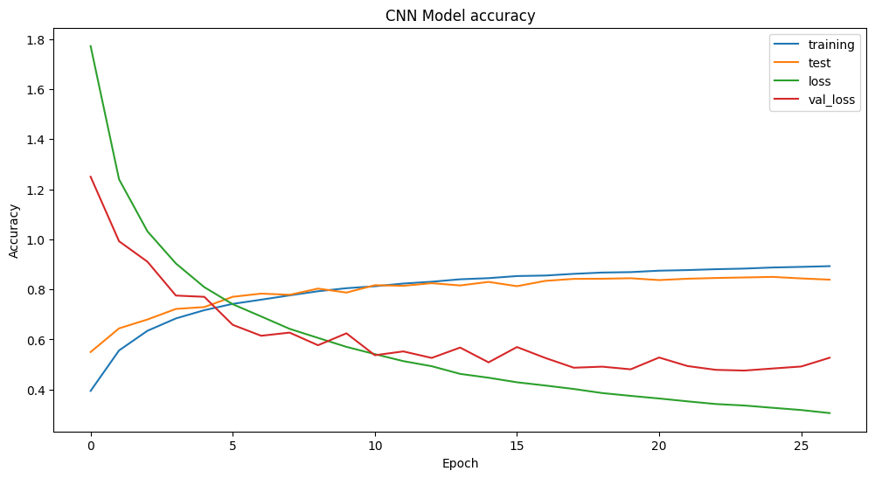
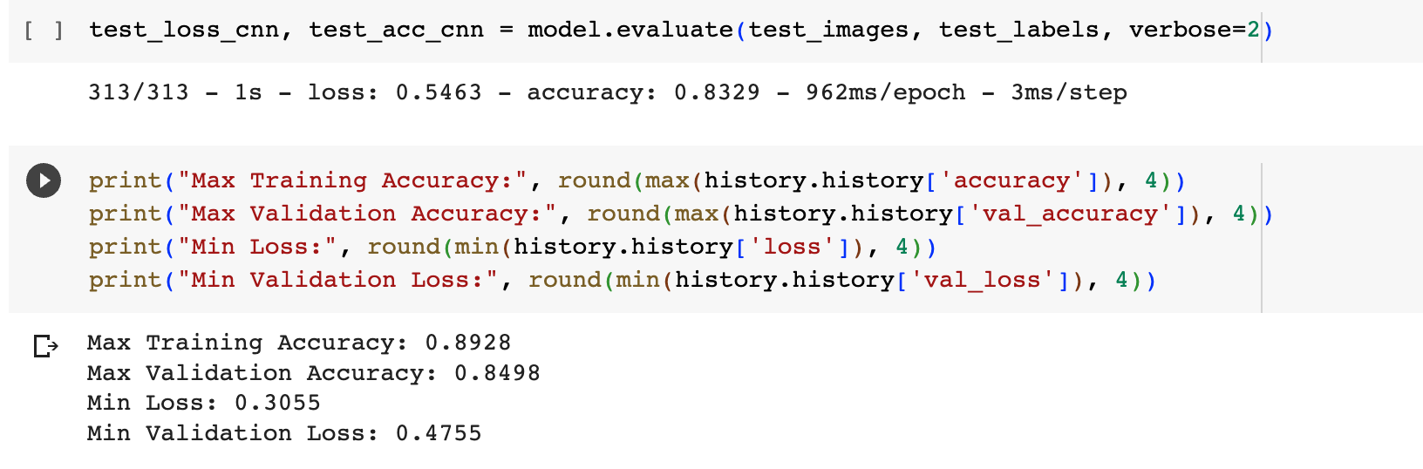
Accuracy Analysis
The model achieved a high test accuracy of approximately 83.29%.
The validation accuracy 84.98% was slight lower than training accuracy 89.28%, indicating that the model was able to generalize well to unseen data.
Overfitting was controlled by using dropout layers and early stopping, which helped maintain a balance between the training and validation accuracies.
The slight difference between the training and validation accuracies indicates that the model has learned the underlying patterns in the data well, without memorizing the training data. This is a good sign of a well-performing model.
Figure 6: Accuracy and Loss Values
Figure 7: Plot Diagram of Accuracy and Loss Value Comparison

Slide 8
Conclusion
A deeper understanding of CNNs and their application in object recognition was gained through this exercise.
Importance of a validation set and techniques to improve model performance. (Change the values, add functions as appropriate.)
Successful implementation of a CNN for object recognition with good accuracy.

Slide 9
References
Krizhevsky, A., Nair, V. and Hinton, G., n.d. CIFAR-10 (Canadian Institute for Advanced Research). [online] Available at: https://www.cs.toronto.edu/~kriz/cifar.html [Accessed: 14 July 2023].
Goodfellow, I., Bengio, Y. and Courville, A., 2016. Deep Learning. MIT Press. Available at: http://www.deeplearningbook.org/ [Accessed: 14 July 2023].
LeCun, Y., Bengio, Y. and Hinton, G., 2015. Deep learning. Nature, 521(7553), pp.436–444. Available at: https://doi.org/10.1038/nature14539 [Accessed: 14 July 2023].
Prechelt, L., 1998. Early Stopping - But When? In: G. Orr and K.-R. Müller, eds., Neural Networks: Tricks of the Trade, pp.55–69. Springer. Available at: https://doi.org/10.1007/3-540-49430-8_3 [Accessed: 14 July 2023].
LeCun, Y., Bottou, L., Bengio, Y. and Haffner, P., 1998. Gradient-based learning applied to document recognition. Proceedings of the IEEE, 86(11), pp.2278–2324. Available at: https://doi.org/10.1109/5.726791 [Accessed: 14 July 2023].

