Slide 1
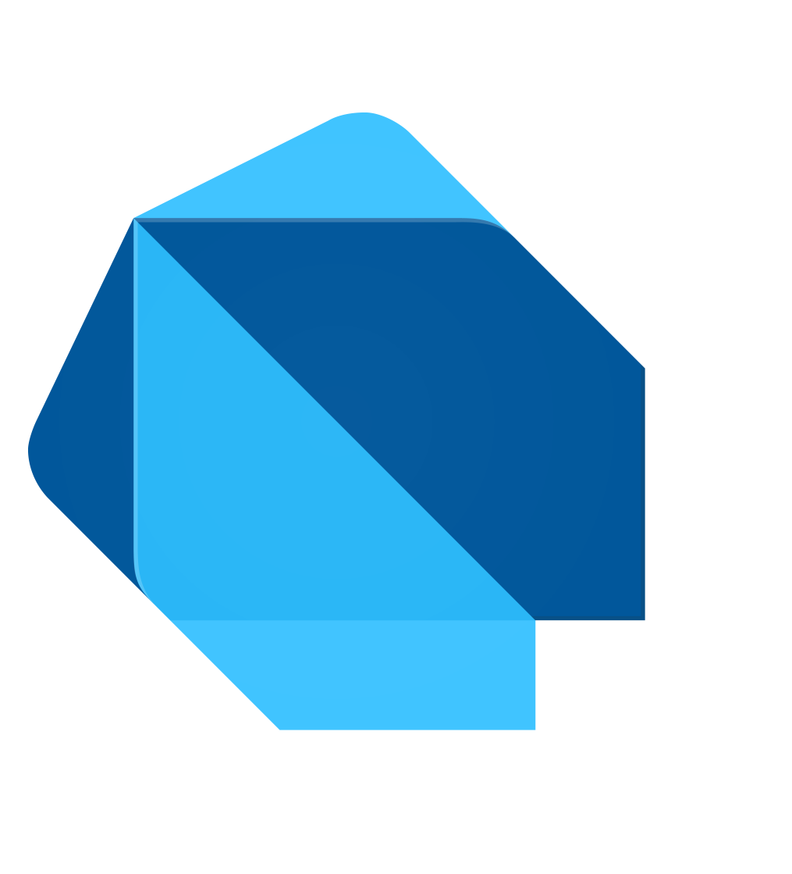
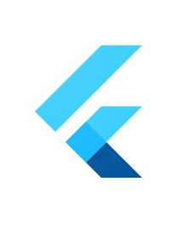
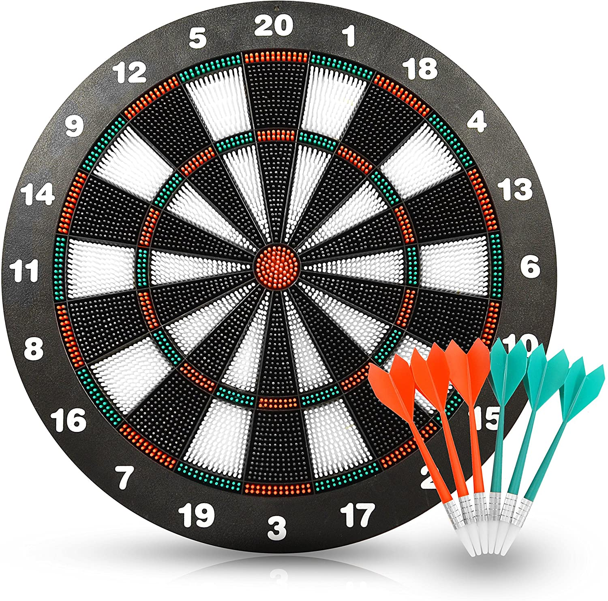
Flutter
(and Dart)

Slide 2
Flutter
Open source framework by Google
cross platform
Uses Dart as programming language
Null safe
Widget based

Slide 3
Dart
Object oriented language
Compiles to native machine code
Optimized for UI

Slide 4
Demo

