Slide 1
When the River Runs Low
Predicting baseflow in the Republican River basin with multiple linear regression
[Team member names] | CS 5830/6830, Project 6
Notes:
Baseflow is the groundwater fed part of a river. It is what keeps streams alive between storms. We asked whether we can predict it, and what irrigation pumping does to it.

Slide 2
Baseflow is the water a river keeps when the rain stops
1
Life support in dry months
Groundwater seepage keeps streams flowing through summer, feeding farms, towns, and wildlife.
Who this is for
Basin water managers
Compact regulators in the three states
Irrigation districts planning well use
Anyone forecasting dry season flow
2
A three state legal question
Colorado, Nebraska, and Kansas share this river under an interstate compact, and pumping disputes have gone to the Supreme Court.
3
A management question
Regulators need to know how much of the decline is climate and how much is irrigation pumping.
Notes:
Stakeholders: water managers and compact regulators. This matters because the Republican River has been fought over in court for decades, and the fight is exactly about groundwater pumping.

Slide 3
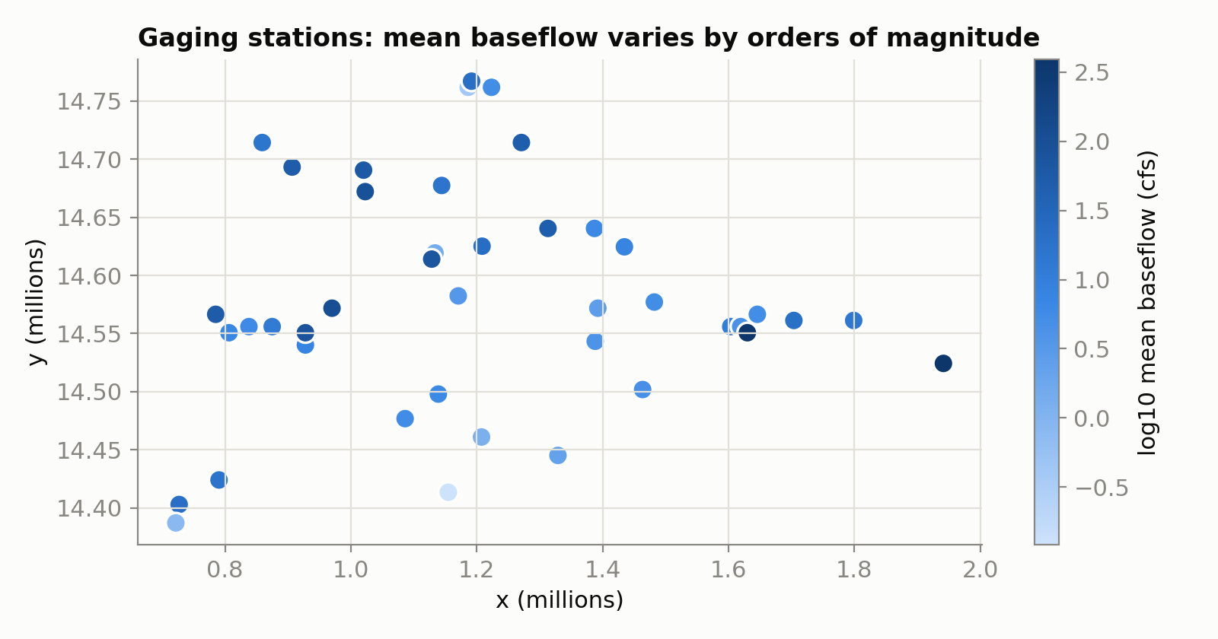
61 years of monthly river and climate records
15,591
monthly observations, Sept 1939 to Aug 2000
42
river segments, each with its own gaging station
4
measured drivers: date, precipitation, evapotranspiration, irrigation pumping
Notes:
Each row is one river segment in one month. The map already shows the main challenge: segments differ by orders of magnitude, from tiny tributaries to main stem reaches near 400 cfs.

Slide 4
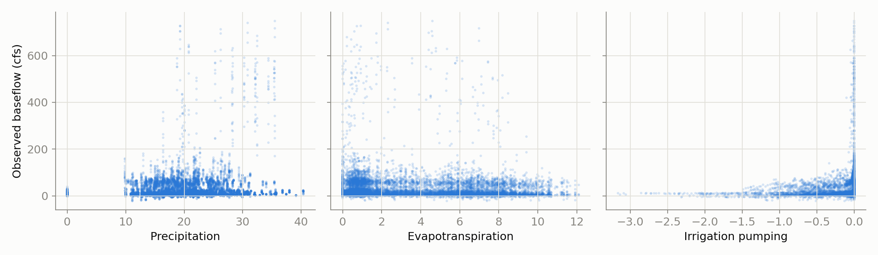
No single input explains baseflow on its own
The strongest single correlation with baseflow is only 0.27 (precipitation). The pooled scatterplots look like noise because 42 very different rivers are stacked on top of each other.
Notes:
This didn’t make sense at first: precipitation barely correlates with baseflow. The resolution is that river identity swamps the climate signal when everything is pooled.

Slide 5
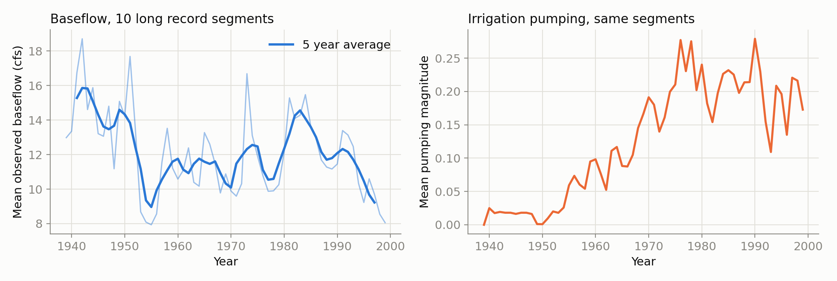
As pumping grew, baseflow declined
Across the ten segments with records spanning the early 1940s through 1999, baseflow fell from about 14 cfs in the 1940s to about 8 cfs by the late 1990s, while irrigation pumping rose from near zero to a sustained high level.
Notes:
A caution we caught: the naive basin average is misleading because the set of gaged segments changes over time. This fixed cohort view is the honest trend, and it still falls by roughly forty percent.

Slide 6
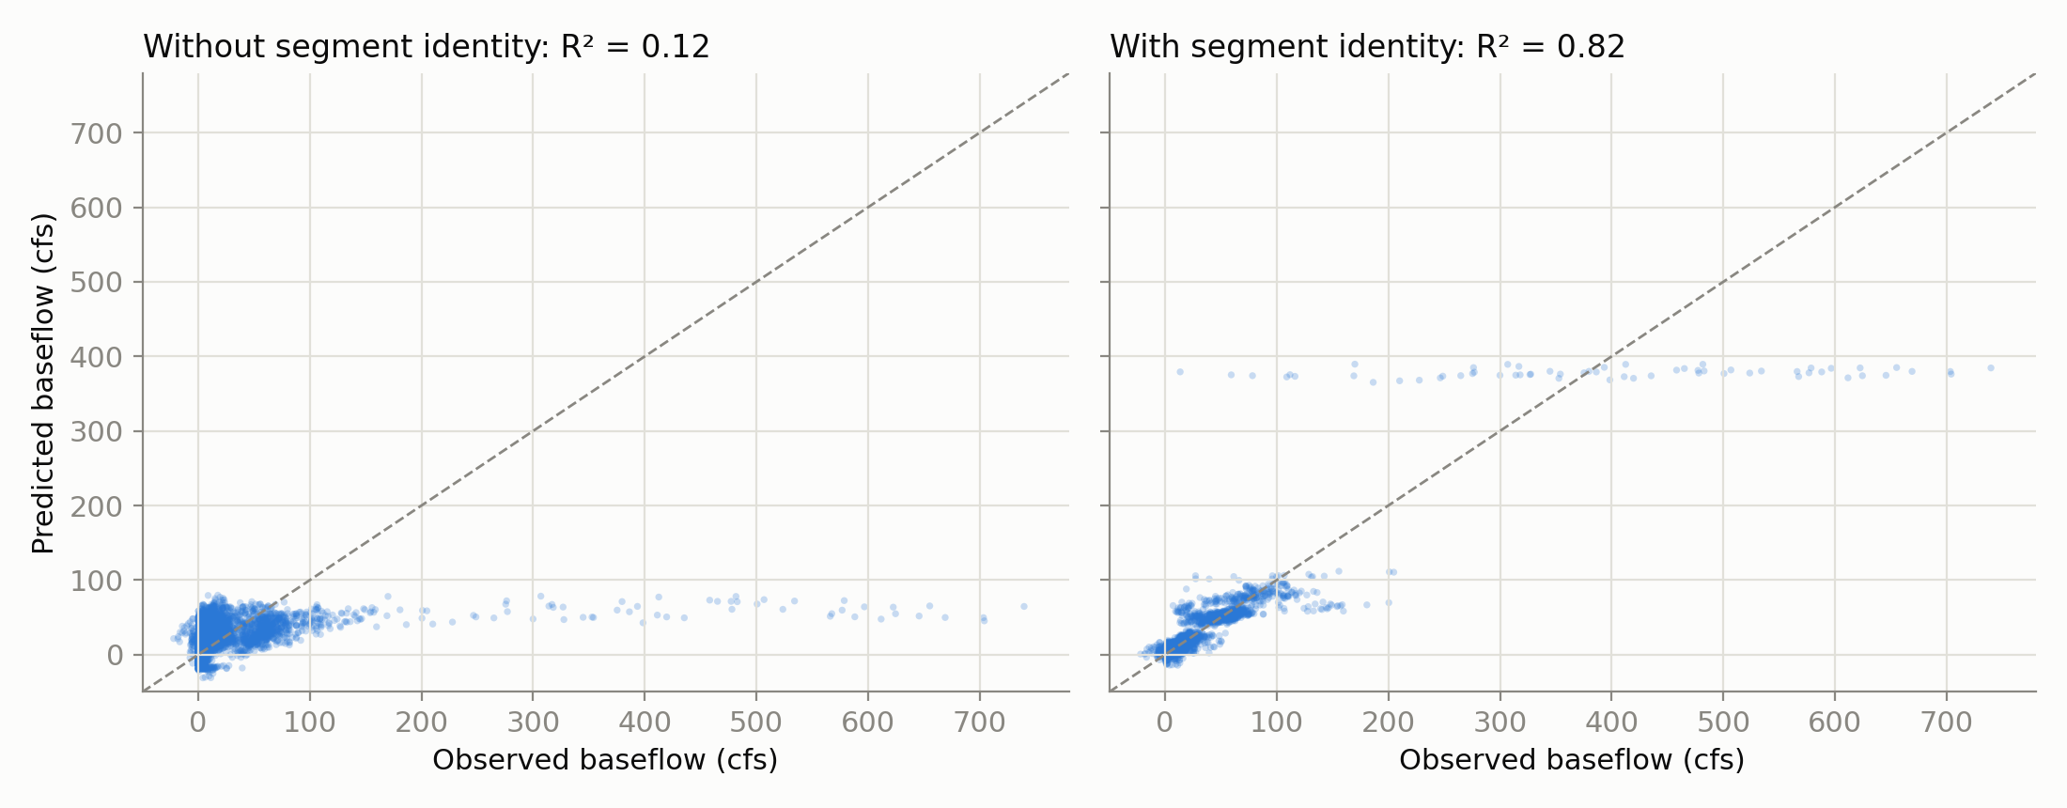
Knowing which river it is transforms the model
0.12
test R² with climate, pumping, and date only
0.82
test R² after adding segment identity (one hot encoded)
25 cfs
typical prediction error, down from 55 cfs
Notes:
This result surprised us with its size: one categorical variable moves R squared from 0.12 to 0.82. Coordinates alone do not substitute, and per segment pumping slopes added almost nothing.

Slide 7
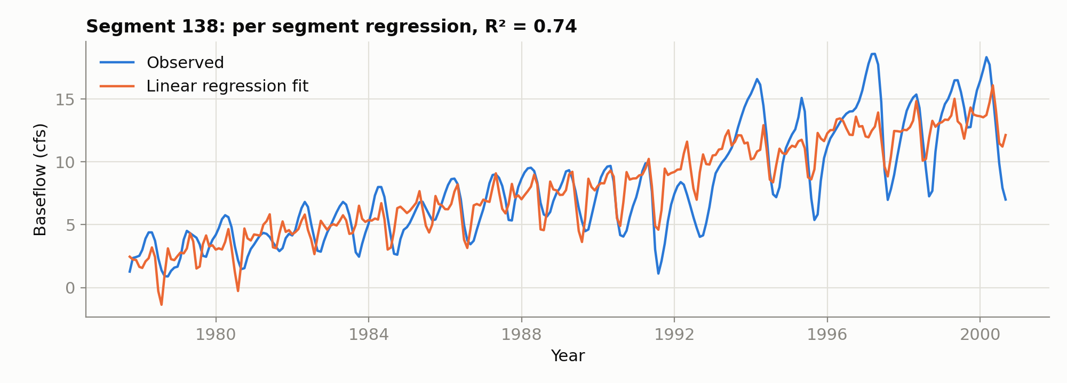
Within a single river, regression reads the drivers
0.38
66%
69%
median R² across 41 per segment models
of segments: significant positive precipitation effect
of pumped segments: more pumping, significantly lower baseflow
Notes:
Per segment regressions let each river respond in its own way. Precipitation adds baseflow, evapotranspiration removes it, and in two thirds of pumped segments the pumping fingerprint is statistically significant.

Slide 8
What we take away
Local identity dominates
Climate acts as expected
A useful baseflow model must know which river segment it is looking at. Segment identity lifts test R² from 0.12 to 0.82 and halves the error.
Rain raises baseflow and evapotranspiration lowers it, with significant coefficients basin wide and in most individual segments.
Pumping leaves a fingerprint
Next steps
In 69 percent of pumped segments, more irrigation pumping is significantly associated with lower baseflow, matching the long run decline.
Add seasonality and lagged precipitation, model log flow, and consider mixed effects models that give each segment its own slopes.
Notes:
The takeaway for a water manager: the model is simple, transparent, and good enough to say where pumping is hurting the river. That is where measurement and management attention should go.

