Slide 1
LLM Uncertainty
Estimation and Application
Speaker: xxx

Slide 2









Necessity: Why do LLMs need uncertainty?
Large models may produce errors , and uncertainty estimates can characterize the reliability of the model output , thereby indicating the possibility that the model output is wrong.
Vanilla Chat Assistant
Uncertainty-aware Assistant
In history, which dynasties was Xi'an the capital?
In history, which dynasties was Xi'an the capital?
The following are the dynasties in history when Xi'an was the capital: 1. Qin Dynasty 2. Han Dynasty 3. Sui Dynasty 4. Tang Dynasty 5. Song Dynasty 6. Yuan Dynasty 7. Ming Dynasty 8. Qing Dynasty
Detecting hallucinations
The following are the dynasties in history when Xi'an was the capital: 1. Qin Dynasty 2. Han Dynasty 3. Sui Dynasty 4. Tang Dynasty 5. Song Dynasty 6. Yuan Dynasty 7. Ming Dynasty 8. Qing Dynasty
Without uncertainty estimation, free output
With uncertainty estimation, indicating unreliable content
Vanilla Multi-agent
Uncertainty-aware
Error,
pass it down
Identify risks
Block delivery /RAG enhancement
Guidance Applications
Without uncertainty estimation, error accumulation
With Uncertainty estimation, improving system stability

Slide 3
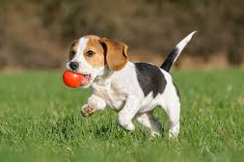

Does traditional probability-based method still work?
Uncertainty characterization methods represented by maximum class probability can provide reliability assessment for traditional classification tasks. In the LLM era, the particularity of generation makes the maximum class probability no longer applicable .
Traditional classification model
LLMs
Model: LLaMA-2-Chat-13b
Probability:
User:
Could you give me one name of president?
User:
Where will the future evolution of the observable universe ultimately lead?
dog
0.98
cat
0.01
LLM:
Sure, here is a historical American president: **$∎$
LLM:
The universe will eventually go to **$∎$
rat
0.01
High confidence,
marked as reliable
Next token confidence distribution:
Next token confidence distribution:
Barack Hussein Obama
0.377
heat death
0.828
Abraham Lincoln
0.202
Heat Death
0.136
Probability:
John Fitzgerald Kennedy
0.178
singularity
0.003
George Washington
0.178
the heat death
0.000
dog
0.43
…
Entropy: 2.03
…
Entropy: 0.68
cat
0.39
rat
0.18
Common knowledge questions
Rare Internet speculation
Low confidence,
marked as unreliable
The model actually knows,
but is marked as unreliable
The model does not actually know,
but is marked as reliable

Slide 4
What does a good LLM uncertainty esitmation look like?
Ability to characterize relative relationships : when generating the next token , among all possible tokens , “which one is more likely to be correct”, that is, relative strength of evidence ;
Ability to characterize absolute relationships : When generating the next token , the knowledge of “ whether the model is sufficient to make the correct answer” is used, that is, the absolute strength of evidence.
Evidence : A measure of the amount of support collected from data in favor of a sample to be classified into a certain class.
[1] Sensoy , M., et al. Evidential deep learning to quantify classification uncertainty. In NeurIPS, 2018.

Slide 5
Why did the absolute evidence information disappear?
The normalization process requires that the sum of all token sharing probabilities is 1 , which results in the loss of the absolute strength of evidence , making it impossible for probability to accurately characterize "uncertainty".
Logits
Probability
softmax
Low evidence but high probability
Evidence strength is lost during normalization
Logits
Probability
softmax
Rare Situation
Evidence accumulation
Common Scenarios
Get the same probability distribution

Slide 6


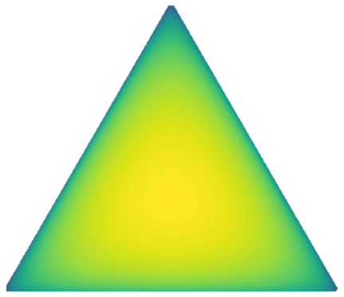



New idea: Uncertainty estimation based on Logits
Uncertainty Modeling
EU (Less-Knowledge)
II
I
AU (Multi-Choice)
III
IV
AU
EU
Probability
LogTokU
I
high
high
I do not know
I have no idea
II
Low
high
I am sure
Lack knowledge, but I suggest
III
Low
Low
I am sure
I am sure
IV
high
Low
I do not know
I know more than one answer
[1] Huan Ma, ., et al. Estimating LLM Uncertainty with Logits, 2025.
[2] Sensoy , M., et al. Evidential deep learning to quantify classification uncertainty. In NeurIPS, 2018.

Slide 7
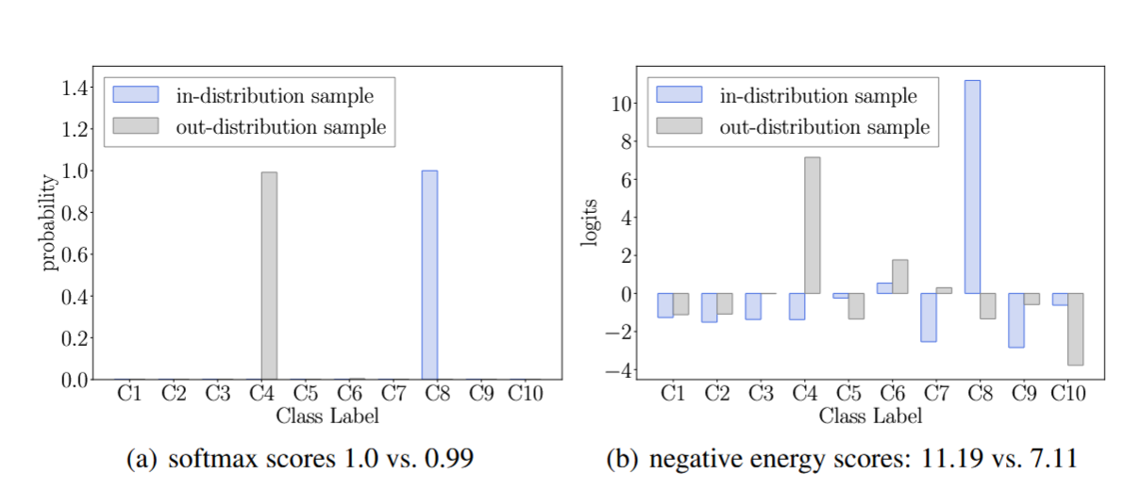
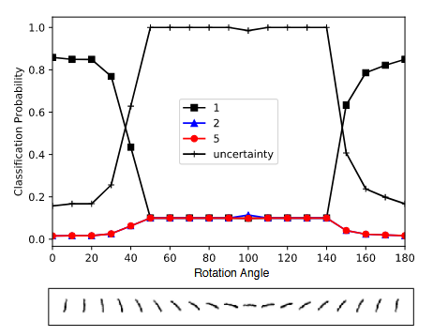
Previous work: Logits have the potential to characterize evidence
The uncertainty of the model can be decoupled through the strength of evidence, and multiple previous work observations suggest that " logits can characterize the strength of evidence".
OOD detection
Evidential Modeling
In previous OOD detection work, the authors found that the values of ID sample logits are higher than those of OOD samples .
In previous work, the authors used Dirichlet modeling to characterize the uncertainty of the classification model by using
[1] Liu, W., et al. Energy-based out-of-distribution detection. In NeurIPS, 2020.
[2] Wei, H., et al. Mitigating memorization of noisy labels by clipping the model prediction. In ICML , 2023.
[3] Sensoy , M., et al. Evidential deep learning to quantify classification uncertainty. In NeurIPS, 2018.

Slide 8
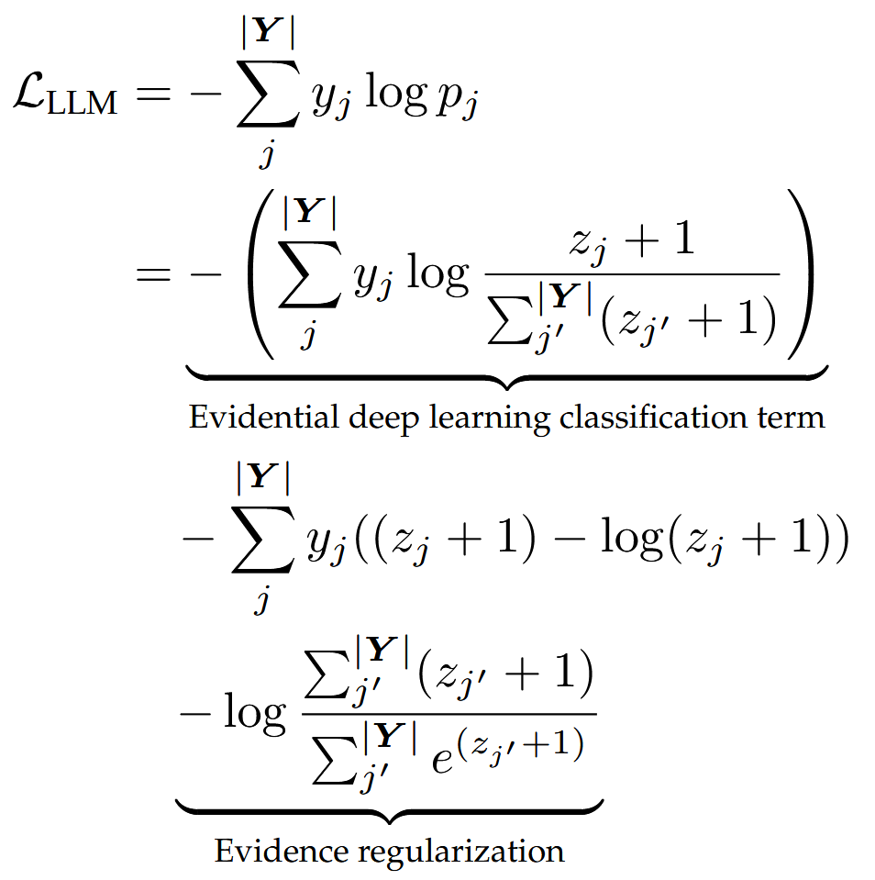
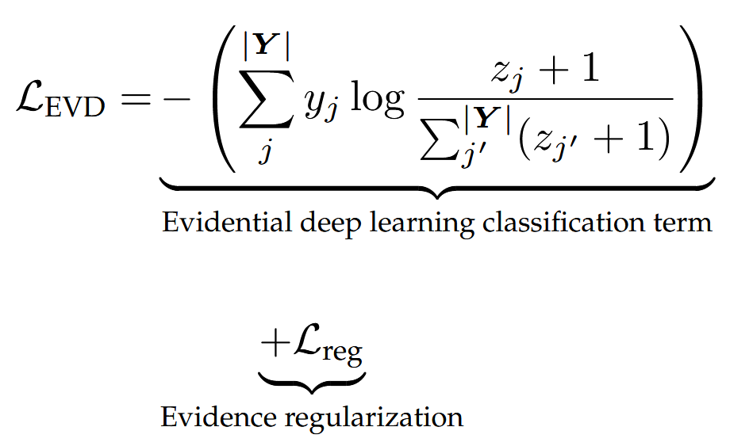
Theory: Why large model logits can be used to characterize evidence
the logits trained under the cross entropy loss still imply information about the strength of the evidence.
Evidence Modeling Training Loss
Cross Entropy
Training Loss
Same
After mathematical transformation, the cross entropy loss can be transformed into an expression that is consistent with evidence modeling
Consistency
[1] Sensoy , M., et al. Evidential deep learning to quantify classification uncertainty. In NeurIPS, 2018.

Slide 9
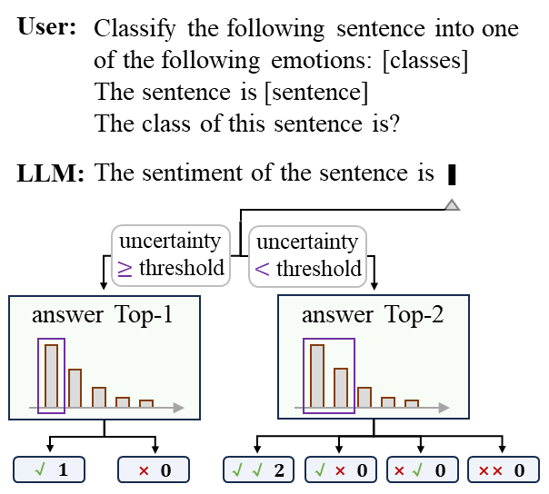
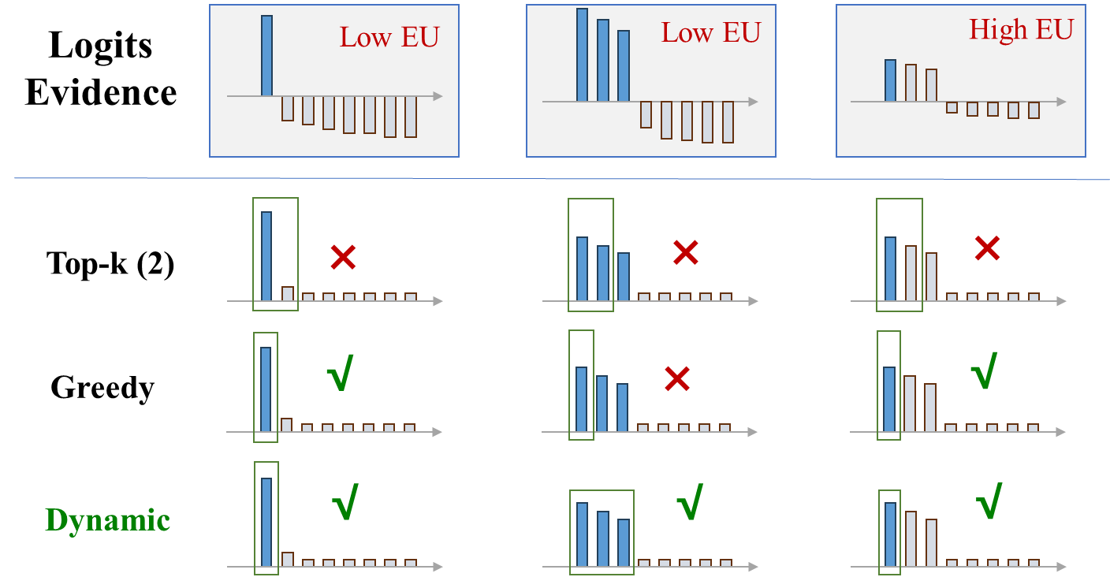
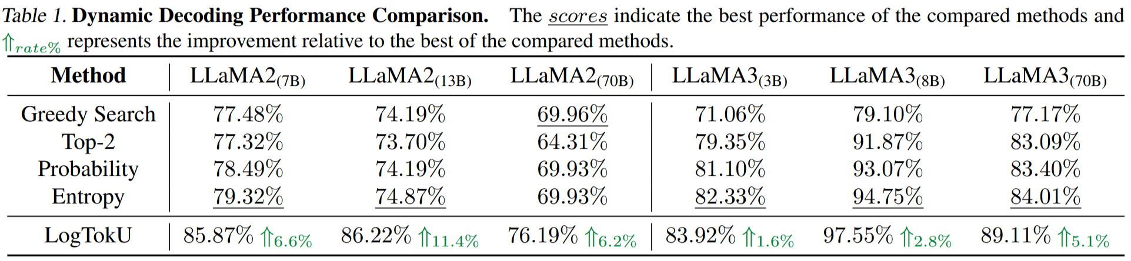
Application 1 : Uncertainty-guided dynamic decoding
By constraining the decoding strategy to be more conservative with greater uncertainty, dynamic decoding with dual guarantees of diversity and reliability can be achieved.
Dynamical decoding
Both diversity and reliability
Experimental improvement

Slide 10
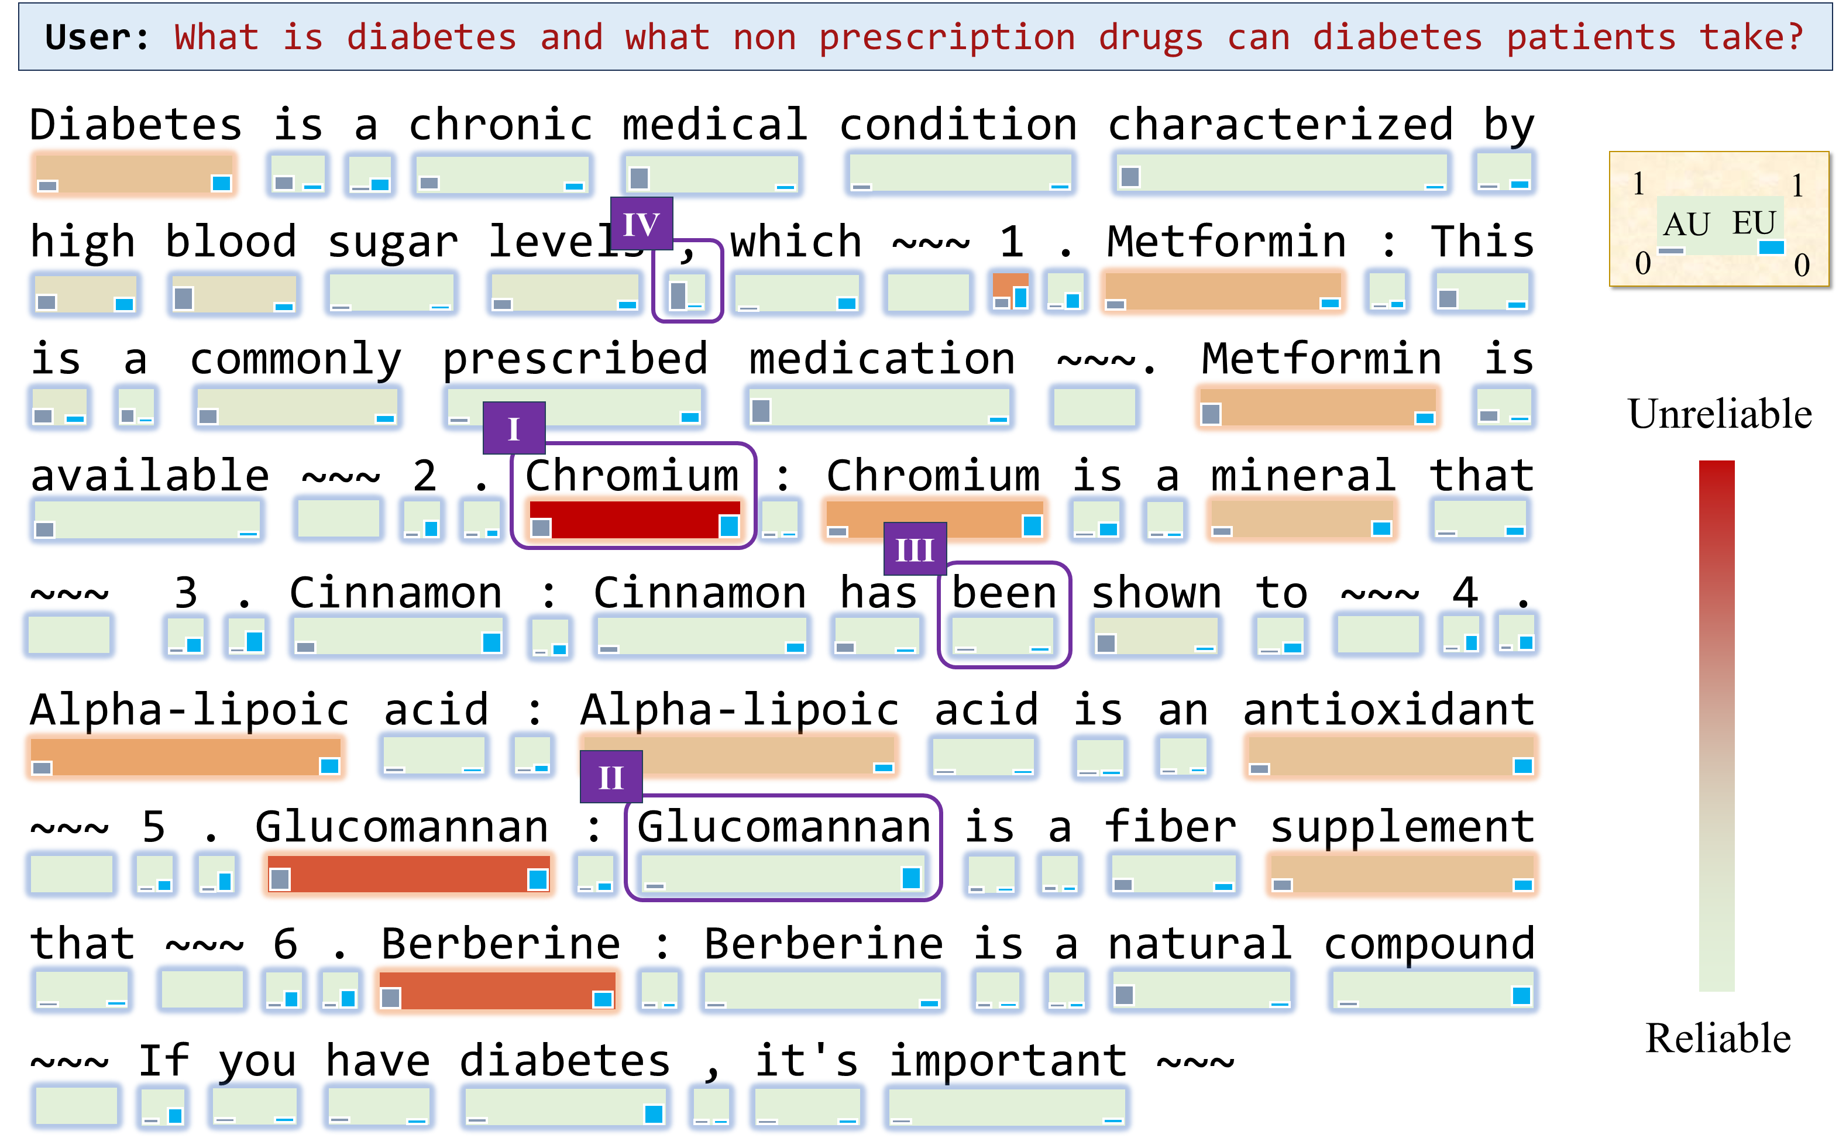
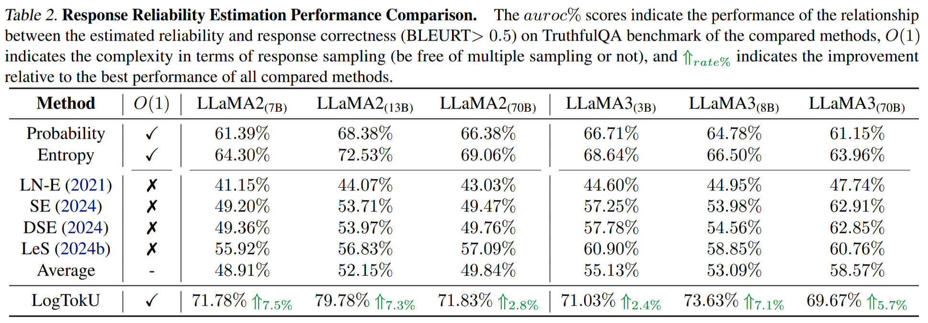

Application 2 : Reliability estimation of large model output
Random uncertainty is combined with model uncertainty to characterize the reliability of multiple levels from words, sentences to responses .
Experimental improvement
Model: LLaMA-2-Chat-13b
Au: 0.75
Eu: 0
Tu: 0
Au: 0.51
Eu: 0.57
Tu: 0.41
Au: 0.0
Eu: 0.0
Tu: 0.0
Au: 0.01
Eu: 0.57
Tu: 0.01

Slide 11
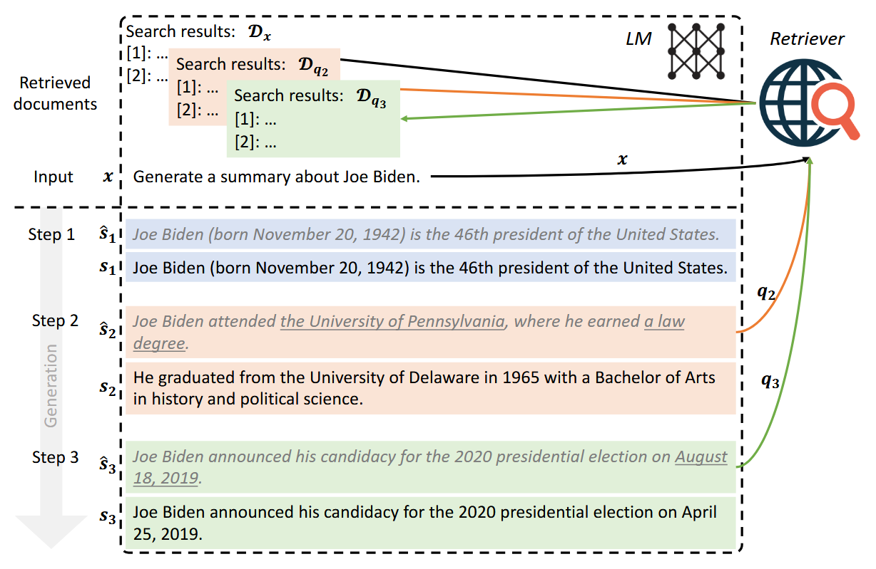
Application 3 : Uncertainty-Guided RAG
Through dynamic retrieval based on evidence accumulation, the efficiency and performance of retrieval enhancement generation can be improved .
Uncertainty is replaced by Probability with LogTokU
Accuracy increased by ~ 10% and
search times decreased by ~ 40%
Search
Times
1142
Probability
LogTokU
592
413
25
102
15
noun
Cardinality
adjective
type
The number of punctuation searches has been reduced from 25 to 4
[1] Jiang, Z., et al. Active retrieval augmented generation. In EMNLP , 2023. Citation: 543

Slide 12
More applications waiting to be explored
Human-Computer Interaction: MIT researchers cited our paper in Chatbot construction and pointed out: "If the logits suggest some threshold of uncertainty has been reached, the chatbot should query for additional information. "
Mentoring RAG : Michigan State University researcher cited our paper in GraphRAG and stated: "Leveraging this property, we implement “Internal Knowledge Filtering", which uses the logits to help refine the answer selection. "
Agents collaboration: A researcher from Korea University reported via email that he has deployed this work to the Uncertainty-aware Multi-agent System to improve the level of agents collaboration.
[1] Hopkins, et al. Chatbot Evaluation Is (Sometimes) Ill-Posed: Contextualization Errors in the Human-Interface-Model Pipeline, MIT , 2025.
[2] Guo, Kai, et al. Empowering GraphRAG with Knowledge Filtering and Integration, MSU , 2025.

