Slide 1
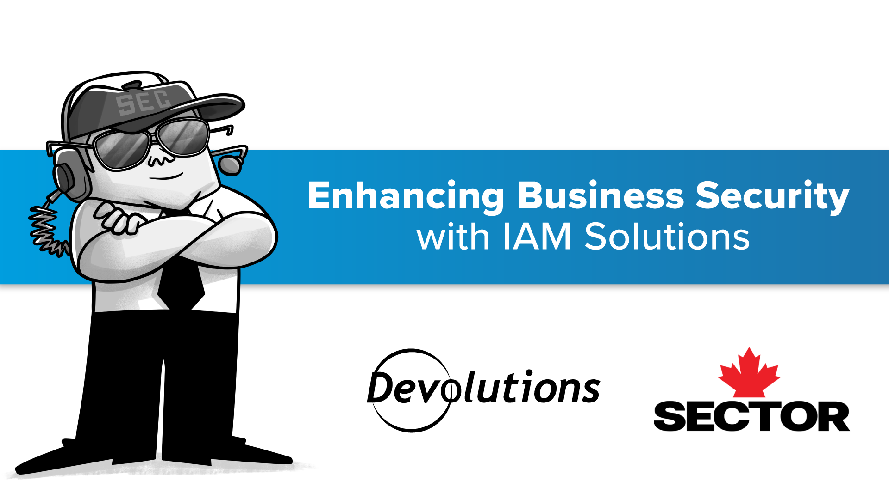

Slide 2
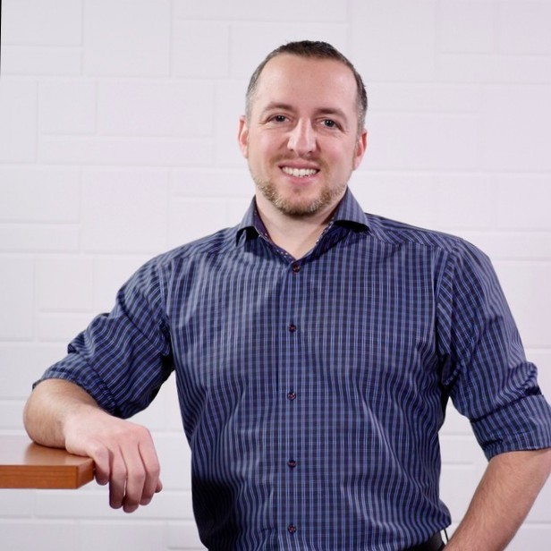
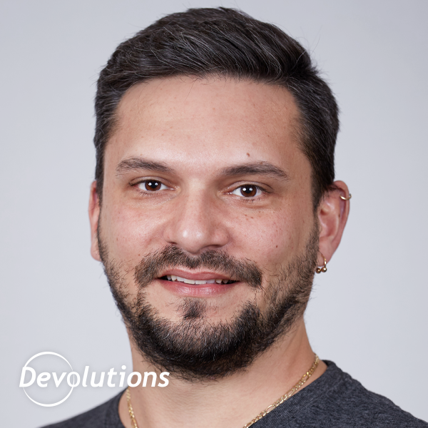
About the Speakers
Co-founder of ISM Group, an MSP Company
Senior Operational Security Specialist
Cybersecurity and IT Expert with over 20+ years of experience
Incident Response Specialist
You can find me:
At a BBQ with friends
Relaxing under a tree in the forest
David Grandolfo: https://www.linkedin.com/in/dgrandolfo/
Chief Security Officer
Over 20 years of experience in cybersecurity and IT administration.
Certified Incident Responder (eCIR)
Leader in implementing people-centered security strategies
You'll find me where there's Music – Beer – BBQ
Patrick Pilotte: https://www.linkedin.com/in/ppilotte/

Slide 3
What is IAM?
IAM (Identity and Access Management)
Definition: A framework of policies and technologies to ensure the right users have the appropriate access to critical systems and resources.
Core functions:
Authentication (verifying user identity)
Authorization (granting access based on roles)
Centralized user management
Auditing and reporting of access events

Slide 4
Why Are We Doing This?
Mitigate security risks: Protect sensitive data and reduce the chance of breaches.
Ensure compliance: Meet regulatory requirements for data security.
Streamline access management: Simplify user management and reduce administrative burden.
Enhance productivity: Ensure the right people have the right access at the right time.
Notes:
Do you consistently revoke access for employees who leave the organization, and how do you ensure this process is followed promptly and accurately?
Introduce To the technical part with David

Slide 5


Implementation Timeline (~2 months)
Planning
Initial Setup
Automation and Optimization
Monitoring and Maintenance
Evaluation of current IAM coverage and associated processes (1-2 days)
Configuration of security groups, creation of workflows, initial tests, and a follow-up explanation meeting (1 week)
Automating role assignments, lifecycle management, and optimizing policies (3-5 weeks)
Initial monitoring setup and adjustments (2-3 weeks)
Regular maintenance and monitoring will be continuous, involving periodic checks, updates, and refinements.

Slide 6
Access Review Process
Define the scope of the access review by selecting the users, groups, or roles to review, and configuring the review settings (e.g., frequency, duration).
Assigned reviewers (managers, administrators, or self-reviews) evaluate users' access to ensure it aligns with their roles and responsibilities.
Based on the review outcomes, approve or revoke access. Reviewers can directly make decisions, or automated actions can be applied if no response is received.
Define the review
Review and Respond
Act on Results

Slide 7
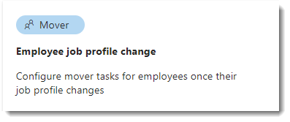
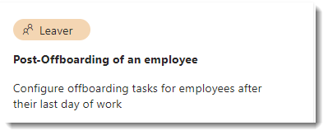
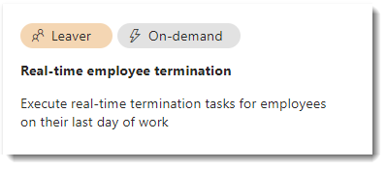
Workflows
Built-in template offered by Microsoft that includes tasks and execution conditions tailored to your needs.

Slide 8
Return on Investment (ROI)
Reduced Operational Costs
Enhanced Security
Increased Productivity
Better User Experience
Scalability and Flexibility
Quantifiable ROI
100% reduction in unauthorized access incidents.
50% faster user provisioning and access management.
Notes:
Reduced Operational Costs
Automating access management reduces manual processes.
Minimizes time spent on password resets, provisioning, and de-provisioning.
Enhanced Security
Prevents unauthorized access, reducing the likelihood of costly data breaches.
Improved compliance reduces the risk of regulatory fines.
Increased Productivity
Streamlined user access improves employee efficiency.
Faster onboarding and offboarding processes save time.
Better User Experience
Single sign-on (SSO) simplifies access to multiple systems, enhancing user satisfaction.
Fewer disruptions from security incidents or access issues.
Scalability and Flexibility
IAM solutions can scale with your business, reducing the need for additional resources as you grow.
Quantifiable ROI
100% reduction in unauthorized access incidents.
50% faster user provisioning and access management.

Slide 9
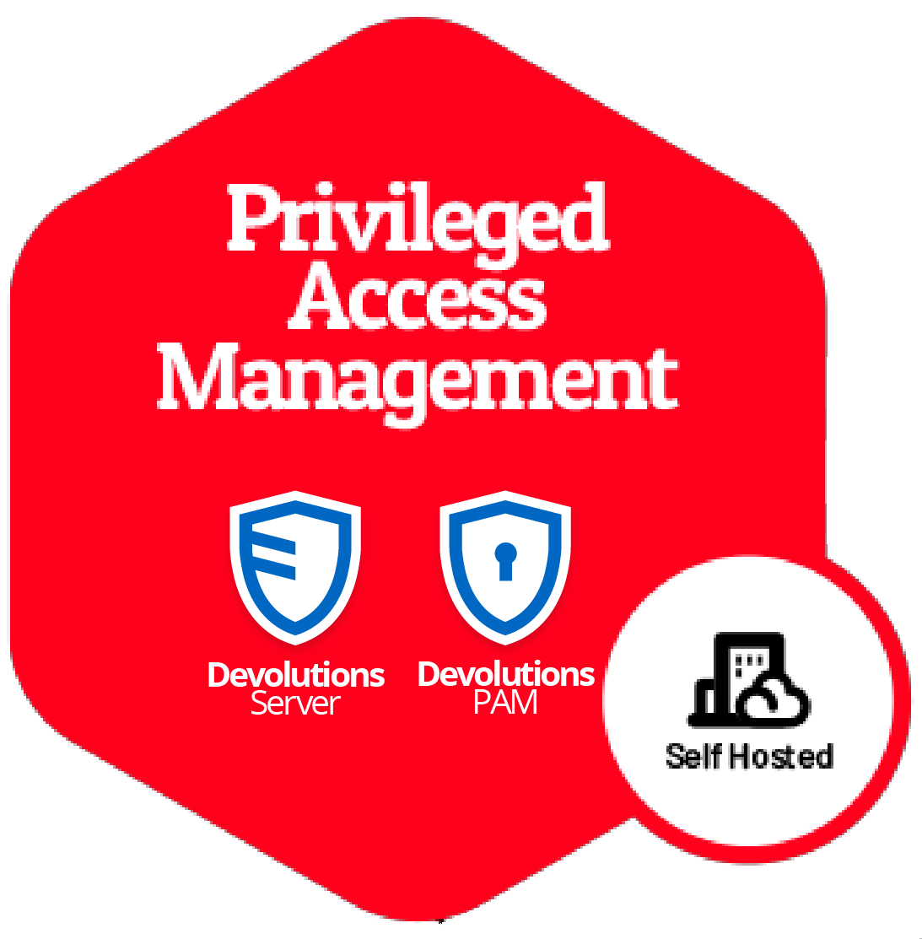
Just-In-Time (JIT) with Devolutions
Configuring Azure Groups
Connections: DVLS with EID
Elevation
PAM Check-out
Links
Setup

Slide 10

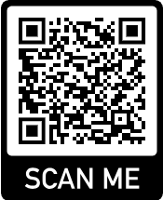
https://github.com/DaGrand/Conference/ tree/main/Sector-2024
Notes:
Is their any question about the presentation
If you prefer or have any other question you can find us all event long near the Devolutions booth

