Slide 1

The Daily News
Sunday 24/10/2021
Newsletter
Edition: 001
“Arabic newspaper topic modeling”

Slide 2
Table of Contents
01
04
02
05
03
Sunday 24/10/2021
Newsletter
Edition: 001
Introduction
Conclusion
Data
Demo
Models

Slide 3

01
Introduction
The Daily News
Sunday 24/10/2021
Newsletter
Edition: 001

Slide 4

Introduction
Sunday 24/10/2021
Newsletter
Edition: 001
Problem
Our problem is about Arabic NLP, and our task will be to prepare the dataset & classify each document into a category.
Goal
We will develop an Arabic topic modeling to predict the correct topic of newspaper articles.

Slide 5

02
Preprocess
The Daily News
Sunday 24/10/2021
Newsletter
Edition: 001

Slide 6
Data
Sunday 24/10/2021
Newsletter
Edition: 001
The dataset we will use contains Arabic newspaper articles.
ID
Subject
Unique for each article.
contains brief description about the article.
Our goal to Categories the articles into 4 categories :
Health
Sports
Politics
Economy
Content
contains the text in the article.

Slide 7


Approch
Sunday 24/10/2021
Newsletter
Edition: 001
Cleaning
Cleaning
Explore
Cleaning
Explore
Vectorize
Explore
Vectorize
Vectorize
Document
Annotate
Clustering
Annotate
Clustering
category

Slide 8

03
Models
The Daily News
Sunday 24/10/2021
Newsletter
Edition: 001

Slide 9
Models
Sunday 24/10/2021
Newsletter
Edition: 001
Clustring
Has gave us best results
LSA
Has not work well with our data
NMF
Has not work well with our data

Slide 10

04
Conclusion
The Daily News
Sunday 24/10/2021
Newsletter
Edition: 001

Slide 11
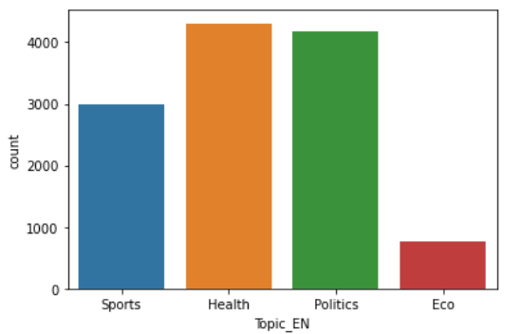
Conclusion
Sunday 24/10/2021
Newsletter
Edition: 001
The topics in the data was unbalanced.
The only model with good results was K-means.
There are only a few resources for Arabic NLP.

Slide 12
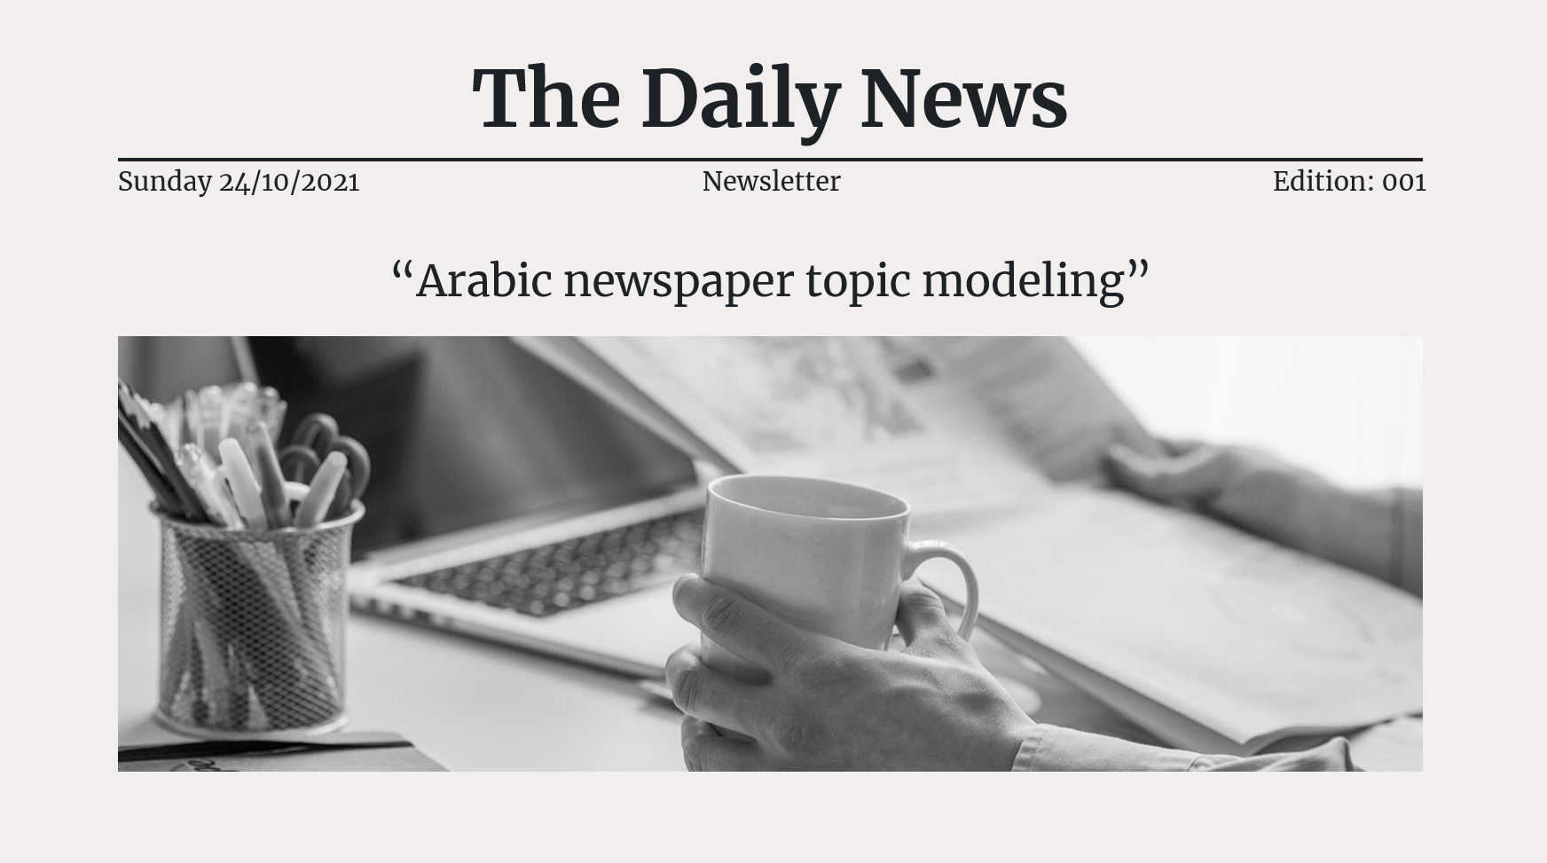
Demo
Sunday 24/10/2021
Newsletter
Edition: 001

