Slide 1

The Daily News
Sunday 24/10/2021
Newsletter
Edition: 001
“Arabic newspaper topic modeling”

Slide 2
Table of Contents
01
04
02
05
03
Sunday 24/10/2021
Newsletter
Edition: 001
Introduction
Conclusion
Data
Demo
Models

Slide 3

01
Introduction
The Daily News
Sunday 24/10/2021
Newsletter
Edition: 001

Slide 4

Introduction
Sunday 24/10/2021
Newsletter
Edition: 001
Problem
Our Problem is about Arabic NLP and our task will be To prepare a dataset & classify each document into a category.
Solution
we will develop an Arabic topic modeling to predict the correct topic of newspaper articles that can correctly classify the topic.

Slide 5

02
Data
The Daily News
Sunday 24/10/2021
Newsletter
Edition: 001

Slide 6


Approch
Sunday 24/10/2021
Newsletter
Edition: 001
Cleaning
Cleaning
Explore
Cleaning
Explore
Vectorize
Explore
Vectorize
Vectorize
Document
Annotate
Clustering
Annotate
Clustering
category

Slide 7
Data
Sunday 24/10/2021
Newsletter
Edition: 001
The dataset we will use contains Arabic newspaper articles.
ID
Subject
contains the ID of article
contains brief description about the article.
Our goal to Categories the articles into 4 categories :
Health
Sports
Politics
Economy
Content
contains the text in the article.

Slide 8

03
Models
The Daily News
Sunday 24/10/2021
Newsletter
Edition: 001

Slide 9
Models
Sunday 24/10/2021
Newsletter
Edition: 001
Clustring
Has gave us best results
LSA
Has not work well with our data
NMF
Has not work well with our data

Slide 10

04
Conclusion
The Daily News
Sunday 24/10/2021
Newsletter
Edition: 001

Slide 11
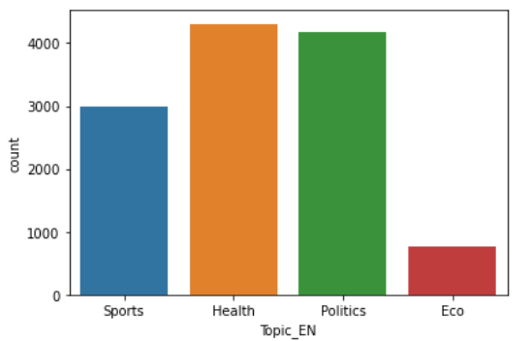
Conclusion
Sunday 24/10/2021
Newsletter
Edition: 001
At the beginning we clean our data and after that We tried three different approaches to topic modeling but the only model with good results was K-means so we will choose this model. From this project we were hoping to have good results with Arabic data since there are only a few resources for Arabic NLP.

Slide 12
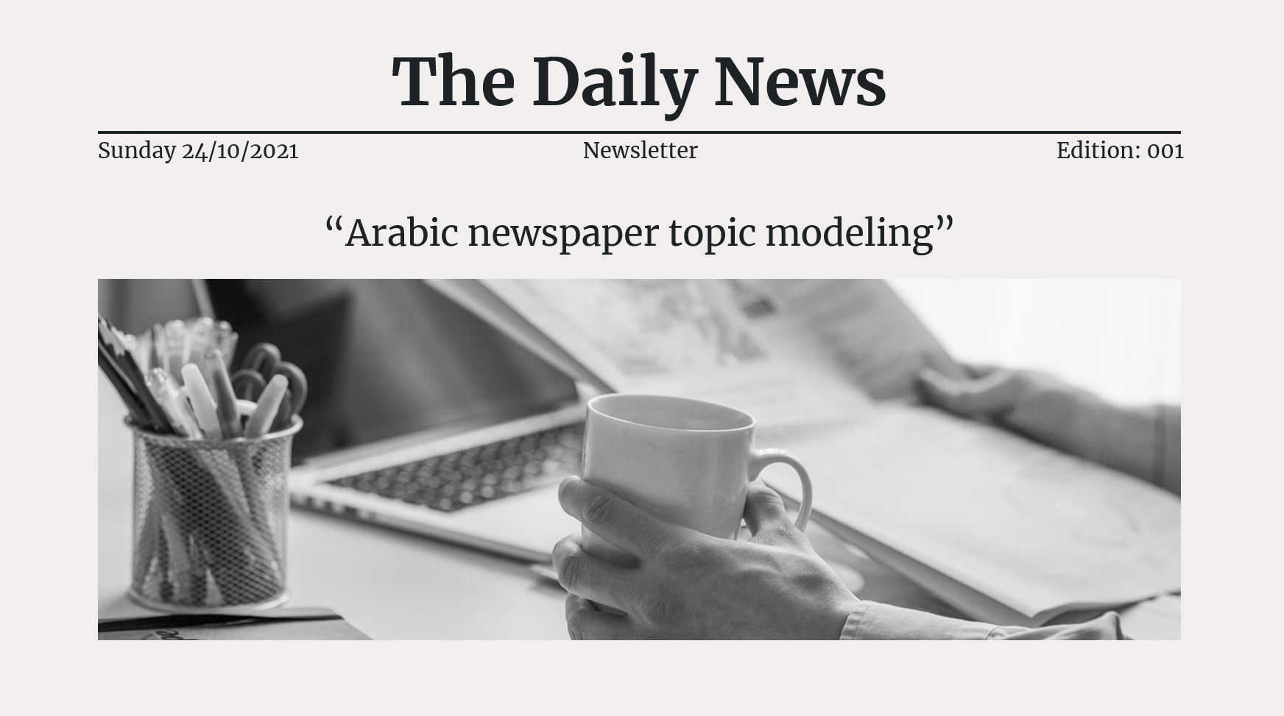
Demo
Sunday 24/10/2021
Newsletter
Edition: 001

