Slide 1

The Daily News
Sunday 24/10/2021
Newsletter
Edition: 001
“Arabic newspaper topic modeling”

Slide 2
Table of Contents
01
04
02
05
03
Sunday 24/10/2021
Newsletter
Edition: 001
Introduction
Conclusion
Data
Demo
Models

Slide 3

01
Introduction
The Daily News
Sunday 24/10/2021
Newsletter
Edition: 001

Slide 4

Introduction
Sunday 24/10/2021
Newsletter
Edition: 001
Problem
Our Problem is about Arabic NLP and our task will be To prepare a dataset & classify each document into a category.
Solution
we will develop an Arabic topic modeling to predict the correct topic of newspaper articles that can correctly classify the topic.

Slide 5

02
Data
The Daily News
Monday 01/02/2020
Newsletter
Edition: 001

Slide 6
Data
Sunday 24/10/2021
Newsletter
Edition: 001
The dataset we will use contains Arabic newspaper articles.
ID
Subject
contains the ID of article
contains brief description about the article.
Our goal to Categories the articles into 4 categories :
Health
Sports
Politics
Economy
Content
contains the text in the article.

Slide 7

03
Models
The Daily News
Sunday 24/10/2021
Newsletter
Edition: 001

Slide 8
Models
Sunday 24/10/2021
Newsletter
Edition: 001
Clustring
Has gave us best results
LSA
Has not work well with our data
NMF
Has not work well with our data

Slide 9

04
Conclusion
The Daily News
Sunday 24/10/2021
Newsletter
Edition: 001

Slide 10
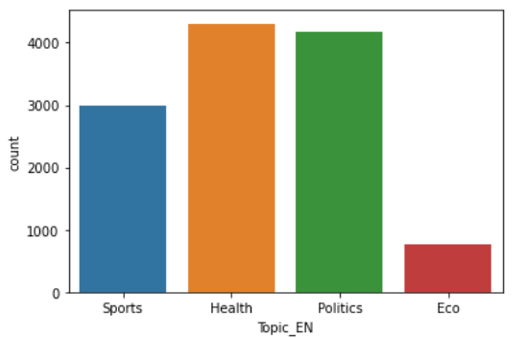
Conclusion
Sunday 24/10/2021
Newsletter
Edition: 001
At the beginning we clean our data and after that We tried three different approaches to topic modeling but the only model with good results was K-means so we will choose this model. From this project we were hoping to have good results with Arabic data since there are only a few resources for Arabic NLP.

Slide 11
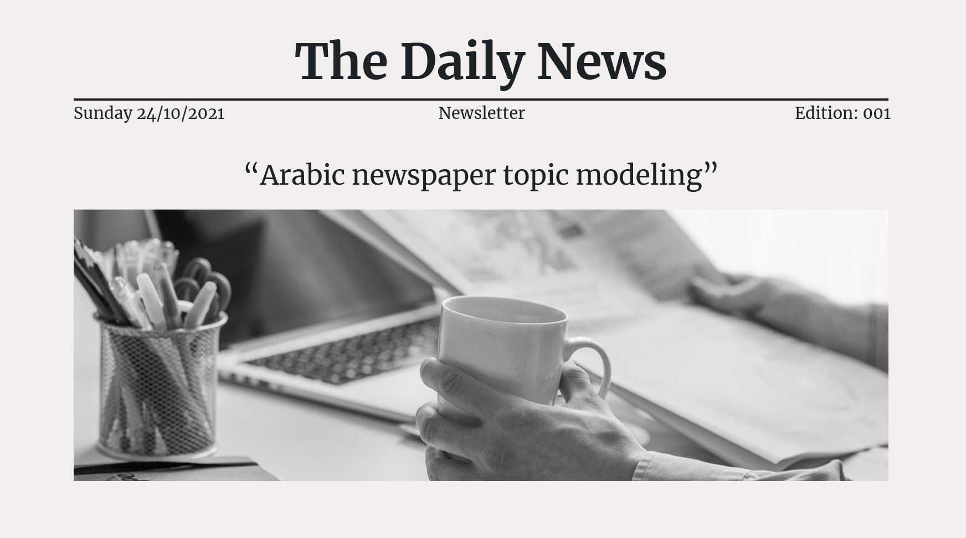
Demo
Sunday 24/10/2021
Newsletter
Edition: 001

