Slide 1
KING COUNTY HOUSING MARKET · EDA BRIEFING
Turning Data Into Returns
An exploratory data analysis of home sales, timing, renovation value,
and location — with recommendations for a seller-investor client.
Maximilian Thormann
Exploratory Data Analysis Project

Slide 2
SECTION 01
Client Profile: Charles Christensen
Return on Investment
CC
1
Where can capital be redeployed for the strongest resale gains?
Renovate or Not?
2
He's unsure whether renovating before resale actually pays off.
Charles
Christensen
Which Neighborhood?
3
No fixed preference — open to wherever the numbers point.
SELLER / INVESTOR
Right Timing
4
When should he buy, and when should he sell?
01

Slide 3
SECTION 02
The King County Housing Dataset
Source & Scope
DATASET AT A GLANCE
Individual King County home sale records (incl. Seattle
21,597
home sale records
KEY FIELDS
Price & sale date
$450,000
the core transaction record
median sale price (range $78K – $7.7M)
Size & location
Square footage, coordinates
May 2014 – May 2015
Age & renovation
sale date window
year built, year renovated
1900 – 2015
Condition & grade
quality ratings
range of year built
Also engineered: season, distance to Seattle, and geographic grid clusters (used in later sections).
02

Slide 4
SECTION 03
Three Hypotheses to Test
Before diving into the numbers, here's what we set out to test — each one gets its own verdict in the sections that follow.
H1
H2
H3
Seasonality
Renovation Age
Location & ROI
House prices fluctuate depending on season — lower in winter, higher in summer.
For homes renovated in the last 20 years, the price increase from renovation is largest for homes built before 1950.
Homes located closer to Seattle allow for a higher return on investment.
Tested on Slide 4
Tested on Slide 5
Tested on Slides 7–8
03

Slide 5
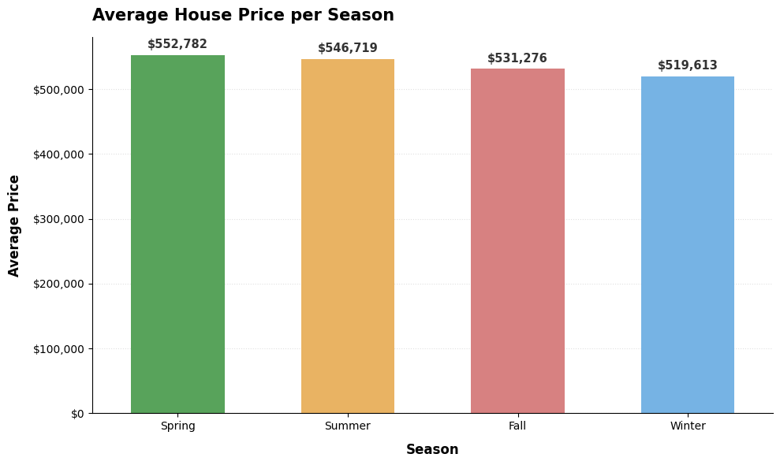
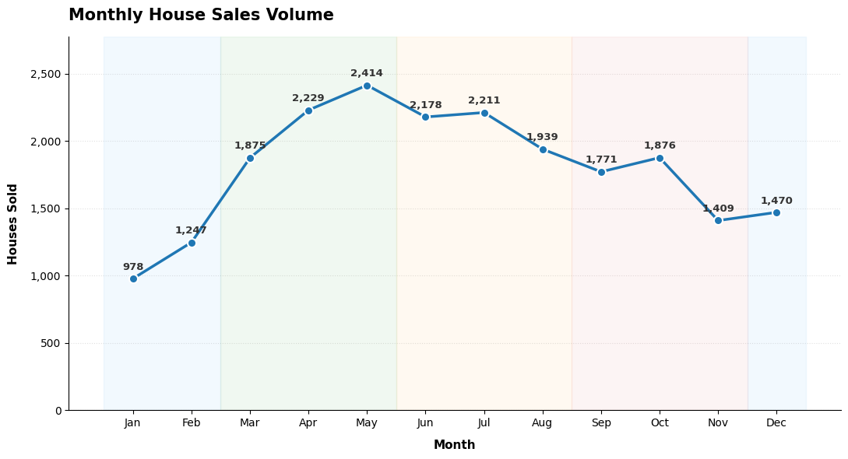
SECTION 04 · TESTING H1
Timing the Market
INSIGHT
RECOMMENDATION
Spring is the seller's market (avg. $552,782); Winter is the buyer's market (avg. $519,613)— a ~6% price gap.
Buy in Winter, sell in Spring to capture the widest price spread.
04

Slide 6
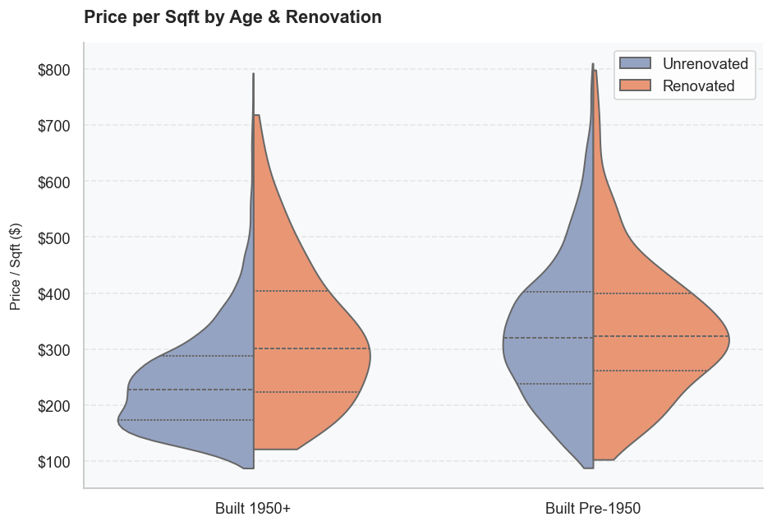
SECTION 05 · TESTING H2
Does Renovation Pay Off?
+32.17%
Renovation premium on price/sqft — homes built 1950 or later
+0.90%
Renovation premium on price/sqft — homes built before 1950
Multiple unaccounted factors may relate to this finding. Further analysis is warranted.
05

Slide 7
SECTION 06 · METHODOLOGY
Building the Resale Dataset
To measure real return on investment, we can't just compare different homes to each other — we need to follow the same property from purchase to resale.
1
2
3
Find Repeat Sales
Pair the Transactions
Compute Annualized ROI
→
→
Filter the dataset down to property IDs that appear more than once — meaning that home was bought and later resold.
Match each property's earlier purchase price with its later sale price, and record the time held between them.
Calculate % price increase, normalized per year held — so a quick flip and a year-long hold are fairly comparable.
Result: 177 resale pairs
06

Slide 8
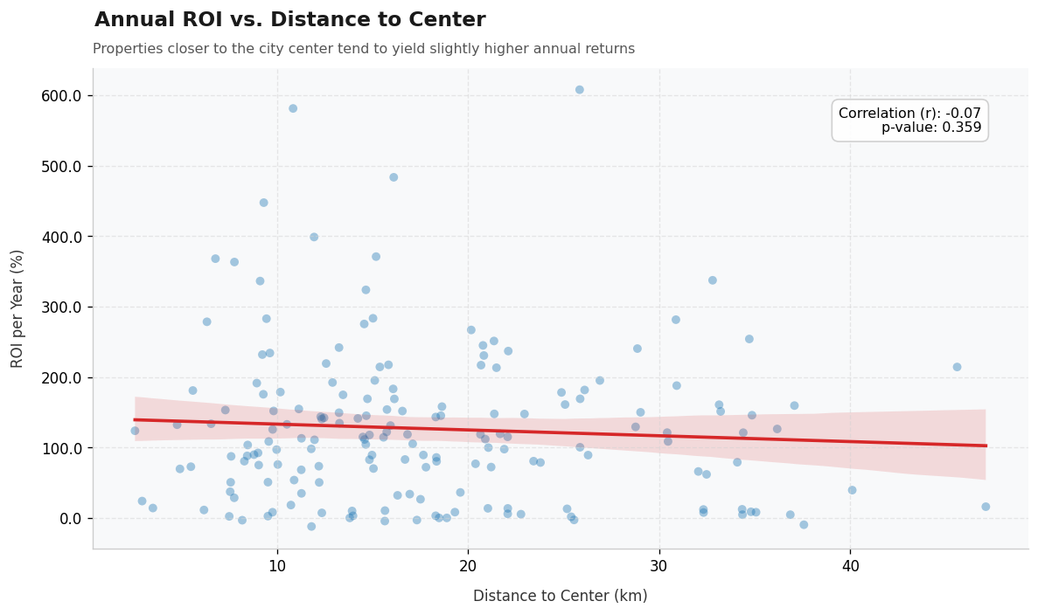
SECTION 07 · TESTING H3
Does Distance to Seattle Predict Returns?
r = −0.07
p = 0.359 — not statistically significant
A trend towards higher return for closer homes may be present, but the relation is very weak.
Takeaway: “closer to the city” is not, by itself, a reliable investment rule. The real pattern lives at the neighborhood level — see next.
07

Slide 9
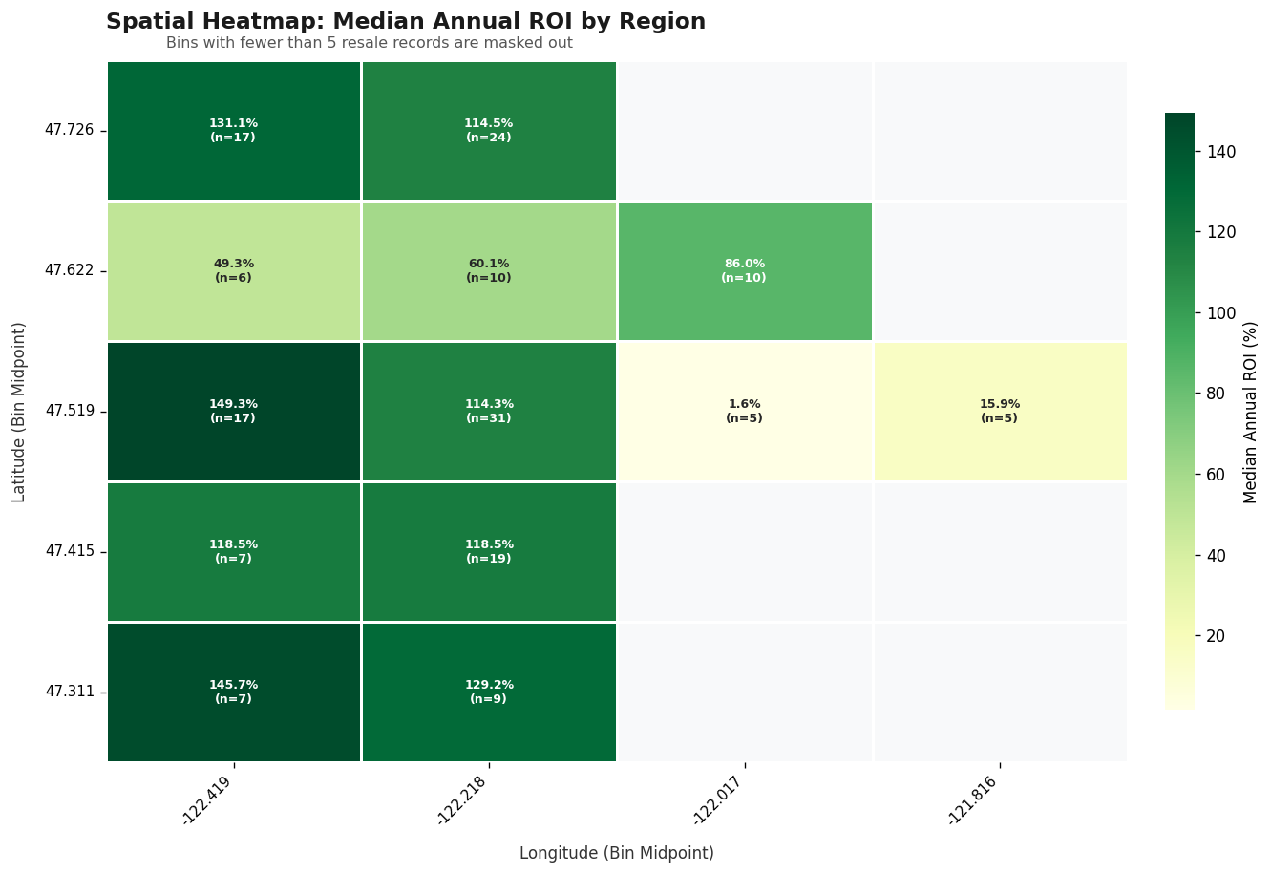
SECTION 08 · GEOGRAPHIC DEEP DIVE
ROI by Neighborhood Cluster
Up to ~149%
median annual ROI in the strongest micro-clusters (southern & western grid cells)
As low as ~2%
median annual ROI just a few grid cells away, in the eastern inland cells
Location still drives returns, however distance itself is less important
08

Slide 10
SECTION 09 · WRAPPING UP
Recommendations for Charles
1
2
3
TIMING
RENOVATION
LOCATION
Buy in Winter, sell in Spring
Renovate newer stock, not older
Target specific clusters, not “distance”
Thank you — questions?

