Slide 1
AES Workshop
Seizure Detection on the IEEG Portal
December 2, 2016
www.tinyurl.com/aesieeg

Slide 2
Workshop Goals
Learn how to use the IEEG Portal for quantitative EEG analysis
Understand a framework for seizure detection on IEEG
Provided:
IEEG.org tutorial (IEEGTutorial.m)
Example seizure detection script for extended canine dataset using
Simple feature and logistic regression classifier
Kaggle winning features and random forest classifier
www.tinyurl.com/aesieeg

Slide 3
Automated EEG Analysis on the Portal
Dataset
NeuroVista
Kaggle
Goal: Develop seizure detector based on features from example seizures

Slide 4
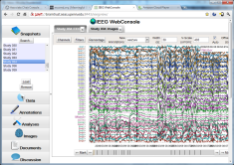
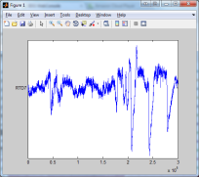
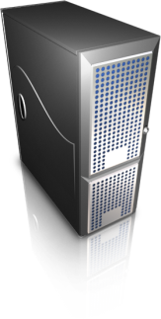
IEEG Portal
Data:
Import pipeline
Search:
Browser-based
User Interface
Tools:
Written in MATLAB, Java, Python, …
Web services
Application Server
Cloud

Slide 5
Data
(EEG seizure and non-seizure clips)
Training data
(EEG clips labeled as seizure or non-seizure)
Extract signal features from each clip
Testing data
(EEG clips we want to classify as seizure v. non-seizure)
Extract signal features from each clip
Feed features into predictive machine learning model
Generate predictions (compare predicted vs true labels for accuracy)

Slide 6
Seizure Detection
Marked Seizures
Ictal
Windows
Feature Extraction
Model Training
Interictal Windows
Classification
Post-processing
Testing Windows
Feature Extraction
Notes:
Interaction with portal
I033_A0012_D001

Slide 7
Seizure Detection on ieeg.org
EEG
Marked Seizures
Windows
Feature Extraction
Validation
Classification
Post-processing
Notes:
Interaction with portal
I033_A0012_D001

Slide 8
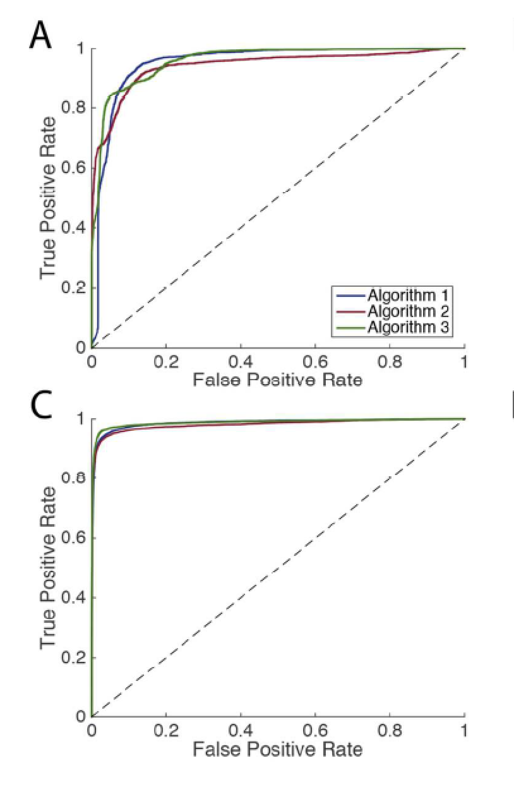
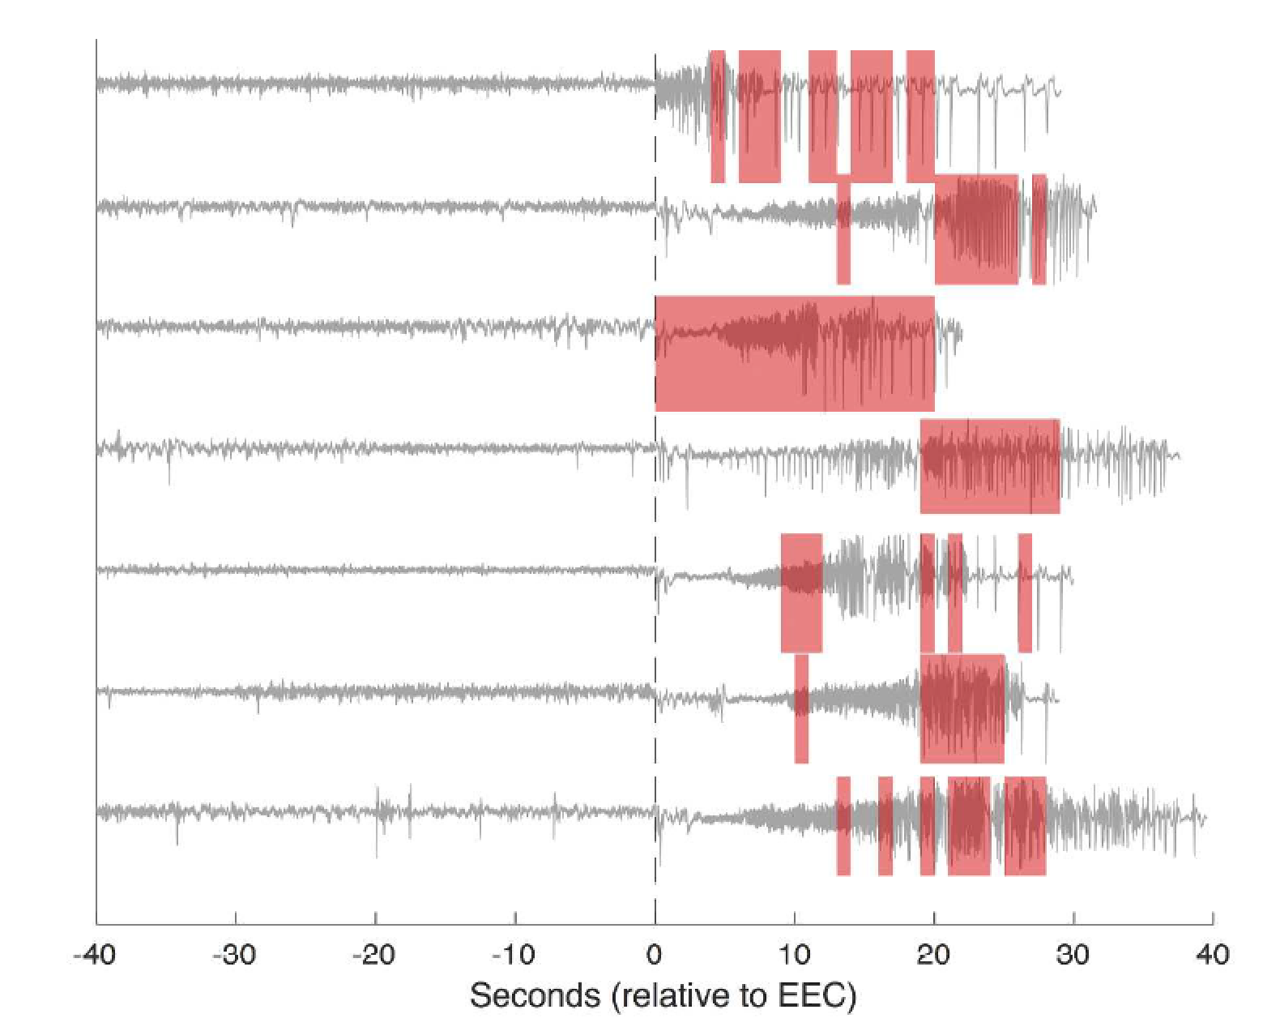
ECoG
(EMU)
ECoG
(NV)
www.kaggle.com/c/seizure-detection/details/winners.
Notes:
1 fp/hr -> sensitivity of .999

Slide 9
Features
Time Domain
Correlation coefficients in time domain + eigenvalues *
Line Length
Energy
Half wave
Frequency Domain
FFT magnitudes from 1 – 47 Hz *
Correlation coefficients in frequency domain + eigenvalues *
Power in bands

Slide 10
Seizure Detection
Open IEEG Session
For each window in training set, extract features and labels
Train model
For each window in testing set, extract features and labels
Test model
Upload predictions to ieeg.org

