Slide 1
AES Workshop
Seizure Detection on the IEEG Portal
Hoameng Ung
December 2, 2016
www.tinyurl.com/aesieeg

Slide 2
Interactive Workshop Goals
Learn how to use the IEEG Portal for quantitative EEG analysis
Understand a framework for seizure detection on IEEG
www.tinyurl.com/aesieeg

Slide 3
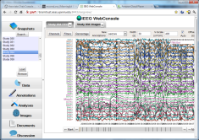
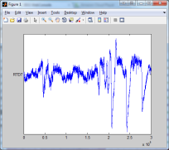

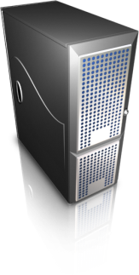
IEEG Portal
Data:
Import pipeline
Search:
Browser-based
User Interface
Tools:
Written in MATLAB, Java, Python, …
Web services
Application Server
Cloud

Slide 4
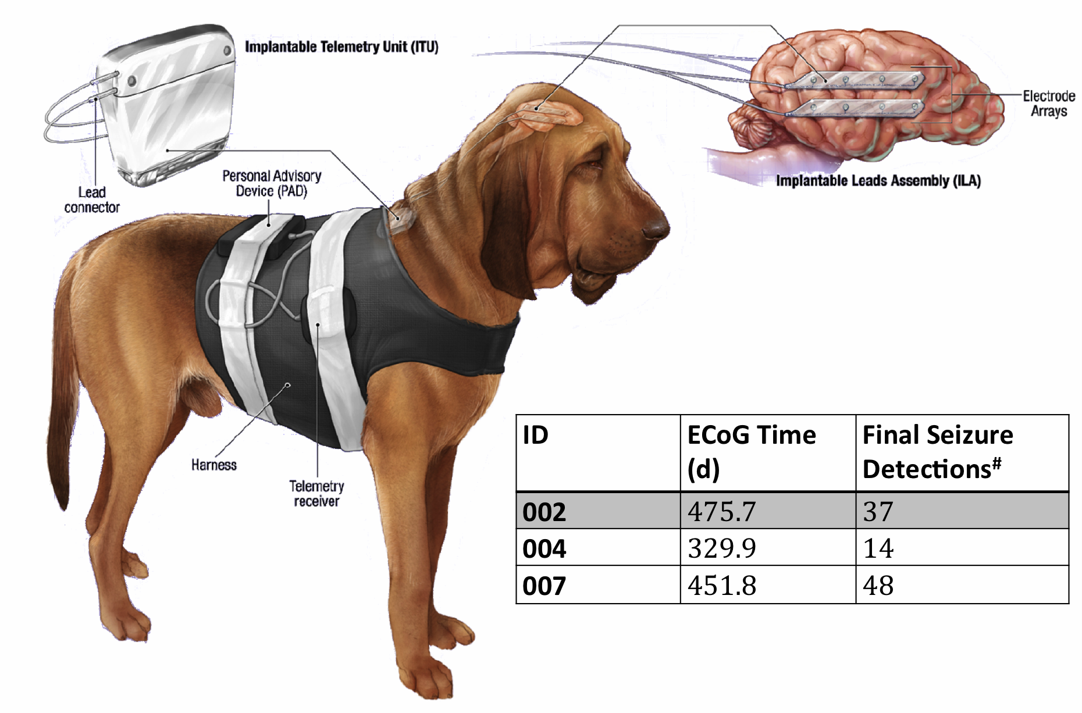
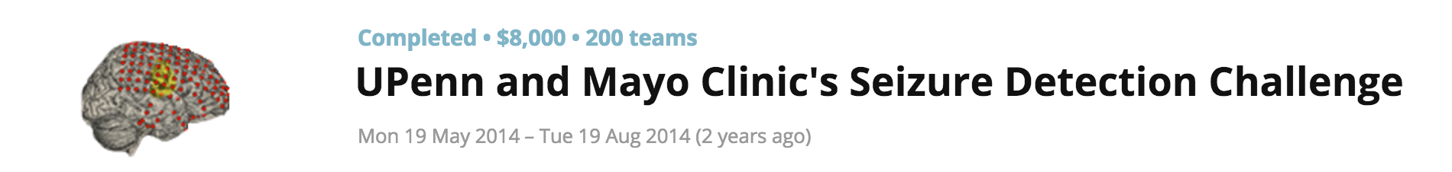
NeuroVista Canine Dataset

Slide 5
Seizure Detection Framework
Model Training
Marked Seizures
Ictal
Windows
Feature Extraction
Train Model
Interictal Windows
Prediction
Post-processing
Validation
Testing Windows
Feature Extraction
Notes:
Interaction with portal
I033_A0012_D001

Slide 6
A few features
Time Domain
Correlation coefficients + eigenvalues *
Line Length
Energy
Half wave
…
Frequency Domain
FFT magnitudes from 1 – 47 Hz *
Correlation coefficients + eigenvalues *
Power in bands
…
*Kaggle features

Slide 7
Workshop
Provided:
IEEGTutorial.m
ieegtrainfeats.m
Example seizure detection script for extended canine dataset using two paradigms
Misc tools and packages
www.tinyurl.com/aesieeg

Slide 8
Workshop
Setup:
Download/clone www.tinyurl.com/aesieeg
Sign-up at main.ieeg.org, add AES2016 to “Data Use” field
Wait for approval and addition to IEEG Portal
Create Username/Password in MATLAB (IEEGTutorial.m)
ieegTrainFeats.m
Open IEEG Session
For each window in training set, extract features and labels
Train model
For each window in testing set, extract features and labels
Test model
Upload predictions to ieeg.org

