Slide 1
AES Workshop
Seizure Detection on the IEEG Portal
December 2, 2016
www.tinyurl.com/aesieeg

Slide 2
Workshop Goals
Learn how to use IEEG Portal for quantitative EEG analysis
Understand a framework for seizure detection on IEEG

Slide 3
Automated EEG Analysis on the Portal
Dataset
NeuroVista
Kaggle
Goal: Develop seizure detector based on features from example seizures

Slide 4
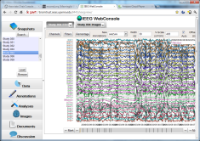
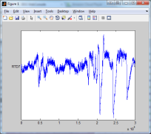
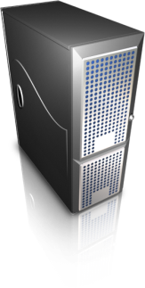
IEEG Portal
Data:
Import pipeline
Search:
Browser-based
User Interface
Tools:
Written in MATLAB, Java, Python, …
Web services
Application Server
Cloud

Slide 5
Machine Learning
Examples -> Features -> Train model -> Test

Slide 6
Seizure Detection on ieeg.org
EEG
Marked Seizures
Windows
Feature Extraction
Validation
Post-processing
Classification
Notes:
Interaction with portal
I033_A0012_D001

Slide 7
Seizure Detection
Open IEEG Session
For each window in training set, extract features and labels
Train model
For each window in testing set, extract features and labels
Test model
Upload predictions to ieeg.org

