Slide 1


Alexa Query Assistant
Querying InstaCart Database with the Voice Input
Team Members: Zekun Zhang, Ziqi Wang, Mo Shi
Instructor: Prof. Saed Sayad

Slide 2
00
Outline
Project Description
Alexa Skills Introduction
Demonstration

Slide 3
01
Project Description
Our major Implementation!!
Input Device - receive the voice input
Transform the input to SQL queries
Backend - InstaCart DB instance on AWS
Send the query result to the web page
Web Interface - display the result
Notes:
part of the language selection webpage
the text and the audio is already the same.
it is finished several centuries ago, so the words it use may not used now.
usually one speaker,

Slide 4
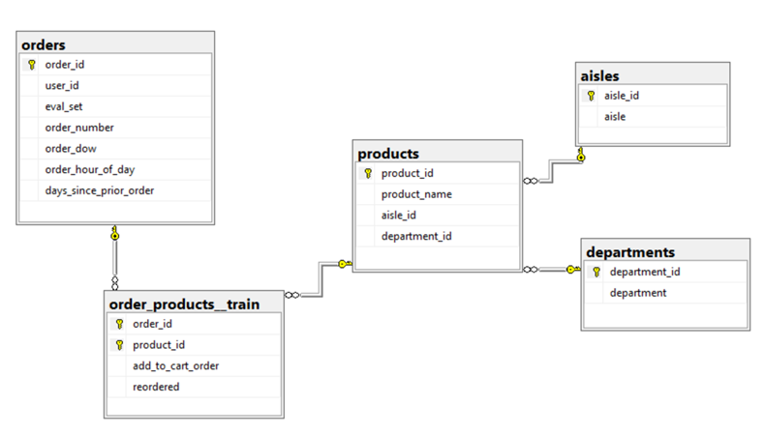
01
Project Description
InstaCart Database Structure

Slide 5
02
Alexa Skills Introduction
General Querying - “speak SQL” directly
e.g. select product name from products
the skill will help format the speech into formal SQL queries
dynamic, hard to implement, not how we talk in daily life
challenging but might not be very useful
Business Skills - for particular purposes
e.g. find the most popular product for me
achieve some functions for more business-like cases
seem helpful, but actually a lot easier to implement

Slide 6
02
Alexa Skills Introduction
1- Query Intent
single/multiple column selecting
selecting all columns from a table
aggregate functions (max, count, etc.)
2- Product Info Intent
find the department/location/name of a product with its ID
originally the info is stored in other tables
3- Find Product Intent
find the most/least popular products
find the [5, 10, 100...] most popular products
results are sorted by the number of products bought in total

Slide 7
03
Demonstration
Video at: https://youtu.be/rlLt7qX1l7I
Notes:
this is the early phase of our work

Slide 8
THANK YOU !

