Slide 1
B.TECH PROJECT — I | REVIEW 3 | VIT CHENNAI
Speech-Driven Drafting of First Information Reports for the Tamil Nadu Police
Implementation progress and interim results: one LangGraph pipeline from a spoken Tamil complaint to a draft IF-1, with the officer as author of record.
Team
23BAI1088 Madhav K
23BAI1245 Nischay Kuchibotla
23BAI1416 Rohit A. S.
Guide
Dr. Shivaranjani
School of Computer Science and Engineering
16 September 2026

Slide 2
Review 3 rubric coverage
BCSE497J Review 3 — 7 parameters, 20 marks. Where each is answered in this deck.
# | Evaluation parameter | Marks | Slides | Evidence
1 | Follow-up on Review 2 feedback; progress vs approved plan | 3 | 3, 4 | action table; 27-milestone status
2 | Implementation and functional progress (~50% of scope) | 3 | 5–11 | end-to-end pipeline, live demo
3 | Technical accuracy and best practices | 3 | 14 | 368 tests, pinned invariants, gazette-cited tables
4 | Interim testing, results and analysis | 3 | 8, 9, 12 | F1 / WER-CER / chrF / P-R tables and figures
5 | Problem-solving and technical refinement | 2 | 13 | 9 findings, each with the corrective action
6 | Progress of the project report | 3 | 15 | Chapters 1–3 revised, Chapter 4 drafted
7 | Presentation, individual responsibility, Q&A | 3 | 16, 18 | contribution table, demo, questions
Speech-driven FIR drafting (TN IF-1) · BCSE497J Review 3 · 16 Sep 2026
2

Slide 3
Follow-up on Review 2 feedback
1 mark: action taken on panel comments. 2 marks: progress against the approved plan (next slide).
Review 2 comment / suggestion | Action taken | Where
«Panel comment 1 — copy from the Review 2 evaluation sheet» | «what was done» | «slide / section»
«Panel comment 2» | «what was done» | «slide / section»
«Panel comment 3» | «what was done» | «slide / section»
Decisions changed since Review 2 — and why
– Compute: the dev machine has an 8 GB GPU, not the 16 GB assumed — the plan's 14B synthetic-data model does not fit; the 7B / 14B-with-offload decision is measured, not assumed (finding 1).
– Statute classifier: InLegalBERT was to be the classifier; on ILSI a TF-IDF baseline beats it by 0.17 micro-F1 and an ensemble adds +0.0006 — TF-IDF is the classifier, the encoder's job becomes element verification (finding 8).
– Cognizability: the planned First Schedule table was a hand-coded stub; it is now parsed from the gazette PDF with page citations, and the stub turned out wrong on 4 of 48 entries (finding 9).
– A Tamil→English translation node was added — the classifier is English-only — and its first real failure (“dowry” → “relief”) produced the cue-scan safety net (finding 5c).
Speech-driven FIR drafting (TN IF-1) · BCSE497J Review 3 · 16 Sep 2026
3

Slide 4
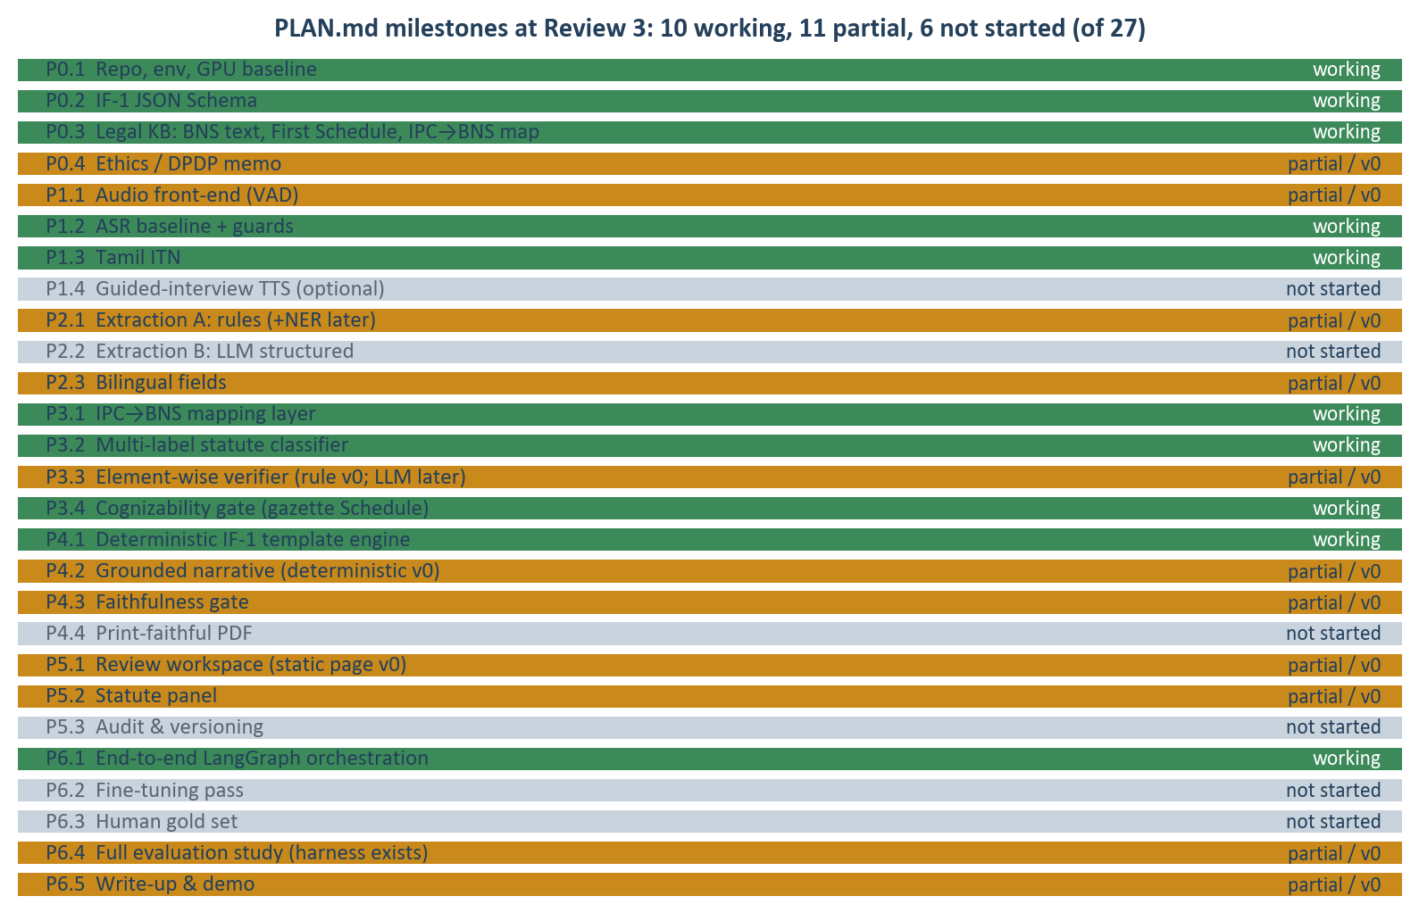
Progress against the approved plan (PLAN.md, 27 milestones)
10 working · 11 partial / v0 · 6 not started. Everything green or amber runs inside one end-to-end graph today.
Semester-1 target (PLAN §2):
– “a thin end-to-end vertical slice on synthetic data”
Status:
– the slice is not thin any more — ASR → extraction → translation → statute-ID → IPC→BNS → cognizability → elements → IF-1 → form → officer page run as one LangGraph graph
Deliberately not started:
– LLM-based modules (P2.2, P3.3-LLM, P4.2-LLM, P6.2) wait on the 8 GB model decision; PDF form and audit log are semester-2 items
Speech-driven FIR drafting (TN IF-1) · BCSE497J Review 3 · 16 Sep 2026
4

Slide 5
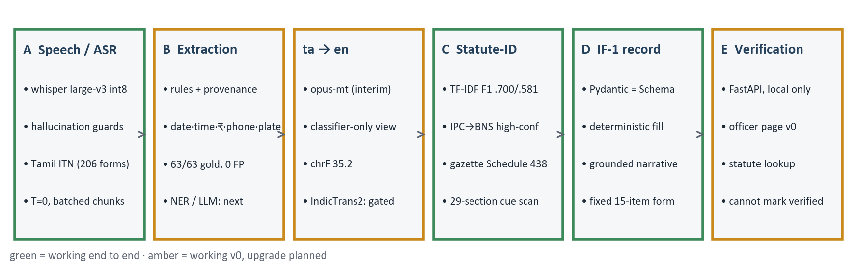
What runs end to end today
One graph: (audio→asr) → extract → translate → statute_id → ipc_bns → cognizability_check → instantiate. ~10,400 lines; text or audio in, IF-1 draft out.
– Decision support by construction: no endpoint, CLI or graph node can set a record to “verified”; the form prints “DRAFT — the officer is the author of record”; every machine-filled slot carries provenance (character offsets into the transcript).
– Strict local-only: models from a local HF cache; the API binds 127.0.0.1; audio uploads are deleted after transcription.
Speech-driven FIR drafting (TN IF-1) · BCSE497J Review 3 · 16 Sep 2026
5

Slide 6
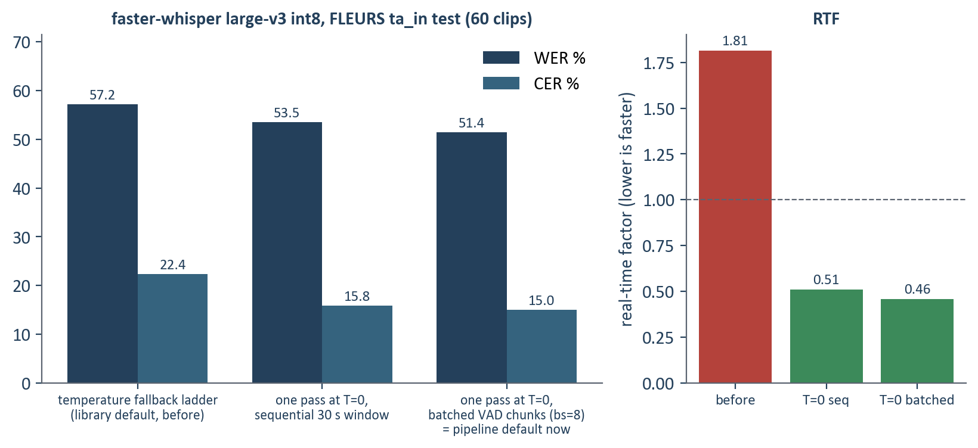
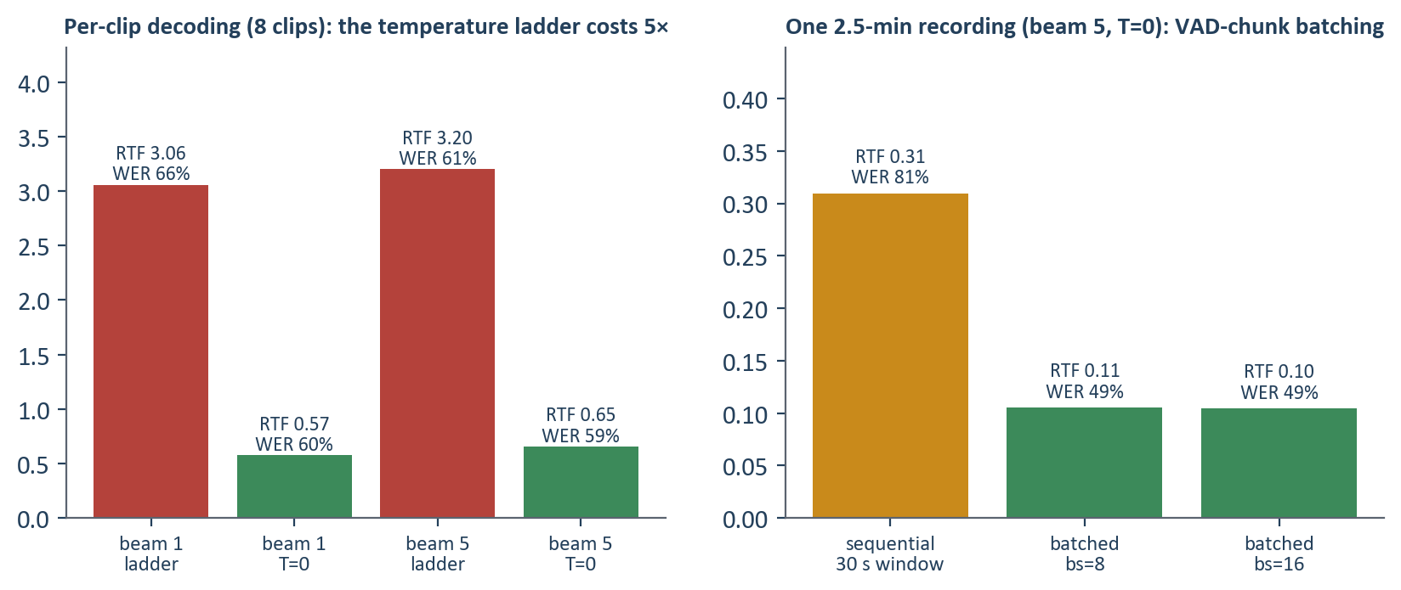
Stage A — Speech and ASR: baseline, guards, normalisation
faster-whisper large-v3 (CTranslate2) on the 8 GB GPU; FLEURS ta_in as the zero-shot yardstick.
Built
– Zero-shot baseline on 60 clips: WER 57.2% → 51.4%, CER 22.4% → 15.0% after this week's decoding fix; Tamil is agglutinative, so CER is reported alongside WER (finding 6c)
– Hallucination guards: duplicated-trigram fraction (replay loops) and foreign-script count (language drift); thresholds calibrated on the real baseline — clean clips score exactly 0%; a flagged transcript blocks auto-resolution (finding 6b)
– Tamil inverse text normalisation: 206-form number lexicon with sandhi, spoken dates/times/amounts → digits, offset map back to the audio transcript (69 tests)
Fixed this week (finding 6f)
– The library's temperature-fallback ladder re-decoded low-confidence Tamil windows up to six times. One pass at T=0 + batched VAD chunks: on 60 clips RTF 1.81 → 0.46 and WER/CER improved, not traded
– On a complaint-length recording: RTF 0.31 → 0.10, WER 81% → 49% (chunks follow pauses, not fixed 30 s cuts)
– Honest caveat: 2 of 60 clips still trip the repetition guard at T=0 — the ladder was the speed cost, not the cause of the replay loop; the guard stays
Speech-driven FIR drafting (TN IF-1) · BCSE497J Review 3 · 16 Sep 2026
6

Slide 7
Stage B — Extraction floor, and the Tamil→English view
Rules with provenance now; NER / LLM extraction is the semester-2 upgrade. The classifier is English-only, so Tamil input is translated for it — and only for it.
Rule extractor (Stage B floor)
Translation node (finding 5b / 5c)
– Slots: dates (digit, spoken, year-less), times, ₹ amounts (digit and spoken, Indian grouping), phone numbers, vehicle plates
– Fills a slot only when unambiguous; several candidates → blank + officer note
– Gold smoke set: 28 adversarial complaints, 63/63 slots, 0 false positives
– Every value carries character offsets — the form can point back at the words
– Limit: names, places and accused descriptions are not extracted yet — that is what the synthetic-data + NER phase is for
– Interim model opus-mt-dra-en: chrF 35.2, BLEU 10.5 on FLoRes ta→en; IndicTrans2 (~+20 chrF) is gated behind a licence click
– Output feeds the classifier only; extraction, elements and the narrative keep the original Tamil
– First real failure: “வரதட்சணை” (dowry) → “relief”; the classifier saw a threat, and a 498A complaint routed to CSR
– Fix: a bilingual element cue-scan on the ORIGINAL text; a cognizable section whose ingredients are all present but unpredicted forces officer review, naming the section
– Pinned by tests that reproduce the exact failure
Speech-driven FIR drafting (TN IF-1) · BCSE497J Review 3 · 16 Sep 2026
7

Slide 8
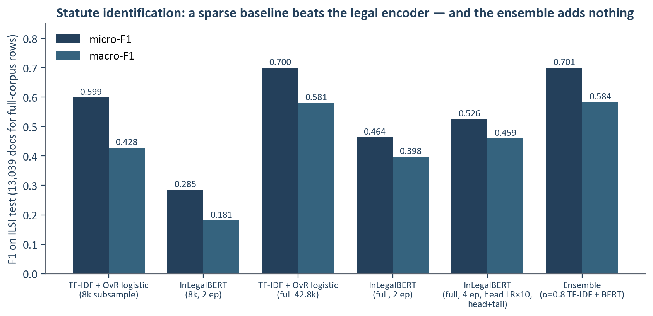
Stage C — Statute identification: the encoder question is settled
ILSI: 42,835 training / 13,039 test court documents, 100 IPC sections, multi-label. Threshold tuned on dev.
Result
– TF-IDF + one-vs-rest logistic: micro-F1 0.700, macro-F1 0.581
– InLegalBERT with every lever (4 epochs, head LR×10, head+tail truncation, pos-weight): 0.526 / 0.459
– Ensemble gain over the best single model: +0.0006
Ruled out as causes
– truncation to 512 wordpieces (costs TF-IDF only 8.6% relative); head collapse (fixed with pos-weight, finding 7); too little data (full corpus used)
Decision
– TF-IDF is the classifier; the encoder's job is element verification. Keep the sparse floor in every comparison.
Speech-driven FIR drafting (TN IF-1) · BCSE497J Review 3 · 16 Sep 2026
8

Slide 9
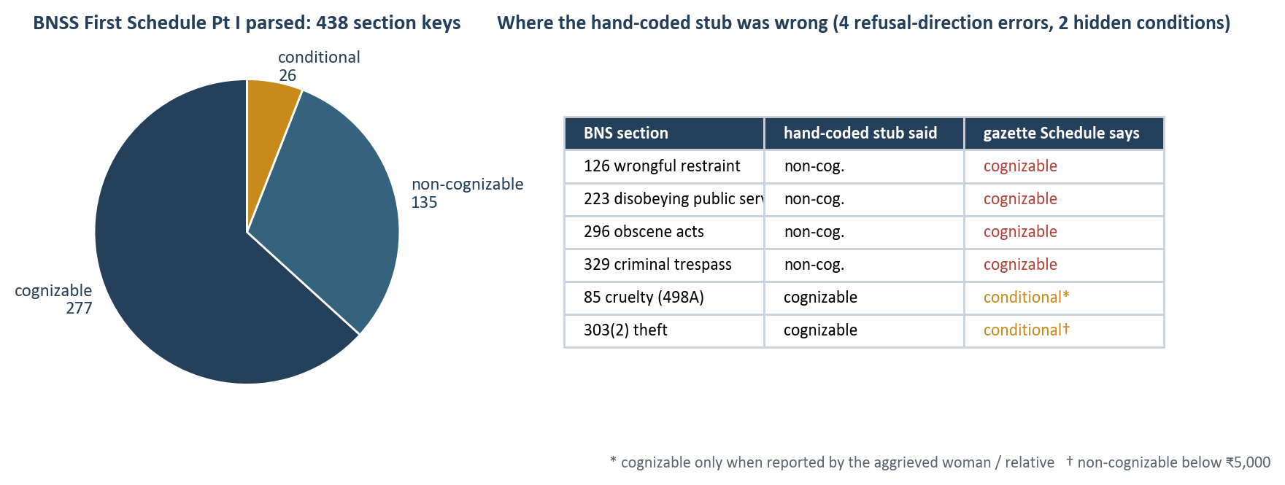
Stage C — The legal knowledge base is now the gazette, not memory
IPC→BNS map with a legal-safety invariant; BNSS First Schedule and all 358 BNS section texts parsed from the official gazette PDFs with page citations.
IPC→BNS map (100 ILSI sections)
– 69 auto-applicable · 29 flagged for review · 7 map outside the BNS. Invariant, pinned by tests: only confidence = high AND needs_review = N AND a real BNS target is applied without a human.
BNSS First Schedule, Part I
– 438 section keys: 277 cognizable, 135 non-cognizable, 26 conditional (abetment follows the offence; s.85 depends on who reports; s.303(2) theft splits at ₹5,000 — resolved from the extracted value)
BNS 2023 text
– 358 sections with headings, chapters and illustration-free operative text; shown beside every suggestion, IPC text kept as lineage
– Status: parsed and spot-checked, not legally signed off
Speech-driven FIR drafting (TN IF-1) · BCSE497J Review 3 · 16 Sep 2026
9

Slide 10
Stage C — Element-wise justification (v0) and the cue-scan safety net
A section is not one thing. The officer sees which ingredients the facts show, quoted from the transcript — and which are still to be established.
Output on the form (IPC 304B → BNS 80, dowry-death sample)
Why it doubles as a safety net
[?] death of a woman — not stated in the narrative; establish: is the deceased a woman?
[x] by burns, bodily injury, or otherwise than in normal circumstances · 'murder'
[x] within seven years of marriage · 'married five years ago'
[x] cruelty or harassment for dowry, soon before death · 'cruelty'; 'demand'; 'dowry'
– Two rules keep it honest: never “no” (absence of a word is not evidence of absence — it yields “unclear”, the officer's cue to ask), and every “yes” carries the matched words and offsets
– 29 sections covered with English + Tamil cues (theft, robbery, hurt, kidnapping, cheating incl. OTP fraud, cruelty, dowry death, trespass …); a 22-complaint battery pins what must and must not fire
– The classifier reads an English view of the complaint; the cues read the original Tamil
– A covered section whose every ingredient is present but which the classifier did not predict is raised as a question — never auto-applied
– If that section is cognizable or conditional and the route would otherwise be CSR, the case goes to the officer with the section named
– Next (PLAN P3.3): replace keyword cues with a local LLM reading each element's BNS text against the complaint — same schema, same tests
Speech-driven FIR drafting (TN IF-1) · BCSE497J Review 3 · 16 Sep 2026
10

Slide 11
Stages D and E — IF-1 record, grounded narrative, form, officer page
Deterministic slot-filling into the fixed CCTNS IF-1; the only free text is the narrative box, and every sentence in it must trace to an extracted fact.
Stage D
– Pydantic record = the canonical IF-1 JSON Schema (parity tests fail on any drift); status draft → csr_advisory → verified, and nothing in src/ can write “verified”
– Decision → record bridge: auto-applied sections become BNS candidates with IPC lineage; held-back mappings are kept, flagged ambiguous, score-capped
– Narrative composer: one sentence per grounded fact, Tamil + English, faithfulness gate = every sentence supported (structural v0; NLI/LLM judge later)
– Renderer: the 15-item form, machine-filled slots annotated ⟨status · confidence · source⟩, items 13–15 always blank (they are the officer's)
Stage E
– FastAPI on 127.0.0.1: /v1/complaint/{text,audio}, /v1/statute/{section}, /v1/health; a static officer page: route, sections with BNS text and element checks, “also consider”, flags, annotated form; “Mark verified” disabled by design
Live demo (5 min)
– 1 Typed theft complaint with a value → FIR route, BNS 303(2) with the ₹5,000 proviso shown
– 2 Same complaint without the value → officer review: “cognizability depends on property value”
– 3 Tamil dowry-cruelty complaint → translation loses “dowry”; the cue scan still raises IPC 498A
– 4 Look up BNS 85 → gazette text + the Schedule's condition
– 5 Spoken Tamil clip → transcript with ITN, guards, then the same path
– Fallback if the GPU is busy: `python -m fir draft --json` on the CLI, same output
Speech-driven FIR drafting (TN IF-1) · BCSE497J Review 3 · 16 Sep 2026
11

Slide 12
Interim results at a glance
All numbers are read from artifacts/reports/*.json by the build script; RESULTS.md is regenerated by `make results`.
Component | Data | Metric | Result | Read
Statute-ID (TF-IDF) | ILSI test, 13,039 docs | micro / macro-F1 | 0.700 / 0.581 | the classifier of record
Statute-ID (InLegalBERT, best) | same | micro / macro-F1 | 0.526 / 0.459 | loses to the sparse floor
ASR before (fallback ladder) | FLEURS ta_in, 60 clips | WER / CER / RTF | 57.2% / 22.4% / 1.81 | 2 clips flagged by the guard
ASR now (T=0, batched) | same | WER / CER / RTF | 51.4% / 15.0% / 0.46 | 2 flagged: replay loop persists at T=0
ASR (T=0, sequential) | same | WER / CER / RTF | 53.5% / 15.8% / 0.51 | 1 flagged
ASR, complaint-length recording | 8 clips joined, 148 s | RTF / WER | 0.10 / 49% (batched) vs 0.31 / 81% (sequential) | batching is also more accurate
Translation ta→en (opus-mt) | FLoRes devtest, 336 pairs | chrF / BLEU | 35.2 / 10.5 | upper bound on Tamil statute-ID
Extraction (rules) | 28 gold complaints | slot P / R | 1.00 / 1.00 (63 slots, 0 FP) | smoke set, not a benchmark
IPC→BNS map | 100 ILSI sections | auto / review / non-BNS | 69 / 29 / 7 | third-party source; gazette check pending
BNSS First Schedule | 438 keys from gazette | cog / non-cog / conditional | 277 / 135 / 26 | stub was wrong on 4/48
Test suite | 17 files | tests passing | 368 | no model weights needed, ~20 s
Speech-driven FIR drafting (TN IF-1) · BCSE497J Review 3 · 16 Sep 2026
12

Slide 13
Technical challenges and corrective action
Each finding is recorded in PROGRESS.md with the measurement that established it and the test that keeps it fixed.
Challenge (finding) | Evidence | Corrective action
GPU is 8 GB, not 16 GB (1) | torch reports 8.5 GB; 14B-Q4 ≈ 9 GB | models.yaml carries a fits flag per model; 7B vs 14B-with-offload to be benchmarked on mains power
WSL VM rebooted under full-corpus jobs (6e) | 6 deaths; predictor = Python heap > ~2 GB | chunked vectoriser / tokenizer / predict; detached launches; logs on /mnt/c
InLegalBERT head collapsed to 6/100 labels (7) | loss flat at 0.142, macro-F1 0.018 | pos-weighted BCE, higher head LR; then measured honestly against TF-IDF
Whisper fabricated text on 2/60 clips (6b) | replay loop 226% WER; Cyrillic drift | transcript guards calibrated on the baseline; flagged → not auto-resolvable
ASR 3× slower than real time (6f) | profile: fallback ladder 3.06 vs 0.57 RTF | one pass at T=0; batched VAD chunks; 60-clip WER 57→51%, CER 22→15%, RTF 1.81→0.46
Translation lost “dowry” → CSR route (5c) | reproduced on the real server | bilingual cue scan on the original; forces officer review
Cognizability stub wrong on 4/48 (9) | gazette parse vs stub: 126, 223, 296, 329 | parse the First Schedule with page citations; conditional class; value-resolved theft split
Classifier abstains on short complaints (5) | top-5 for a theft sample has no 379 | not a threshold problem — in-domain synthetic data; cue scan carries short inputs
Speech-driven FIR drafting (TN IF-1) · BCSE497J Review 3 · 16 Sep 2026
13

Slide 14
Technical accuracy and engineering practice
What a reviewer can check without trusting us.
Testing
– 368 tests in 17 files, ~20 s, no weights: golden end-to-end fixtures, schema parity, ITN, cue battery, Schedule integrity, serving, CLI
– Legal invariants are tests: the IPC→BNS auto-apply rule, “unknown never defaults”, “nothing can set verified”, threat ≠ attempt/murder
– ruff clean; LF-only repo; reproducible builds: `make schedule`, `make bns-text`, `make results`
Evaluation practice
– Sparse baseline kept in every comparison; thresholds tuned on dev, reported on test; CER beside WER for Tamil; per-clip distributions, not just corpus means
– Negative results recorded: encoder < TF-IDF; ensemble +0.0006; condition_on_previous_text did not fix replay; int8 vs fp16 WER gap was fallback noise
Provenance and safety
– Every extracted value: character offsets; every element “yes”: quoted words; every Schedule row: gazette page; every model: local cache path
– Decision support only — route and sections are proposals; the officer is the author of record; CSR is advisory
– Local-only inference; no hosted API anywhere in the code; PII-minimal (audio deleted after transcription)
Best-practice choices
– CTranslate2 int8 for VRAM headroom; LangGraph for an inspectable state machine; Pydantic ↔ JSON Schema parity; config-driven (pipeline.yaml, models.yaml, datasets.yaml)
– Honest limits stated on the form: “stub”/“parsed, not signed off”/“interim model” wherever true
Speech-driven FIR drafting (TN IF-1) · BCSE497J Review 3 · 16 Sep 2026
14

Slide 15
Project report progress
Review3_Report.docx: Chapters 1–3 carried forward with a revisions section; Chapter 4 drafted from the same JSON reports as this deck.
Chapter | Status | Contents at Review 3
Preliminary pages | updated | abstract with a Review-3 status paragraph; rubric map for Review 3; TOC
1 Introduction | unchanged | background, problem, objectives, scope, expected outcomes
2 Literature / patent review | unchanged | 16 sources; comparative analysis; gap
3 Methodology / design | revised | §3.8 Revisions since Review 2: compute budget, classifier choice, translation node, gazette-parsed KB, team allocation
4 Implementation and results | new (initial) | environment; implementation by stage; testing & validation; interim results (6 tables, 5 figures); analysis; limitations; individual contribution
5 Conclusion and future work | outline | to be written for Review 4
References | extended | gazette notifications, faster-whisper / CTranslate2, opus-mt, sacreBLEU added
AI-tool acknowledgement (guideline §2): an AI coding assistant (Claude Code) was used for implementation support under the team's direction; all design decisions, legal tables and results were reviewed and are reproducible from the repository. «confirm wording with the guide»
Speech-driven FIR drafting (TN IF-1) · BCSE497J Review 3 · 16 Sep 2026
15

Slide 16
Individual contribution
«Confirm before the review — the panel grades each member's demonstrated contribution (guideline §2).»
Member | Ownership (as planned at Review 2) | Delivered at Review 3 | Demonstrates
Madhav K (23BAI1088) | Stage C/D: statute identification, IPC→BNS, cognizability, IF-1 instantiation; integration | «…» | «slides / demo steps»
Nischay Kuchibotla (23BAI1245) | Stage A: ASR benchmark, guards, Tamil ITN, code-switch fine-tune | «…» | «…»
Rohit A. S. (23BAI1416) | Stage B: extraction, synthetic data engine, NER seeding | «…» | «…»
The repository records who did what: PROGRESS.md is the dated engineering log; every module has an owner in IMPLEMENTATION.md. Present the split as it actually happened — the rubric rewards demonstrated contribution, not the plan.
Speech-driven FIR drafting (TN IF-1) · BCSE497J Review 3 · 16 Sep 2026
16

Slide 17
Plan to Review 4 (12–16 October 2026)
Complete implementation, final results, report verification — and proof of a publication submission (Review 4 parameter 9, 2 marks).
Weeks 1–2
– Decide the local LLM on mains power (7B-Q4 vs 14B-Q4 offload) → synthetic Tamil complaint → IF-1 generator (PLAN §5.2)
– IndicTrans2 (licence click) or NLLB-600M replaces opus-mt; re-measure Tamil statute-ID end to end
– IndicWhisper / IndicConformer benchmark against the corrected Whisper numbers
Weeks 3–4
– LLM element verifier reading BNS text (P3.3) behind the same ElementCheck schema; NER (MuRIL) for names / places / accused
– Legal read-through of the Schedule CSV and the 29 flagged mapping rows with the guide
– Self-recorded Tamil complaint gold set (P6.3), consent script from the DPDP memo
Publication plan «confirm venue with the guide»
– Paper 1 (ready to write from Chapter 4): “A sparse baseline beats a domain-pretrained encoder on Indian statute identification — and what the encoder is for instead” (ILSI, full-corpus results, element verification)
– Paper 2 (after the gold set): “Officer-in-the-loop FIR drafting from spoken Tamil complaints: provenance, cognizability and the cost of translation”
– Candidate venues: ICON 2026 (NLP in India), FIRE 2026 (legal track), or an IEEE/Springer conference with a Dec–Jan deadline — submission proof needed by 12 Oct
– Artefacts already reusable: RESULTS.md tables, r3_*.png figures, reproducible harness
Speech-driven FIR drafting (TN IF-1) · BCSE497J Review 3 · 16 Sep 2026
17

Slide 18
Summary
Half the approved scope runs as working modules, in one graph, with the officer as author of record.
– An end-to-end pipeline from spoken Tamil to a draft IF-1 exists and is tested; nothing in it can file anything
– The research question was measured, not assumed: on ILSI a sparse baseline beats InLegalBERT (0.700 vs 0.526 micro-F1); the encoder's role is element verification
– The legal tables the routing depends on now come from the gazette with page citations — and doing so caught four refusal-direction errors in the hand-coded version
– ASR runs 4× faster with better WER and CER after one measured change; two real safety failures (translation loss, fabricated transcripts) each produced a guard that is pinned by a test
– Next: the local LLM decision unblocks synthetic data, the element verifier and the fine-tuning pass; publication draft from Chapter 4
Questions — and the live demo.
Speech-driven FIR drafting (TN IF-1) · BCSE497J Review 3 · 16 Sep 2026
18

