Slide 1
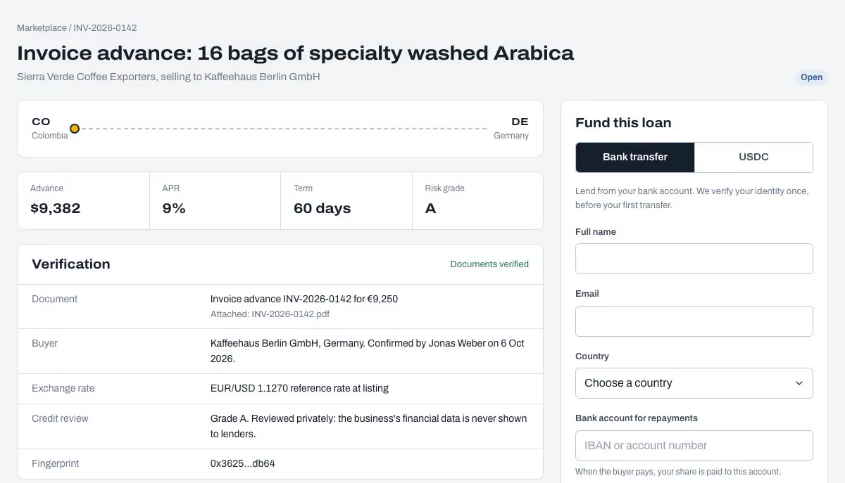
Tradeflow
Fund the goods
already on their way.
A listed loan in the app: verified, priced and open for funding
Maadhav Sharma, Founder & CEO, CodeDecoders
TOKEN2049 Origins, Singapore. Built on Chainlink CRE.
Notes:
Tradeflow funds goods that are already on their way. A business gets an advance on a confirmed invoice, bill of lading or equipment order, lenders fund it, and every decision that depends on off-chain facts is made by a Chainlink CRE workflow.

Slide 2
Shipped today, paid months later
Goods shipped
Buyer pays
In between, the exporter still has to pay for the next order.
$2.5 trillion
Global trade finance gap, 2022
Source: Asian Development Bank, 2023 Trade Finance Gaps, Growth, and Jobs Survey.
Notes:
Exporters, shippers and manufacturers wait months to be paid for goods they have already shipped, and still have to pay for the next order in between. The Asian Development Bank puts the global trade finance gap at 2.5 trillion dollars in 2022.

Slide 3
Sell the wait to lenders
Business
Buyer
Lenders
Business
Buyer
Asks for an advance
Confirms by link
Fund in fiat or USDC
Is paid out in fiat
Pays, lenders repaid
Who benefits
Exporters
Lenders
Tradeflow
Paid when the goods ship
Short, document-backed yield: 9% to 19% APR in the demo
A fee on each advance
Every off-chain decision is a Chainlink CRE workflow, written onchain as a signed report.
Notes:
The business enters a confirmed invoice, bill of lading or equipment order. The buyer confirms it through a link, and nothing lists until they do. Lenders fund it by bank transfer, on-ramped to USDC, or with USDC from a wallet. The business is paid out in fiat as soon as the loan is fully funded, and when the buyer pays, lenders are repaid with interest. Exporters are paid when the goods ship, not months later. Lenders get short, document-backed yield: the two demo loans priced at 9 and 19 percent APR. Tradeflow's model is a fee on each advance.

Slide 4
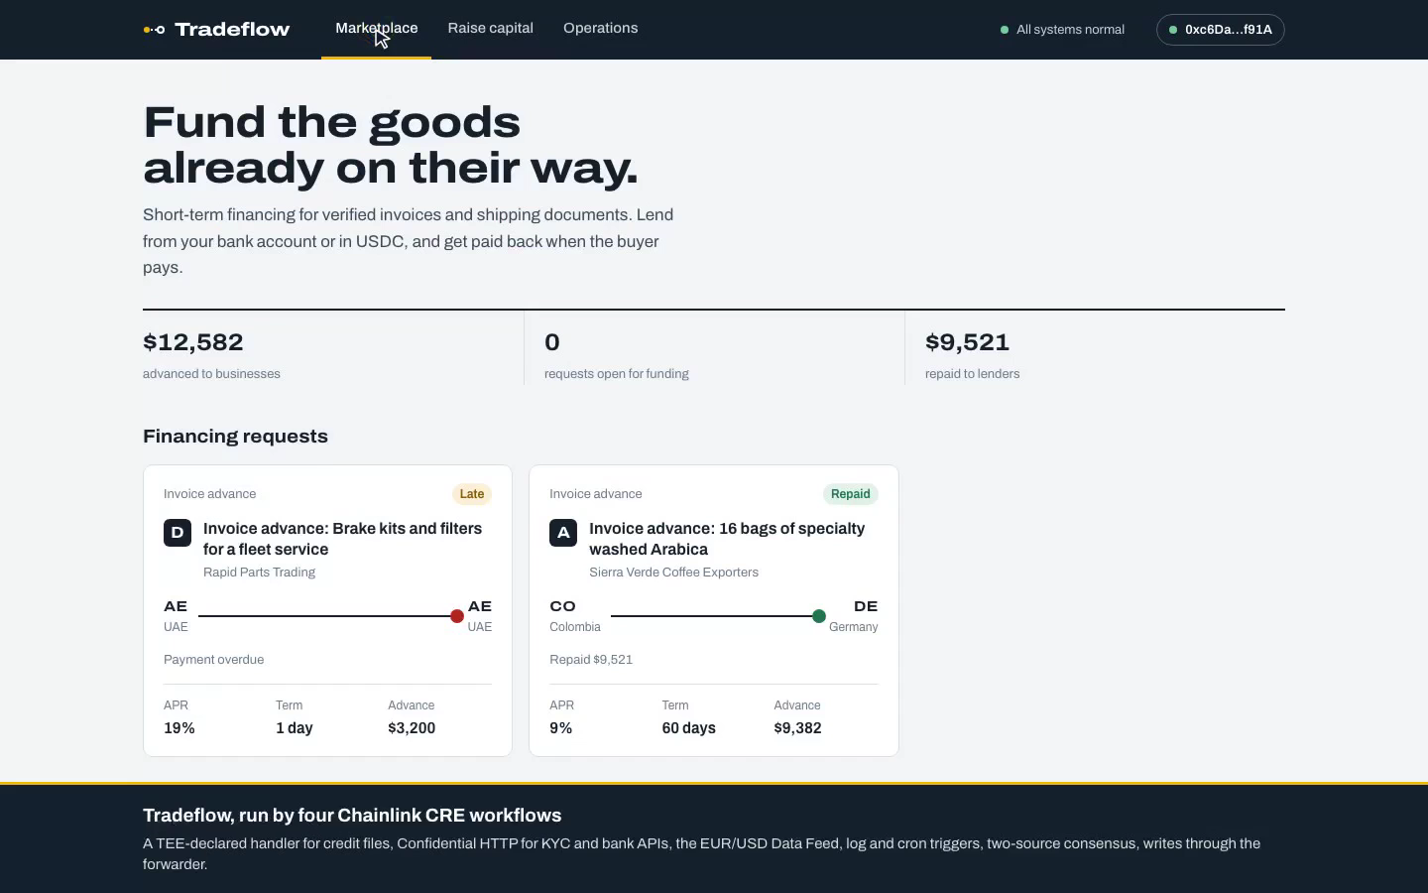
Demo
1:27
Full 2:46 cut: last slide
Listed
Funded
Paid out
Repaid
Paused
Late, frozen
Notes:
The video starts on its own and runs on Ethereum Sepolia. The buyer confirms the invoice and the listing workflow runs: the credit review is a TEE-declared handler, and the terminal shows the same run in the CRE CLI. A bank deposit is checked against the Chainlink Data Feed, the loan funds and the business is paid out. Repayment is confirmed by two independent sources. Then the bank books a deposit that never reached the chain, and the monitor pauses funding onchain. A second loan goes late and the business is frozen. The longer cut is on the last slide.

Slide 5
CRE makes every off-chain decision
listing
lender
settlement
monitor
HTTP trigger
TEE handler
Data Feed: EUR/USD
HTTP trigger
Confidential HTTP
Data Feed, 1% FX check
Log + HTTP triggers
Two-source consensus
Cron trigger
Circuit breaker
Is the document real, confirmed and creditworthy? Then list the loan.
Is the lender verified? Did the bank deposit really arrive?
Pay the business once funded. Repaid only when two sources agree.
Late loan? Books out of balance? Freeze the business or pause funding.
Each run writes a signed report onchain through the Chainlink CRE forwarder.
Notes:
Four workflows, seven handlers. Listing verifies and prices the document, and prices euro documents with the Chainlink EUR/USD Data Feed. Lender runs KYC over Confidential HTTP and only credits a bank deposit when the on-ramp rate is within 1 percent of the feed. Settlement pays out on the funded log event, and an HTTP-triggered run confirms repayment from two independent sources. Monitor runs on a cron, catches late loans and reconciles the books, with an onchain circuit breaker.

Slide 6
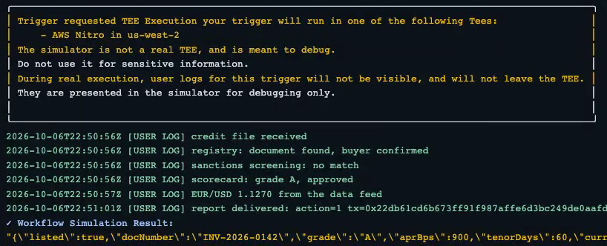
Confidential by design
Stays in the enclave
Only the verdict leaves
AWS Nitro on a deployed DON, declared with handlerInTee
Written onchain with the document's terms
Revenue and open debts
Grade
Payment history
APR
Sanctions screen
Advance
Confidential HTTP
KYC and bank deposit checks call their APIs with a Vault DON secret. On a deployed DON it is injected inside the enclave, never held in workflow code.
CRE CLI simulation of run 1: the handler requests AWS Nitro, the simulator runs it locally and says so, then delivers the signed report to Sepolia.
Notes:
The listing handler is declared for TEE execution with handlerInTee. On a deployed DON the credit file, the registry response and the sanctions result are processed inside an AWS Nitro enclave, so node operators never see a business's revenue, debts or payment history. From the credit file only the grade, APR and advance come out, written onchain with the document's own terms and hash. Lender KYC and bank deposits use Confidential HTTP with a Vault DON secret. What you see here is the CRE CLI simulation: it runs the same handler locally, says in its banner that it is not a real TEE, and then delivers the report to Sepolia. Deploy access is not enabled for the hackathon.

Slide 7
Lenders do not take our word for it
KYC-gated loan notes
Enforced by code
ERC-1155 notes that only move between verified holders.
A late loan freezes the business. A books mismatch pauses all new funding.
contracts/src/LoanNotes.sol
frozenBorrower, fundingPaused in TradeflowMarket
No double financing
Every decision is signed
The document hash is recorded onchain. The same invoice cannot list twice.
A CRE report through the forwarder. The market rejects anything outside policy.
usedRef in TradeflowMarket, checked by the listing workflow
TradeflowMarket is a CRE ReceiverTemplate
Notes:
The chain is where the rules are enforced, not just recorded. Loan notes can only be held by verified people. A late loan freezes the business onchain, and a reconciliation mismatch trips a circuit breaker. Every financed document's hash is recorded, so the same invoice cannot be financed twice. Every state change arrives as a signed CRE report, and the contract checks it against policy. Unlike onchain credit pools where a trusted originator attests to its loans, each Tradeflow loan is verified by a CRE workflow before it lists.

Slide 8
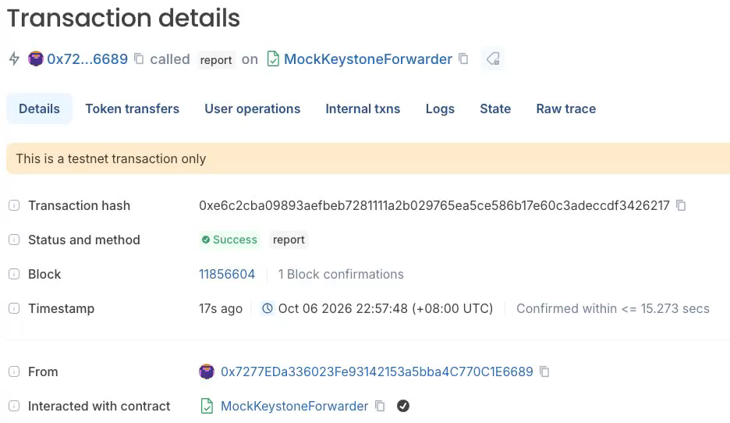
It runs on Ethereum Sepolia
14
CRE workflow runs, 14 Sepolia transactions
cre workflow simulate --broadcast
8 of 8
contract tests pass (forge test)
12
step end-to-end test, on a local Sepolia fork
Monitor run 10 on Sepolia: the books disagree, so a signed CRE report pauses funding onchain. The CLI simulator delivers through its Sepolia MockKeystoneForwarder.
github.com/Maadhav/tradeflow
Banks, KYC, credit bureau and on-ramp are simulated services. The workflows, contracts and Sepolia transactions are real. USDC is a test token.
Every run's log and transaction hash: evidence/
Notes:
Everything was run with the CRE CLI, cre workflow simulate with broadcast, which writes real Sepolia transactions: 14 workflow runs across the four workflows. One run was a rejection with no write, and one monitor run wrote two, so 14 transactions. Deploy access is not enabled, so reports go through the simulator's Sepolia forwarder. 8 contract tests pass, and a 12 step end-to-end test drives the whole lifecycle on a local fork of Sepolia. The banks, KYC provider, credit bureau and on-ramp are simulated services; the stablecoin is a test token. Logs and transaction hashes are in the evidence folder of the repo.

Slide 9
What is next
Deploy on CRE
Banking partners
More documents
On the CRE network, with confidential compute for the listing handler
Real banks, on-ramps and payout providers behind the same workflows
More document types and trade corridors, the same CRE decisions
Tradeflow
Maadhav Sharma
Founder & CEO, CodeDecoders
Fund the goods already on their way.
Built by CodeDecoders, the team behind GSOS
gsos.io github.com/Maadhav/tradeflow
Notes:
Next: deploy on the CRE network with confidential compute, plug in real banking, on-ramp and payout partners, and add more document types and corridors. Built by CodeDecoders, the team behind GSOS. Thank you.

Slide 10
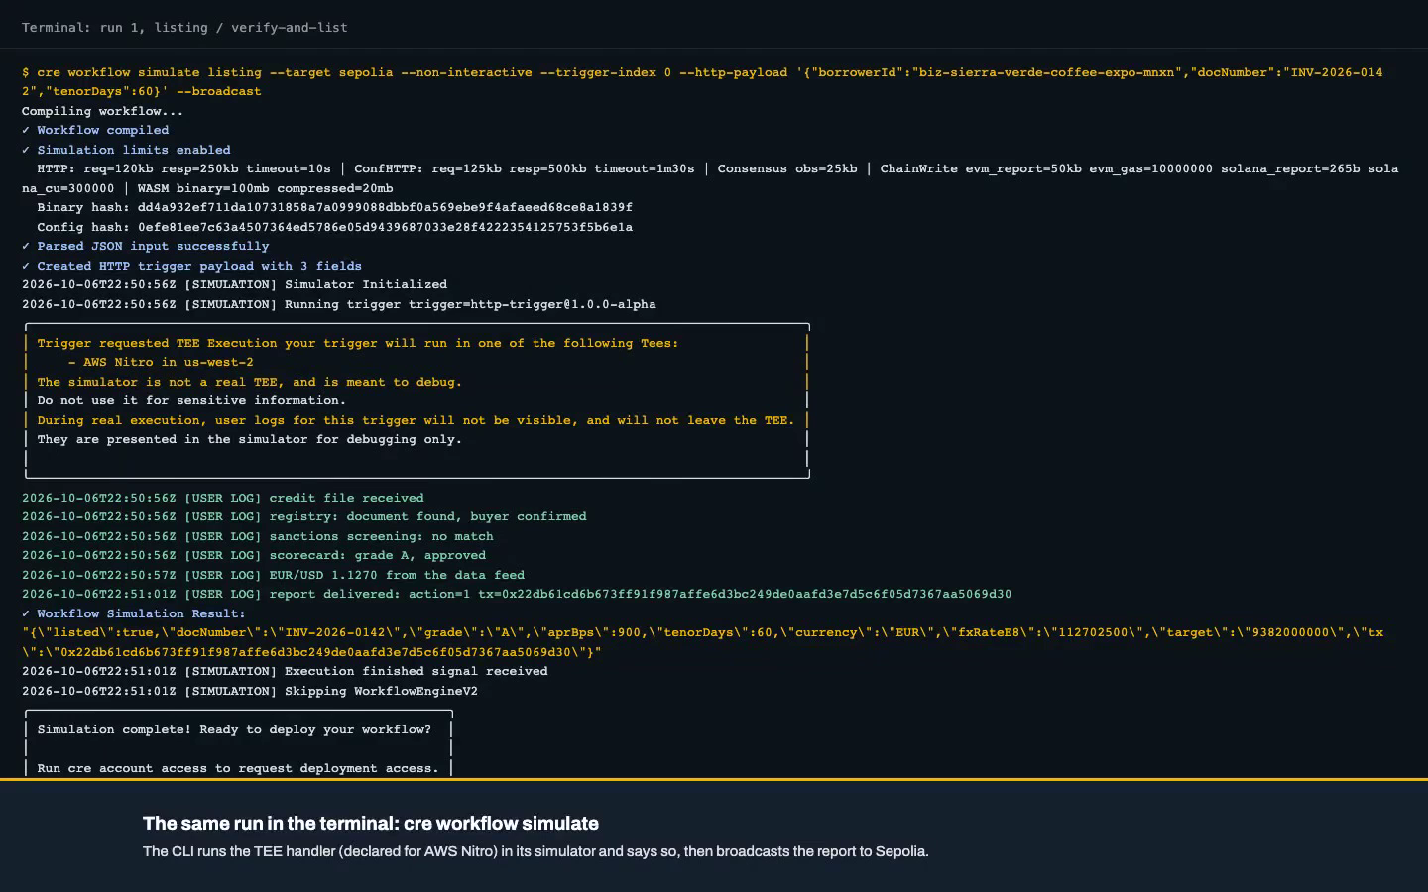
Appendix
2:46
Full walkthrough: the longer cut of the same Sepolia take. Sign-up, the buyer link, a bank lender and a wallet lender, payout, repayment, the circuit breaker and the late loan. Click the video to play.
Notes:
Appendix for reviewers, not part of the live pitch: the longer cut of the same Sepolia take shown on the demo slide.

