Slide 1
Concept Presentation
October 15th 2021

Slide 2
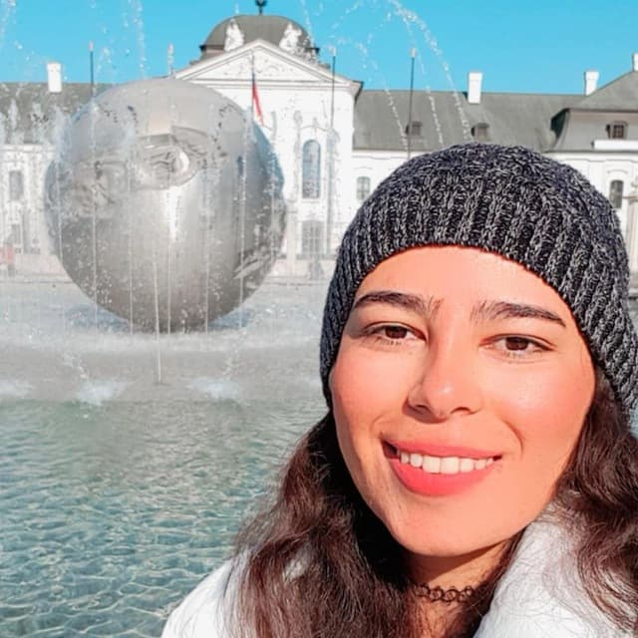
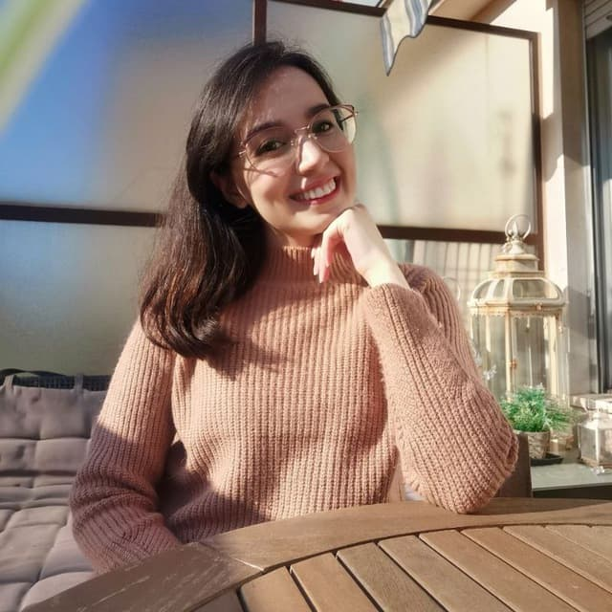


Our team
Group # 6
Razieh Ahmadi
Farimah Anvari
Mansoure Ebrahimi
Sajedeh Firouzizadeh

Slide 3
How it appears?
You need a caregiver you have some demands but:
you cannot find someone to fulfill your requirements.
You don’t have enough time?!
You don’t know where you should find him?

Slide 4
How it appears?
You need a caregiver you have some demands but:
you cannot find someone to fulfill your requirements.
You don’t have enough time?!
You don’t know where you should find him?

Slide 5
What is your gain?
Find your best matches in a short run not only if you are caregiver but also if you need a caregiver.
Choose between several options (Comparison between your options and select the best)
Connect you to your personal doctor or the specialist.

Slide 6
Is there anybody who solve this problem?
YES
BUT their services is provided for a specific demand.
We try to gather all aspects together in a unique platform.

Slide 7
THANKS

