Slide 1


Concept Selection
October 29th 2021

Slide 2





Slide 3

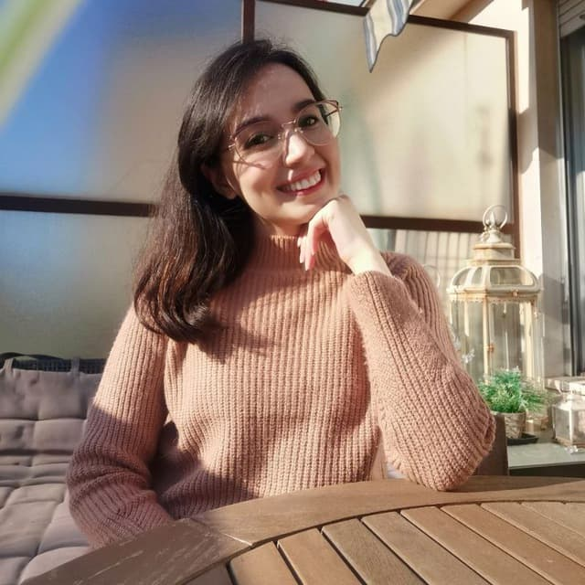
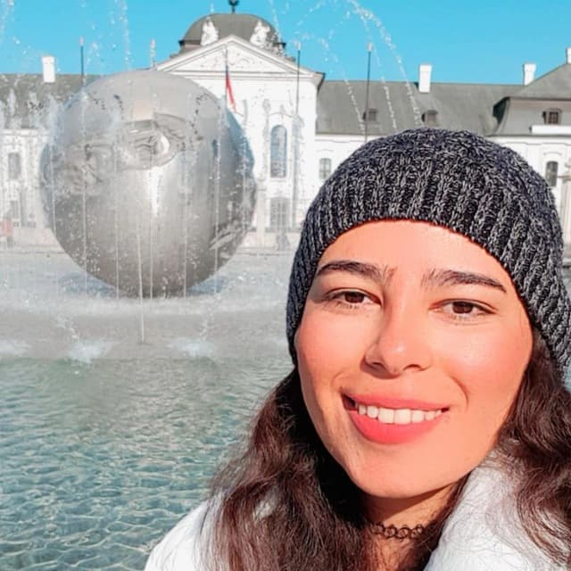

Our team
Group # 6
Mansoure Ebrahimi
Farimah Anvari
Razieh Ahmadi
Sajedeh Firouzizadeh
1

Slide 4
What is our BUSINESS?
01
2

Slide 5
Our Business is created to help students to find their caregiver/nurse easily and in a short time.
We can help you if you:
have some disabilities, and you need someone to help you
Your family need help
need medical care.
need someone to help you in house chores.
3

Slide 6
Why is it a successful IDEA?
02
4

Slide 7
There is no easy way for students to find a CAREGIVER/NURSE
There is no platform for caregivers to introduce themselves.
Number of Students in Italy that need help.
TIME & COST are important.
5

Slide 8
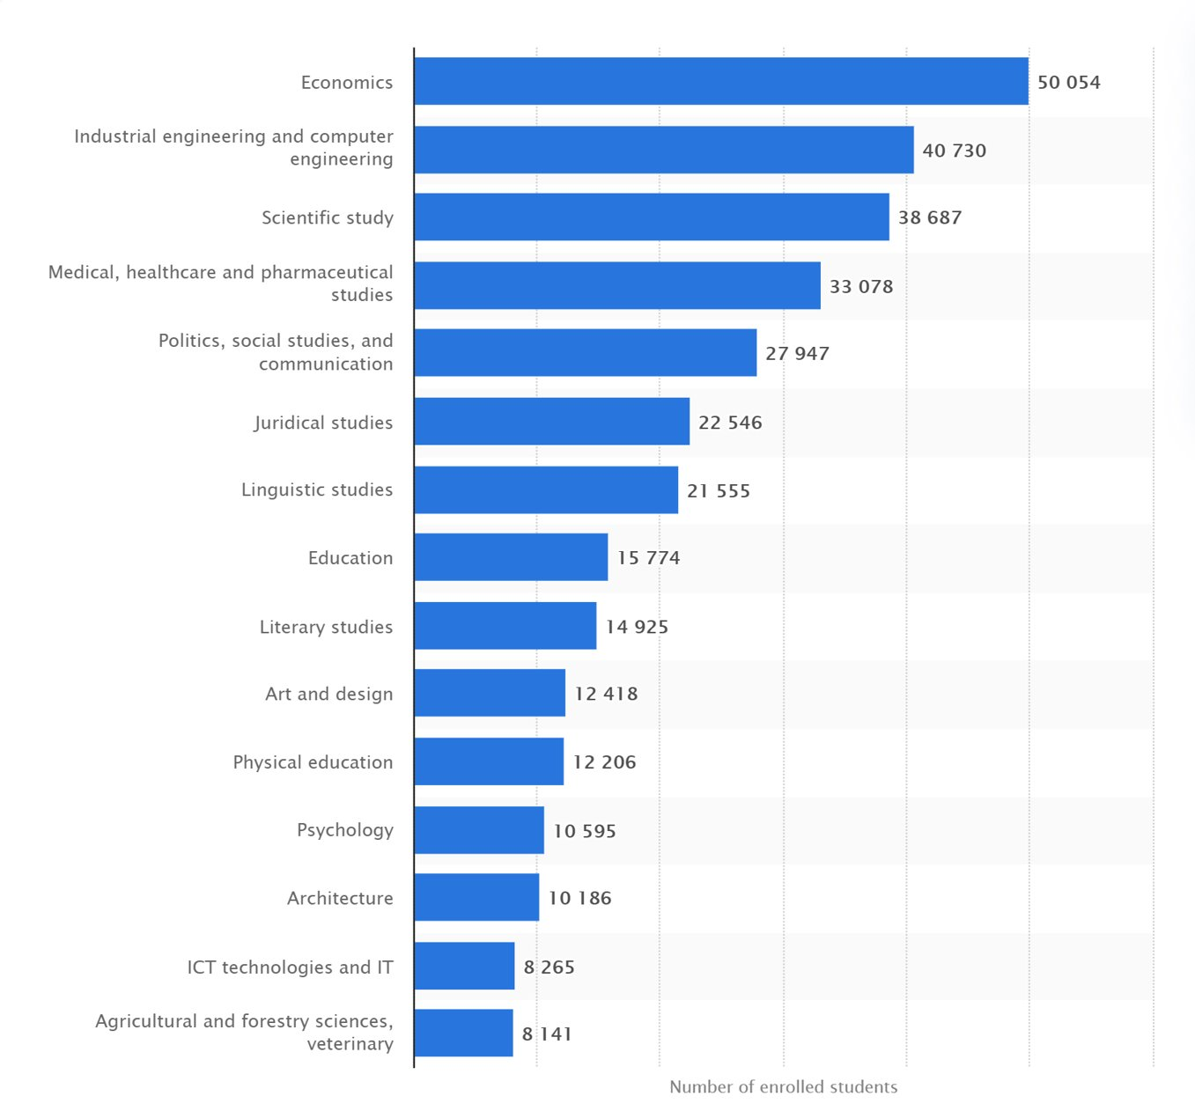
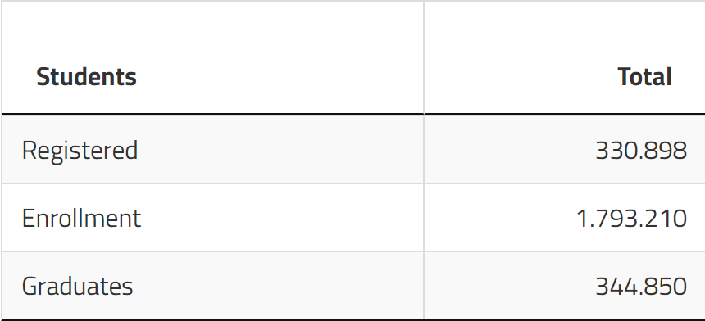
Students’ Community:

Slide 9
What is our users' need and How we satisfy them?
03
6

Slide 10
Search between available service providers by using filtering
Use application suggestions based on you profile.
We authorize them, you just select freely your best option.
Be sure that our professional nurses are up to date.
Hire your caregiver in easiest way
Use the feedbacks
Immediate caregiver replacement
Earn credit and use services by free.
Checking your satisfaction and feedbacks during the period.
7

Slide 11
Who are our players?
04
8

Slide 12
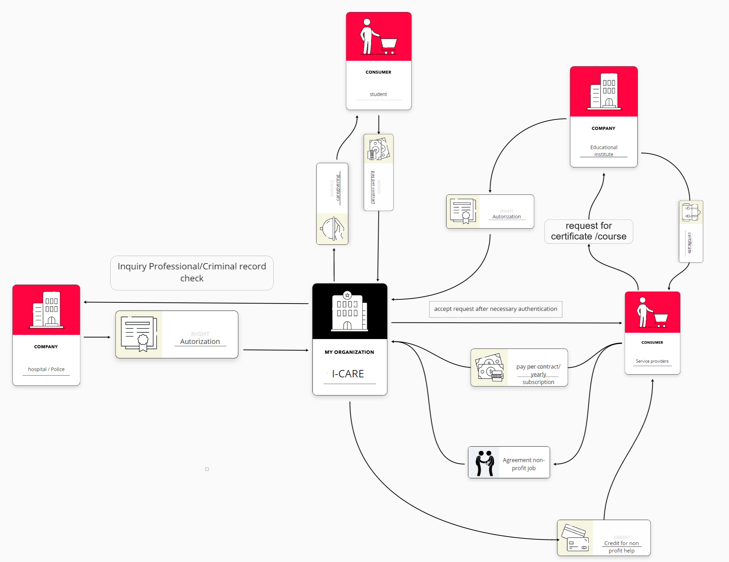
​
Revenue Model
9

Slide 13
THANKS

