Slide 1

Learning Objectives:
Chapter 5: Organic Chemistry
Episode: AlcReaction mechanisms
Chemistry class: F4
At the end of this episode, students should be able to
Define Isomers
State types of isomers
Describe polymerization
Describe types of polymerization

Slide 2
Chapter 5: Organic Chemistry
Episode: Isomers
Chemistry class: F4
Isomers
Isomers Are organic compound with the same molecular formula but different structure
There are two types of isomers:
Structural isomerism
Stereoisomerism
Structural isomerism : organic compound that have same molecular formula but the atoms are arranged in a different way
Example: Butane C4H10 has two isomers

Slide 3
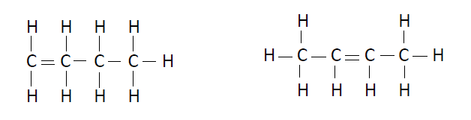

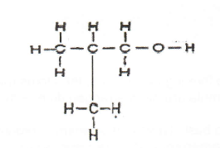
Chapter 5: Organic Chemistry
Episode: Isomers
Chemistry class: F4
Positional isomerism: The functional group are different position
Chain isomerism: The hydrocarbon chain are different

Slide 4
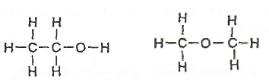
Chapter 5: Organic Chemistry
Episode: Isomers
Chemistry class: F4
Functional group isomerism: The functional group are different
Stereoisomerism: organic compound that have same molecular formula but different spatial arrangement
There are two types of stereoisomerism:
Optical isomerism
Geometrical isomerism

Slide 5
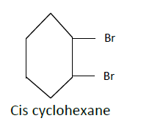

Chapter 5: Organic Chemistry
Episode: Isomers
Chemistry class: F4
Cis-trans (or geometric) isomerism:
Geometric isomerism occurs in alkenes when both carbon atoms forming the double bond are attached to two different groups.
There must be:
a C=C double bond
two different groups attached to each carbon end to the double bond
Cis( same side)
Trans(opposite side)

Slide 6
Chapter 5: Organic Chemistry
Episode: Isomers
Chemistry class: F4
Polymerization:
Polymerization is the the process that small molecules are joined to form long chain.
Types of polymerization:
1. Addition polymerization
2. condensation polymerization

Slide 7
CONT…..
Chapter 5: Organic Chemistry
Episode: Isomers
Chemistry class: F4
Monomer: Small repeating unit
Polymer: Long chain organic molecule that are formed by joining monomers. There are two types of polymers:
Natural polymer ( protein, carbonhydrate,cellulose, natural rubber)
Artificial polymer
Plastics, Nylon, polyethene, poly vinyl chloride, polypropene

Slide 8
Chapter 5: Organic Chemistry
Episode: Isomers
Chemistry class: F4
Copolymer: contain two different monomer
Homopolymer: Contain same monomer
Addition polymerization: small molecules are joined together to form one large saturated molecule
General formula of addition formula:

Slide 9
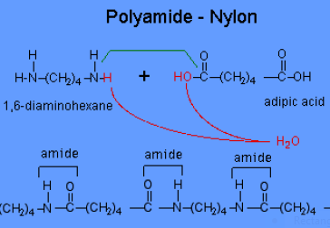
Chapter 5: Organic Chemistry
Episode: Isomers
Chemistry class: F4
Condensation polymerization: is a type of polymerization that small molecules are released

Slide 10
Types of Plastics
Chapter 5: Organic Chemistry
Episode: Isomers
Chemistry class: F4
Thermoplastic: plastics that soften when heated
Thermosetting: plastics that cannot melt easily

Slide 12
Learning Objectives:
Chapter 5: Organic Chemistry
Episode: Reaction mechanisms
Chemistry class: F4
At the end of this episode, students should be able to
1. State types of reaction mechanism
2. Differentiate two types of bond fission
3. Define electrophile and nucleophile
4. Explain substitution reaction mechanism
5. Describe halogenoalkanes
6. List uses of halogenoalkanes

Slide 13
Chapter 5: Organic Chemistry
Episode: Reaction mechanisms
Chemistry class: F4
Reaction mechanisms
Three types of organic reactions are
Addition reactions
Alkenes
2) Substitution reactions
Alkanes
3) Alcohol
Elimination reactions

Slide 14
Chapter 5: Organic Chemistry
Episode: Reaction mechanisms
Chemistry class: F4
Reaction Mechanism
Reaction mechanism: explains the detailed steps of chemical reaction occurs
Types of bond fission
The breaking of a covalent bond is called bond fission.
Two types of bond fission are:
1. Homolytic fission
2. Heterolytic fission

Slide 15

Chapter 5: Organic Chemistry
Episode: Reaction mechanisms
Chemistry class: F4
Homolytic fission: in homolytic fission, bond breaking produces two species of the same (homo-) type

Slide 16
Chapter 5: Organic Chemistry
Episode: Reaction mechanisms
Chemistry class: F4
Heterolytic fission
ln heterolytic fission, bond-breaking produces two species of different (hetero -) type
Heterolytic fission forms oppositely charged ions

Slide 17
Chapter 5: Organic Chemistry
Episode: Reaction mechanisms
Chemistry class: F4
Positive ions are known as electrophiles
Negative ions are known as nucleophiles
Free radical: is a species that contain un paired electrons

Slide 18


Chapter 5: Organic Chemistry
Episode: Reaction mechanisms
Chemistry class: F4
Substitution mechanism
Free radical substitution reactions proceed in three stages: initiation, propagation and then termination.
Initiation
Propagation
iii) Termination reaction

Slide 19
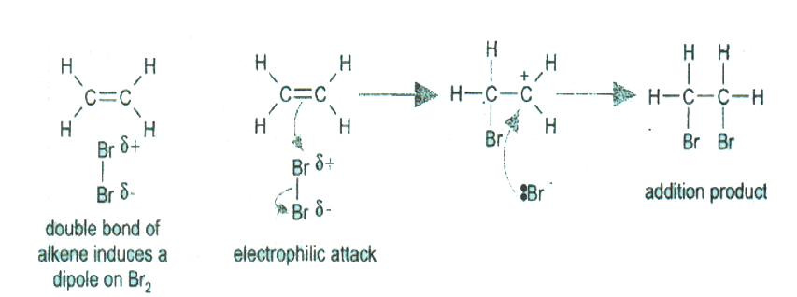
Chapter 5: Organic Chemistry
Episode: Reaction mechanisms
Chemistry class: F4
Mechanism of electrophilic addition

Slide 20
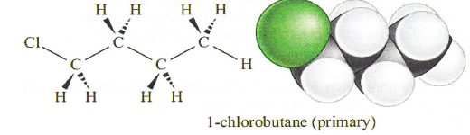
Chapter 5: Organic Chemistry
Episode: Reaction mechanisms
Chemistry class: F4
Halogenoalkanes
General formula
CnH_{2n}+1X
Types of halogeno alkanes
Primary halogeno alkanes

Slide 21
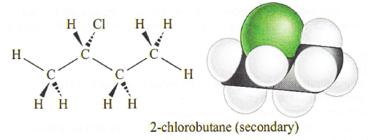
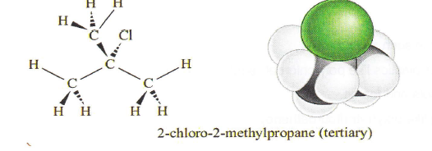
Chapter 5: Organic Chemistry
Episode: Reaction mechanisms
Chemistry class: F4
2. Secondary halogen alkanes
3. Tertiary halogenoalkanes

Slide 22
Uses of Halogenoalkanes
Chapter 5: Organic Chemistry
Episode: Reaction mechanisms
Chemistry class: F4
Synthesis of medicine such as Ibuprofen
Direct application of plastics like chloroethene
Production aerosols and foams
Waterproof clothing like poly(tetraflouroethene)

Slide 23

Destruction of ozone layer by CFCs
Chapter 5: Organic Chemistry
Episode: Reaction mechanisms
Chemistry class: F4
Usually chlorofluorocarbons are very unreactive. However in the upper atmosphere the C-Cl bonds can undergo homolytic fission if exposed to ultra-violet light
However if CFCs find their way into the upper atmosphere and the ultra-violet light breaks them down into Cl radicals, these Cl' radicals act as catalysts in the destruction of the ozone

