Slide 1

Learning Objectives:
Chapter 5: Organic Chemistry
Episode: Reaction mechanisms
Chemistry class: F4
At the end of this episode, students should be able to
1. State types of reaction mechanism
2. Differentiate two types of bond fission
3. Define electrophile and nucleophile
4. Explain substitution reaction mechanism
5. Describe halogenoalkanes
6. List uses of halogenoalkanes

Slide 2
Chapter 5: Organic Chemistry
Episode: Reaction mechanisms
Chemistry class: F4
Reaction mechanisms
Three types of organic reactions are
Addition reactions
Alkenes
2) Substitution reactions
Alkanes
3) Alcohol
Elimination reactions

Slide 3
Chapter 5: Organic Chemistry
Episode: Reaction mechanisms
Chemistry class: F4
Reaction Mechanism
Reaction mechanism: explains the detailed steps of chemical reaction occurs
Types of bond fission
The breaking of a covalent bond is called bond fission.
Two types of bond fission are:
1. Homolytic fission
2. Heterolytic fission

Slide 4

Chapter 5: Organic Chemistry
Episode: Reaction mechanisms
Chemistry class: F4
Homolytic fission: in homolytic fission, bond breaking produces two species of the same (homo-) type

Slide 5
Chapter 5: Organic Chemistry
Episode: Reaction mechanisms
Chemistry class: F4
Heterolytic fission
ln heterolytic fission, bond-breaking produces two species of different (hetero -) type
Heterolytic fission forms oppositely charged ions

Slide 6
Chapter 5: Organic Chemistry
Episode: Reaction mechanisms
Chemistry class: F4
Positive ions are known as electrophiles
Negative ions are known as nucleophiles
Free radical: is a species that contain un paired electrons

Slide 7


Chapter 5: Organic Chemistry
Episode: Reaction mechanisms
Chemistry class: F4
Substitution mechanism
Free radical substitution reactions proceed in three stages: initiation, propagation and then termination.
Initiation
Propagation
iii) Termination reaction

Slide 8
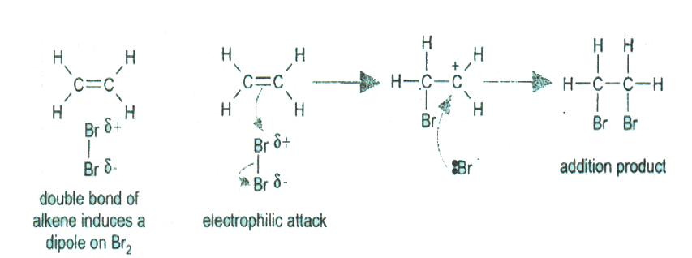
Chapter 5: Organic Chemistry
Episode: Reaction mechanisms
Chemistry class: F4
Mechanism of electrophilic addition

Slide 9
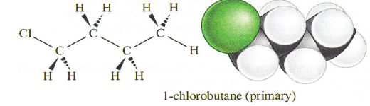
Chapter 5: Organic Chemistry
Episode: Reaction mechanisms
Chemistry class: F4
Halogenoalkanes
General formula
CnH_{2n}+1X
Types of halogeno alkanes
Primary halogeno alkanes

Slide 10
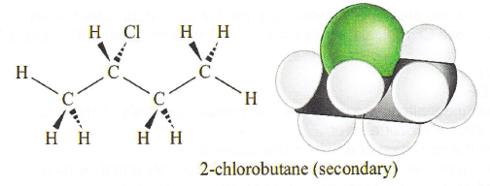
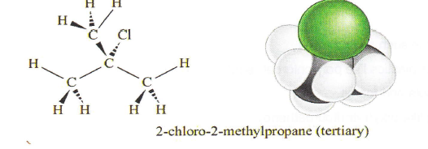
Chapter 5: Organic Chemistry
Episode: Reaction mechanisms
Chemistry class: F4
2. Secondary halogen alkanes
3. Tertiary halogenoalkanes

Slide 11
Uses of Halogenoalkanes
Chapter 5: Organic Chemistry
Episode: Reaction mechanisms
Chemistry class: F4
Synthesis of medicine such as Ibuprofen
Direct application of plastics like chloroethene
Production aerosols and foams
Waterproof clothing like poly(tetraflouroethene)

Slide 12

Destruction of ozone layer by CFCs
Chapter 5: Organic Chemistry
Episode: Reaction mechanisms
Chemistry class: F4
Usually chlorofluorocarbons are very unreactive. However in the upper atmosphere the C-Cl bonds can undergo homolytic fission if exposed to ultra-violet light
However if CFCs find their way into the upper atmosphere and the ultra-violet light breaks them down into Cl radicals, these Cl' radicals act as catalysts in the destruction of the ozone

