Slide 1

Geography class: form four
Agriculture
Chapter 1
Geography class: F4
Chapter 1: Agriculture
Episode: Fruit crops
Lesson Objectives
Describe Fruit crops selectively Mangoes, Banana and Citrus Fruits
Discuss each by focusing on : Origin, Types, Growing conditions, Cultivation, Harvesting ,and Producing regions.
Describe Crop and animal fibers including Cotton, Sisal, Wool and Silk
Explain Types, Growing conditions, Cultivation, Harvesting , Origin and producers of Cotton and Sisal crops.
Discuss animal fiber Wool and Silk by focusing on Processing, Types and producers.
Describe Oil crops particularly Palm oil Coconut and Groundnut by focusing on their ,Origins, Types, Growing conditions, Cultivation, Harvesting , and Producing regions.

Slide 2
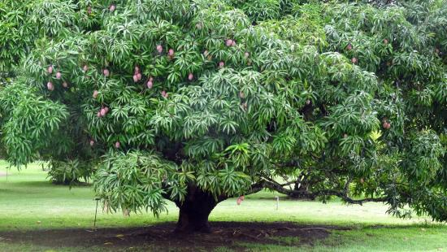
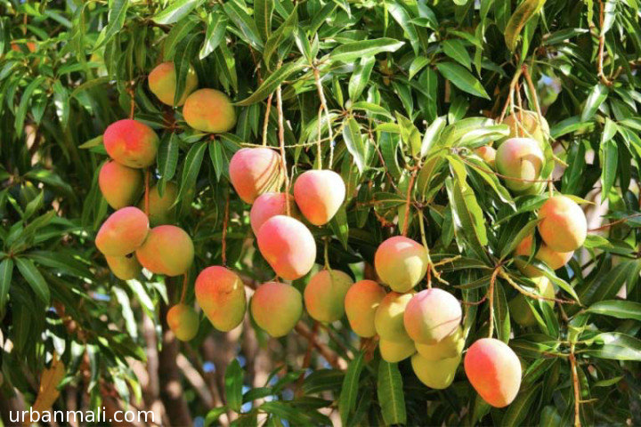
Geography class: Form four
Agriculture
Chapter 1
Geography class: F4
Chapter 1: Agriculture
Episode: Fruit crops
Fruit crops are plants cultivated primarily for their edible, fleshy fruits, which are consumed fresh or processed for juice, jams, or other products.
Mango
Origin: India & Southeast Asia
Growing Conditions: Hot, wet summers; cool, dry winters; deep, well-drained soil.
Types of mangoes: Indian mangoes and Indo China Mangoes.
Cultivation: Grown from grafted seedlings; pruned regularly

Slide 3
Geography class: F4
Chapter 1: Agriculture
Episode: Fruit crops
Harvesting & Processing: Picked when turning yellow/red or while green; ripens at room temperature
Mango pests and Disease: the most common mango disease is Anthracnose while bugs and borers are the main mango pests.
Top Producers: India, China, Thailand
Top Exporters: India, Mexico

Slide 4
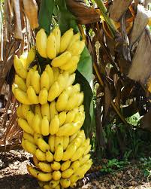
Geography class: Form four
Agriculture
Chapter 1
Geography class: F4
Chapter 1: Agriculture
Episode: Fruit crops
Banana
Origin: Southeast Asia; now global in tropics
Growing Conditions: Warm, humid; rich, moist, well-drained soil
Cultivation: Grown from suckers/rhizomes; perennial herb
Harvesting & Processing: Cut the whole bunch when fruits are mature green; ripened in controlled conditions
Top Producers: India, China, Indonesia
Top Exporters: Ecuador, Philippines

Slide 5
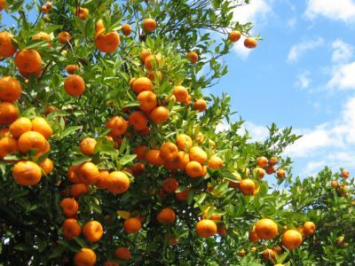
Geography Form Four
Agriculture
Chapter 1
Geography class: F4
Chapter 1: Agriculture
Episode: Fruit crops
Citrus Fruits (Oranges, Lemons, Limes, Grapefruit)
Origin: Asia
Growing Conditions: Warm, frost-free; 10–13°C minimum temp; well-drained soil
Cultivation: Grown from seeds or grafted plants; often in pots in temperate zones
Harvesting & Processing: Hand-picked when fully colored; packed fresh or juiced
Top Producers: China, Brazil, India
Top Exporters: Spain, South Africa, Egypt

Slide 6
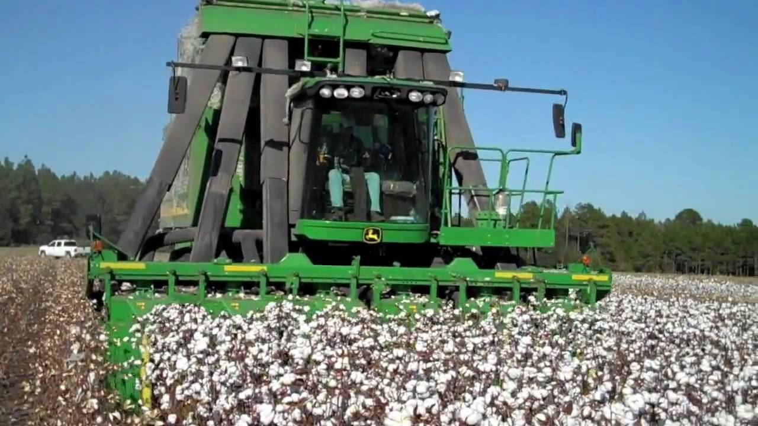
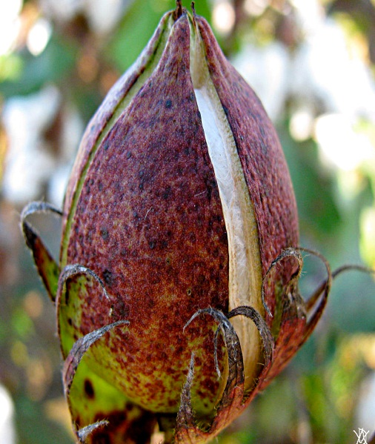
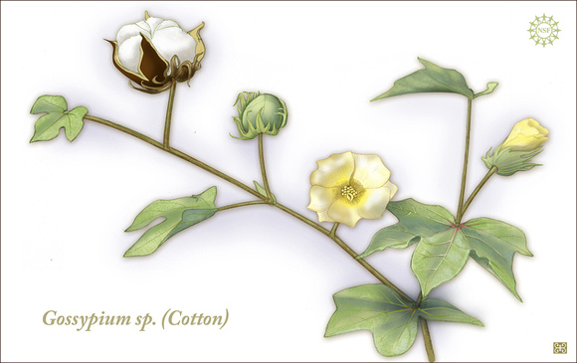
Geography class: Form four
Agriculture
Chapter 1
Geography class: F4
Chapter 1: Agriculture
Episode: Fruit crops
Definition: Plant and Animal Fibers
Plant and animal fibers are natural materials obtained from plants or animals, used for making textiles, ropes, and clothing through spinning and weaving.
Cotton (Plant Fiber)
Source: Cotton plant (fruit fibers)
Types of Cotton: Short stable when the fiber is less than 3cm and long stable cotton when the fiber is longer than 3cm.
Fig, shows cotton

Slide 7
Geography class: F4
Chapter 1: Agriculture
Episode: Fruit crops
Growing Conditions: Warm climate; 500–1000 mm rain; deep, rich soil
Cultivation: Grown from seeds; needs weeding, pest control
Harvesting & Processing: Hand/machine picked → ginned → spun into yarn → woven into cloth
Top Producers: China, India, USA
Top Exporters: USA, Brazil

Slide 8
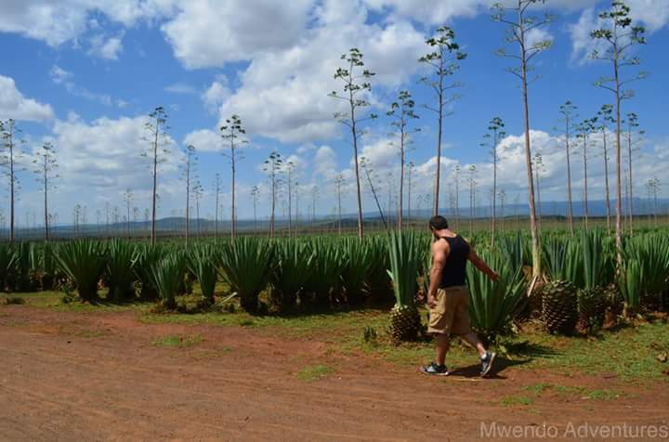
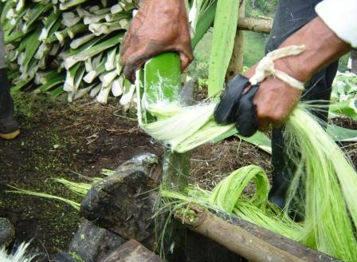
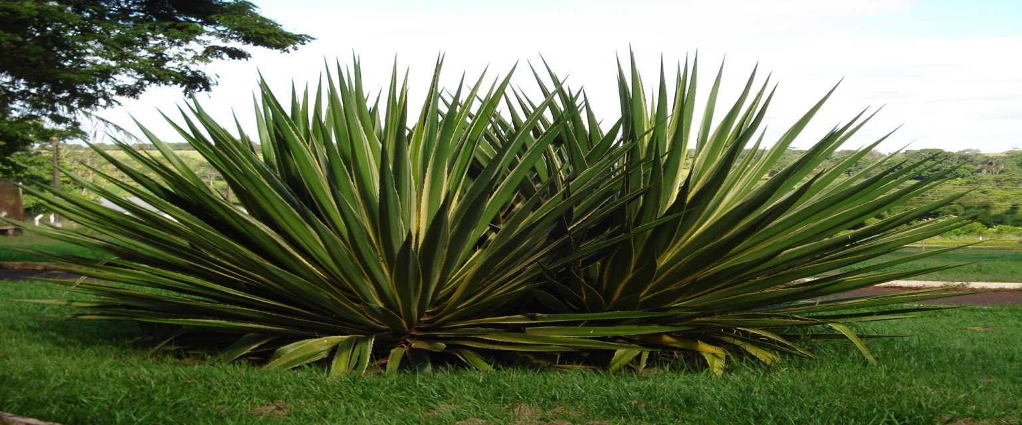
Geography class: Form four
Agriculture
Chapter 1
Geography class: F4
Chapter 1: Agriculture
Episode: Fruit crops
Sisal Hemp (Plant Fiber)
Source: Leaves of the sisal plant
Growing Conditions: Hot, dry regions; 890 mm rain
Cultivation: Grown from suckers; leaves cut 2–3 times/year
Harvesting & Processing: Leaves decorticated (fiber separated) → dried → baled
Origin: Yucatan in Mexico
Top Producers: Tanzania, Kenya, Brazil
Top Exporters: Tanzania, Brazil
Fig, shows sisal

Slide 9
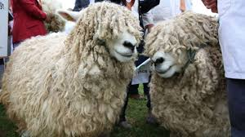
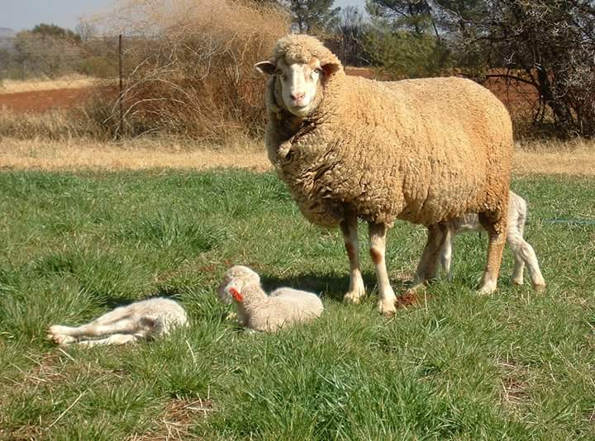
Geography class: Form four
Agriculture
Chapter 1
Geography class: F4
Chapter 1: Agriculture
Episode: Fruit crops
Wool (Animal Fiber)
Source: Fleece of sheep
Types: Merino (fine), Crossbred (medium), Carpet wool (coarse)
Uses: Clothing, Blankets and bedding Home insulation
Processing: Sheared → cleaned → spun into yarn
Top Producers: Australia, China, New Zealand
Top Exporters: Australia, New Zealand
Fig, shows wool

Slide 10
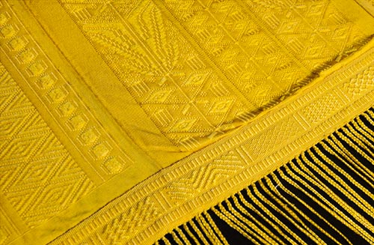
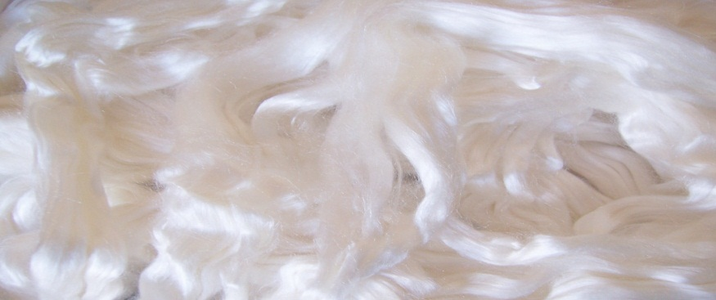
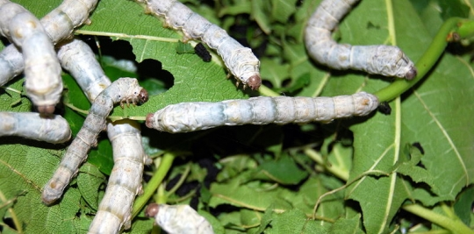
Geography class: Form four
Agriculture
Chapter 1
Geography class: F4
Chapter 1: Agriculture
Episode: Fruit crops
Silk (Animal Fiber)
Source: Cocoon of the silkworm (fed on mulberry leaves)
Regions Found: Mild climates; access to mulberry trees
Cultivation: Sericulture (silkworm farming)
Sericulture and life cycle of silk worm: Egg, Grub, Chrysalis, Moth.
Preparation: Cocoons boiled → threads unwound → twisted into silk yarn
Top Producers & Exporters: China, India
Fig, shows silk

Slide 11
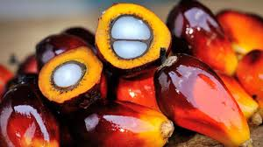
Geography class: Form four
Agriculture
Chapter 1
Geography class: F4
Chapter 1: Agriculture
Episode: Fruit crops
Definition: Vegetable Oils
Vegetable oils are fats extracted from seeds, fruits, or other plant parts, used for cooking, industry, and cosmetics.
Oil Palm
Origin: West Africa
Growing Conditions: Hot, humid tropical climates; high rainfall; well-drained soil
Fig, shows silk

Slide 12
Geography class: F4
Chapter 1: Agriculture
Episode: Fruit crops
Cultivation: Grown from seeds → nursery → transplanted → reaches maturity in 10 years
Harvesting & Processing: Fruit bunches cut → pericarp pulped for palm oil → kernel pressed for palm kernel oil
Mature: 10 years after planting
Top Producers: Indonesia, Malaysia, Nigeria
Top Exporters: Malaysia, Indonesia

Slide 13
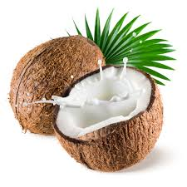
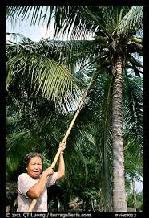
Geography class: Form four
Agriculture
Chapter 1
Geography class: F4
Chapter 1: Agriculture
Episode: Fruit crops
Coconut Oil
Origin: Tropical coastal regions (Southeast Asia, Pacific Islands)
Growing Conditions: Lowland tropics; sandy, well-drained soil; 25–32°C
Cultivation: From seed (nuts) → matures in 6–10 years
Harvesting & Processing: Coconuts split → copra dried → oil extracted by pressing
Top Producers: Philippines, Indonesia, India
Top Exporters: Philippines, Indonesia
Fig, shows Coconut Oil

Slide 14
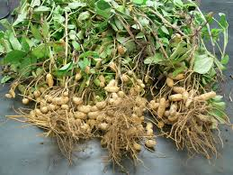
Geography class: Form four
Agriculture
Chapter 1
Geography class: F4
Chapter 1: Agriculture
Episode: Fruit crops
Groundnut (Peanut) Oil
Origin: South America; widely grown in Africa & Asia
Growing Conditions: Warm climates; sandy, well-drained soil; moderate rainfall
Cultivation: Grown from seeds; legumes fix nitrogen
Harvesting & Processing: Pods dug up → shelled → nuts pressed for oil
Top Producers: China, India, Nigeria
Top Exporters: Argentina, Senegal
Fig, shows Groundnut

Slide 15
Geography class: F4
Chapter 1: Agriculture
Episode: Fruit crops
Work to Do
Explain how to cultivate either one of the following crops:
Sugar cane, coffee, tea and cocoa.
2. List at least four growing conditions for the first two crops in
3. What are the main types of plant and animal fibers?
4. State any three growing conditions of cotton plant and sisal.

Slide 16
Geography class: F4
Chapter 1: Agriculture
Episode: Fruit crops
5. Discuss how silk fiber is formed.
6. What are the main types of cotton plants?
7. Describe the different types of sheep wool.
8. List any four vegetable oil crops.
9. State the growing conditions of:
Palm oil
Coconut

