Slide 1
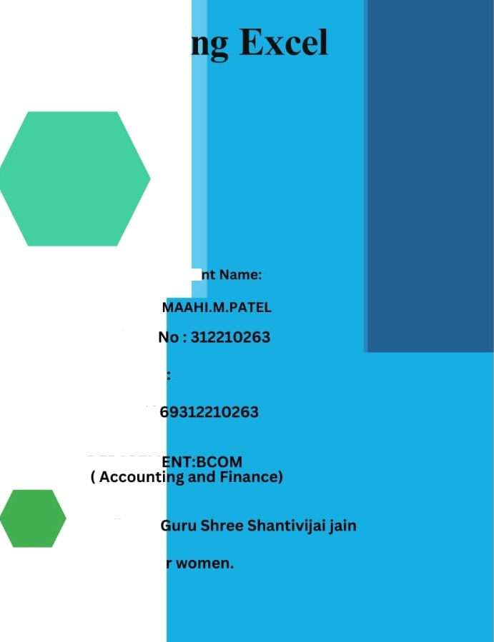

Employee Data Analysis usi
Stude
Register
username
asunm13
DEPARTM
CoŒege:
college fo

Slide 2








k0ú CT Tì
Employee Performance Analysis
using F.xcel

Slide 3







.Problem Statement
2.Project Overview
.End Users
4.Our Solution and
Proposition
.Dataset Description Modelling Approach
.Results and Discussion
Conclusion
2 U2 n n ud I Revd ew

Slide 4


ROBLEM STATEMENT
Analysing employee performance to track their working skills and to motivate the low level employees by various tasks .
To track the performance and give rewards to
improve the current performance.

Slide 5


PROJECT OVERVIEW
In this project we known about the employees how they perform by various graph and pivot table
Employee performance analysis lS important to
identify the performance level toward the project and improve their level by assigning new taks to emerge themselves

Slide 6


WH ARE TH EN
RSî
Em loyees
rga isatio
Em loye

Slide 7











SO UTI
AN ITS VA
ROPOS
Filtering
remove missing
Charts
visualization repots
Pivot tabe summary
Con itional formattin
missing
identify
Formula performance level

Slide 8

Dataset Description
Employee data set - the employee datas are taken from the Kaggle to analysis employ
9 features
Employee ID: Unique identifier for each employee in the organization. First Name: The first name of the employee.
Title: The job title or position of the employee within the organization
.Business Unit: The specific business unit or department to which the employee bet Employee Status: The current employment status of the employee (e.g., Active, On Employee Type: The type of employment the employee has (e.g., Full—time, Part—tim

Slide 9
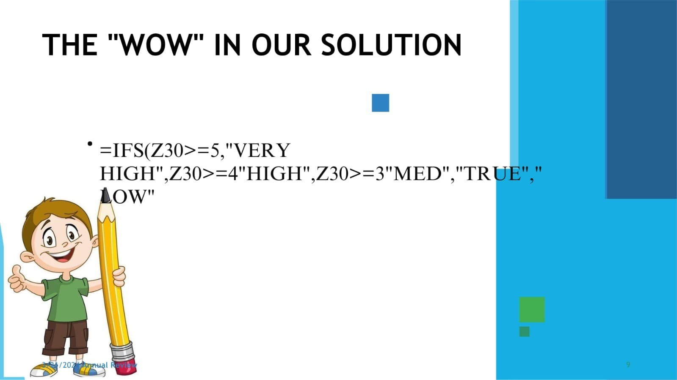

Slide 10








II i
e em loyee performance analysis table are taken from the website ca
From the ata we ha some missin fi ures to identify the missing terms
con itional techniques to ident the missing terms like exit data etc..
T en we use filterin an sortin to fi the missin fi ues
Pivot table
harts
on itiorial formattin

Slide 11
Pivo table
Click insert
From the insert bar click pivot table in new excel sheet
Select business unit and drag it in row
Then select performance level and drag it in column
Select gender in value
Performance level
From the pivot table we can see the analysis for female male and all and we can a type of employees by ineling slivers to see how many are full time ,part time and contract based employees.
Insert graph for better analysis the graph shows the accurate levels and the
performance of employees. We can see the various graph by changing the option
graph options

Slide 12
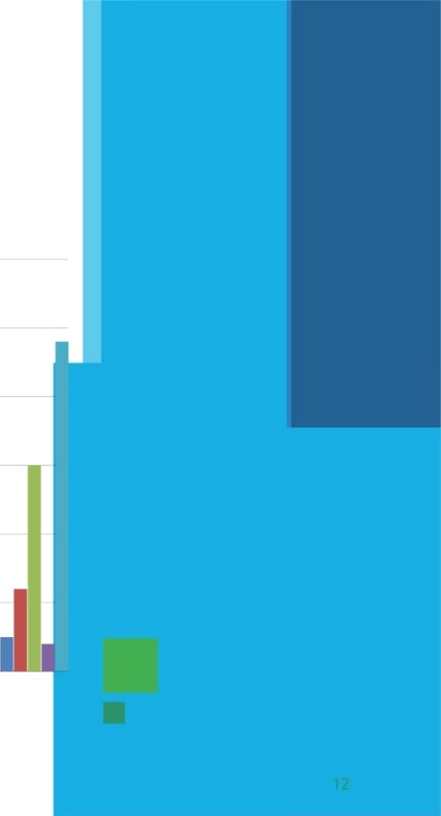









HIGH
LOW
MED
VERY HIGH
@ (klank)
50.0
30.0
30.0
20.0
100
0.0
BPC
CCDR
EVv
MSC
NEL
PL
PYZ
SVG
TNS
WBL

Slide 13


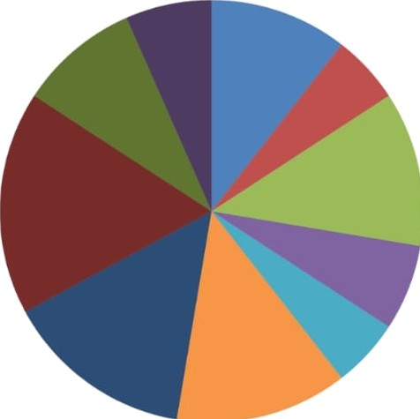
Pie chart
high level performance
BF'C
CCDR
PL

Slide 14

onclusion
From the above analysis the low IeveI,medium level to b improved by assigning various tasks and training in the field
The current high and very high level employees are
improve their intensity by rewards and appreciations towards their growth to increase their participation a to give more potential towards their project.

