Slide 1

A QUESTION FOR OUR CREDIT TEAM
Should we judge a loan
by how much someone earns,
or by their credit history?

Slide 2
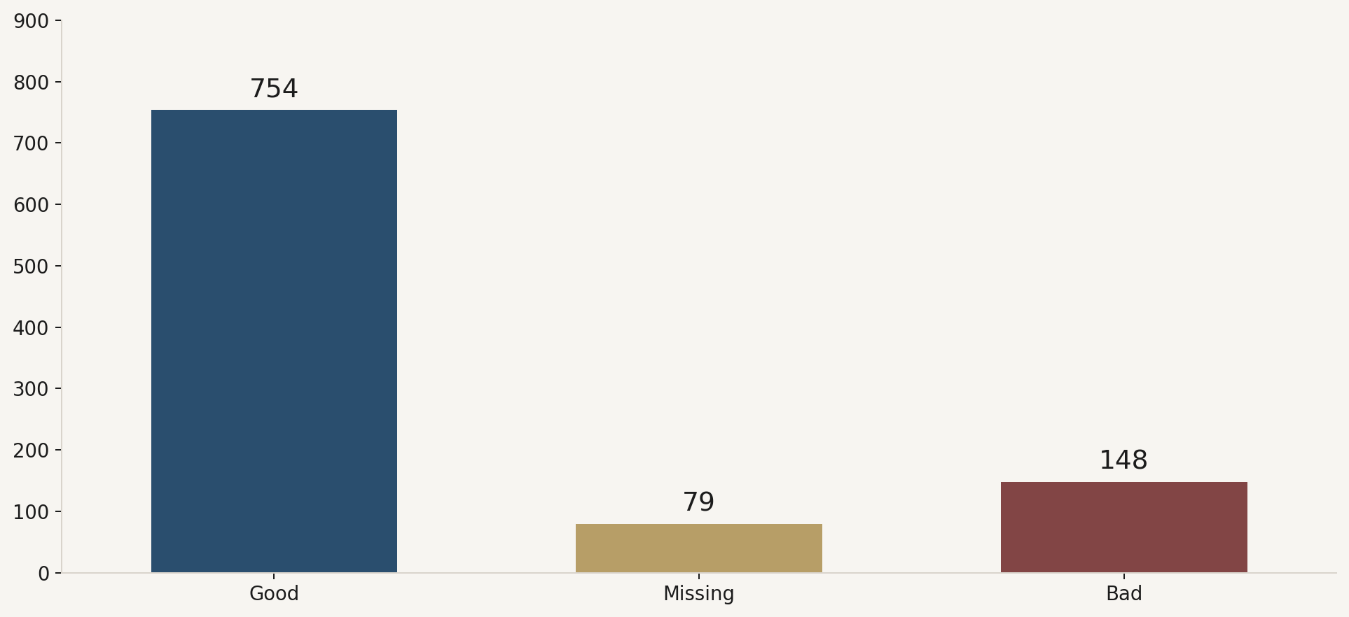
WHAT THIS IS
Our data team cleaned 981 loan applications.
754
Good credit
79
Missing credit
148
Bad credit

Slide 3
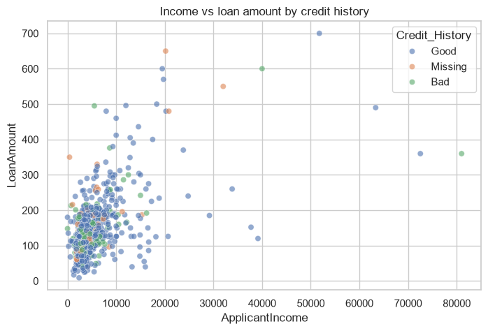
WHAT WE SAW
Credit history splits the file. Income does not.
Most applications already have good credit.
01
That same pattern appears in every group; education, area, dependents, gender.
02
On the scatter, Good, Bad and Missing sit in one cloud. A bigger salary does not mark a safer file.
03
Income and loan size mix together. Colour — not position — is the signal.

Slide 4
WHAT WE SHOULD DO
Sort every new file by credit history.
FAST
HOLD
CHECK
754
79
148
Good credit.
Move it today.
Missing credit.
Find the record.
Bad credit.
A senior officer looks.

