Slide 1
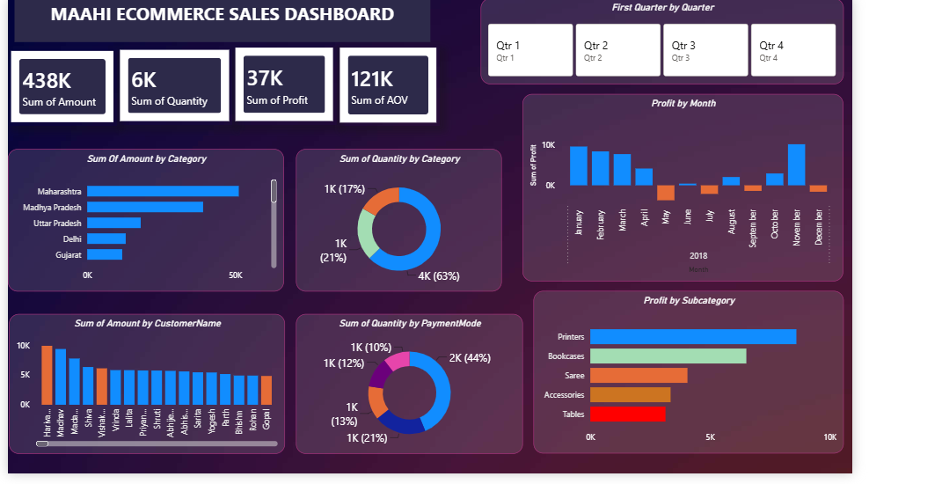
E-Commerce Sales Dashboard
• Tools: Power BI
• Dataset: E-Commerce Orders
• KPIs: Sales, Quantity, Profit, AOV
• Interactive Dashboard

Slide 2
Objective
• Design an interactive dashboard.
• Help stakeholders analyze sales performance.
• Provide filters and KPI tracking.

Slide 3
KPIs
• Sales: 438K
• Quantity: 6K
• Profit: 37K
• AOV: 121K

Slide 4
Visualizations
• Sales by State
• Quantity by Category
• Profit by Month
• Profit by Subcategory
• Sales by Customer
• Payment Mode Analysis

Slide 5
Features
• Quarter slicer
• Interactive filtering
• Consistent color theme
• Business-friendly layout

Slide 6
Insights
• Highest sales from Maharashtra.
• COD is the most used payment mode.
• Printers have highest profit.
• Monthly profit fluctuates.

Slide 7
Conclusion
• Dashboard provides quick business insights.
• Supports better decision-making.
• Can be enhanced with drill-through and additional KPIs.

